Slide 1
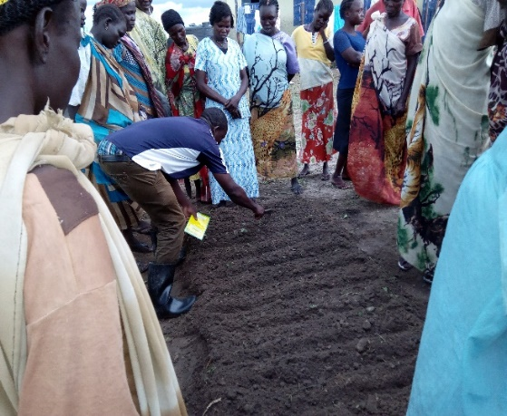
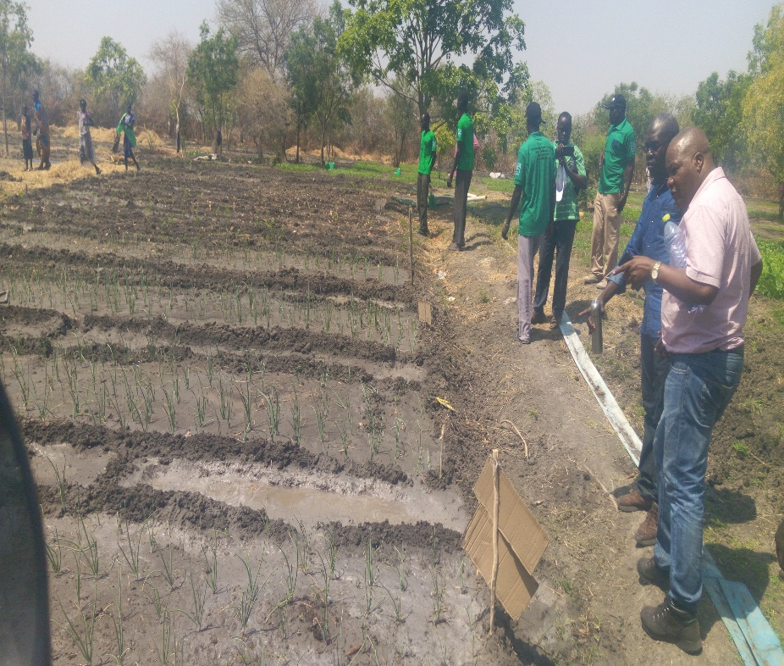

Enhancing food security and Resilience
EU Pro Resilience project

Slide 2
context
Upper Nile State
Upper Nile experiences both natural hazards and conflict.
The security situation in the Western Bank of River Nile, the project site, deteriorated from late Conflict continued in 2017 that affected project implemention. For example:
    Feb 2016, July 2016, January / February 2017, March 2017, Panyikang attacked: People displaced and insecurity increased hampering any movement in the area.
    April 2017, Kodok (Fashoda) attacked displacing population further to Abrouc and Sudan.
Clashes between opposition forces, influx of small arms, has worsened the food security and increased vulnerability while slowing down PRO-ACT activities at some point.
The volatile situation has put humanitarian interventions on constant emergency mode. However, the overall security situation has drastically improved on the 2nd half of 2017 and early 2018
As a result the implementation of the planned activities has not been on schedule

Slide 3
Basic Project information
Basic project data
Contract beneficiaries: Cordaid and co-applicant SSUDA
Project title: Enhancing the Food Security and Resilience of Vulnerable communities in Upper Nile state, South Sudan
Project ref. EUROPEAID/136723/DD/ACT/SS
Project locations: Upper Nile State - 3 Counties Fashoda, Malakal, Manyo - 9 Communities / Payams
Project period: 09/12/2015-08/12/2018
Project budget: 2,654,379 EUR
Project utilization rate as Dec 2017: 45%

Slide 4
Project objective
Project objective and results
Overall Objective:
Enhancing Food Security and Disaster Resilience of Vulnerable Communities Selected Payams Fashoda, Makal West and Manyo Counties (Upper Nile State)
Expected Key-Results
Improved knowledge and capacity of 9 Payams, 4 county government departments and 3 local NGO’s to enhance food security and disaster resilience in an integrated manner (incl. peace building and disaster prevention and mitigation);
Enhanced food security of 9 Payams (3,000 Households) through the implementation of food security disaster resilience measures, including improved agricultural income generation, natural resource management, access to clean water and peace building.

Slide 5
Implementation approaches
Project Implementation Methodologies
Capacity building training of partners staff, local authorities and facilitators in CMDRR;
Community Managed Disaster Risk Assessment and Analysis – (Using different tools to analyze hazards, vulnerabilities and capacities of people);
Community Level Action Plans – (Prioritizing identified capacity gaps, development of contingencies (disaster preparedness) plans, and development of (disaster risk reduction) plans and based on plans, providing scenario on how to act in cases of disasters;
Agriculture extensions: Farmers Field School Approach (FFS)-lead farmers approach and peace building
People’s organization – Through formation of DRR Forums or DRR Committees – (Committee are responsible for joint planning, implementation and monitoring of the DRR action plans
Participatory Monitoring, Evaluation and Learning System (MEALS) – Ability to learn from events and activities can further enhance resilience

Slide 6
Linking Relief Rehabilitation and Development
Interventions
Construction of market structures is on going in Fashoda and Makal Counties. It serves FFS groups to sell their harvests.
Provision of unconditional cash to 600 vulnerable households
Provision of conditional cash (Cash for Work) for 600 individuals
Distribution of 1000 tools and seeds kits in Malakal, Fashoda and Manyo Counties
Capacity building of local farmers on basic modern farming methods in Upper Nile
Cond100 farmers (69 female and 31 male) have been trained on crop production and good agricultural practices for 8 days in Fashoda and Malakal Counties.
Trained 100 (71 female and 19 male) farmers on post-harvest management.

Slide 7
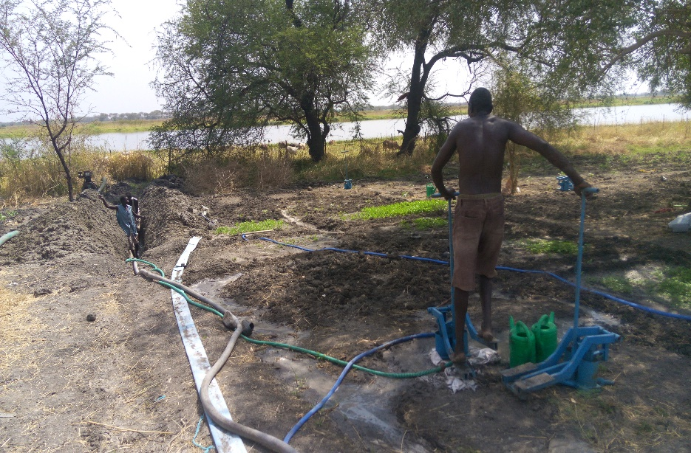
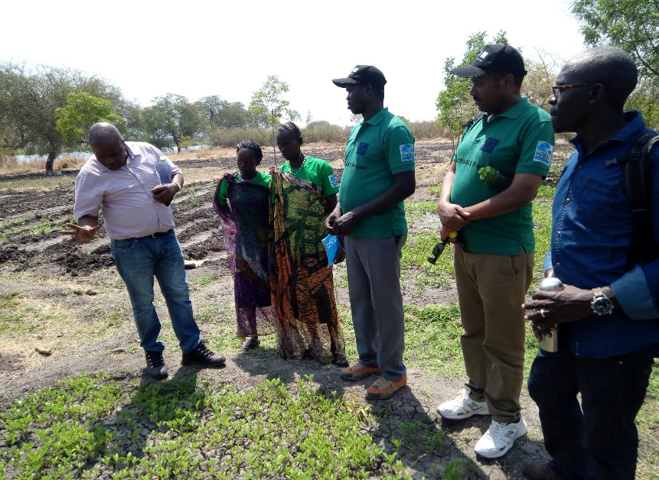
Project progress
The Interventions
Overall 2.682 individual beneficiaries (1.245 female and 1.437 male) out of the planned 3.000 beneficiaries were reached
43 Farmers Field School facilitators are trained on agriculture extension and facilitation of FFS/lead farmers
Formed 15 farmers groups comprising of 450 members in total and provided them with agricultural inputs and extension services
Result oriented monitoring (ROM) conducted by EU ROM expert in Nov 2017
Monitoring mission conducted by EU TA M&E expert in February 2018
Baseline survey conducted on 2017
Project logframe targets are revised and submitted to EU based on ROM and TA recommendations.

Slide 8
Project Results
Result 1: Improved knowledge and capacity of 9 communities, 4 county government departments and 3 local NGO’s to enhance food security and disaster resilience in an integrated manner
Outputs/activities | Planned | Achievement
Training of local authorities and community members in CMDRR & PDRA | 50 trainers (ToT) | 32 participants out of 50 targeted received CMDRR ToT. The remaining 18 will be trained in year 3.
 | 270 communities | 271 (last year 122 + this year 149) community members participated in PDRA exercise and training
Training on and support on peace building & reconciliation processes | 150 selected person | 6 peace building committees are formed with 2 in Malakal, 2 in Manyo and 2 in Fashoda. 50 key community members have been identified and registered for training on peace building.
Establish 100FFS groups representing 3000 communities | 100 FFS (30 member each) | 34 FFS facilitators were trained in November 2017 and 15 FFS groups enrolled on the cycle in 3 counties
Number of feasible and promising agri-business opportunities developed | 9 communities | Y3 and developed fragility and food security assessment tools

Slide 9
Project Results
Result 2: Enhanced food security of 9 communities (3,000 households) through the implementation of food security and disaster resilience measures
Outputs/activities | Planned | Achievement
All 9 communities have taken action in reducing flood risks | Conduct survey in 9 communities to Flood Risk reduction plans developed in each of the 9 communities Construction of dykes, check dams, reinforcement of river banks by planting trees | PDRA undetaken in 5 communities in two counties Conducted an assessment and consulted target communities to determine the level of flood risk and risk mitigation structures
All 9 communities have access to clean drinking water | A survey in each of the 9 communities to assess the drinking water situation | Identified non-functional boreholes and hand dug wells to rehabilitate and construct in year 3 of the project.
 | Construction./rehabilitation of water sources in 9 communities | Feasibility study on going

Slide 10
Project Results
Result 2: Enhanced food security of 9 communities (3,000 households) through the implementation of food security and disaster resilience measures
Outputs/activities | Planned | Achievement
300 persons, especially women and adolescents, have acquired skills and knowledge to successfully implement a new agri-business model | Training of 150 people on feasible and innovative agri-business | Participants to be identified from already formed 15 FFS groups in 3 counties
 | 300 persons are implementing the agri-business model taught | Ground working ongoing
300 persons, especially women and adolescents, successfully implement a new agri-business model | 300 people implement new agri-business model | Ground working ongoing
 | Establishment of VSLA in each community (9 communities) | Ground working started for establishment of VSLA in 3 counties

Slide 11
Plan for the remaining project period
Overview plan
Boost project activities implementation using window of opportunity – the relative stability & return of beneficiaries to their location
Support the FFS groups and establish the remaining FFS groups in Manyo, Fashoda and Makal Counties (2018)
Establish VSLAs, training, mentoring and coaching of the groups ( April – May 2018)
Rehabilitate water infrastructure based on the community prioritization
Conduct annual review workshop that will focus on:
    Project progress against planned activities and outputs
    Mapping existing gaps and challenges and identify solutions
    Gauge and review stakeholders (including beneficiaries) feedback
    Identify changes to and improve modalities for successive year project implementations
Conduct mid-term evaluation (2018)

Slide 12
Lessons learnt
Lessons drawn
Working on resilience includes working at different time scales, which means the ability to switch between development modus and early response and emergency modus. A crisis modifier or LRRD allow for flexibility and adaptation to changing contexts.
Program scaling down during crisis and scaling up when window of opportunities are available to minimize loss of investments, optimize impacts / realize outcomes
Effectiveness of adaptive and innovative LRRD approach/crisis modifier
Good relationship with existing structures –
Maintaining good relationships with the communities, Payam & Boma Chiefs
Good coordination with clusters and stakeholders

Slide 13
Key challenges
Challenges & risks
Challenges:
Volatile security situation and access to project locations
Local procedures and clearance
Inflation and high costs of operation (Boat fuel, car rental prices)
mines/UXO’s in the targeted area
People leaving in IDPs / host communities are forced to move to PoCs
Relations between different ethnic communities and their political affiliations.
Unpredictable rainfall patterns leading to high flooding
Communities priority need
Vegetable pests and diseases affecting demonstration gardens
Risks:
Security threats
Conflict and displacement

Slide 14
Any questions?
Thank you

