Slide 1

European Union’s Partners’ Quarterly Review Meeting (QRM 8)
Zonal Effort for Agricultural Transformation: Bahr-el-Ghazal Effort for Agricultural Development
21 - 22 March 2018 | Delegation of the European Union Conference Hall | Juba, South Sudan

Slide 2

Project Overview
Project Name: ZEAT BEAD Feeder Roads Project
Project Number:88050
Project Description: Implementation of Community Sensitization Mobilisation and Capacity Building Activities for Achol Pagong-Ayein Market feeder road in Warrap State South Sudan. This project was implemented by The Norwegian Refugee Council (NRC) in close collaboration with State Ministry of Agriculture and Rural Development and Ministry of Physical Infrastructure (Warrap state) and United Nations Office of Project Services (UNOPS)
Duration: 15th July 2015 to 5th December 2016
Amendment: April 2016
Budget: 176,666 USD

Slide 4
Objective
The overall objective of the intervention was: To contribute to improved livelihoods of rural households in Gogrial and Twic Counties in South Sudan and Specifically: To Strengthen local capacities in construction and maintenance of Achol Pagong – Ayien Market and Ayien Market - Panliet feeder road in Gogrial West and Twic Counties
This objective is in line with the over-arching objective of the SORUDEV / ZEAT BEAD program which is to contribute to increased food security, reduced vulnerability and enhanced livelihoods of rural households in South Sudan.

Slide 5
Activities and Achievements
Result 1: Local communities demonstrate willingness to participate in road construction and maintenance activities.
All the activities under this result area were achieved as follows:
Activity 1.1: Sensitization and mobilization of local community leadership and government and private stakeholders about the road construction and maintenance project.
Sensitisation of communities along the areas where the road passed were
Sensitization was done at different levels: first the line ministries of Agriculture and Physical Infrastructure and the county commissioners were properly sensitized about the road construction
At the community level, chiefs and community elders were directly involved in the project

Slide 6
Activities and Achievements
Activity1.2 Sensitization and mobilization of the local community about the objectives and scope of the road construction and maintenance activities – including community mapping and road alignment negotiations.
Several community meetings were organized in each of the 10 Bomas that are along the constructed feeder road
Dissemination of information on community mapping and road alignment negotiations.
Activity 1.3: Engage Baseline and M&E expert to conduct Baseline and develop M & E framework
M&E framework was conducted the report is shared with UNOPS
Activity 1.4 Prepare a plan to engage the local communities to participate in the road construction and maintenance activities.
NRC together with the local community representatives developed a work plan that was followed for community engagement activities
The plan highlighted how and when the CBOs were formed, the sequence of the 7 awareness sessions (trainings) and the role of the community leaders in the road alignment negotiations.

Slide 7
Activities and Achievements
Activity 1.5: Develop a standard procedure for the formation of CBOs.
A common structure in terms of leadership and CBO constitution was developed with support from UNOPS and it is on this basis that the CBOs were formally structured.
Activity 1.6: Community mapping
Community mapping was done for Ayien and Panliet bomas. These are the two main locations connecting the feeder road which has been constructed.
In the community mapping report the following items are highlighted: community demographics, functioning facilities, water sources, markets, and a community SWOT analysis is also done.

Slide 8
Activities and Achievements
Result 2: Local communities have improved knowledge and skills in implementing and managing road construction and maintenance activities.
Activity 2.1: Facilitate organization of 10 CBOs and a Central Management Committee.
10 CBOs were formed and 2 Central Management Committees were selected and registered with RRC as the main CBOs. Each Central Management Committee was composed of 7 members
NRC registered 2 main CBOs; one for Ayien Section and the other for Panliet (Gogrial West legally registered with the Relief and Rehabilitation Commission (RRC) in their respective counties
Activity 2.2 Training the CBO Committee in leadership skills.
100 CBO members have been trained on leadership skills, 10 members from each CBO.
Out of the 100 members trained, 93 are males and 7 females. The training was conducted in January 2016 (Achol-pagong), April 2016 (Ayien-Amuol) and October 2016 (Panliet).

Slide 9
Activities and Achievements
Activity 2.3: Public Private Partnership development.
PPP activities were concluded in all locations in October 2016 involving all the 100 CBO members (93 males, 7 females). A memorandum of understanding was signed by each community to acknowledge their support in this initiative.
Activity 2.4 Preparation and execution of community conversations
This activity was conducted in all the communities in which the feeder road passes. Community members were brought together to discuss issues affecting them like peace and conflict resolutions, use of common resources, and identification of community needs.
This activity was done in February 2016 for Ayien section and in October-November 2016 for road extension in Panliet. 100 CBO members were actively involved in this activity.

Slide 10
Activities and Achievements
Activity 2.5 Conduct sessions in gender, protection, conflict resolution and peace building for 160 people
Gender equity trainings were conducted. In Ayien section, this activity was done in March and June 2016 but for the road extension in Panliet, it was concluded in October-November 2016.
A total of 100 CBO members benefited from this training (93 males, 7 females). The public at large approximately 900 community members were part of the awareness sessions and thus benefited from this message.
Activity 2.6 Conduct HIV and AIDS awareness sessions for 900 people
900 community members (540 males, 360 females) also benefited from this activity.
A public gathering was sensitized about HIV/AIDS; first through training to 100 CBO members and later through drama sessions in which members of the public became part of this sessions. Training to members was done between April and May but in November-December 2016, drama sessions were carried out in the local communities as an awareness approach.

Slide 11
Activities and Achievements
R3 – Local communities utilizing opportunities created by the feeder road construction and maintenance activities to diversify their livelihoods.
Activity 3.1 Engage with CBOs to identify income generation opportunities presented by the road construction and maintenance activities.
Throughout the time of contact with the communities, the CBO members have been sensitized on opportunities that are brought about by the road.
An emphasis was put on business opportunities as the local farmers can easily transport their produce to the nearby markets for sale and they can also access other goods and services in the local markets.
Activity 3.2 Conduct training in Basic Business Management skills for CBO leadership.
The training was delivered at different locations and dates and was conducted by NRC project officers from 26th January 2016 to June and later concluded in October 2016 in Gogrial and Twic States (former Warrap State).
Up to 100 participants (93 males and 7 females) took part in these sessions. A total of 10 groups were trained over the stated time period.

Slide 12
Emerging Issues
The project was initially planned to take place from July 2015 - June 2016 (12 months) but following the endorsement by the Minister of Physical Infrastructure Twic State, the extension of the road from Ayien Market to Panliet became part of the action.
Due to this extension, the project timeline was pushed to 5th August 2016 but this was also followed with No-Cost-Extension period which took the action up to 5th December 2016.
The main risk in the areas where the trainings were conducted was inter-communal fighting between Aguok and Apuk communities.
Another risk is that people whose properties were affected along the road were not willing to relocate. This delayed work. Community in Ayien (Twic County) rejected the road extension but accepted it later; this delayed the implementation.

Slide 13
Lessons Learnt
Higher level government support is very paramount for the success of the road construction project and as well as for addressing some of the issues arising from the road construction from the communities affected.
Drama should be an integral component of the awareness project as drama sessions at last emerged as the most appreciated tool for awareness creation.
CBO registration process at the state level takes a lot of time; this activity needs to be allocated more time in the future.
It is important that concerns presented by the community are taken seriously and resolutions made with the support of the local authorities.

Slide 14
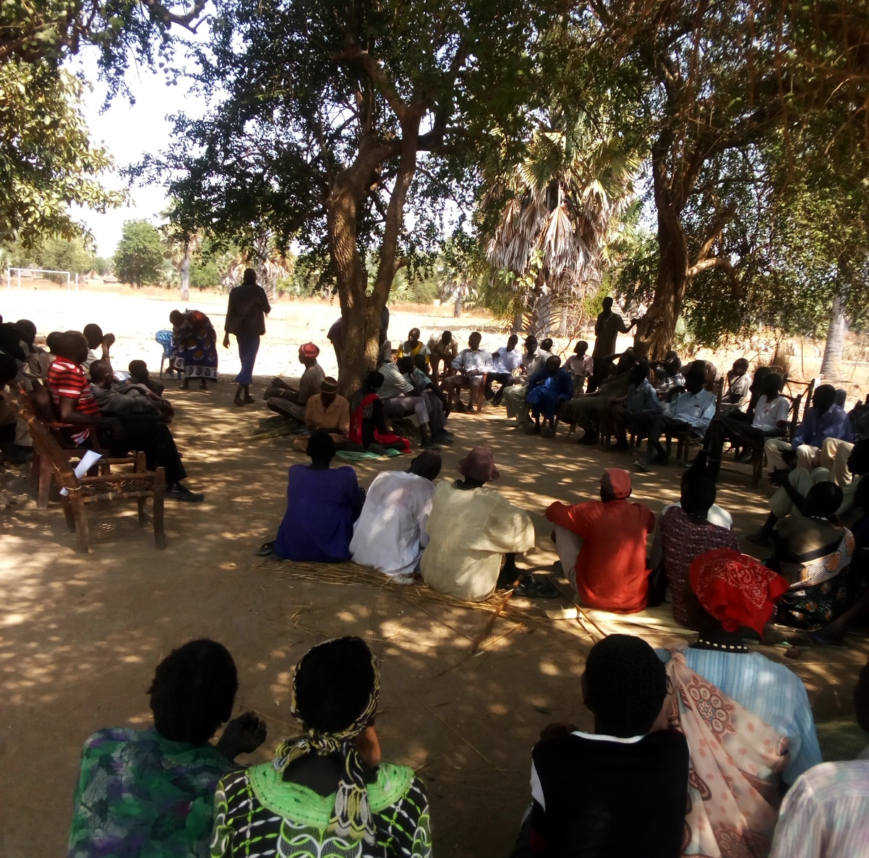
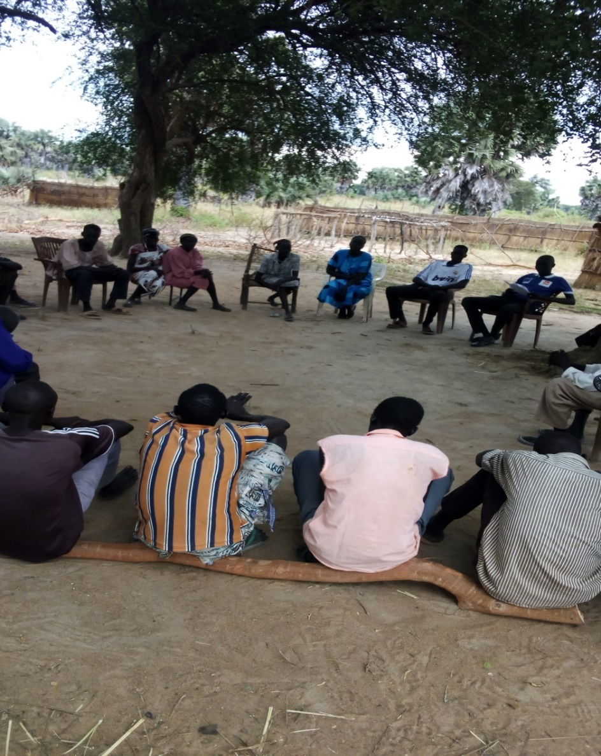
Figure 1: Members of the community attending an
awareness session in Mayom Totin. November 2016: Photo by Yai Majok
Figure 2: Gender awareness session in Agumut. Photo by Mario. 24th October 2016: Photo by Yai Majok

