Slide 1

VSF GERMANY QRM 8 PRESENTATION
Privatized extension services provision

Slide 2
Approach
Cost-Based Extension service provision
R1- Increased agriculture production and productivity through strengthened extension services and innovative farming
Extension Agents:
COTS –Community Ox-plough Trainers
CAHWS-Community Animal Health Workers
POULTRY AUXILLARIES
PRIVATE AGRIC EXTENSION OFFICERS

Slide 3
Key Lessons learnt
Viability and sustainability of cost-based extension service delivery depends on three critical components:
1)Ability of the community to pay for the services
2)Need and or market driven service provision
3)Strengthened value chain systems(linkages to value chain systems)

Slide 4
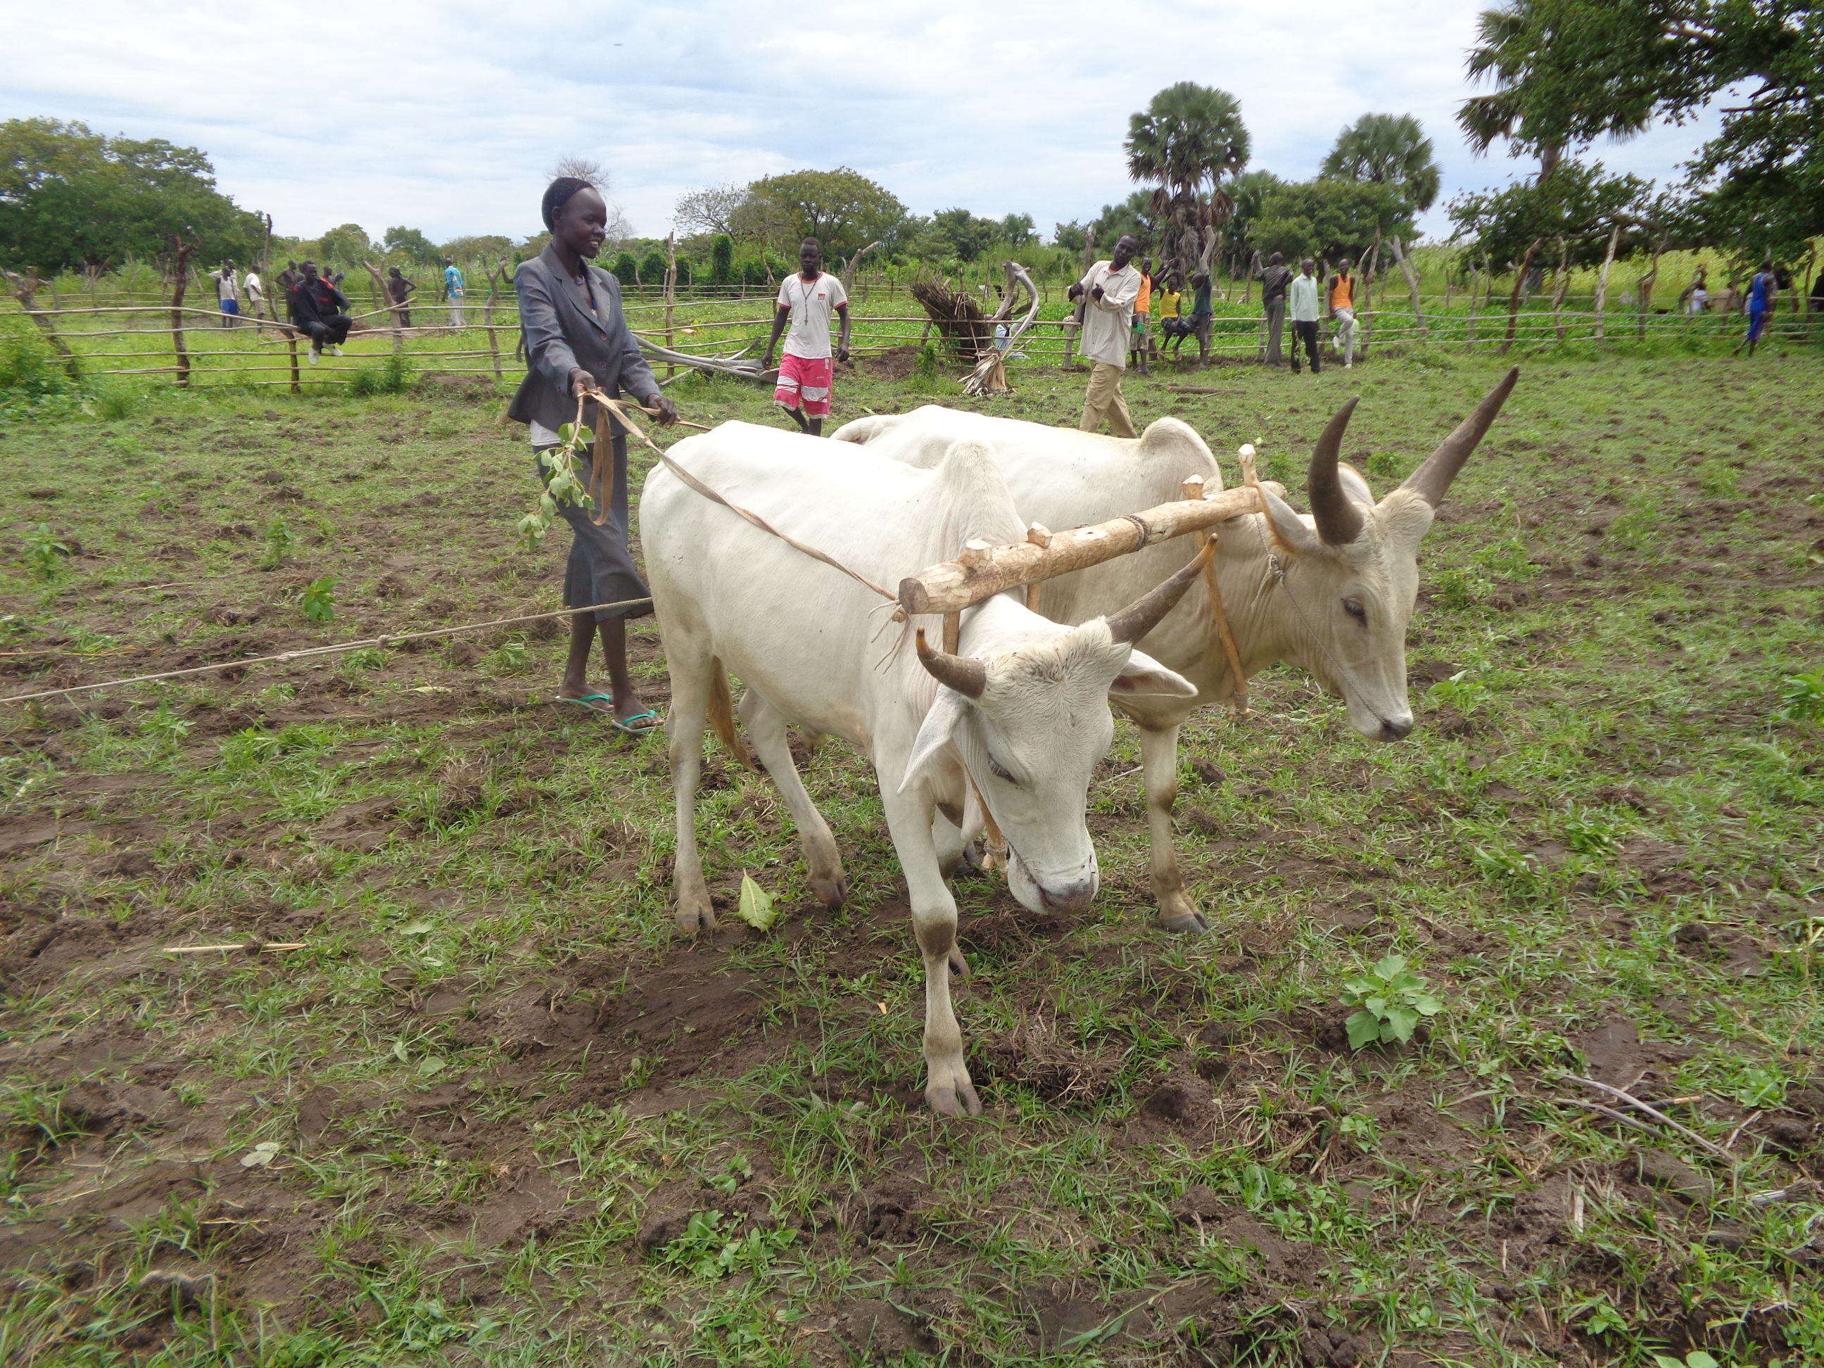
COTS
As it is need based, this has been the most sustainable extension outreach method in our target payams COTs train households on bull training, ox-plough use and maintenance. Immediate self-sufficiency within the first year of the project implementation COTs associations spread risk, share costs Linkages to value chain actors such as ox-plough suppliers and blacksmiths (for fabrication of spare parts) has been critical in ensuring sustainability.

Slide 5
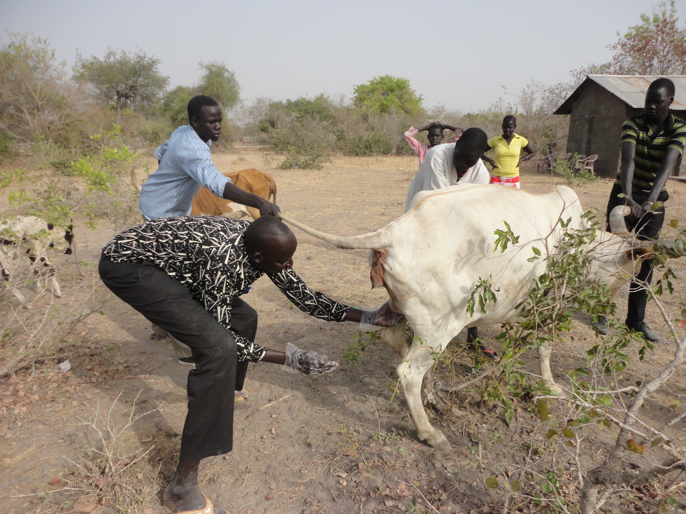
CAHWS
Strategy employed
Shifting from direct provision of veterinary starter kits to vet drug voucher system has aided in sustainability Community sensitization has been critical-especially in paying for vaccination services. Coordination with the relevant line ministries has been critical-to date in Gogrial State, vaccination campaigns are now exclusively run by the ministry with communities paying for the services

Slide 6
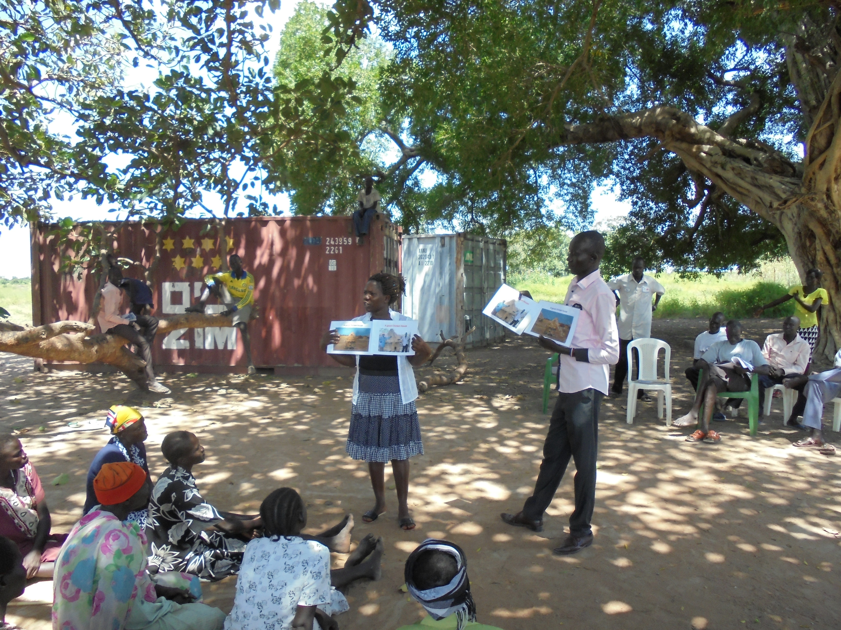
Poultry Auxiliaries
Strengths Need based-due to the introduction of the improved poultry breeds in the target location there has been increased demand of poultry specific extension service provision Gender inclusive-as a component area heavily dominated by women, the poultry auxillaries (being women themselves) has increased reach beyond target areas.

Slide 7
Challenges
Excludes the poor end farmers who cannot afford to pay for the basic services
Often specialized ,specific stream lined trainings,(a farmer has to pay more for varied services)
Actors lack harmonization of approaches
South Sudan’s complex context due to initial responces being predominantly emergency interventions.

Slide 8
Recommendations
Harmonisation of approaches with other actors-particularly livestock actors with regards to CAHWs & cost recovery approach
Sensitization of the extension actors on the importance of capacity building in light with ever changing context.
Integration of the different agent components ie COT’s being trained in agric extension in addition to their primary roles.
Literacy & numeracy skills enhancement e.g. CAHWs

