Slide 1


“Resilience Recovery for Food and Nutrition Security (RRFNS) in Jonglei State, including Greater Pibor Administrative Area”.
Counties:
Bor South
Pibor, Gumuruk & Lekwangole
Akobo

Slide 2
EXPECTED RESULTS.
a. Ability to produce sufficient staple food for own household restored.
b. Resilience against climate related crop-failures built-up.
c. Access to healthy and diverse types of food increased.
d. Access to farm-input supply systems for seeds, tools and fertilizers obtained

Slide 3
Ability to produce sufficient staple food for own household restored.
i. No land access challenges were reported, but rather demarcation and protection of crop gardens from grazing areas. Efforts have been made but crop destruction by animals still remains a big challenge in all project areas. Yet, community expectations on how to protect their gardens still remains problematic, there is thus need for continued dialogue to come up with local solutions that are affordable and sustainable.
ii. Target number producer groups, 60 (1500hh) have been formed, trained and supported with farm inputs, for production of staple food (Sorghum and maize).
iii. The process of facilitating formation of producer associations has been initiated. Bor has already established a functional Producer association. Not possible in Pibor and Akobo due to poor production.
iv. Extension staff, 10, have been seconded by local government at state level and continue to receive on-job and formal training and are being facilitated by ZOA to offer regular on-site support to producer groups and VSLA members.

Slide 4
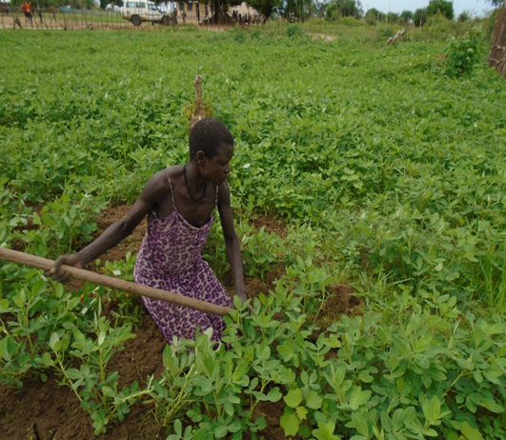
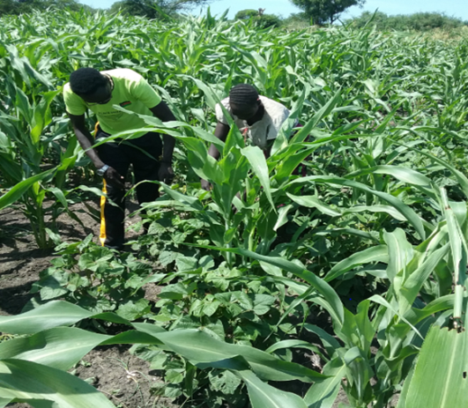

Slide 5
Resilience against climate related crop-failures built-up.
i. Training and construction of household granaries continues and hermetic bags were distributed. These bags have been effectively used in Bor as shown on the photos.
ii. Local markets reinstitution – given the reality in the project areas this activity has seemed not to be feasible for two reason. The budget allocation was quiet insufficient and reinstruction of markets where insecurity is rampant has proved to be hard..
iii. Support (re)introduction of small livestock at Hh level is ongoing in Bor and Pibor

Slide 6
Access to healthy and diverse types of food increased.
i. The process of facilitating formation of vegetable producer groups is completed and 12 (300HH)are formed. They’re in the process of receiving vegetable growing training and support and training on use of treadle pumps for irrigation has been is also ongoing.
ii. 12 Fishing groups (300HH) has been established and their capacity building is work in progress.
iii. Food Nutrition and hygiene training and campaigns is work in progress. It integrated in all the trainings sessions. To further strengthen this activity, we are in the process of establishing lead mothers food hygiene and nutrition promoters.

Slide 7
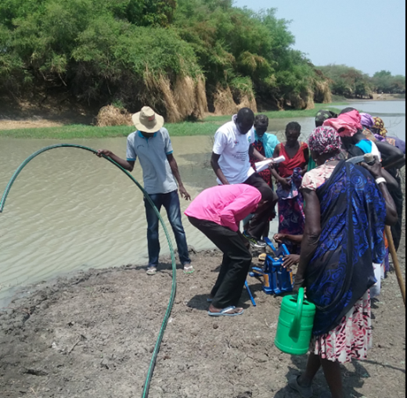
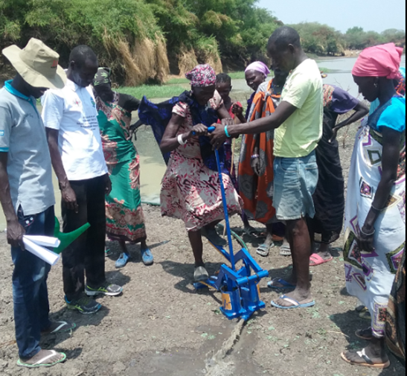

Slide 8
Access to farm-input supply systems for seeds, tools and fertilizers obtained.
i. Local supply chain and private sector promotion – yet to be done. No longer relevant and is being reviewed.
ii. Rebuilding seed system with local private actors – yet to be done. This action will be intensified in two (Bor and Akobo) regions. This is because Pibor region has shown it requires more relief and emergency actions than developmental.
iii. 21VSLA groups have been formed as a result of graduating form the producer groups. These groups are regularly saving. As at last year, they had a total of
The concept of savings and borrowing is slowly being appreciated but faced with numerous challenges ranging from high inflation rate, illiteracy, hunger and limited opportunities/sources to access regular incomes.

Slide 9
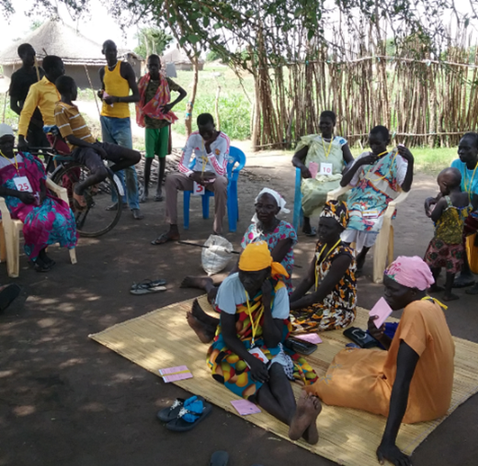
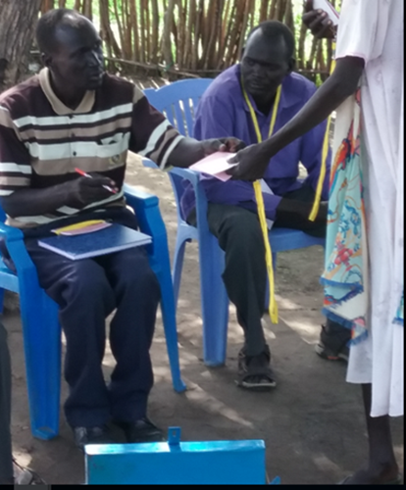

Slide 10
CHALLENGES
• Tribal, clan, cultural (cattle raiding) and age-set fighting and constant threats of possible attack exist across the regions. With Pibor being the most affected region.
• Erratic rainfall leading to crop failures either due to delayed rain fall and floods that destroyed crops hence poor harvests leading to famine.
• The economic meltdown leading to high rate of inflation and SSP devaluation. This has increased risks for local traders involved in local trading. This has made setting up of inputs supply chain a high risk venture
• Absence of function local businesses dealing agro products in all the project areas.

Slide 11
Thank you

