Slide 1


Technical Advisory Committee Meeting
Strengthening the resilience of pastoral & agro-pastoral communities in South Sudan’s cross border areas with Sudan, Ethiopia, Kenya and Uganda
Alemu A. Manni
Project Manager
EU Cross Border Project
Juba, SS
March 2018
WITH FUNDING FROM THE EUROPEAN UNION

Slide 2

FAO’s mandate

Slide 3





FAO’s priorities
1. Eradicate hunger and malnutrition
2. Make agriculture, forestry and fisheries more productive and sustainable
3. Reduce rural poverty
4. Enable inclusive and efficient agricultural and food systems
5. Increase the resilience of livelihoods to threats and crises

Slide 4
Project Overview
European Union Funded Project
August 2017 – July 2020
Project overall objective:
to improve governance and conflict prevention to reduce forced displacement and irregular migration in cross-border areas of South Sudan
Notes:
B1-Focus on understanding the underlying causes of food insecurity and the impact this may have on the pastoral and agro-pastoral communities. Currently the situation worsening.
B2-FSIS flagship products are the IPC (Integrated Food Security Phase Classification) and CFSAM, based on a solid partnerships platform with WFP, UNICEF, OCHA, NGOs and GRSS
B2- IPC and CFSAM used in SSD by both government and development partners to determine the scale of needs and geographic targeting.
B3-The livestock sector and its real impact on food security remains poorly understood, and as such remains a major gap in overall food security assessments, including the work done currently on the IPC, which is underpinning much of the current humanitarian response. The development of a robust livestock information system should address this gap, and add value to an effective early warning system for pastoral and agro-pastoral communities.
Similarly, recent efforts to better align humanitarian and development efforts within a resilience context analysis framework have brought out the need to better understand the risks that are facing these vulnerable groups. A better profiling of livelihood change and vulnerability would help to improve the targeting of the humanitarian and development response strategies.

Slide 5
Project Thematic Results
Result 1
Food security and nutrition and early warning systems are strengthened to improve regional and national policy and response capacity
Result 2
Transboundary animal diseases, prevention, detection and control measures are strengthened and harmonized
Result 3
Crop production, livelihood diversification and cross-border market access enhanced
Result 4
Natural resource management in cross-border regions is improved
Focus on communities in South Sudan’s cross-border areas with Sudan, Ethiopia, Kenya and Uganda
34%
21%
29%
16%

Slide 6
Implementation Areas

Slide 7
Project Status
Project builds on the activities already initiated and implemented through actions previously funded by the European Union; and Other Donor Agencies
  including Agriculture and Food Security Information System and livestock activities in the Abyei Administrative Area, and alternative livelihood options
Inception phase until end of January 2018

Slide 8
Inception Phase
Operational Aspects
Project Start up and determine the operational counties within the Cluster Areas
Prepared a Procurement, HR and Distribution Plan
Ongoing procurement of required project items
Finalizing Recruitment of Project team
Revise the logframe and risk log and adjust the work plan
Prepare monitoring and evaluation and communication and visibility plan
Identification of implementing partners
Establishment of FAO field office in Maban (within the UNHCR compound)

Slide 9
Inception Phase
Program Aspects
Baseline studies to refine log frame, indicators and targets conducted
An Inception Report – with 12 Annexes prepared and submitted
Technical Advisory Committee (TAC) members identified and initial discussions conducted
More than 30 field missions facilitated and various technical support mobilized
Engagement with core implementing partners started:
  FAO/RTEA, ECTAD (Emergency Center for Transboundary Animal Diseases) and IGAD - introduction meeting in Nairobi
Background on FS Info Sys conducted - Govt and International Institutions assessed
Coordination Platforms and Policies assessed
Food Security Analysis Framework formulated
Coordination with Ongoing Projects assessed and synced

Slide 10
Inception Phase
Major Technical Activities (Result 1 – 4)
NRM Strategy Prepared - LS and LL strategies in process
Various assessments and Baseline works conducted
CFSAM, FSNMS, and IPC products released – CLiMIS portal ongoing
Livestock Vaccination campaign facilitated
Pre-migration and conflict mitigation meetings facilitated and attended
Community Animal Health Worker training conducted
Landcover update work started

Slide 11
Project Implementation Modalities
Direct implementation
Implementation through partners (Letter of Agreement)
Collaboration with
  Ministries; I/NGOs; UN Agencies, Funds and Programmes; UNMISS; IGAD; Donors; FAO offices (including RTEA and ECTAD); and private sector

Slide 12
Project Strategy
Demand driven interventions
Strategic peace-building and conflict sensitivity programming
Communication for development
Support communities to connect to humanitarian and resilience opportunities
Regional approach and cross-border coordination
Partnership and collaboration

Slide 13
Project Impact Evaluation Strategy
Baseline study
QRM Updates – and Major Timeline Descriptions
Annual Reporting and reviews
Mid-term evaluations and reviews
Final evaluation

Slide 14
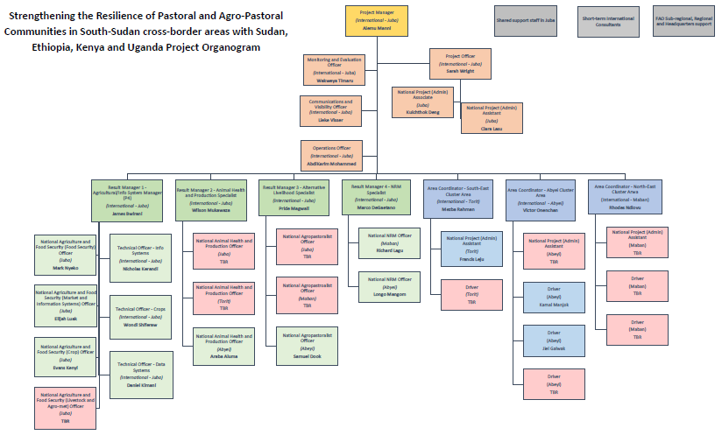

Slide 16
2018/19 Implementation Plan
– Major Deliverables
Technical team (Result 1)
Program Management Unit
Support the Value Chain Analysis
Start Predictive Early Warning System (PLEWS)
Resilience Index Measurement & Analysis (RIMA) training
Conduct Special Market Assessment (Study)
Facilitate the signing agreements with Ips
Technical Advisory Committee Meeting
Finalize recruitment & update procurement plan
Annual Report Submission
Facilitate all other admin tasks,
  Monitor workplan, logframe, budget, procurement, logistics, signing of LoA, MoU, etc.
  Construction of Maban office and Budget Revision

Slide 17
2018/19 Implementation Plan
– Major Deliverables
Technical Team (Result 2)
Technical team (Result 3)
Conduct surveillance, to control disease outbreaks
Organize cross-border annual meetings
Pilot Livestock Identification & Traceability strategy
Establish network of community-based LS extension
Finalize SS Strategy and Plan
Form a South Sudan National Livestock Council (SSNLC)
Conduct value chain analysis & socio-economic study
Facilitate the signature of MoU for cross border trade
Form (support) new/old small-scale artisan groups
Train and provide inputs to women and youth groups
Training and provision of small grants for blacksmith and carpentry (for canoes)

Slide 18
2018/19 Implementation Plan
– Major Deliverables
Technical Team (Result 4)
Analyse the NRM institutional frameworks, related conflict drivers and community mitigation mechanisms
Develop geo-spatial tools (e.g. remote sensing and GIS) for planning and monitoring purpose
Support/Establish Natural Resource Management Committees (NRMCs)
Facilitate seasonal migration conferences and workshops
Support/Establish Water Management Committees (WMCs) including scoping of responsibility, training needs, capacity building

Slide 19
Challenges and Mitigating Measures
Challenges/Risks | Mitigating Measures
Disrupted peace and security - Political instability and unrest | Situation monitoring to provide early warning of potential interruptions
Macro-economic deterioration Unstable World Markets, rising food & oil prices | Diversification of banking channels and money vendors
Insufficient state level implementing partners’ presence and capacity | Monitor situation to have flexible implementation modalities
Limited institutional and human capacity of partners (including the Government) in the target clusters | Strong collaboration and support from FAO and core UN and Devt partners; Capacity building and Communication for Development (ComDev)

Slide 20
Challenges and Mitigating Measures
Challenge/Risk | Mitigating Measures
Lack of utilization of all info system outputs/reports | Advocacy and active dissemination and regular user survey
Low government absorption capacity to run the system | Demonstrate values and ensuring on job training
Conflicts in scheduling of cross-border joint action with other countries | Awareness raising at all levels on IGAD and its role
Intertribal conflicts | Work with local institutions, UNMISS/UNISFA and other agencies
Influx of new Returnees/IDPs | Vulnerable groups will be engaged in the project activities

Slide 21

THANK YOU
WITH FUNDING FROM THE EUROPEAN UNION

