Slide 1
INTRODUCTION TO
PUBLIC FINANCE MANAGEMENT
Module 1.1. : Introduction & key concepts

Slide 2
Introductions
Name
Organisation and position
Experience with PFM
Specific expectations

Slide 3
Practical issues
Agenda (working hours, breaks)
Lunch
Mobile phones
Anything else...

Slide 4
Course objectives
Understand the key functions of Public Financial Management;
Acquire a conceptual basis for looking at and assessing PFM systems;
Understand role and importance of PFM in the development process.

Slide 5
Related MKS courses
Budget Support
Specific courses for selected key assessment areas:
  Macroeconomics I (Macro for development)
  Macroeconomics II
  Public Finance Management I
  Public Finance Management II (PFM Reform)
  Domestic Revenue Mobilisation
  Public Expenditure & Financial Accountability (PEFA)

Slide 6
Course outline (1)
DAY 1: PFM and the Budget
  1.1. Introduction to PFM and the key concepts
  1.2. Budget Cycle + exercise
  1.3. Macroeconomics and the Budget+ case study/exercise
DAY 2: Budget preparation and execution
  2.1. The Budget, budget preparation and MTEF + exercise
  2.2. Budget planning & performance + country cases
  2.3. Budget execution
  2.4. Internal control
DAY 3: Budget Execution; Treasury management
  3.1. Payroll, procurement and IT
  3.2. Treasury management + simulation exercise on Treasury Single Account

Slide 7
Course outline (2)
DAY 4: Revenue; Accounting & Reporting
  4.1. Coding & Classification
  4.2. Revenue Administration
  4.2. Accounting, recording, reporting + exercise
DAY 5: Audit & External Scrutiny; Link with Budget support
  5.1. Internal Audit
  5.2. External Audit and Oversight
  5.3. PFM diagnostic tools, and the PEFA
  5.4. Introduction to PFM reform sequencing
  Q&A Session with DEVCO

Slide 8
Module outline
Some definitions
The specific objectives of PFM
The limits of technical approaches to PFM

Slide 9

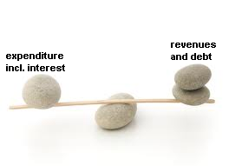
What is PFM?
  Public Financial Management deals with the management of public resources: the allocation and use of resources collected from the economy.
  3 basic elements of public finance:
    Public expenditure
    Revenues
    Government debt

Slide 10
What is PFM?
  OECD DAC 2009 Definition:
  “ It includes all components of a country’s budget process… including strategic planning, medium-term expenditure framework, annual budgeting and also revenue management, procurement, control, accounting, reporting, monitoring and evaluation, audit and oversight.“

Slide 11
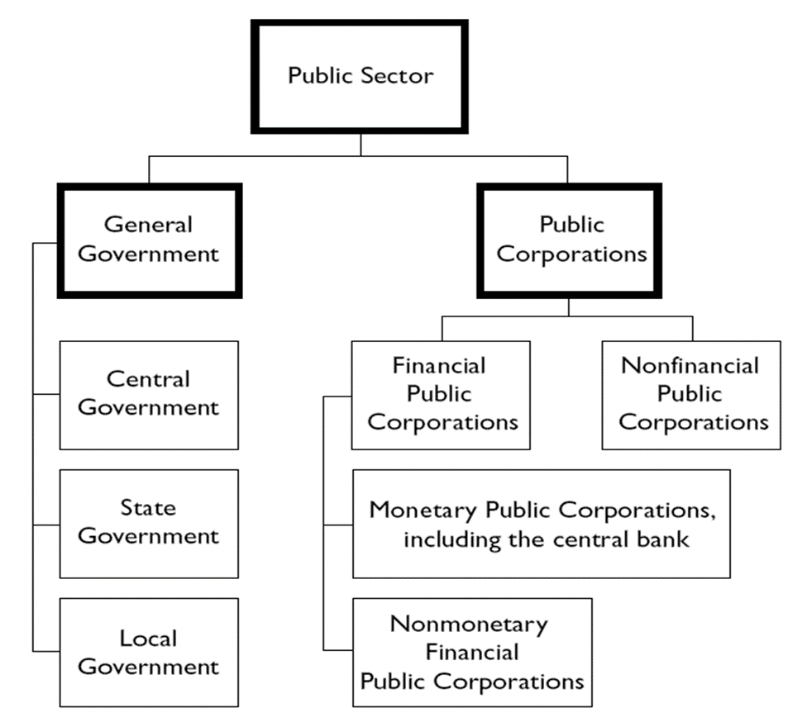
What is the Government?
Source: Government Finance Statistics (GFS). IMF

Slide 12
Module outline
Some definitions
The specific objectives of PFM
The limits of technical approaches to PFM

Slide 13
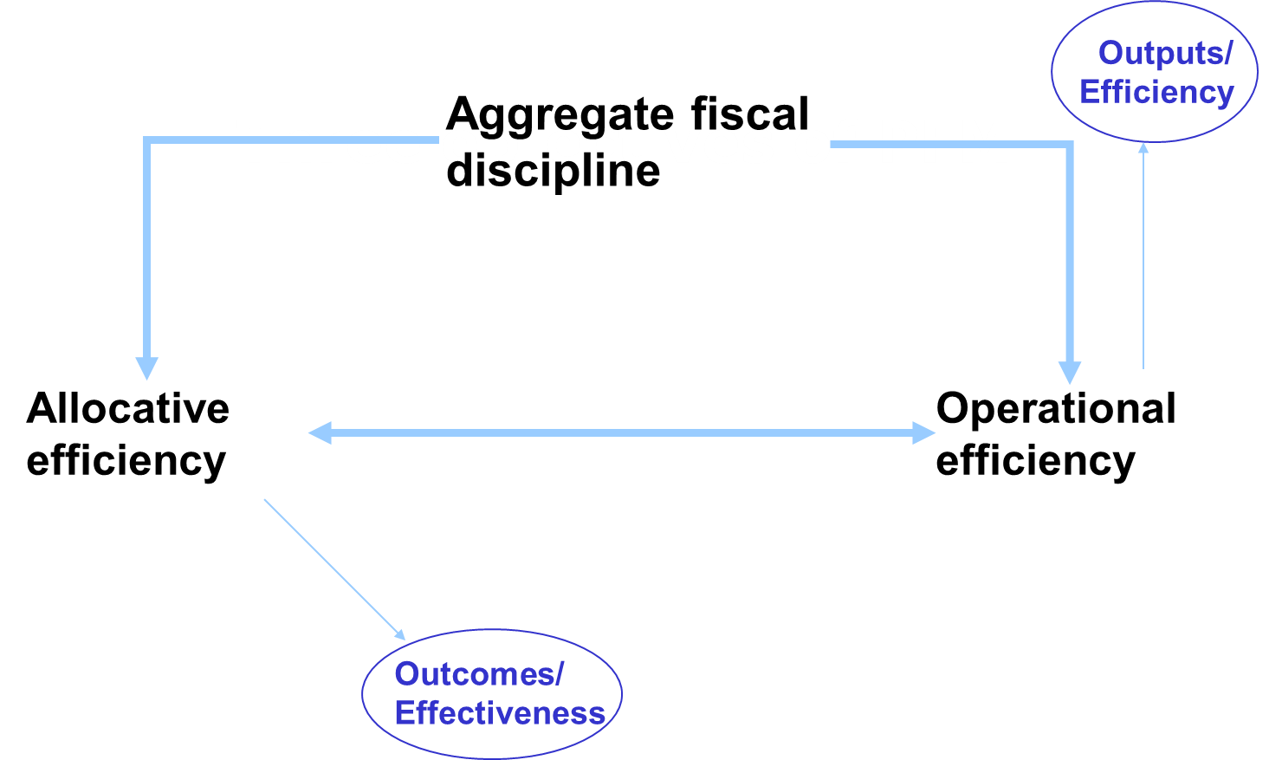
Specific objectives of PFM

Slide 14
Specific objectives of PFM
PFM is only one of the instruments to implement public policies, but it is probably the more important. As instrument, PFM has specific objectives to implement properly policies, which should not be confused with policy objectives.

Slide 15
Policy
PFM | Aggregate fiscal discipline Strategic allocation of resources Efficient service delivery
Outcomes

Slide 16
Specific objectives of PFM
Aggregate Fiscal discipline refers to:
maintaining a sustainable balance between revenues, expenditures and the level of public debts
respecting the expenditures ceilings at all levels and by all actors of the Government administration

Slide 17
Specific objectives of PFM
Allocative Efficiency refers to:
Allocating and spending public resources in such a way that that attainment of the government objectives is maximised
Preconditions for optimising allocative efficiency:
  Clearly defined national objectives and priorities
  Existence of effective sector programmes
  Capacity to plan resources
  Information on results and outcomes

Slide 18
Specific objectives of PFM
Operational Efficiency refers to the:
Ability to make efficient and effective use of resources in the implementation of strategic priorities
Key elements
  Use of liquidity (debt, cash management)
  Resources to service delivery units
  Reduce leakage

Slide 19
Specific objectives of PFM
1/Aggregate fiscal discipline
Ensuring macro-economic stability
Control of totals
2/Allocation of resource in conformity with policy objectives
Importance of political aspects
Requires appropriate mechanisms for revealing policy choices and for policy dialogue
3/Efficient public service delivery and resource management
Importance of systems (e.g. Treasury system)

Slide 20
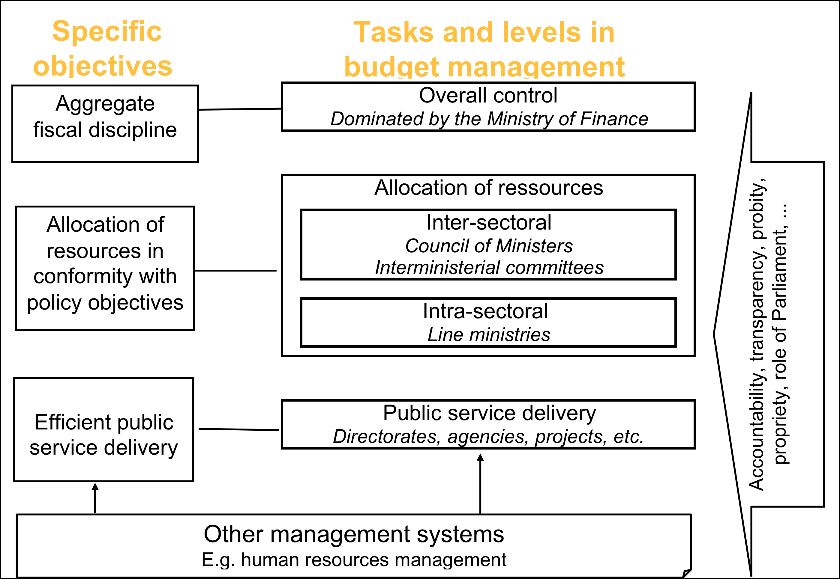
Specific objectives of PFM

Slide 21
Specific objectives of PFM
PFM is an instrument to deliver public policies, it is not a policy as such;
Public finance policies
  Tax policy
  Public expenditure policy
  Debt policy
  National and sector policies
  Poverty Reduction Strategy
  Sector strategies, etc.

Slide 22
Module outline
Some definitions
The specific objectives of PFM
The limits of technical approaches to PFM

Slide 23
The limits of technical approaches
Can PFM reform STOP Corruption?
NO
but it helps in identifying where there are failings
  Strengthening PFM systems will help in curbing administrative corruption
  However, fighting grand corruption, which involves powerful politicians is largely a political and societal matter

Slide 24
The limits of technical approaches
Important underlying points…
  Realistic expectations;
  View PFM in its political context;
  PFM processes should aim to make informal rules visible;
  Transparency is crucial;
  Attention should be also paid to external (to the executive) control.

Slide 25
Key messages
PFM is an important instrument to implement government policies.
The main tasks of PFM are to ensure aggregate fiscal discipline, resource allocation in conformity with policy objectives and efficient public service delivery.
Political aspects of PFM must be taken into account and informalities must be made visible.

