Slide 1
INTRODUCTION TO
PUBLIC FINANCE MANAGEMENT
Module 1.2: The Budget Cycle

Slide 2
Module Outline
The six phases of the Budget Cycle

Slide 3
The Six Phases of the Budget Cycle
Policy Review
Budget
Execution
Strategic
Planning
External Audit &
Scrutiny
Budget
Preparation
Accounting &
Reporting

Slide 4
Budget Cycle Exercise
Match Tasks and Institutions in public finance the six main Stages of the Budget Cycle – 30 mins

Slide 5
Phase 1. Strategic Planning
Conversion of economic and social policies into a medium-term programme of action, taking into account available resources
Macroeconomic policy
National Development Plan
Medium-Term Fiscal Framework
Sector strategies
Aggregate Budget and Expenditure Ceilings
Costing / fiscal impact assessments
priorities within a fiscal constraint...
fiscal side
planning side

Slide 6
Phase 2. Budget Preparation
Budget preparation is the process of converting strategic plans into public spending; the Budget preparation process must:
Be defined in the legislative framework: the Constitution, the Organic Budget Law or PFM Act, financial regulations and administrative procedures;
Should integrate a medium term rolling process with the annual Budget;
Ultimately lead to the executive receiving “authority to spend” by the legislature in the Annual Budget Law – known as appropriations.
NB: Changes in the Budget Law require supplementary appropriations

Slide 7
Phase 2. Budget Preparation
Cabinet
Determine budgetary ceilings by sector/ministry
Send budget circular
Line ministries
Ministry of Finance
Submit bid
Hearings
Submit to Parliament for Appropriation
Parliament
7
Notes:
7

Slide 8
Phase 3. Budget Execution
Budget Plan
Expenditure control
Payroll
Procurement of goods/services
Transfers / subsidies
... and other...
Revenue collection
Taxes (direct/indirect)
Excises
Duties
Non-tax revenues
Donor funding
Liquidity management
Short term (cash management)
Medium / long term (debt management)

Slide 9
Phase 3. Budget Execution
Authorisation by the Ministry of Finance or Line Ministry
Commitment to undertake future payment: contract
Verification of delivery to spending unit: liability
Payment Authorisation by MoF or Fin. Dept.
Cash Payment by Treasury or LM
Notes:
9

Slide 10
Phase 4. Accounting & Reporting
Budgetary Accounting
Definition: maintaining records and reporting on the execution of the budget.
Aim: monitor and control compliance with budget appropriations.
Accounting basis (cash or accrual, same as the budgeting basis).

Slide 11
Phase 4. Accounting & Reporting
Financial Accounting
Definition: maintaining records and reporting on revenues and expenditure, assets and liabilities.
Aim: Annual Financial Statements;
  Revenues and expenditures;
  Balance sheet (assets and liabilities).
Accounting basis (cash or accrual, does not depend on the budgeting basis).

Slide 12
Phase 4. Accounting & Reporting
Coding Structure
Chart of Accounts (CoA): coding framework for financial transactions.
Aim: recording each financial transaction for purposes of expenditure control, costing, and economic and statistical analysis.

Slide 13
Phase 5. External Audit
Supreme Audit Institution (SAI):The institution of the State responsible for public external scrutiny of the government’s Annual Financial Statements
“The principal task of SAIs is to examine whether public funds are spent economically, efficiently and effectively in compliance with existing rules and regulations.” INTOSAI (2009)
International standards require...
Independence from executive;
Legislative mandate enshrined in Constitution.
l
Notes:
13

Slide 14
Phase 6. Policy Review
Assessment of actual versus desired government policy outcomes;
Ex-post analysis of impact of government policy programmes;
Is there a Performance Assessment Framework (PAF) for monitoring and evaluation?
Adaptation of Strategic Planning on the basis of analysis of policy implementation.
NB: ... should be integrated with the Strategic Planning Phase of the Budget Cycle

Slide 15
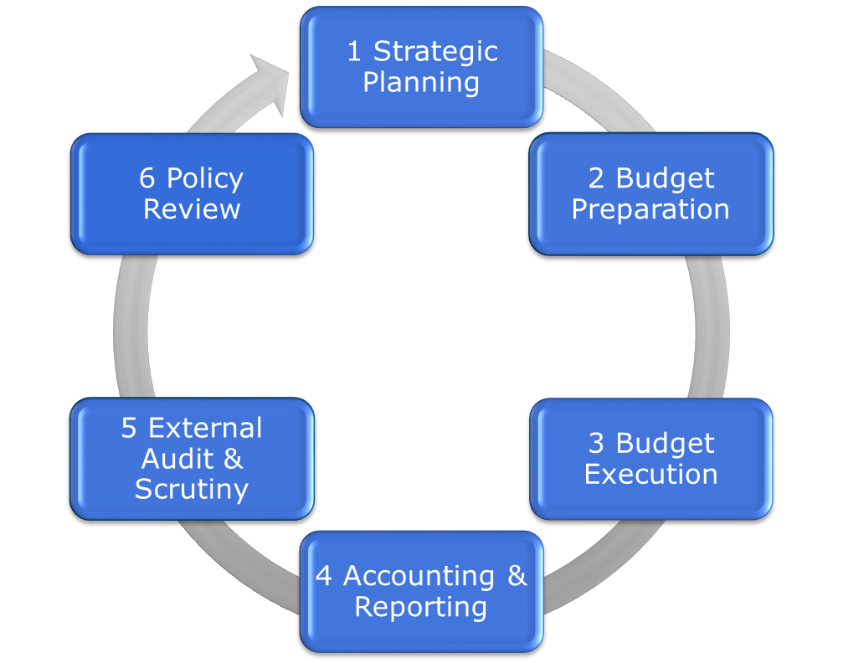
Key message...

Slide 16
Key message...
Fiscal Year:
Budget
T-1
Strat. Planning
& Budget Prep.
Budget Execution
Account. & Rep.
External Audit
Policy Review
Budget
T
Strat. Planning
& Budget Prep.
Budget Execution
Account. & Rep.
External Audit
Policy Review
Budget
T+1
Strat. Planning
& Budget Prep.
Budget Execution
Account. & Rep.
External Audit
Policy Review
t-2
t-1
t
t+1
t+2
Notes:
16

