Slide 1
INTRODUCTION TO
PUBLIC FINANCE MANAGEMENT
Module 1.3: Macroeconomics & the Budget

Slide 2
Module Outline
How to look at the economy; the role of PFM
The Government ‘Fiscal Constraint’; how to read a Statement of Government Operations
Definitions of the ‘Deficit’; the starting point for budgetary analysis
How to finance the Deficit; impact on the economy
How PFM can contribute to macro-fiscal stability?

Slide 3
The Real Sector
(National Accounts)
The Public Sector
(The Statement of
Government
Operations/TOFE)
The External Sector
(Balance of
Payments)
The Money Sector
(The Monetary
Survey)

Slide 4
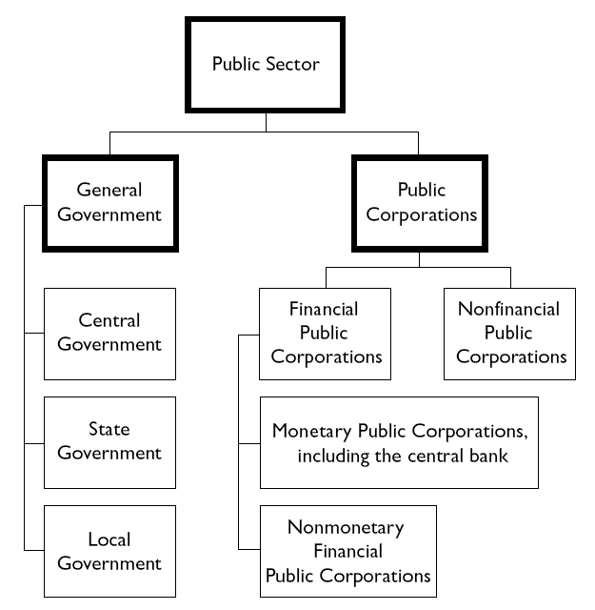
Source: Government Finance Statistics (GFS). IMF

Slide 5
Basic Economic Equilibrium model
and in an open...
Expenditure in a closed economy...
Y = C + I + G
and
Y = C + S + T
Y – Expenditure/Income [GDP]
C – Consumption
I – Investment
G – Government spending
S – Saving
T – Taxes
+ (X – M)
X – Exports
M – Imports

Slide 6
Basic Economic Equilibrium model
The linkages of PFM with the economy...
Y = GDP = C + I + G + (X – M) = C + S + T or
G – T = (S – I) + (M – X)
Y – Expenditure/Income [GDP]
C – Consumption
I – Investment
G – Government spending
S – Saving
T – Taxes
X – Exports
M – Imports
BUDGET DEFICIT/
DEBT FINANCING
BALANCE OF PAYMENTS GAP
SAVINGS GAP

Slide 7
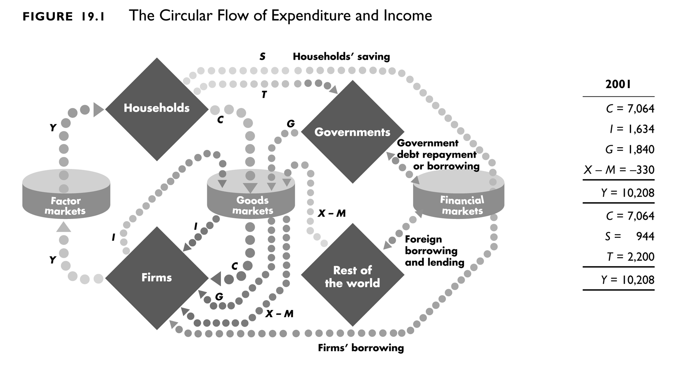
Expenditure
Uses of income

Slide 8
Module Outline
How to look at the economy; the role of PFM
The Government ‘Fiscal Constraint’; how to read a Statement of Government Operations
Definitions of the ‘Deficit’; the starting point for budgetary analysis
How to finance the Deficit; impact on the economy
How PFM can contribute to macro-fiscal stability?

Slide 9
The ‘Government Fiscal Constraint’
G^{K}+ G^{R} + r(D) = T + GRANTS + Δ(D)
G^{K} – Capital Expenditure
G^{R} – Recurrent Expenditure
r(D) – Interest payments on Debt
T – Domestic Resources (Tax and Non-Tax)
Δ(D) – Borrowing (change in the stock of Debt)

Slide 10
Statement of Government Operations

Slide 11
Module Outline
How to look at the economy; the role of PFM
The Government ‘Fiscal Constraint’; how to read a Statement of Government Operations
Definitions of the ‘Deficit’; the starting point for budgetary analysis
How to finance the Deficit; impact on the economy
How PFM can contribute to macro-fiscal stability?

Slide 12
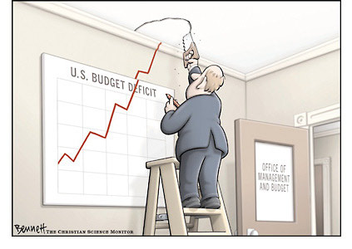
Which budget deficit?
‘A deficit may be like an elephant: one always recognises it when one sees it, even though it may be difficult to measure or describe it in a way that is satisfactory to everybody and for every purpose’ (V. Tanzi)
Four commonly used concepts:
Overall balance (‘budget’ or fiscal balance)
Primary balance
Revenue balance (or current balance)
Overall balance without external grants

Slide 13
Basic fiscal indicators
FISCAL INDICATOR DEFINITION
Overall (fiscal) balance Expenditure – Income (Revenue)
Primary balance Fiscal balance – interest payments
Current (Revenue) balance Current revenues – current expenditures
Overall balance w/t grants Fiscal balance - grants
External budget balance Expenditure – externally financed receipts
Domestic budget balance Fiscal balance – external budget balance
Consolidated balance Central + decentralised government balance

Slide 14
‘Above’ or ‘below the line’?
‘Above the line’: revenue/expenditure
‘Below the line’: net financing (because it creates or takes away a liability)
    What about...?
    Interest payment
    Principal repayment (amortisation)
    New loans
    Budget support

Slide 15
CASE STUDY - EXERCISE
ANALYSIS
STATEMENT OF GOVERNMENT OPERATIONS
OF MOLDOVA
30 mins

Slide 16
Module Outline
How to look at the economy; the role of PFM
The Government ‘Fiscal Constraint’; how to read a Statement of Government Operations
Definitions of the ‘Deficit’; the starting point for budgetary analysis
How to finance the Deficit; impact on the economy
How PFM can contribute to macro-fiscal stability?

Slide 17
Financing the Budget Deficit
What Financing options?
Domestically
Banks
Individuals
1. Borrowing
Others
Externally
Banks
Financial institutions
2. Not paying and building up Arrears
3. Selling Assets
4. “Printing Money”
Governments

Slide 18
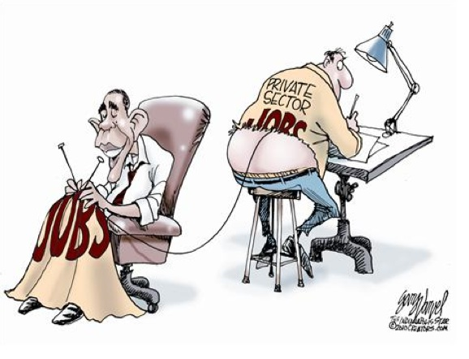
The ‘Crowding Out’ Effect
Crowding out is the reduction of private sector consumption or investment resulting from ‘additional’ government financing [deficit]…
an additional tax; reduces disposable income for private sector;
domestic borrowing; i.e. the effect of increasing the interest rate and the cost of borrowing for private sector (or directly limits availability of finance in countries with weak financial markets).
The negative effect of absorbing scarce resources at the expense of the private sector.

Slide 19
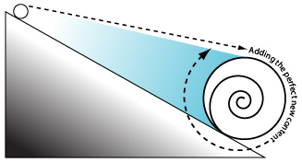
Challenges with Financing
The “Snow Ball Effect”
Primary deficit is kept stable,
but debt increases nonetheless...
Example:
2% GDP growth
7% inflation
10% interest rate
Fixed % primary revenue and expenditure of GDP

Slide 20
Challenges with Financing

Slide 21
Debt Sustainability
Debt sustainability is the ability of a country to meet current and future debt service obligations in full, without:
  Debt rescheduling; accumulation of arrears; default;
  Compromising economic growth.
Debt sustainability is essential for:
  Economic stability, growth, development and poverty reduction;
  Fiscal management;
  Access to capital markets.

Slide 22
Debt Sustainability
Debt Sustainability Analysis (DSA) – a standard annex in IMF Article IV Consultation and/or Country Review reports...
  Highly dependent on “accuracy” of macroeconomic projections
  Important exogenous factors to be analysed:
  Exchange rates;
  Export and import prices on world market (e.g. oil and food);
  Weather (e.g. good or bad harvest);
  Changing international interest rates.

Slide 23
Module Outline
How to look at the economy; the role of PFM
The Government ‘Fiscal Constraint’; how to read a Statement of Government Operations
Definitions of the ‘Deficit’; the starting point for budgetary analysis
How to finance the Deficit; impact on the economy
How PFM can contribute to macro-fiscal stability?

Slide 24
PFM and macro-fiscal stability
While preparing the Budget…
Are the macroeconomic and fiscal constraints taken into account properly?
Are the economic assumptions and revenue projections underlying the Budget accurate and consistent?
Is there adequate consideration of implicit fiscal risks?
Is there a Medium Term Fiscal Framework (MTFF) reflecting the above in a consistent and systematic manner?
Further discussion under Module 2.1
Notes:
They may apply to every tier of government.
NB
G Kopits and S Symansky, ‘Fiscal policy rules’, 1998.: An effective fiscal rule should be: “well defined, transparent, simple, flexible, adequate, enforceable, consistent and efficient.”
Kopits, George: « Fiscal Rules: Useful Policy Framework or Uncessary Ornament », IMF Working Paper, September 2001.
On fiscal rules:
Murray, Alisdair and Wilkes, Giles: « Fiscal Rules OK? », Centre Forum, January 2009.
These authors arguethat fiscal rules allow governments to avoid debate on fiscal policy issue and to delegate the problems away by sticking narrowly to a set of rules or pronouncements of experts.

Slide 25
PFM and macro-fiscal stability
Aggregate fiscal discipline is paramount...
Adequate systems; macro-fiscal policy, medium term budget planning et.al. must be robust to prevent uncontrolled ‘additional’ financing over and above what is planned in the Budget;
Fiscal rules; ‘bind’ a government (central and/or sub-national) into a specific fiscal behaviour and prevent discretionary intervention – examples:
Capping deficit/GDP and Debt/GDP ratios in legislation;
Precluding local government from incurring debt;
‘Golden rule’ debt financing only for capital spending.
Notes:
They may apply to every tier of government.
NB
G Kopits and S Symansky, ‘Fiscal policy rules’, 1998.: An effective fiscal rule should be: “well defined, transparent, simple, flexible, adequate, enforceable, consistent and efficient.”
Kopits, George: « Fiscal Rules: Useful Policy Framework or Uncessary Ornament », IMF Working Paper, September 2001.
On fiscal rules:
Murray, Alisdair and Wilkes, Giles: « Fiscal Rules OK? », Centre Forum, January 2009.
These authors arguethat fiscal rules allow governments to avoid debate on fiscal policy issue and to delegate the problems away by sticking narrowly to a set of rules or pronouncements of experts.

Slide 26
PFM and macro-fiscal stability
Types of Fiscal Rules? [IMF 2012]
Debt rules set an explicit limit or target for public debt in percent of GDP;
Budget balance rules constrain the variable that primarily influences the debt ratio and are largely under the control of policy makers;
Expenditure rules set limits on total, primary, or current spending;
Revenue rules set ceilings or floors on revenues and are aimed at boosting revenue collection and/or preventing an excessive tax burden.
NB: Some countries combine two or more fiscal rules.

Slide 27
PFM and macro-fiscal stability
Fiscal Governance in the European Union
The Stability and Growth Pact (SGP) requires that:
  General government deficit must not exceed 3% of GDP; and
  Public debt must not exceed 60% of GDP (or at least diminish sufficiently towards the 60% threshold).
For the EU, fiscal governance refers to the rules, regulations and procedures that influence fiscal and budgetary policy. This Includes:
  National numerical fiscal rules;
  Independent fiscal institutions; and
  Medium term budgetary frameworks.
Notes:
SGP – agreement among EU member-states

Slide 28
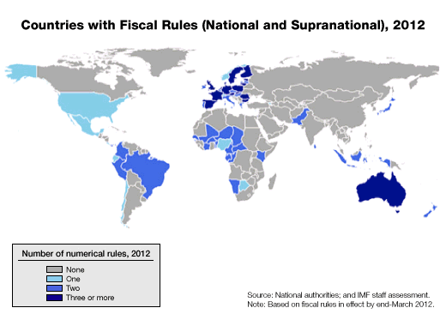
PFM and macro-fiscal stability
Rules for: Debt, Deficit, Revenue, Expenditure

Slide 29
Key message...
...how the Budget is financed matters!
Printing Money
Inflation
Domestic Borrowing
Crowding out
Foreign Borrowing
Debt
Gov’t
Deficit
Asset sales
Sustainability
Arrears
Crowding out
Grants
Predictability

