Slide 1
INTRODUCTION TO
PUBLIC FINANCE MANAGEMENT
Module 3.1: Special issues: Payroll, Procurement and IT

Slide 2
Why improving Payroll and Procurement systems?
  Not paying employees and suppliers in a timely (and accurate) way reduces allocative efficiency (hampering public service delivery).
  Poor allocative efficiency can lead to macro problems and reduces credibility of the budget.

Slide 3
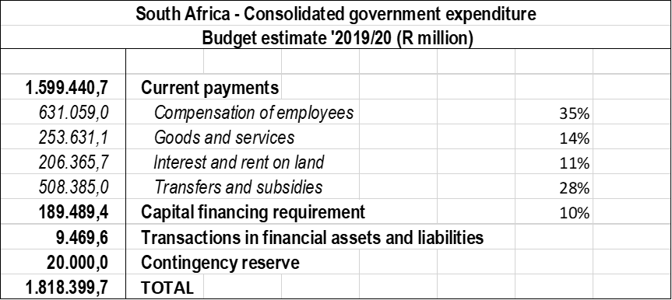
Why improving Payroll and Procurement systems?
These are the largest expenditure items of Government…

Slide 4
Why improving Payroll and Procurement systems?
Fraud
  Action that misleads to obtain financial benefit
  Inside PFM system
Corruption
  Giving or receiving financial benefit to influence decisions/actions
  Usually outside PFM system

Slide 5
Module Outline
Payroll procedures, processes and risks
Procurement methods and practice
Use of IT, challenges of large IT projects

Slide 6
Payroll procedures, processes and risks
Payroll Management
Effective control is achieved by segregation of three sets of data files:
Personnel and payroll data is to be updated promptly & may be linked or one database.
funded posts -
personnel database
payroll

Slide 7
Payroll Management cont.
Payroll procedures, processes and risks
Personnel files are dynamic – starters, transfers, and terminations;
Restricted access to data, clear authorisation;
Audit trails for all changes;
Controls over standing data on wage rates, taxation etc.;
Payroll audits and checks undertaken regularly.

Slide 8
Payroll Management cont.
Payroll procedures, processes and risks
Ministry of Public Administration – controls the number and grades of posts and the personnel budget;
Public Service Commission – manages the appointment and promotion of staff (nominal roll);
Above two functions may be combined;
Central Payroll (Ministry of Finance) – often decentralised.

Slide 9
PEFA on Payroll… Indicator 23
Payroll procedures, processes and risks
Dimension 23.1 assesses the degree of integration between personnel, payroll, and budget data;
Dimension 23.2 assesses the timeliness of changes to personnel and payroll data;
Dimension 23.3 assesses the controls that are applied to the making of changes to personnel and payroll data;
Dimension 23.4 assesses the degree of integrity of the payroll. Payroll audits should be undertaken regularly to identify ghost workers, fill data gaps, and identify control weaknesses.

Slide 10

IMF public sector wage ceilings
Payroll procedures, processes and risks
ActionAid study in 2006 showed that out of a sample of 41 countries with an IMF loan agreement, 18 had a ceiling on the wage bill.
Largest group of public sector workers are teachers, the second largest are health workers.
“Wage bill ceilings have been used to protect macroeconomic stability and still may be needed in exceptional cases, but their use should become less frequent” (IMF Board 2007).

Slide 11
Module Outline
Payroll procedures, processes and risks
Procurement methods and practice
Use of IT, challenges of large IT projects

Slide 12
Procurement methods and practice
Procurement is the process of:
Identifying what is needed – procurement plan;
Determining the best person or company to supply this need – ordering/contracting;
Ensuring what is procured is delivered to the right place, at the right time, for the best price,
All of this is done in a fair and transparent manner.

Slide 13
Procurement Process
Procurement methods and practice
Planning
Tendering
advertising
opening
Quality control
check delivery to order
estimate value of work done
Payment
tender evaluation
certification of payment
retention, mobilization fee
procurement plan
specification/bid documents

Slide 14

Procurement approaches
Procurement methods and practice
Standard list of suppliers
Written quotations
Formal tenders – pre-qualification
Exceptions:
Single source procurement
Restricted tendering

Slide 15
Procurement management
Procurement methods and practice
Integration of procurement into budget;
No initiation of procurement without available funds;
Segregation of duties;
Transparency from the bidding stage to contract award (including bid prices);
Effective Competition.

Slide 16
Procurement management cont.
Procurement methods and practice
Effective competition in the selection of the contractors:
  Controls over contract slicing;
  Adequate advertising;
  Sealed bids;
  Tender specification of both compliance criteria as well as evaluation criteria;
  Prompt evaluations;
  Adequate period for complaints/appeals after contract award.

Slide 17
Institutional arrangements
Procurement methods and practice
Ministerial tender boards – letting contracts;
Central tender boards – letting larger contracts;
Public Procurement Authority – regulation, monitoring, complaints & training;
Central Purchasing Organisation.

Slide 18
Procurement methods and practice
PEFA on Procurement… Indicator 24
Dimension 24.1 assesses the extent to which prudent monitoring and reporting systems are in place within government for ensuring value for money and for promoting fiduciary integrity;
Dimension 24.2 analyses the percentage of the total value of contracts awarded with and without competition;
Dimension 24.3 reviews the level of public access to complete, reliable and timely procurement information;
Dimension 24.4 assesses the existence and effectiveness of an independent, administrative complaint resolution mechanism.

Slide 19
Module Outline
Payroll procedures, processes and risks
Procurement methods and practice
Use of IT, challenges of large IT projects

Slide 20
Integrated Financial Management Information System (IFMIS)
Use of IT, challenges of large IT projects
Single integrated computer system for:
  all financial aspects: budgeting, general ledger, procurement payroll etc.
  all governments: local, provincial and national
May bring government into 21st century and facilitate other major changes, but:
2003 World Bank survey – only 21% successful; took seven years to complete and cost on average $12.3million

Slide 21
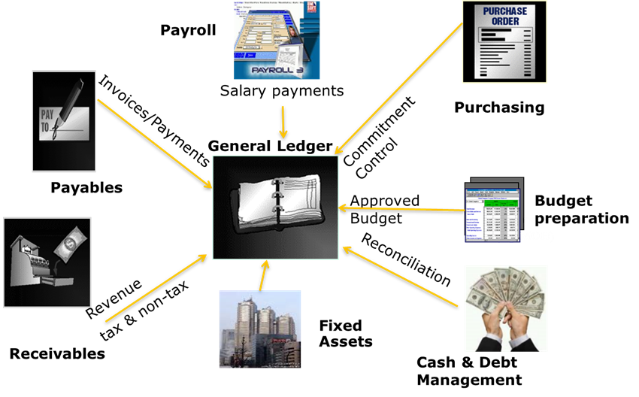
Modules of an IFMIS…
Use of IT, challenges of large IT projects

Slide 22
IFMIS can be a high risk approach to development
Use of IT, challenges of large IT projects
Risks increase because:
Projects are complex;
Capacity of local officials to understand/assess all aspects of a project;
Projects are led or heavily influenced by external or foreign consultants;
Political support the willingness to provide appropriate resources is not always available.

Slide 23
Before starting the Namibian case … Acronyms list
Use of IT, challenges of large IT projects
  PDMS – Payroll Deductions Management System
  HRIMS – Human Resources Information Management Systems.
  MEDAID – Medical Aid
  S & T – Subsistence and Travel
  IRD – Inland Revenue Department
  ASYCUDA – Automated Systems for Customs Data and Administration
  GL- General Ledger
  AP – Accounts Payable
  AR – Accounts Receivable
  AM- Asset Management
  PO- Purchase Order
  CM- Cash Management
  HC - Housing Collateral
  Med Aid - Medical Aid
  DSA – Daily Subsistence Allowance
  Debt MGMT- Debt Management

Slide 24

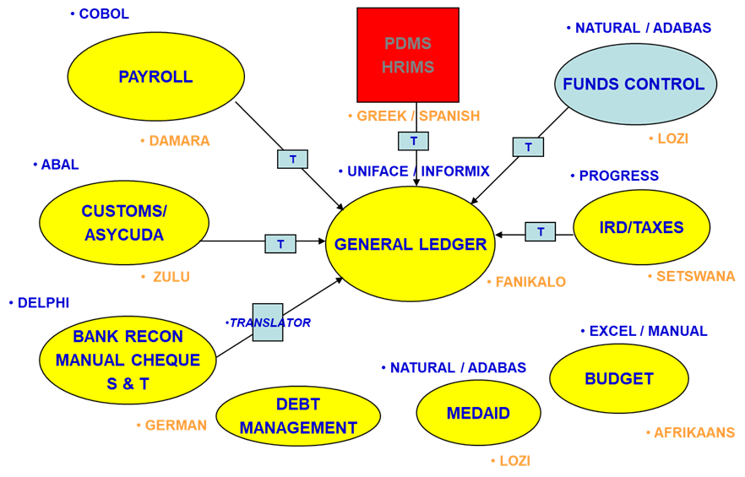
The Namibian case… islands of data…
Use of IT, challenges of large IT projects

Slide 25
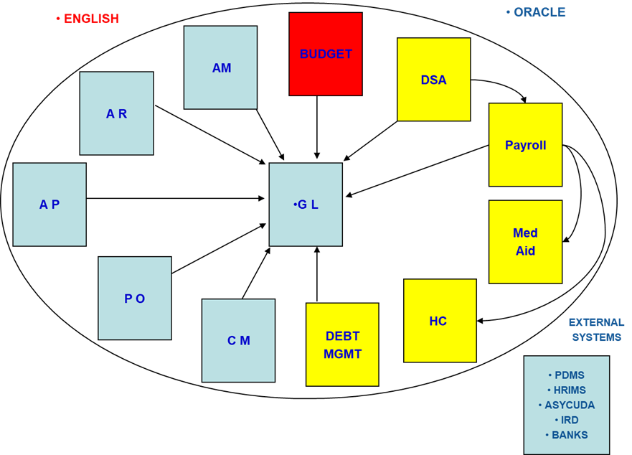
The Namibian case… integrated data…
Use of IT, challenges of large IT projects

Slide 26
Key messages
Payroll risky area for fraud;
Procurement is a risky area for fraud and corruption;
Internal controls can reduce the risk;
International standards and guidance available;
Do not be seduced by IT – it is not always the answer.

