Slide 1
INTRODUCTION TO
PUBLIC FINANCE MANAGEMENT
Module 4.2: Revenue administration

Slide 2
Scope and Rationale
Scope: This module covers tax revenue – see course on Domestic Revenue Mobilisation for other revenues.
High risk area: Tax Authorities handle large amounts of money and considerable scope for waste & corruption if poor management, and insufficient oversight & accountability.

Slide 3
  Module outline
  Tax policy and Revenue administration
  Main categories of taxes
  Conditions for effectiveness, transparency and due process
  Institutional arrangements
  Revenue Forecasting

Slide 4
Tax Policy and
Tax Revenue Administration
Tax policy determines:
  The total tax burden;
  The structure of tax revenue and the relative share of each tax;
  The basis and the rate of each tax.
Revenue administration fulfils the following basic tasks:
  Identification of the taxpayers;
  Calculation of the tax basis, establishment of tax due by the taxpayer;
  Tax collection.

Slide 5
Annual listing of tax, fees and charges
All revenue receipted and promptly banked intact
Summary of all income received produced monthly
Income & receipts reconciled to bank statements

Slide 6
Tax Policy and
Tax Revenue Administration
Tax evasion v Tax avoidance
Evasion: Use illegal activities to hide tax liabilities
Avoidance: Use legal methods to avoid tax liabilities (e.g. transfer pricing)

Slide 7
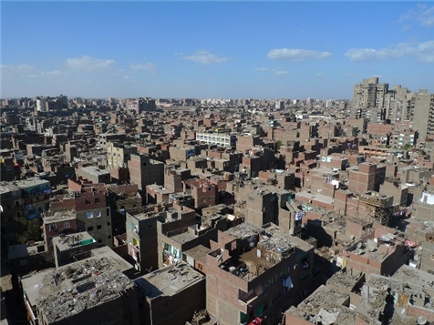
Cairo – why were the buildings never finished?
Tax Policy and
Tax Revenue Administration
Poorly worded/designed taxes can lead to unintended consequences
Cairo Skyline:
Taxes paid on completed dwellings.
Tax avoidance or tax evasion?
Buildings not completed but occupied.

Slide 8
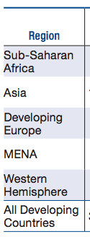
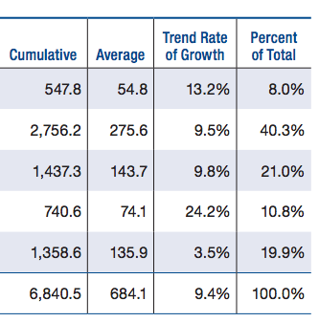
Tax Policy and
Tax Revenue Administration
Real Illicit Financial Flows by Region, Growth Rate 2003-2012 (in billions of constant U.S. dollars, base year 2010, or in %)
Illicit Financial Flows (IFF) generally involve the following practices:
Money laundering;
bribery by international companies;
Tax evasion (2/3 of all IFF);
Trade mispricing.
Data:http://www.gfintegrity.org/wp-content/uploads/2014/12/Illicit-Financial-Flows-from-Developing-Countries-2003-2012.pdf

Slide 9
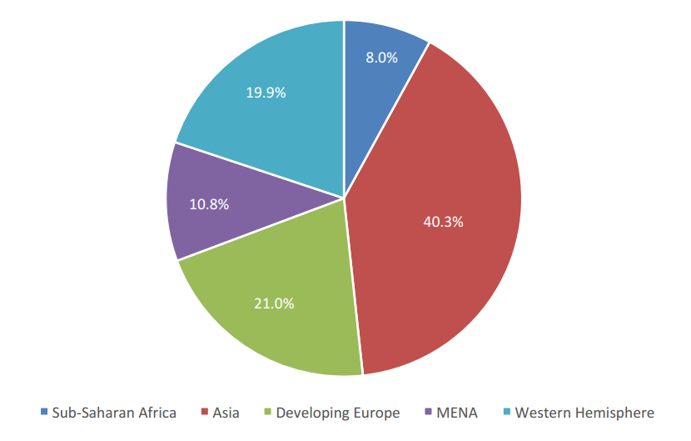
Tax Policy and
Tax Revenue Administration
Cumulative Illicit Financial Flows by Region, 2003-2012 (as %of total real illicit outflows)
The developing world lost US$991.2 billion in IFF in 2012, over ten times the amount of ODA received by these countries in that year
From 2003 – 2012, US$6.6 trillion left developing country economies illicitly
Data: http://www.gfintegrity.org/wp-content/uploads/2014/12/Illicit-Financial-Flows-from-Developing-Countries-2003-2012.pdf

Slide 10
  Module outline
  Tax policy and Revenue administration
  Main categories of taxes
  Conditions for effectiveness, transparency and due process
  Institutional arrangements
  Revenue Forecasting

Slide 11
Tax categories
Direct vs Indirect tax
  Direct tax: Tax on the agent (tax payer)
    e.g. wage tax/social security contribution may be administered by employers
  Indirect tax: Tax on an event
    e.g. the purchase of a consumption good, it is supported by the consumer but paid by the seller

Slide 12
Notes:
Source: GFS

Slide 13
  Module outline
  Tax policy and Revenue administration
  Main categories of taxes
  Conditions for effectiveness, transparency and due process
  Institutional arrangements
  Revenue Forecasting

Slide 14
Effectiveness, Transparency and
Due Process
Transparency of Taxpayer Liabilities
Clarity & Comprehensiveness of Tax Liabilities
Requirements:
  (1) Clear and comprehensive legislation with limited discretionary power of tax agency;
  (2) Easy access to understandable information on tax liabilities and administrative processes;
  Existence and functioning of tax appeal mechanisms.

Slide 15
Effectiveness, Transparency and
Due Process
Effective Tax Payer Registration and Assessment
Controls in taxpayer registration system ➔ those who should be registered, are registered; registration then enables assessment:
  Unique tax payer identification system;
  Database with linkage to other relevant government; systems;
  Occasional surveys.
Effective (Punitive) penalties for non-compliance.
Effective system to audit self-assessments

Slide 16
Effectiveness, Transparency and
Due Process
Effective collection of tax payments
Tax liabilities still unpaid at end of the financial year should be collected in next financial year.
Tax collections should be transferred to Treasury-controlled accounts (daily).
Tax collections submitted to Treasury must be consistent with assessments. Any inconsistency needs to be checked.

Slide 17
  Module outline
  Tax policy and Revenue administration
  Main categories of taxes
  Conditions for effectiveness, transparency and due process
  Institutional arrangements
  Revenue Forecasting

Slide 18
Institutional Arrangements
General directorate for customs and indirect taxes: bases the taxation and collects:
  Taxes and duties on imports and exports
  VAT on imported goods
  Domestic taxes on fuel products
  Excise duties
General directorate of taxes: assesses the tax due and sometimes collects:
  Direct taxes
  Domestic VAT
  Land tax, etc.

Slide 19
Institutional Arrangements
Tax recovery: two main variants
Revenue Administration establishes the tax base, the tax due and issue a request of payment.
The taxpayer assesses the tax due and pays it, generally to the Revenue Administration; often the case for Corporate Tax, VAT.

Slide 20
Institutional Arrangements
Organisational aspects of revenue administration (1)
Two models:
Revenues are administered by division of the Ministry of Finance.
Autonomous, or semi-autonomous under Ministry of Finance, revenue agencies/authorities established in the interests of efficiency:
    May have separate salary structure;
    Hiring & firing does not have to be approved by civil service;
    Not subject to same regime as rest of civil service.

Slide 21
Institutional Arrangements
Organisational aspects of revenue administration (2)
Revenue Administration usually organised along functional lines, particularly: Inspection, Data processing, Internal Audit.
  Common to have Large Taxpayers Unit (LTU), a small number of taxpayers may represent a large proportion of all tax collected - may include natural resourced-based companies, or these may be covered by separate unit.
  Customs may have Enforcement Unit (anti-smuggling).

Slide 22
Institutional Arrangements
Resource dependent countries
Narrow tax base;
Susceptible to market volatility;
Specialist tax departments;
High potential for corruption/fraud;
May use resource income from commodities other than taxation.

Slide 23
Institutional Arrangements
Standard setting at International Level
  Reforming existing international tax standards to fight tax evasion and avoidance and to increase information sharing
  Extractive Industry Transparency Initiative (EITI)
  Tripartite Initiative EU/WB/ OECD on Transfer Pricing
  G20/OECD base erosion and profit shifting (BEPS)Action Plan
  G20/OECD Automatic Exchange of Information (AEOI) Roadmap
  OECD Task Force "Tax and Development "
  Global Forum on Transparency and Exchange of Information for Tax Purposes
  International Tax Compact
  UN Committee of Experts on International Cooperation in Tax Matters
  Financial Action Task Force FATF
GOAL

Slide 24
  Module outline
  Tax policy and Revenue administration
  Main categories of taxes
  Conditions for effectiveness, transparency and due process
  Institutional arrangements
  Revenue Forecasting

Slide 25
Revenue forecasting
Importance of credible revenue estimates
  The amount of revenue in the budget appropriations is an estimate, but credibility is paramount.
  For the preparation of the budget: determination of the expenditure ceilings depends on the revenue estimate.
  For medium-term planning e.g. evolution over time of revenue in case of tariff reduction and introduction of VAT).

Slide 26
Revenue forecasting
Projections of revenue in the budget documents of the previous years serve as a starting point:
  If macro-economic determinants have changed they must be updated
  If changes in tax policies are proposed they must be incorporated
  Basis identity: revenue of tax i (TR) is tax base (TB) times tax rate (t): TR_{i} = TB_{i} x t_{i}
From one year to the next:
ΔTR_{i} = ΔTB_{i} x t_{i} + TB_{i} x Δt_{i}
NB: In many cases it is necessary to start from scratch (combine macroeconomic projections)

Slide 27
Key messages
Efficient revenue administration essential to mobilization of resources necessary to finance public services.
Taxpayers need clarity on tax obligations.
Revenue agency needs to ensure tax payers are registered and comply with tax obligations, and that tax revenues are collected & deposited promptly in central treasury account.
Large scope for tax evasion and avoidance, and corruption in revenue collection; care needed prior to devolving responsibility to an autonomous revenue agency.

