Slide 1
INTRODUCTION TO
PUBLIC FINANCE MANAGEMENT
Module 4.3: Accounting and Reporting

Slide 2
Module outline
  Users of Accounts and traditional structure
  Differences between private sector and public sector financial reporting
  Issues of cash versus accrual based accounting
  IPSAS & the status of accounting standards

Slide 3
Who uses the accounts?
Parliament
  Media
  Civil society and trade unions
  Citizens and voters
Others: World Bank, IMF and Other Development Partners

Slide 4
Traditional structure of Government Accounts
Ministry of Health
salaries
medicines
Ministry of Education
salaries
travel
Ministry of Agriculture
salaries
subsidies
travel
books
fertiliser
Development
Fund

Slide 5
Traditional structure of
Government Accounts
Cash accounting
Cash basis - traditional approach in public sector
Accounts = budget out-turn reports
Modified cash records:
  debtors & creditors
  financial balance sheet – debt & bank balances etc.
Account for all money spent or received in-year

Slide 6
Budget out-turn report
Traditional structure of
Government Accounts
Ministry of Health | Budget | Actual | Variance
wages & salaries | 225 | 220 | 5
books | 75 | 70 | 5
stationary | 13 | 12 | 1
telephone | 5 | 3 | 2
travel | 12 | 8 | 4
rent | 12 | 10 | 2
other goods & services | 8 | 10 | (2)
financing costs | 10 | 15 | (5)
TOTAL | 360 | 348 | 708

Slide 7
Module outline
  Users of Accounts and traditional structure
  Differences between private sector and public sector financial reporting
  Issues of cash versus accrual based accounting
  IPSAS & the status of accounting standards

Slide 8
Private vs Public Sector Financial Reporting
Private sector accountability
Boards accountable to shareholders
– financial accountability.
Financial statements measure profit.
Audit opinion on whether the accounts show a true and fair view (of the financial position).

Slide 9
Private vs Public Sector Financial Reporting
Public sector accountability
Accountability to the electorate
– political accountability.
Accounts traditionally show budgetary
compliance.
Traditional Audit of regularity and probity.

Slide 10
Private vs Public Sector Financial Reporting
Some accounting terms
Assets – receivables (debtors)
Liabilities – payables (creditors)
Payments/expenditure (cash/accruals)
Receipts/revenue (cash/accruals)
Contingent liabilities
Suspense accounts

Slide 11
Module outline
  Users of Accounts and traditional structure
  Differences between private sector and public sector financial reporting
  Issues of cash versus accrual based accounting
  IPSAS & the status of accounting standards

Slide 12
Cash vs Accrual based Accounting
Accrual accounting (1)
Accrual accounting = private sector style accounts.
Show the ‘profit’ (surplus or deficit) for year.
Main differences with cash accounting:
  physical assets valued in balance sheet;
  Liabilities recognised such as staff pension liabilities.

Slide 13
Cash vs Accrual based Accounting
The Balance Sheet Under Accruals Accounting
Assets
= Equity + Liabilities
OR
Assets - Liabilities = Equity

Slide 14
XYZ Business
XYZ Government
Balance Sheet as at 31st December 20XX
$ $ $
Non Current Assets
Land & Building XX
Plant & Machinery XX
Motor vehicles XX
Furniture & Fittings XX
XXX
Current Assets
Inventory X
Receivables X
Cash X
XX
Current Liabilities
Trade payables X
Bank Overdraft X
( X)
Net Current Assets XX
(Working Capital)
XXXX
Non-Current Liabilities
Bank Loans XX
Mortgages XX
Debentures XX
(XXX)
Net Assets XXX
Equity XXX

Slide 16
Cash vs Accrual based Accounting
Accrual accounting (2)
Cash accounting – assets recognized in year paid for;
Accrual accounting – cost of assets spread over their ‘useful lives’via depreciation.

Slide 17
Cash vs Accrual based Accounting
Depreciation
A measure of the wearing out, consumption or other loss of value of a fixed asset whether arising from use, time or obsolescence through technological charge or market changes.
The cost of an asset is allocated to the income statement over the asset’s useful life (depreciation).

Slide 18
Cash vs Accrual based Accounting
Calculating Depreciation
Straight Line
Cost - Disposal Value.
Estimated Useful life
Example:
A Truck is purchased for $130,000;
It is anticipated it will be sold for $30,000 after 5 years;
The depreciation will be $20,000 per year.

Slide 19
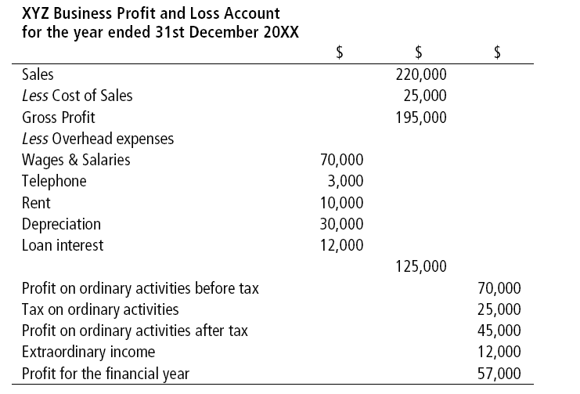
Cash vs Accrual based Accounting
Income Statement

Slide 21
Cash vs Accrual based Accounting
Advantages of accrual accounting?
Financial reports prepared on an accrual basis allow users to:
Assess the accountability for all resources the entity
controls and the deployment of those resources
Assess the performance, financial position and cash
flows of the entity
Make decisions about providing resources to, or doing
business with the entity
International Public Sector Accounting Standards Board (2002)

Slide 22
Cash vs Accrual based Accounting
International Public Sector Accounting Standards - IPSAS
Set by the international accounting bodies;
Based on Commercial based International Accounting Standards adjusted to meet needs of the public sector.

Slide 23
Cash vs Accrual based Accounting
Commercial Sector
Government Sector
Measuring Profit
  Economic resources earned
  LESS
  Economic resources consumed
Analysing Expenditure
Economic resources consumed
LINKED TO
Programmes and if possible outputs

Slide 24
Cash vs Accrual based Accounting
Commercial Sector
Government Sector
Decision making on investment and economic consumption by:
  Company Directors;
  Shareholders.
Based on:
  Returns to shareholders in terms of dividends and share price.
Decision making on investment and economic consumption by:
  Government;
  Legislature.
Based on:
  Fiscal Sustainability/ stability;
  Better info on economic consumption to achieve programmes;
  Policy choices.

Slide 25

Cash vs Accrual based Accounting
Moving to accrual accounting ?
Over the past 30 years move in many countries to adopt “accruals” accounting similar to commercial accounting and a move away from cash accounting as part of PFM reforms.
Many implications and often controversial.

Slide 26

Cash vs Accrual based Accounting
Accrual accounting – the evidence?
“There was no evidence that the perceived benefits from the introduction of... accruals accounting... were being realised”
Mellett, Macniven & Marriott, 2008
(funded by ICAS)
Accrual accounting in NHS from 1991

Slide 27
Cash vs Accrual based Accounting
Accrual accounting – the evidence?
“Departments have made significant progress in using accruals-based accounting ... This has allowed departments to better understand how they are using their financial resources, for example by offering more detailed information to manage their assets and liabilities. Departments have used this information to help identify under-utilised assets and to dispose of those no longer required.”
UK National Audit Office, 2008

Slide 28
Cash vs Accrual based Accounting
Risks of moving to accrual accounting before capacity developed…
Auditor General, Cayman Islands, April 2010:
“the state of financial accountability reporting has gotten worse in the two years since I last reported on this matter”
“I believe this situation has become a national crisis that could lead to tremendous consequences for the Cayman Islands
Government if not addressed immediately”

Slide 29
Cash vs Accrual based Accounting
Even problems in developed countries
UK Government Accounts, Published Nov 2011: (20 months late)
NAO press release – accounts have 3 pages of qualifications
“The publication of the first audited Whole of Government Accounts is a landmark event, which has substantially furthered the cause of transparency and accountability in public spending.”
“The accounts need to be significantly improved, though, if they are to play a full part in comprehensive and meaningful analysis of the government’s financial position. I am particularly concerned that large organisations which in my view are clearly owned and controlled by the government, have been excluded.”
Notes:
Qualifications include:
Exclusion of state owned banks
Exclusion of railways in an arms length organisation
Poor reporting of schools
Disgreement over how 3G licences are reported

Slide 30
When are transactions recognised?
Transaction stages over time
Budget approved
In gov’t legal
authority for
expenditure
Funds warranted
Authority to spend
delegated to
specified official
Order
For goods or
services under
delegated authority
Invoice received
Point at which
legal liability to
pay arises
Cash payment
To supplier for
goods or
services
Gov’t financial
management must
track budget
changes, e.g.
transfers between
budget heads
Delegation of
authority to spend
key budget
management stage
for gov’t financial
management
Commitment to
spend important in
gov’t budget
management
to monitor
expenditure against
budget ceilings
Recognition of
transaction under
accrual accounting
Recognition of
transaction under
cash accounting
Michael Parry, ‘Accrual Accounting for National Governments’ in Public Fund Digest, Vol 5 Nr 2, 2005 p 63

Slide 31
Module outline
  Users of Accounts and traditional structure
  Differences between private sector and public sector financial reporting
  Issues of cash versus accrual based accounting
  IPSAS & the status of accounting standards

Slide 32
International Public Sector Accounting Standards (IPSAS)
International Federation of Accountants (representing 118 of the world’s professional Accounting bodies) set up IPSAS Board to establish global standards.
Based on commercial sector International Financial Reporting Standards (IFRS) adjusted to meet the needs of the public sector.
As an interim for some countries there are IPSAS cash-based to give international confidence before moving to full IPSAS.

Slide 33
International Public Sector Accounting Standards (IPSAS)
Seen as part of identifying inter temporal fiscal constraints (remember MTEF?) in identifying long term liabilities such as government pensions.
Seen as part of efficiency measures and priority setting as the system captures economic consumption of assets.
Is consistent with commercial accounting easing path to privatisation, PPPs and markets for delivery of public goods/services.

Slide 34
International Public Sector Accounting Standards (IPSAS)
As of March 2018 there were 40 IPSAS.
Controversial in that it needs very strong capacity and infrastructure – dealt with in the PFM reform course.
Depends on/supports other Public Administration reforms.

Slide 35
Key messages
Accounting and reporting systems are crucial for accountability.
Attention should first focus on:
  Establishing key link in accountability to parliament & public (with audit report);
  Timeliness, clarity and simplicity of financial reporting.
Moving towards full accrual accounting is complex and requires significant resources.
Controversy is not in what information is provided but in
  the cost of building and maintaining capacity and;
  Relevance in the political decision making.

