Slide 1
Module 5.3: PFM diagnostic tools and the PEFA
INTRODUCTION TO
PUBLIC FINANCE MANAGEMENT

Slide 2
Module outline
Assessment of PFM systems and diagnostic tools
The Public Expenditure & Financial Accountability (PEFA) tool
PEFA scoring
The PEFA reach

Slide 3
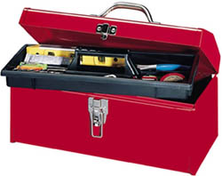
PFM assessment & diagnostic tools
Toolkit
What diagnostic tools to assess PFM systems are you familiar with?

Slide 4
PFM assessment & diagnostic tools
Standard diagnostic assessments of PFM systems:
Public Expenditure & Financial Accountability Assessment (PEFA) – seven partners;
Fiscal Transparency Evaluation (FTE/FTR) – IMF;
Operational Assessment (OA) for Macro-Financial Assistance –ECFIN;
Public Expenditure Review (PER) Public Expenditure Tracking Surveys (PETS) for Sectors – World Bank;
Methodology for Assessing Procurement Systems (MAPS) – OECD;
Debt Management Performance Assessment (DeMPA) – IMF & WB;
Tax Administration Diagnostic Assessment Tool (TADAT) – IMF;
Public Investment Management Assessment (PIMA) – IMF.

Slide 5
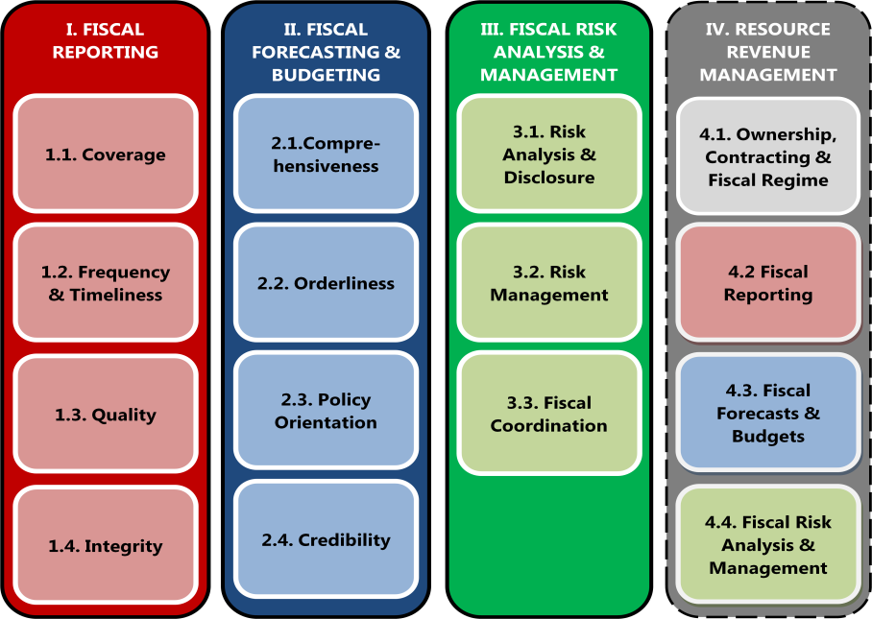
IMF Fiscal Transparency Evaluation (FTE) based on 4pillars
PFM diagnostic tools

Slide 6
IMF Fiscal Transparency Evaluation (FTE) based on 4pillars
PFM diagnostic tools
Pillar I: Fiscal Reporting should provide:
relevant, comprehensive, timely, and reliable information on the government’s financial position and performance.
  https://www.imf.org/external/np/exr/facts/fiscal.htm

Slide 7

OECD Methodology for Assessing Procurement Systems (MAPS)
PFM diagnostic tools
How does the procurement work?
Background
  Need for a detailed procurement tool and consistent approach
Introduced in 2006 following the PEFA approach
  12 indicators, 54 sub-indicators
  Base Line Indicators (BLIs)
  Compliance/Performance Indicators (CPIs)
Enables tracking progress over time

Slide 8
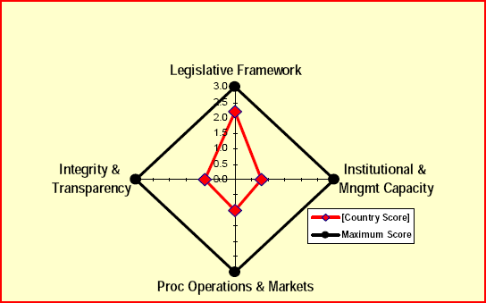
OECD Methodology for Assessing Procurement Systems (MAPS)
PFM diagnostic tools

Slide 9
Debt Management Performance Assessment (DeMPA)
PFM diagnostic tools
How is public debt managed?
Background
    Limited coverage of debt management in other tools
    No insight into underlying causes of weak performance
Methodology designed by WB 2006-2009 (revision in 2009)
    DeMPA modelled on PEFA
    6 core functions
    15 indicators, 35 dimensions
Enables tracking progress over time

Slide 10
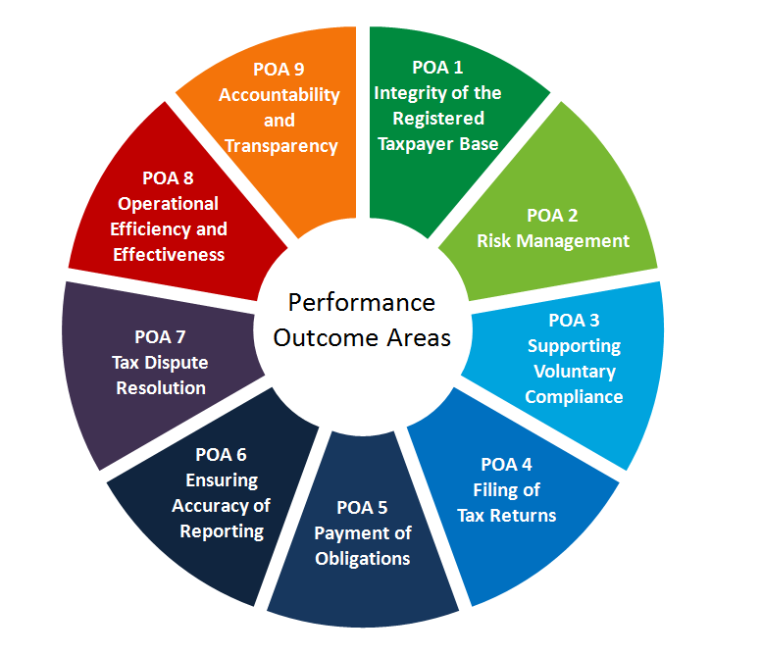
PFM diagnostic tools
The Tax Administration Diagnostic Assessment Tool (TADAT)
The tax administration is transparent in the conduct of its activities and accountable to the government and the community.
All businesses, individuals, and other entities that are required to register are included in a taxpayer registration database. Information held in the database is complete and accurate.
Tax administration operations are efficient and effective in performing key functions and achieving expected outcomes.
The tax administration’s management of compliance risks results in higher levels of voluntary compliance and community confidence in the tax administration.
The tax dispute resolution process is independent, accessible to taxpayers, and effective in resolving disputed matters in a timely manner.
Taxpayers have the necessary information and support to voluntarily comply at a reasonable cost to themselves.
Taxpayers report complete and accurate information in their tax returns.
Taxpayers file returns on time.
Taxpayers pay their taxes in full on time.

Slide 11







The Tax Administration Diagnostic Assessment Tool (TADAT)
PFM diagnostic tools
TADAT is supported by international development partners and institutions.
http://www.tadat.org/

Slide 12
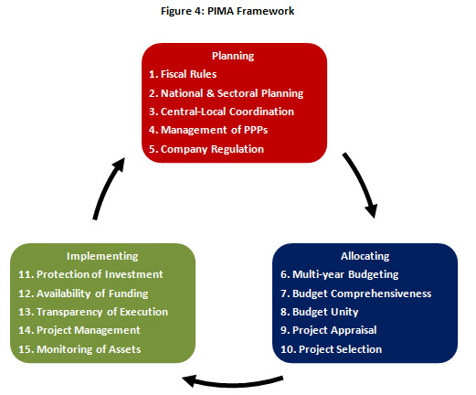
PFM diagnostic tools
Public Investment Management Assessment (PIMA)
The PIMA evaluates 15 institutions that shape public investment decision-making:
Planning sustainable investment across the public sector;
Allocating investment to the right sectors and projects; and
Implementing projects on time and on budget.

Slide 13

SIGMA OECD – EU
PFM diagnostic tools
Since 2014, the European Commission has defined the scope of public administration reform as covering six core areas:
the strategic framework for public administration reform;
policy development and co-ordination;
public service and human resource management;
Accountability;
service delivery;
public financial management.
For EU Neighbourhood pre-candidate and candidate countries.

Slide 14
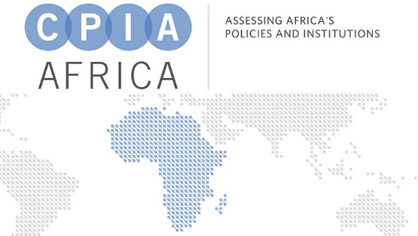

World Bank CPIA
Country Policy &Institutional Assessment (CPIA)
PFM diagnostic tools
Each country's performance scoring is assessed against a questionnaire of 18 criteria, grouped on 5 clusters based on:
coherence of its economic management;
coherence of its structural policies;
degree to which its policies and institutions promote equity and social inclusion;
quality of its governance and public sector management; and
degree to which its regulatory framework is enabling infrastructure development and regional integration.

Slide 15
PFM assessment & diagnostic tools
 | PEFA | FTE | ECFIN/ OA | PER | PETS | MAPS | DeMPA | TADAT
Identification of PFM strengths & weaknesses | X | X | X | X | X |  | X
Focused on part of the Budget Cycle |  |  |  | X | X | X | X | X
Integrated Focus | X | X | X
In-depth analysis of capacity factors |  | X |  | X |  | X |  | X
Recommendations for reform |  | X | X | X | X
Assess fiduciary risk to public/external funds |  | X | X
Track progress over time | X |  |  |  |  | X | X | X

Slide 16
PFM assessment & diagnostic tools
1 policy design & review
3 budget Preparation
4 budget Execution
5 accounting & Reporting
6 external audit & scrutiny
2 strategic Planning
INTOSAI
PEFA/FTE
PER/PETS
IPSAS
PETS, TADAT
MAPS, DeMPA

Slide 18
Module outline
Assessment of PFM systems and diagnostic tools
The Public Expenditure & Financial Accountability (PEFA) tool
PEFA scoring
The PEFA reach

Slide 19
What is the PEFA Programme?
Public Expenditure & Financial Accountability
Objective:
Results orientation in development of PFM systems
Harmonization of PFM analytical work
  ‘Strengthened Approach’ to support PFM Reforms
Established:
  Established in 2001 by seven agencies
  Contributing to development effectiveness: builds on the “Addis Ababa Action Agenda” (Third International Conference on Financing for Development)

Slide 20







Who are the PEFA Partners?

Slide 21
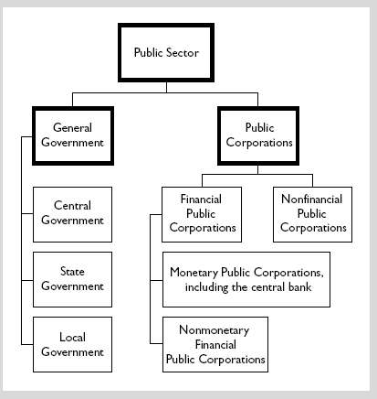
The PEFA diagnostic tool
Central Government Budget
Sub-National Government Budget

Slide 22
The PEFA diagnostic tool
Introduced in 2005, revised in 2011, final new version in February 2016…
The 2016 framework:
31 indicators; 4 new indicators, 3 donor indicators discontinued;
Dimensions increased from 76 to 94;
Seven core pillars; one new pillar on asset and liability management.

Slide 23
The PEFA diagnostic tool
The PEFA Operating Design Principles
An open and orderly PFM system that supports the 3 PFM objectives: Aggregate fiscal discipline
        Strategic allocation of resources
        Efficient service delivery
Seven core dimensions:
Credibility of the budget
Comprehensiveness and transparency
Asset and liability management
Budget Cycle
  Policy-based budgeting
  Predictability and control in budget execution
  Accounting, recording and reporting
  External scrutiny and audit
Key elements of operational PFM performance:
31 performance indicators

Slide 24
The PEFA Model
The PEFA diagnostic tool
C. Budget Cycle
C(1)
Policy-based budgeting
(PI:14-18)
B(1)Comprehensiveness
and Transparency
(PI:4-9)
B(2) Asset and Liability
Management
(PI:10-13)
A. PFM Outturns
B. Cross-cutting Issues
C(4)
External
scrutiny
and audit
(PI-29-30)
C(2)
Predictability
and control
in budget
execution
(PI:19-25)
Budget
Credibility
(PI:1-3)
C(3)
Accounting, Recording
and Reporting
(PI-26-28)

Slide 25
The PEFA diagnostic tool
PEFA 2016 enhancements:
  Credible fiscal strategy
  Fiscal risk
  Internal control framework
  Management response to audit
  Independence of Supreme Audit Institution
  Public Service performance

Slide 26

The PEFA Iceberg – how comprehensive?
The PEFA diagnostic tool
Procurement
Fixed asset register
Political context
Market
Supply chain management
Engaged civil society
Financial administrative network
Capacity
Quality of expenditure management

Slide 27
The PEFA diagnostic tool
Operating Design Principles
Focus on high level standardised performance indicators applied to the central or sub-national government level;
Widely applicable: relevant to countries at all levels of development;
Assessment must be evidence based;
Capable of capturing progress over time and facilitates PFM reform;
Uses data that can be collected cost effectively;
Comprehensive: cover all aspects of the PFM cycle;
Basis of sound PFM rests on the three PFM objectives.
22

Slide 28
The PEFA diagnostic tool
Operating Design Principles
PEFA does not provide an assessment of:
underlying causes for good or poor performance i.e. the capacity factors.
government fiscal & financial or other policies.

Slide 29
The PEFA diagnostic tool
The PFM Performance Report…
Executive summary
Introduction
Country background information
Assessment of PFM performance
Conclusions on the analysis of PFM systems
Government PFM Reform Process
Annexes
    i. Performance indicator summary
    Summary of observations on the internal control framework
    Sources of information
    Tracking performance to previous PEFA using an
    earlier version of the framework
s.4.2 Effectiveness of the internal control framework

Slide 30
Module outline
Assessment of PFM systems and diagnostic tools
The Public Expenditure & Financial Accountability (PEFA) tool
PEFA scoring
The PEFA reach

Slide 31
PEFA Scoring
Indicators and Dimensions
  Scores of indicators use a four point ordinal scale (A, B, C and D)
  Certain indicators may have more than one dimension
  Intermediate scores (B+, C+, D+) only for multi-dimensional indicators i.e. differences in dimension scores
  Arrow ▲ may be used to indicate improvement not captured in change of indicator score
Two scoring methods:
  Method M1 ‘weakest link among dimensions’
  Method M2 ‘average of dimensions’

Slide 32
PEFA Scoring
NB: Dimensions reflect important elements, that may or may not register significant improvement or deterioration. Such changes may not be reflected in the overall score of a multi-dimensional indicator!
Mini Exercise
Let us try to score a multi-dimensional indicator
Please refer to pages 9 and 10 of the new 2016 PEFA Guidelines in your participants’ packs

Slide 33

Interdependencies
PEFA Scoring
PFM linkages are analogous to foundation footing linkages – the strength of a foundation is determined by it weakest footing
That is the reason why the Tower of Pisa leans. The performance of a PFM system is determined by the strength of its weakest PFM activity
As a general rule PFM scores, like the strengths of foundation footings, cannot be averaged

Slide 34
Module outline
Assessment of PFM systems and diagnostic tools
The Public Expenditure & Financial Accountability (PEFA) tool
PEFA scoring
The PEFA reach

Slide 35
The PEFA reach…
By March 2018...
577 assessments completed … 15 planned…
...(Source: https://pefa.org/)

Slide 36
The PEFA reach…
As of April 2016... 506 assessments were completed in 140+ countries, 120+ led by EU...(Source: Budapest Conference, April 2016)
  312 assessments at national level; 146 baseline and 166 repeat assessments
  194 sub-national assessments; 165 baseline and 29 repeat assessments
Used by:
  94% of Low Income Countries (LIC)
  All Lower Middle Income Countries (LMIC)
  80% of Upper Middle Income Countries (UMIC) and
  28% of High Income Countries

Slide 37
Key messages
The PEFA Framework measures the performance of PFM systems in achieving their objectives, but does not assess the causes of performance.
It focuses on the “basics” of PFM systems.
It monitors progress in systems.
It does not deal with policy issues.
There are several more PFM diagnostic tools to assess in detail specific PFM areas.
NB: There is a dedicated PEFA course.

