Slide 1

JOINT PROGRAMMING WORKSHOP
Working Better Together in West Africa
Brussels
11 June 2018

Slide 2
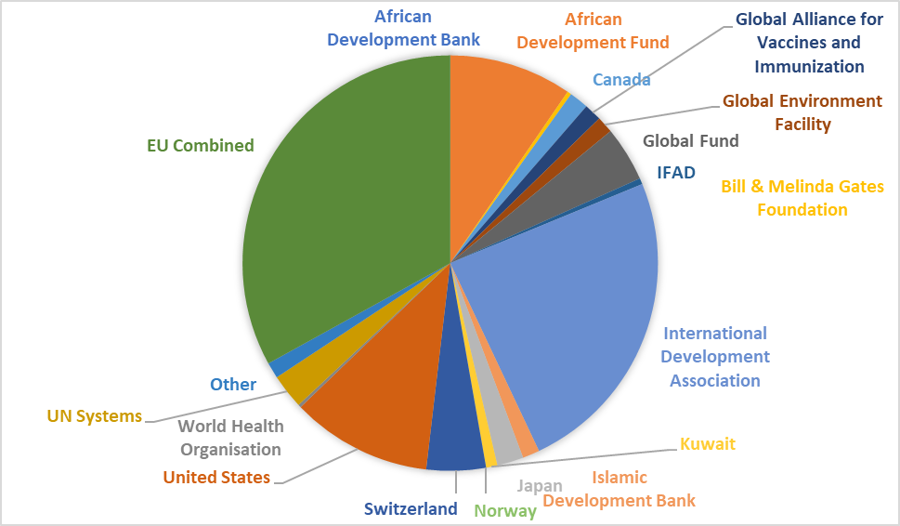
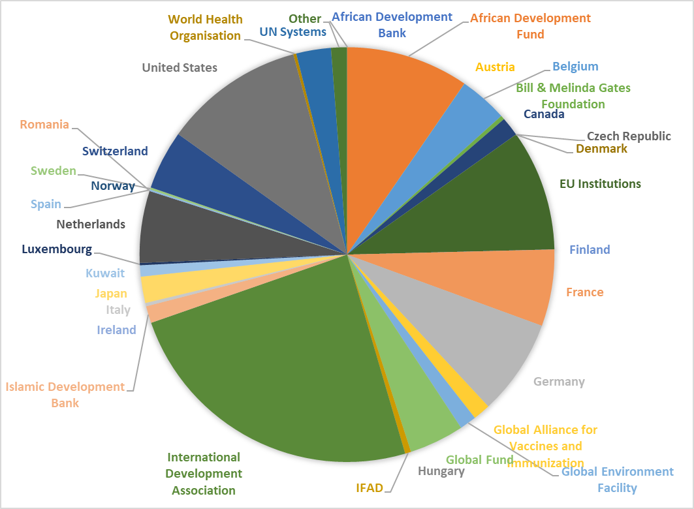
€454 million for BENIN (2016, EU combined)

Slide 3
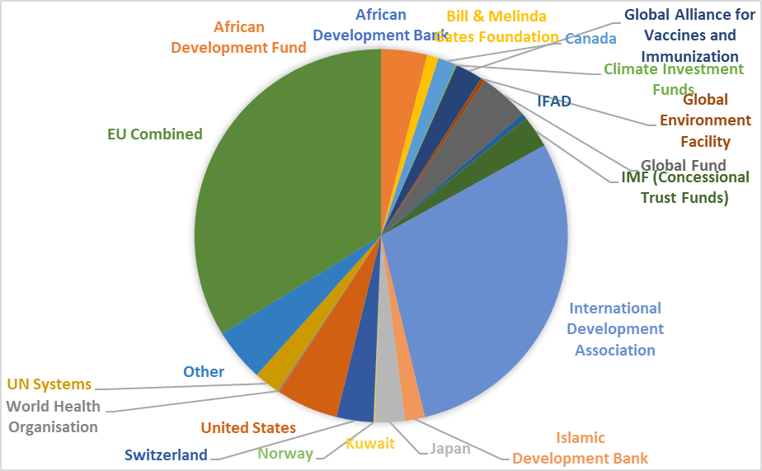
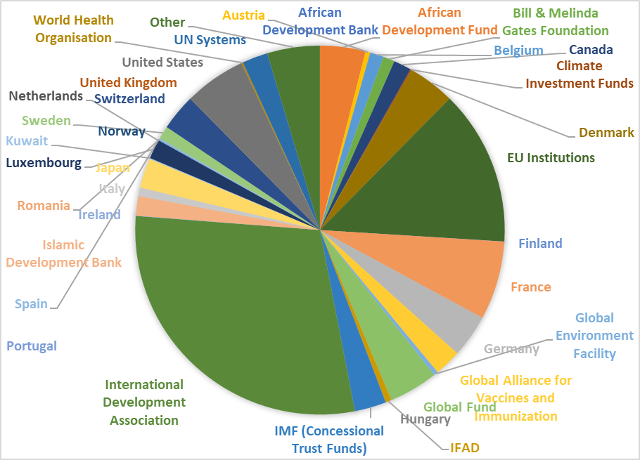
€990 million for BURKINA FASO (2016, EU combined)

Slide 4
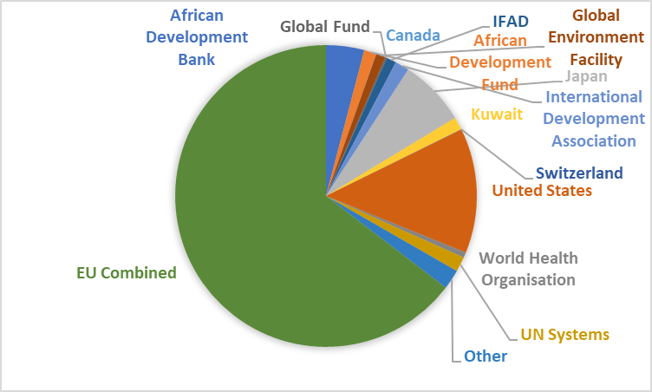
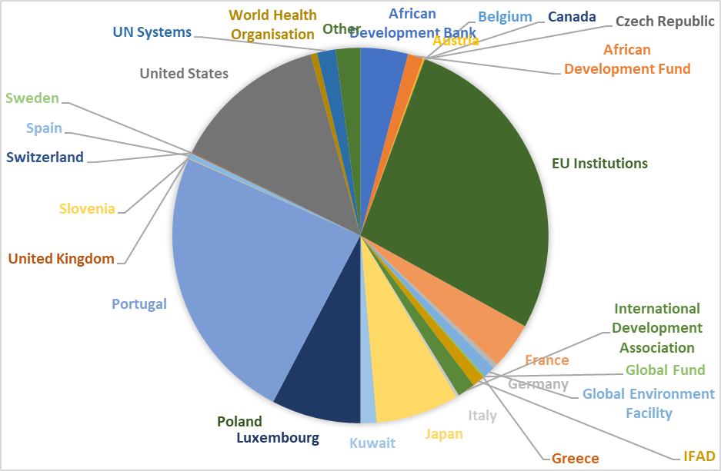
€121 million for CAPE VERDE (2016, EU combined)

Slide 5
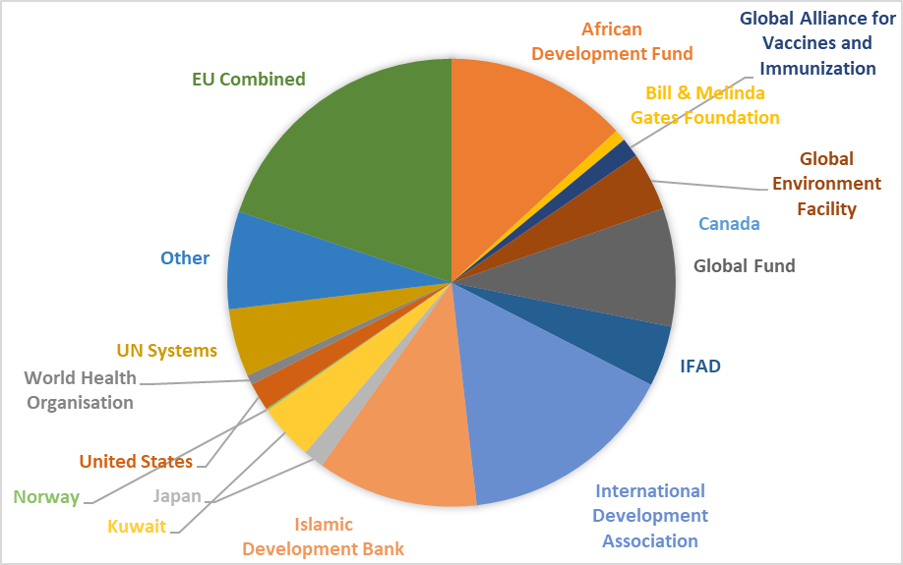
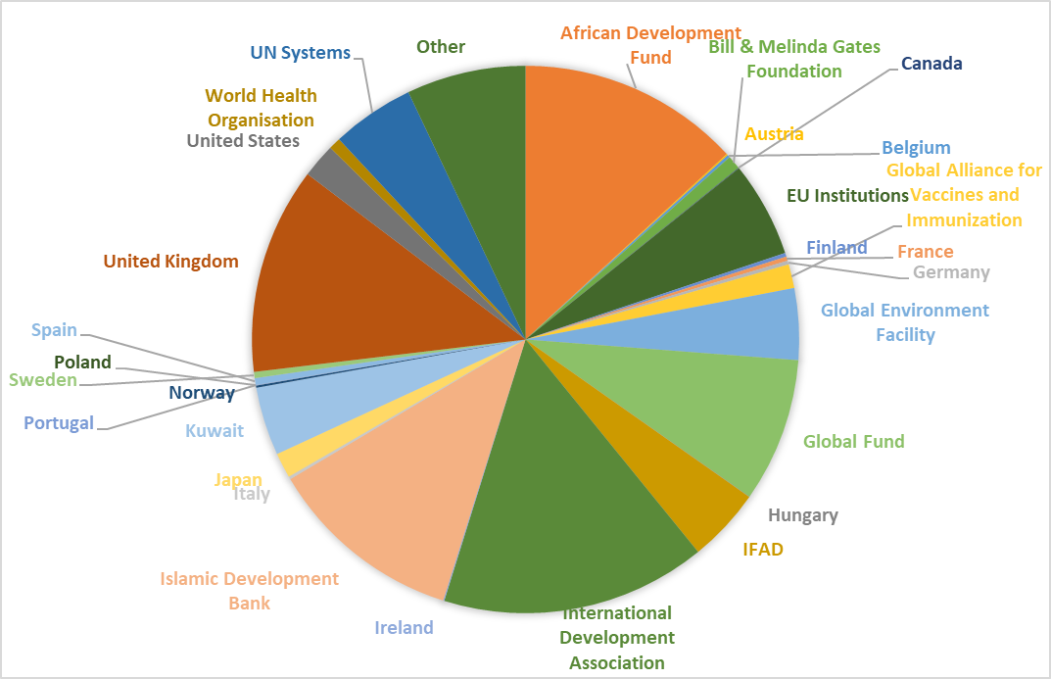
€1.002 million for COTE D’IVOIRE (2016, EU combined)

Slide 6
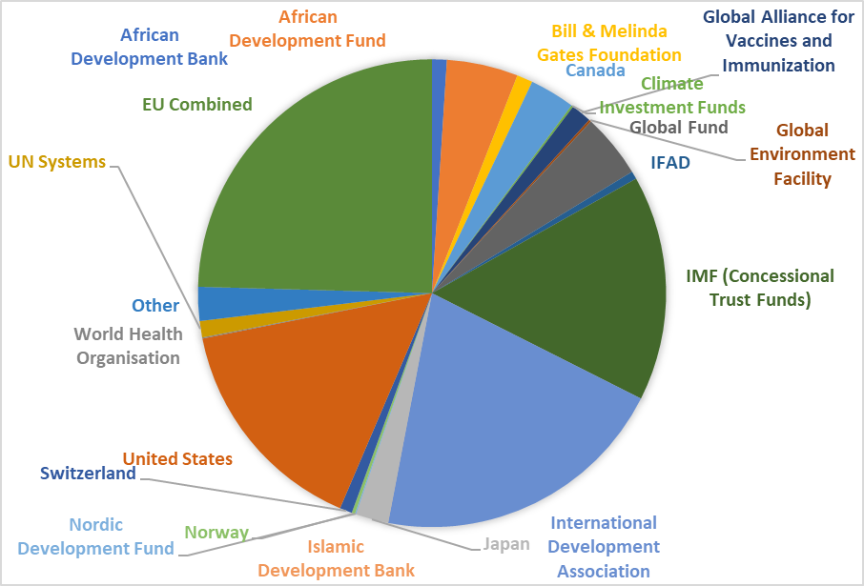
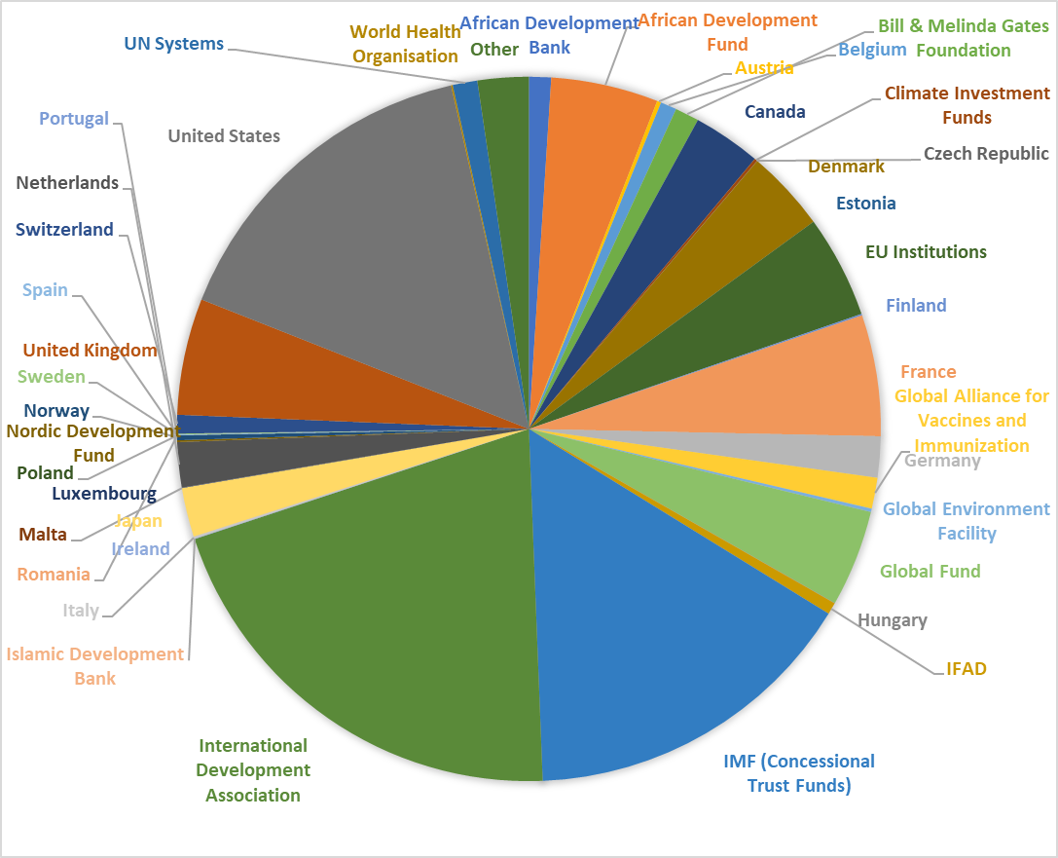
€1.300 million for GHANA (2016, EU combined)

Slide 7
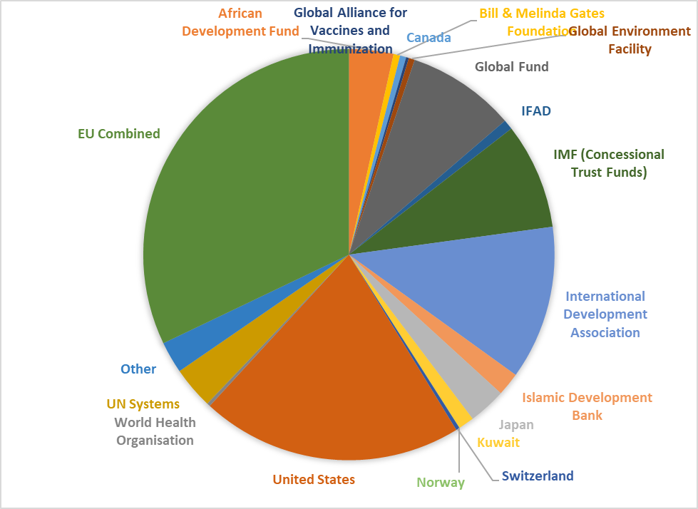
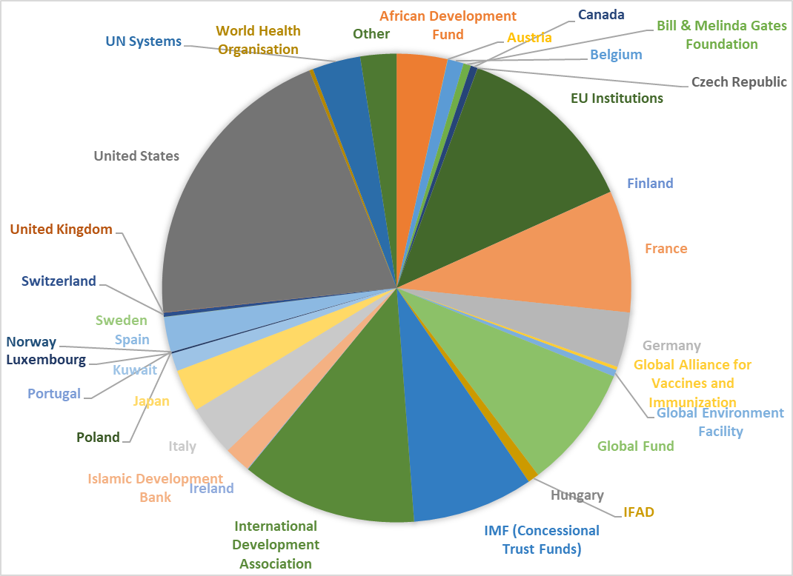
€527 million for GUINEA (2016, EU combined)

Slide 8
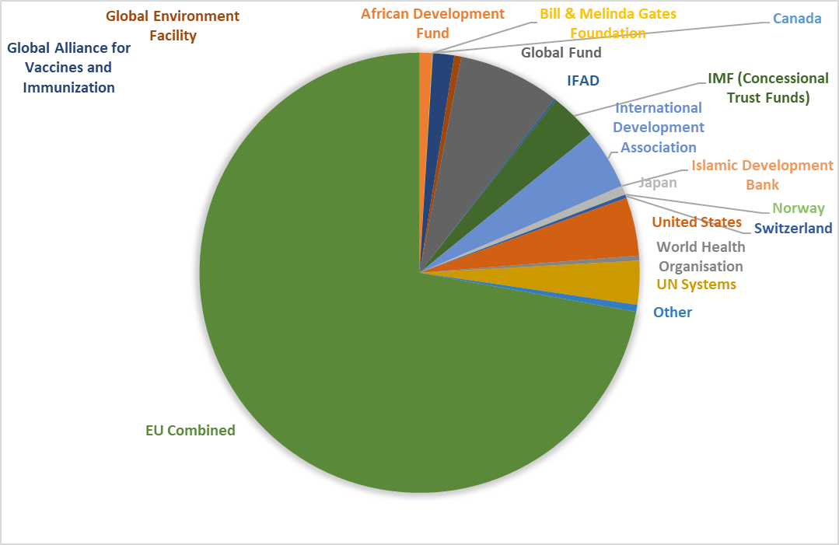
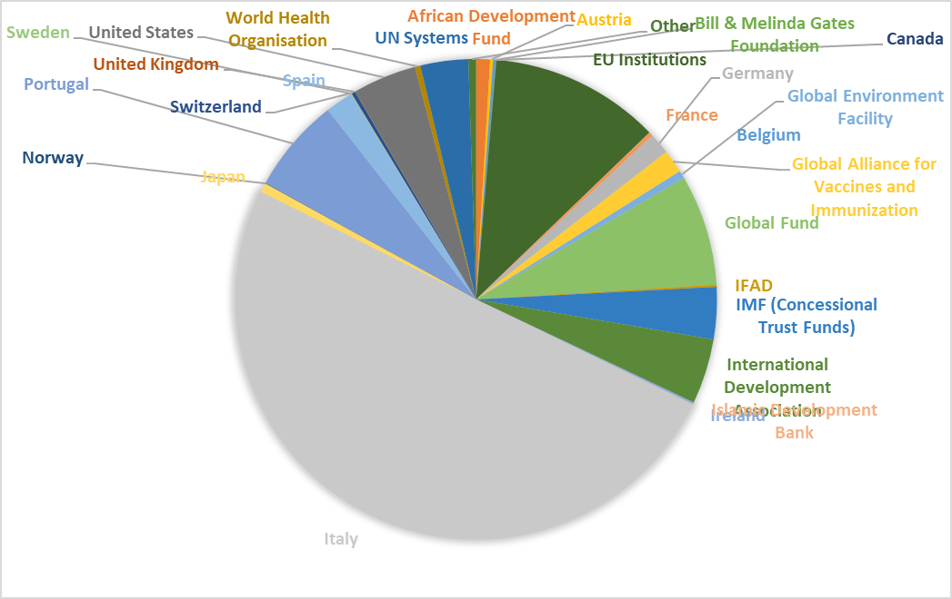
€174 million for GUINEA-BISSAU (2016, EU combined)

Slide 9
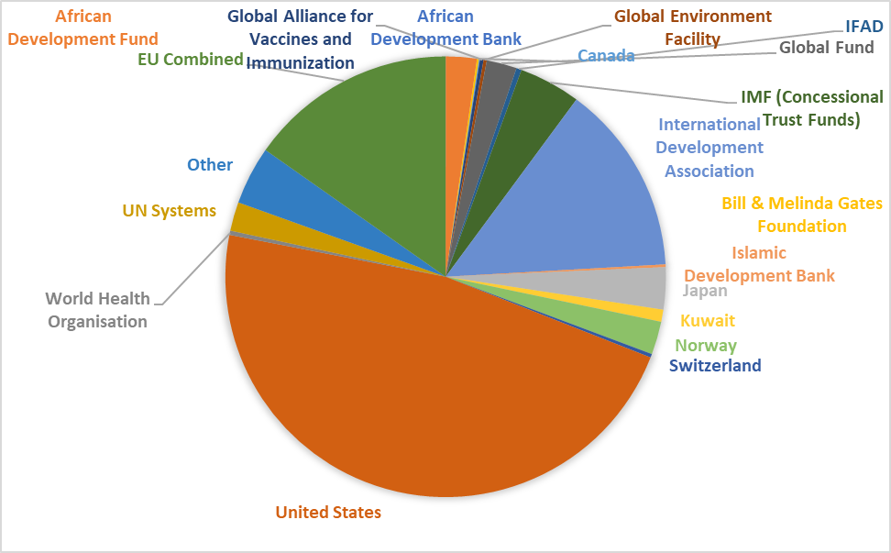
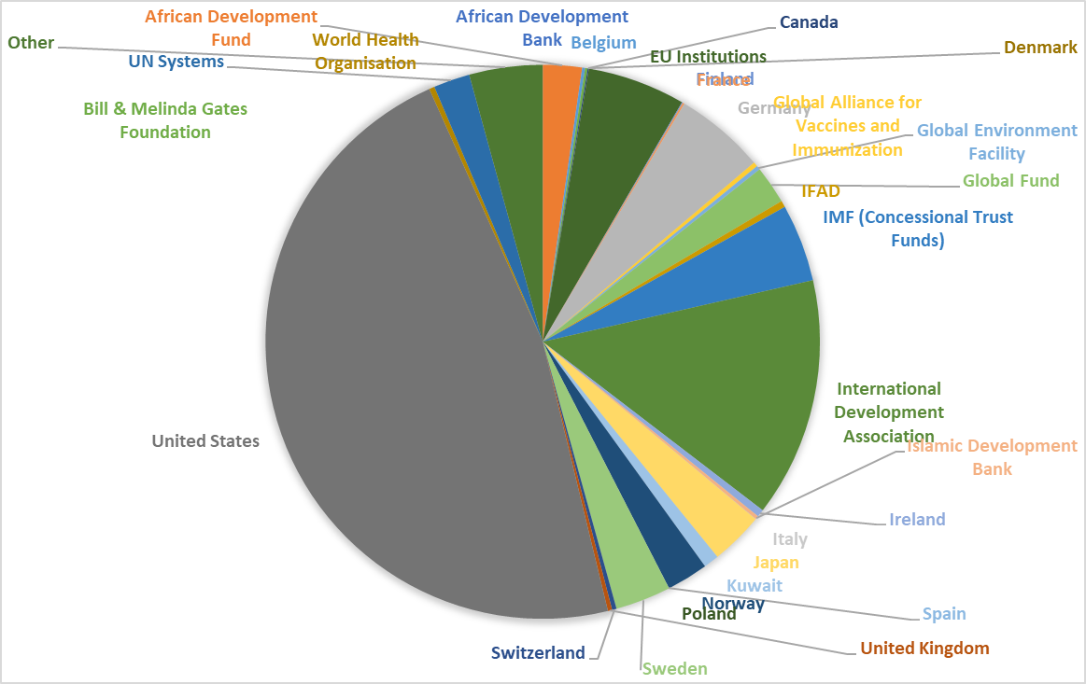
€729 million for LIBERIA (2016, EU combined)

Slide 10
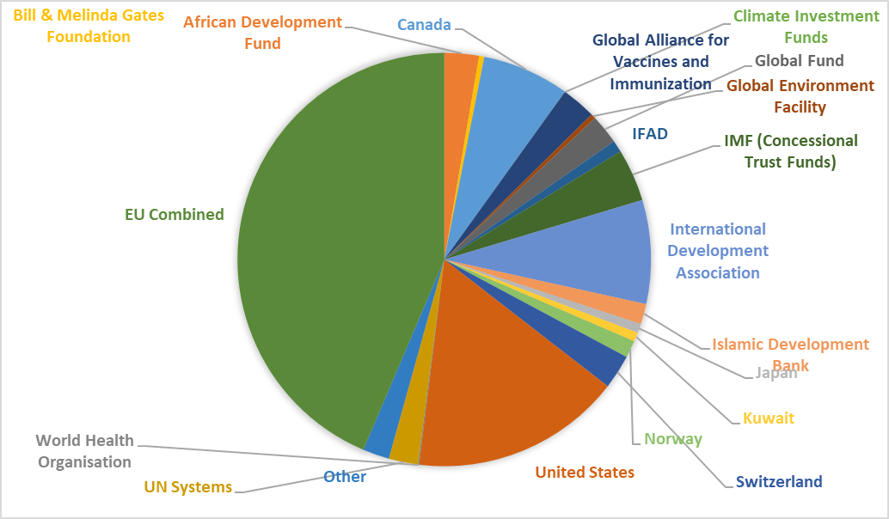
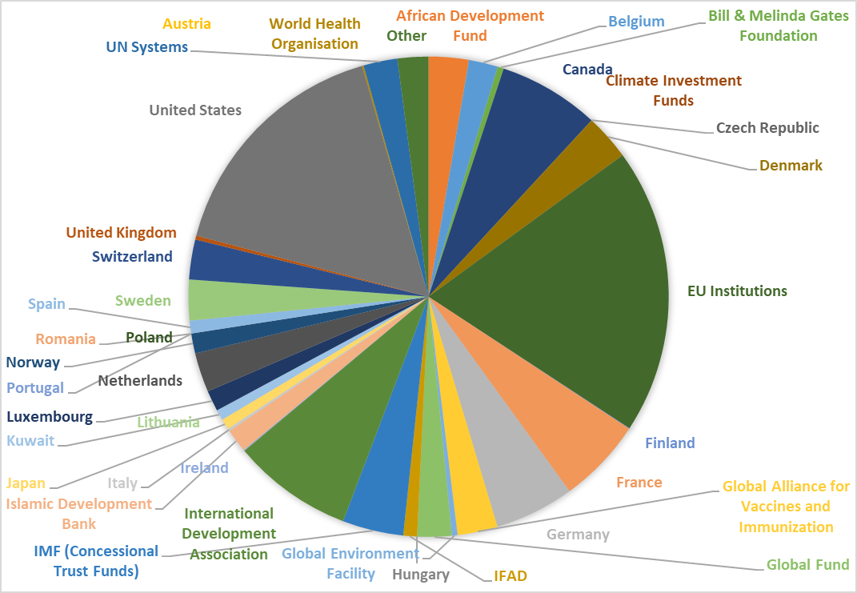
€1.100 million for MALI (2016, EU combined)

Slide 11
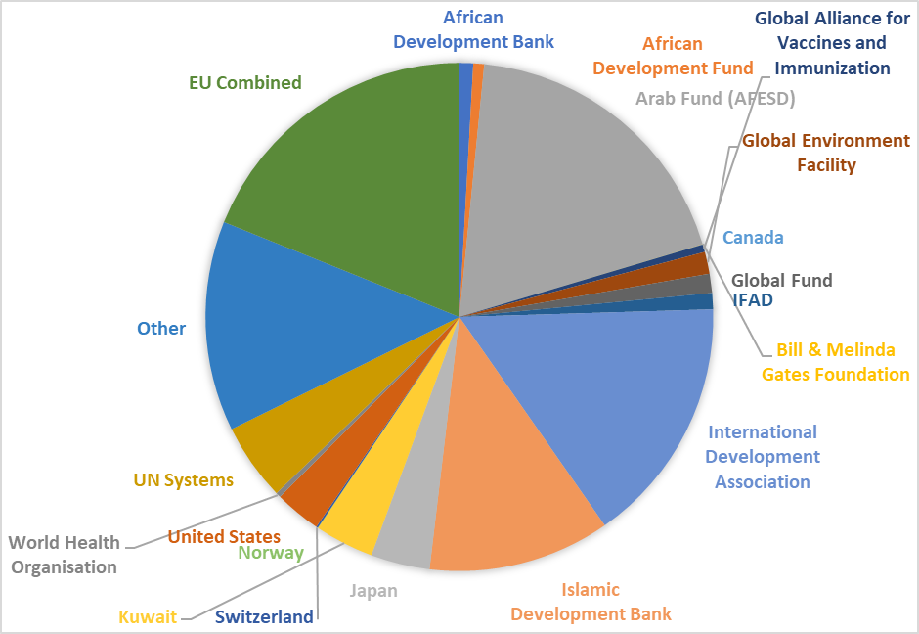
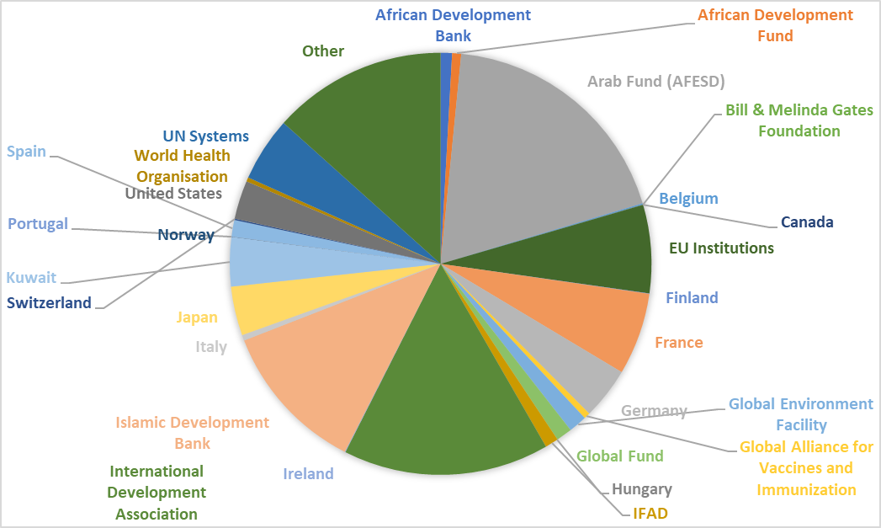
€356 million for MAURITANIA (2016, EU combined)

Slide 12
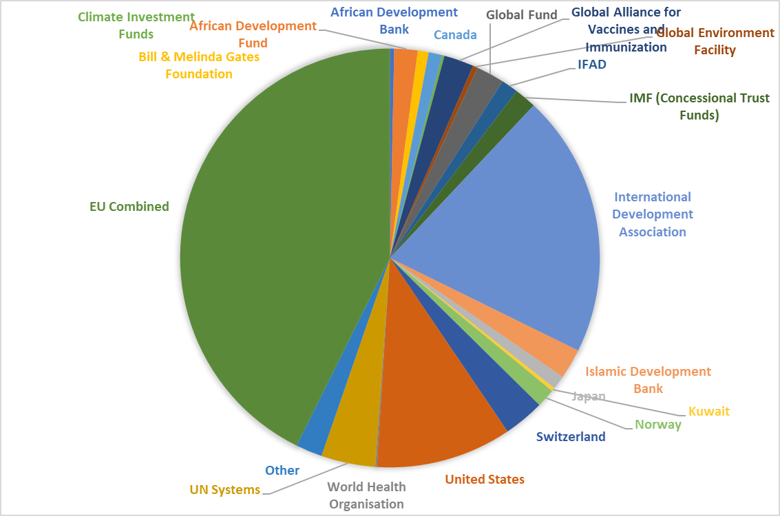
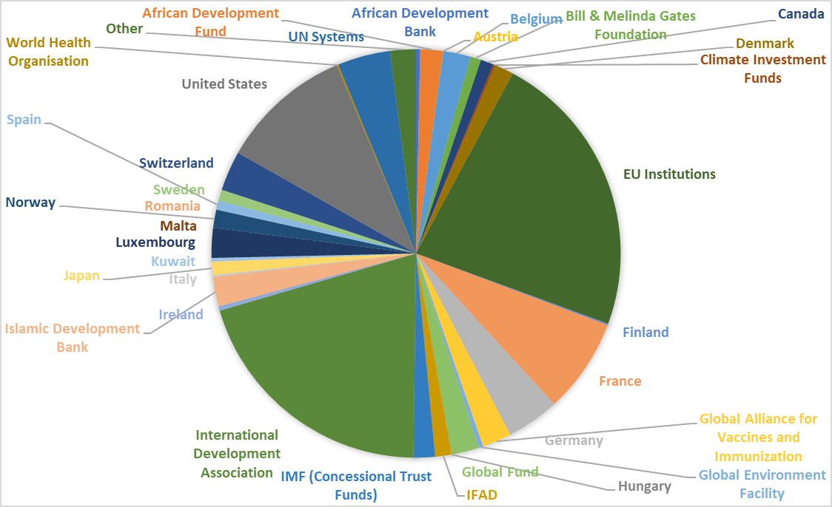
€870 million for NIGER (2016, EU combined)

Slide 13
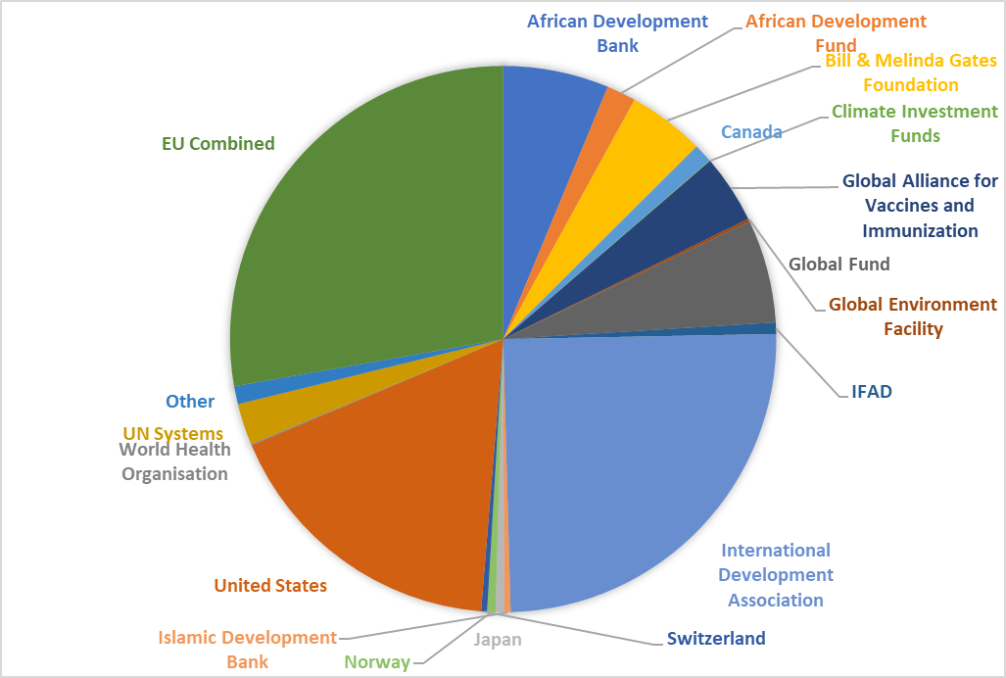
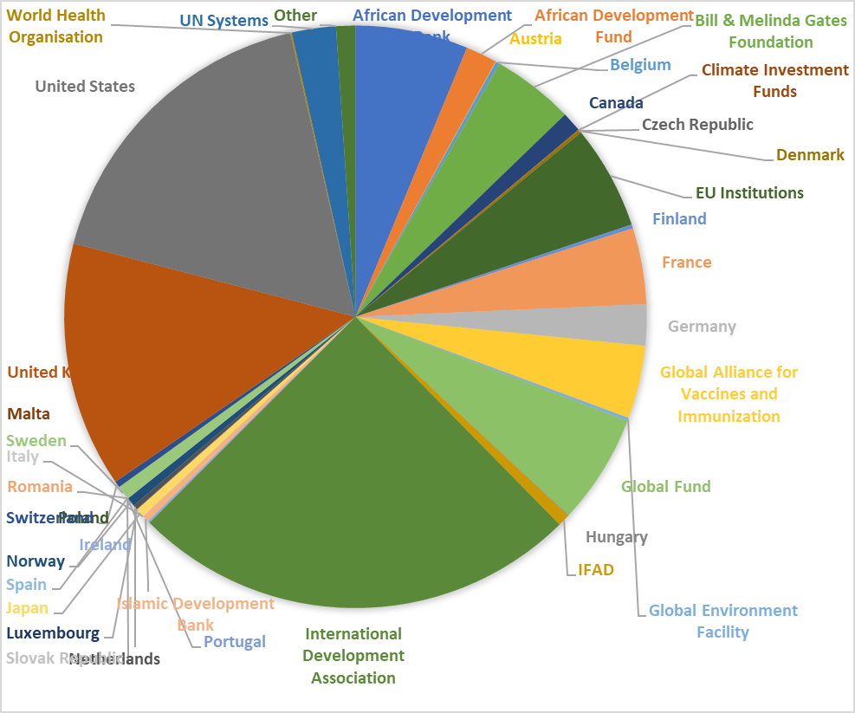
€2.700 million for NIGERIA (2016, EU combined)

Slide 14
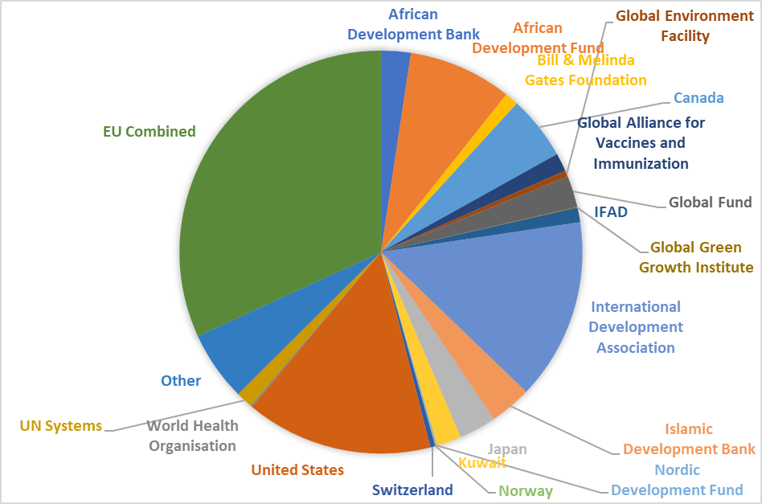
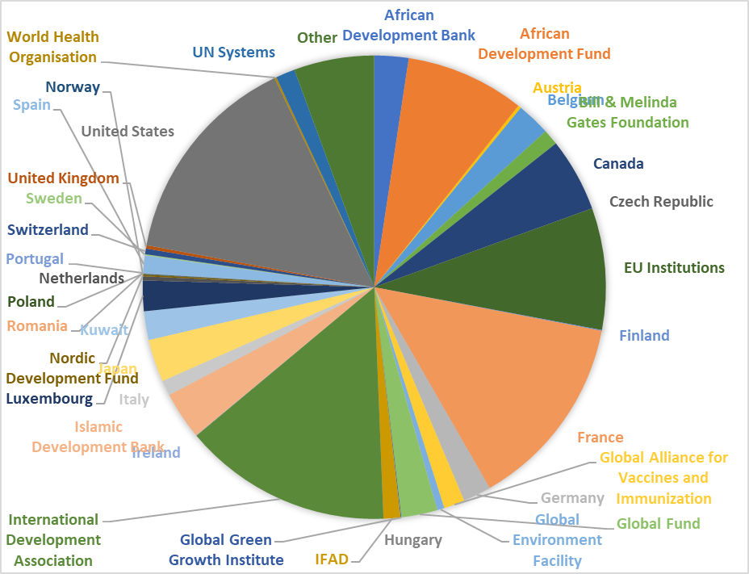
€805 million for SENEGAL (2016, EU combined)

Slide 15
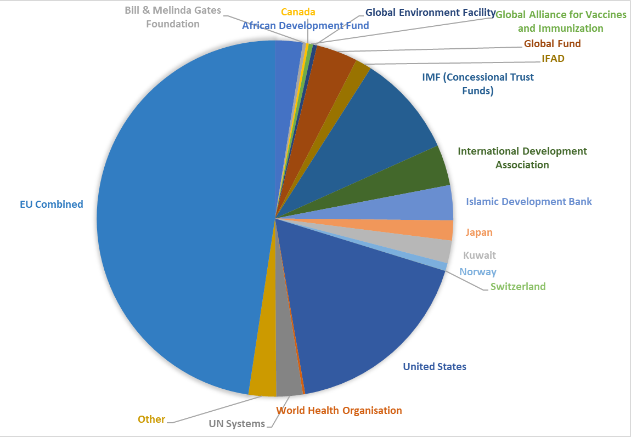
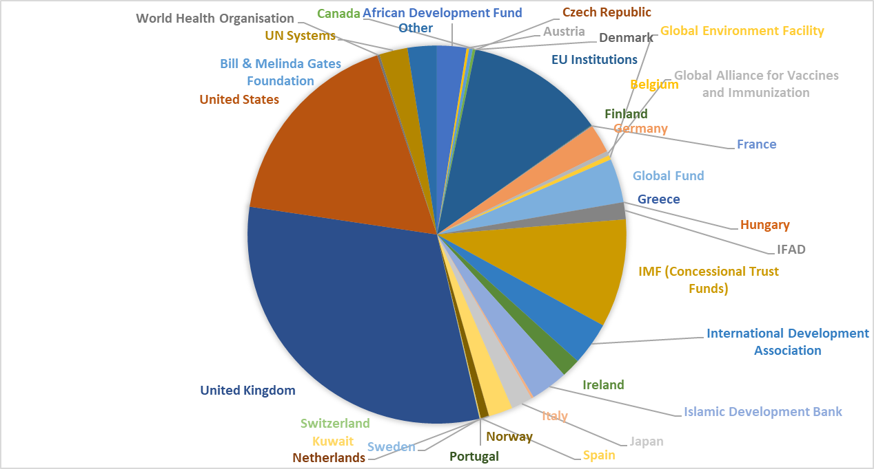
€628 million for SIERRA LEONE (2016, EU combined)

Slide 16
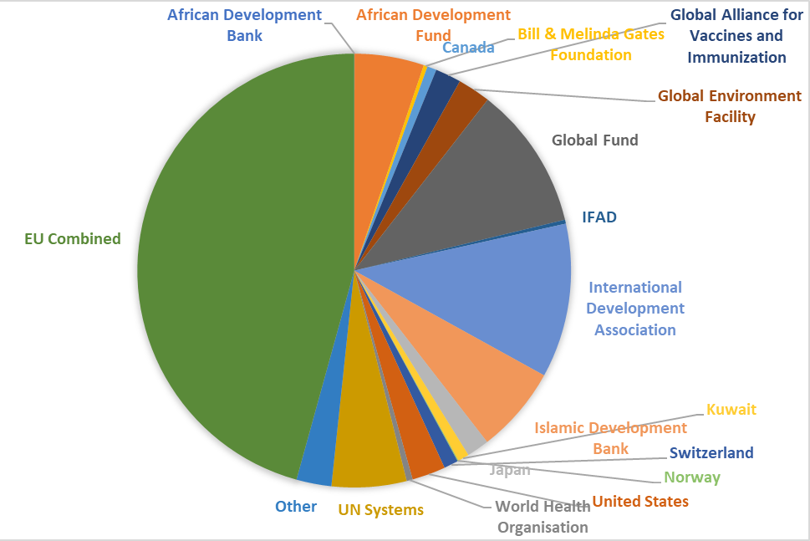
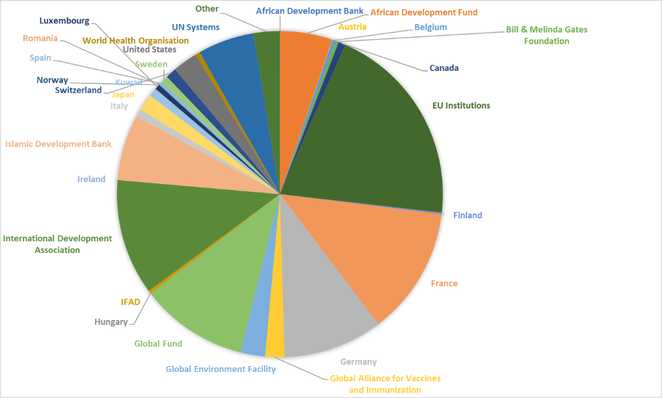
€171 million for TOGO (2016, EU combined)

Slide 17
Global State of Play of Joint Programming
23 (+2)
20
COUNTRIES IN THE PROCESS OF JOINT PROGRAMMING (JOINT ANALYSIS OR ROADMAP)
Joint Analysis: Armenia, Belarus, Benin*, Georgia, Morocco*, Niger, Zambia
17
7
COUNTRIES EXPLORING JOINT PROGRAMMING POTENTIAL (FEASIBILITY/SCOPING EXERCISE)
Joint Monitoring / Results Framework
Bolivia, Cambodia, Comoros, Ethiopia, Ghana, Kenya, Laos, Mali, Myanmar, Nicaragua, Palestine, Rwanda
Replacement
FR in Comoros, FR in Kenya, EU in Laos, DE and FR in Mali, EU in Palestine, EU in Senegal
JOINT PROGRAMMING DOCUMENTS
Afghanistan, Algeria, Angola, Bangladesh, Guinea Conakry, Iraq, Jordan, Kyrgyzstan, Liberia, Libya, Philippines, Somalia, Tajikistan, Tanzania, Ukraine, Uzbekistan, Yemen
Bolivia (2017-2020), Cambodia (2014-2018), Central African Republic (2017-2021)*, Chad (2014-2017), Comoros (2015-2020), Egypt (2017-2020), Ethiopia (2018-)*, Ghana (2017-2020), Guatemala (2014-2020), Honduras (2018-2022)*, Ivory Coast (2017-2020), Kenya (2018-)*, Laos (2016-2020), Mali (2014-2018), Moldova (2017-2020), Nicaragua (2018-2020), Palestine (2017-2020), Paraguay (2014-2018), Rwanda (2014-2018), Senegal (2018-2023), Togo (2014-2020), Tunisia (2017-2020)*, Uganda (2015-2019)
Old: Myanmar (2014-2016), Namibia (2014-2017)
Roadmap: Azerbaijan, Burkina Faso, Burundi*, Cameroon, El Salvador, Haiti, Lebanon, Madagascar*, Malawi*, Mauritania, Mozambique*, Nepal, Pakistan
12
JP ACTIVE IN 43
60 Active countries
*drafts / Ethiopia and Kenya explore a 2nd cycle of Joint Programming

Slide 18
West Africa State of Play of Joint Programming
5
4
COUNTRIES IN THE PROCESS OF JOINT PROGRAMMING
Joint Monitoring / Results Framework
Ghana, Mali
JOINT PROGRAMMING DOCUMENTS
Ghana (2017-2020), Ivory Coast (2017-2020), Mali (2014-2018), Senegal (2018-2023), Togo (2014-2020)
2
Joint Analysis: Benin*, Niger
Roadmap: Burkina Faso, Mauritania*
JP ACTIVE IN 9
*drafts
GHANA: CZ, DK, FR, DE, NL, UK + CH, EIB.
IVORY COAST: BE, FR, DE, IE, IT, NL, ES, UK.
MALI: BE, DK, FR, DE, LU, NL, ES, SE, IT + CH.
SENEGAL: AT, BE, CZ, FR, DE, IT, LU, NL, PL, RO, ES, PT.
TOGO: FR, DE.

Slide 19



Cooperation Days 2018
BrusCONTACT US:
DEVCO-Joint-Programming-Support@ec.europa.eu
JOINT-PROGRAMMING-SUPPORT@eeas.europa.eu
Or check our group in capacity4dev:
europa.eu/capacity4dev/joint-programming

Slide 20
EXPERT MISSIONS
Experts:
Alex O'Riordan: supported Angola, Moldova, Philippines, Georgia, Palestine, Yemen, Iraq, Somalia, Mozambique
Katarina Courtnadge-Kovačević: supported Tajikistan, Laos, Cambodia, Pakistan, Afghanistan;
Iradj Alikhani: supported Mali, Senegal, Benin, Haiti, Mauritania, Madagascar
Sybille Koenig: supported Tunisia, Burkina Faso, CAR, Honduras, Burundi, Cameroon
1. Demand driven short-term technical assistance for in-country missions:
Missions can support:
Consultations
Mapping/country analysis
Facilitating Workshops/retreats
Drafting documents
Communication material
  BUT, consultants work cannot replace the importance of LOCAL OWNERSHIP
  Participating partners need to plan for longer term support to Joint Programming
2. Methodological advice and inputs regarding JP process and drafting of JP documents

Slide 21
SAVE THE DATE
Encourage staff in your Delegation to register
in EU Learn for the JOINT PROGRAMMING training
course
Date: 25 September 2018 (back-to-back to PPCM training)
All Heads of Cooperation from Asia and beyond are invited to the 3-day “GLOBAL WORKSHOP ON JOINT PROGRAMMING” learning event In Cambodia
Date: 4-6 December 2018

