Slide 1
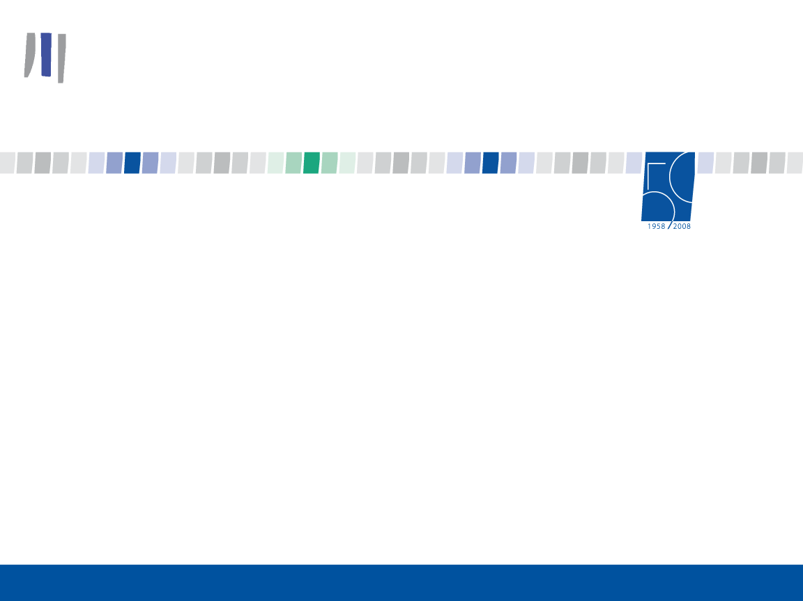
EUROPEAN INVESTMENT BANK
European Union Regional Water & Sanitation Workshop
Nairobi 18-21 October 2010
Nikos Milianitis, Senior Resident Loan Officer

Slide 2
To come: Topics
General EIB Presentation
EIB Instruments
EIB in the Water Sector
EIB Water Projects in Africa: Collaboration with the ACP EU Water Facility
EIB Intervention: Example 1: Peri-urban WatSan, Malawi
EIB Intervention: Example 2: Maputo Water Project, Mozambique
Closing Comments

Slide 3
EIB: Background Information
Birth: Treaty of Rome, 1958
Purpose: “Provide long term lending to promote European objectives”
Shareholders: 27 EU Member States
Governance:
Board of Governors | - | EU Finance Ministers
Board of directors | - | Member States & European Commission
Management Committee | - | EIB’s executive body
Audit Committee | - | Independent, non-resident

Slide 4
EIB: Priority Objectives
Within the Union:
  Cohesion and convergence
  Small and medium-sized enterprises (SMEs)
  Environmental sustainability
  Knowledge Economy
  Trans-European Networks (TENs)
  Sustainable, competitive and secure energy
Outside the Union:
  Private sector development
  Infrastructure development
  Security of energy supply
  Environmental sustainability
  Support for EU presence in Asia & Latin America via
  Foreign Direct Investment

Slide 5
EIB: 2009 key figures *
Projects signed
 | European Union |  | EUR 70.6 bn
 | Partner countries Total Lending |  | EUR 8.5 bn EUR 79.1 bn
Borrowings |  |  | EUR 79.4 bn
Subscribed capital (at 01/04/2009) |  |  | EUR 232.4 bn
*Situation as at 31/12/2009

Slide 6
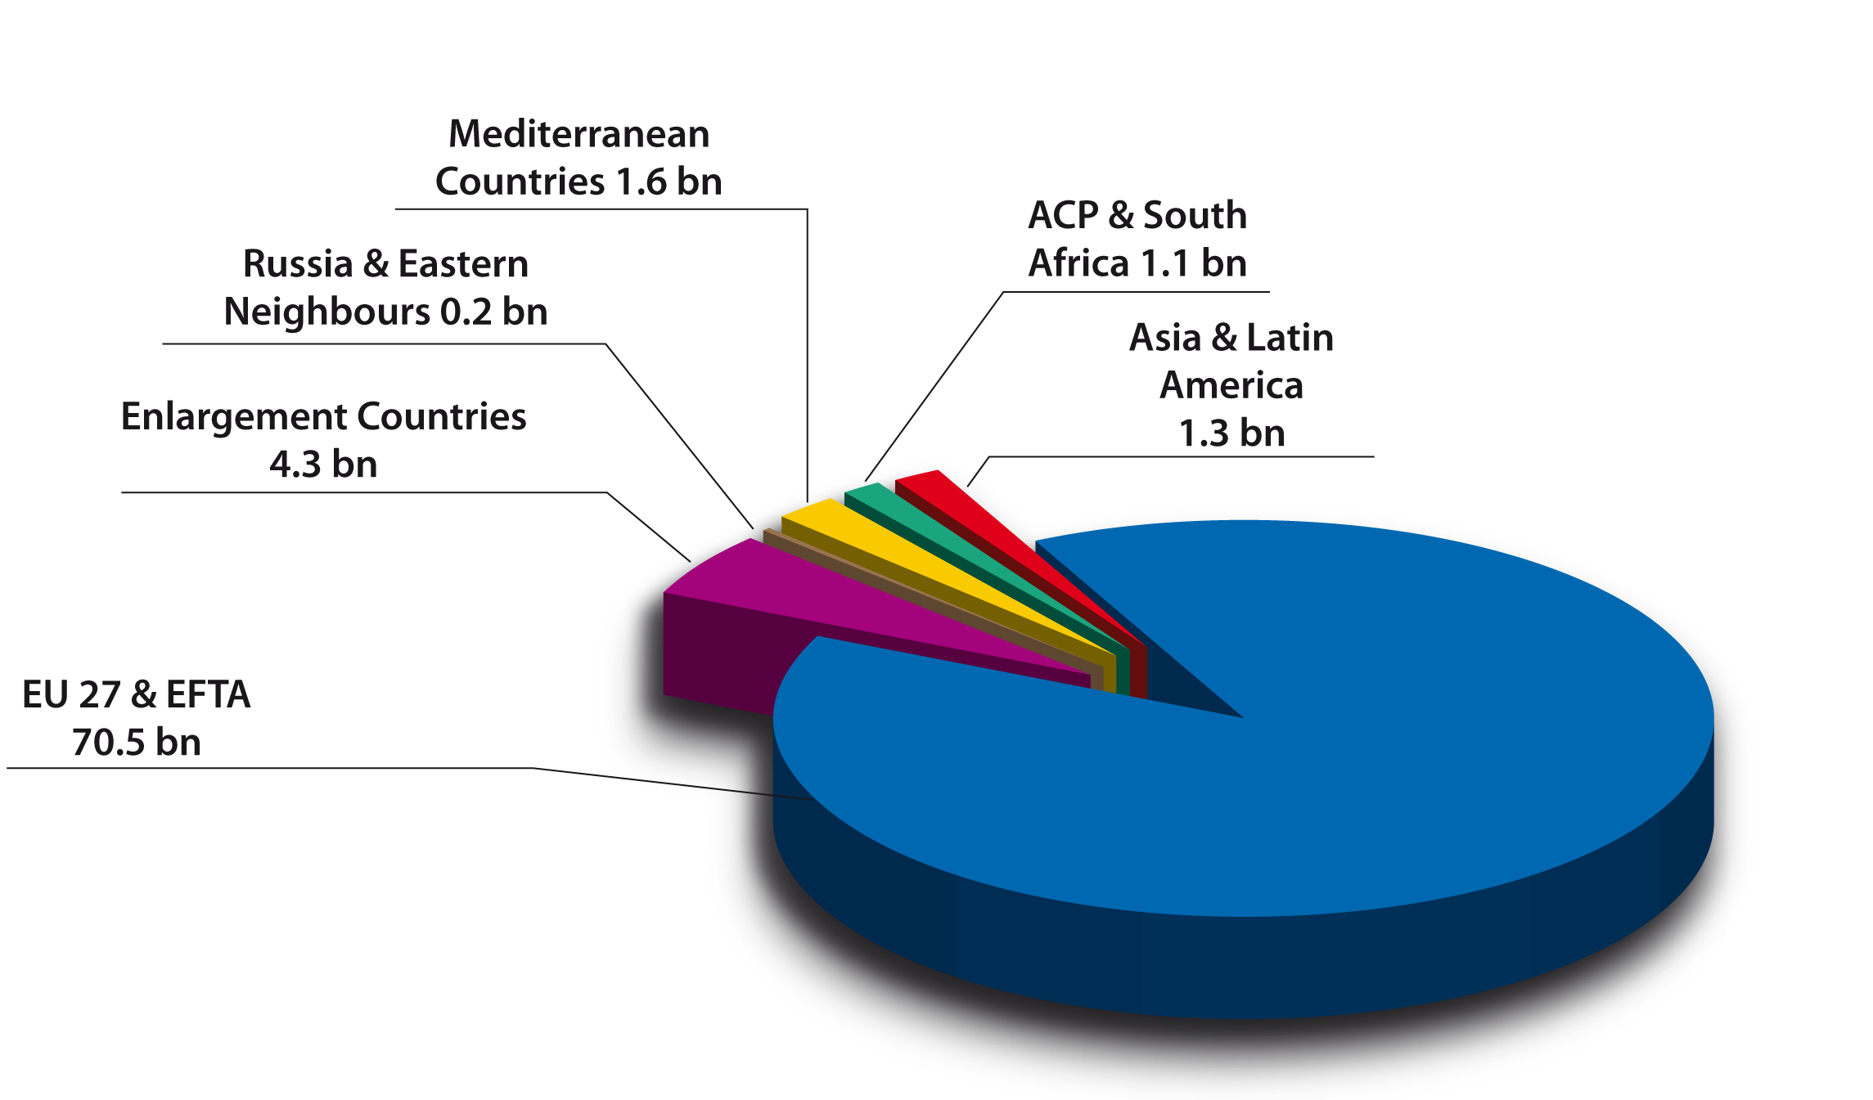
EIB lending in 2009 (in EUR billion)
Notes:
ACP: 11.8 bn, more than 1,200 projects, in 91 countries since the 60s.

Slide 7
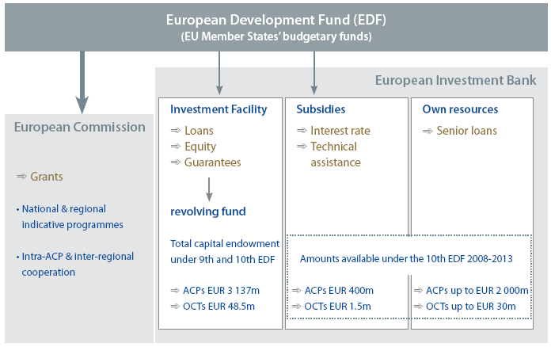
EIB lending in ACPs & OCTs

Slide 8
Breakdown of funds managed by the EIB
 |  | EUR m
✓ Republic of South Africa (2007-2013) |  | EUR 900
✓ ACP countries (2008-2013):
- Investment Facility revolving fund |  | EUR 3,137
- Investment Facility grants |  | EUR 400
- Own resource lending | up to | EUR 2,000
✓ OCTs (2008-2013):
- Investment Facility revolving fund |  | EUR 48.5
- Investment Facility grants |  | EUR 1.5
- Own funds lending | up to | EUR 30
Other initiatives:
ACP Water Project Preparation Facility (2008-2010) |  | EUR 3
EU-Africa Infrastructure Trust Fund (2007-2013) |  | EUR 372
South Africa Risk Capital Facility (2007-2011) |  | EUR 50
Global Energy Efficiency and Renewable Energy Fund (GEEREF) |  | EUR 108
8

Slide 9
Active management of the portfolio: 2003-2009
ACP & OCT figures
  Investment Total approvals EUR 2.97 bln
  Facility Total signatures EUR 2.50 bln
  At the end of 2009 ~ 45.5% of the portfolio under/partly/fully disbursed
  Own Total approvals EUR 1.9 bln
  Resources Total signatures EUR 1.5 bln
  At the end of 2009 ~ 43% of the portfolio under/partly/fully disbursed

Slide 10
Other initiatives in the ACPs
supporting development-oriented initiatives
  EU-Africa Infrastructure Trust Fund: finance cross- border infrastructure projects in sub-Saharan Africa
  ACP Water Project Preparation Facility (ACP-EU Water Facility) : identify and prepare water and sanitation projects
  RSA Risk Capital Facility: promote South African SMEs owned by disadvantaged people
  Global Energy Efficiency and Renewable Energy Fund: support renewable energy & energy efficiency project developers and SMEs

Slide 11
Breakdown by sector
Different Own Resources Portfolio Breakdown
Industrial undertakings: 36%
Energy projects: 22%
Credit lines: 10%
Services: 8%
Water/sewerage: 9%
Investment Facility
Cumulative Signatures ACPs & OCTs
01/04/2003-31/12/2009

Slide 12
Project requirements
Technically sound
Financially viable
Bear a positive impact on the economy:
- economic and social impact assessment framework
Comply with environmental protection and procurement regulations:

Slide 13

Terms and conditions
EIB operates on market related terms: risk pricing, cost recovery
Long maturities and grace periods
EIB = catalyst ➔ encourages co-financing
max. 50% of funding provided by EIB
Direct or indirect intervention (major /smaller scale investments)
Subsidies are available:
for project related technical assistance
to ensure concessionality whenever required

Slide 14
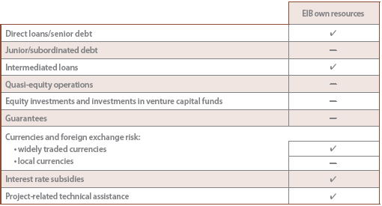

Instruments EIB own resources
Funds borrowed on the capital markets
providing
Senior debt
denominated in EUR and widely traded currencies
1st class guarantee or prime-quality security
usually required (unless sovereign risk)

Slide 15
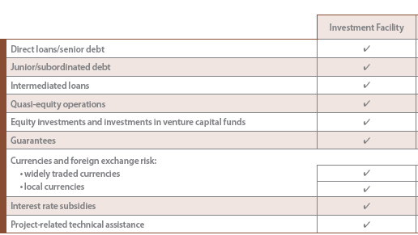
Instruments The Investment Facility
A revolving fund
providing
Flexible / risk-bearing financial instruments
denominated in EUR, widely traded currencies or local currencies

Slide 16
Own Resources versus Investment Facility
Instruments
OR & IF resources complement each other
EIB own resources:
Public sector investments: sovereign/sub-sovereign borrowers
Private sector projects covered by a third party guarantee
IF resources:
Private sector investments requiring risk-bearing instruments
e.g.: conditional loans/ subordinated loans/guarantees/equity

Slide 17
Technical assistance & Interest-Rate Subsidies
Up to EUR 400 m (ACPs) and 1.5 m (OCTs)
over the 2008-2013 period
to provide
Project-related TA grant funding covering the whole project cycle
and Interest-rate subsidies lowering cost of financing to promoter
Aim(s):
enhancing project quality and success-rate
increasing the efficiency of EIB’s investment activities
complementing other EIB products

Slide 18
Some Facts: EIB in the Water Sector
Key objective is to finance projects that contribute to the implementation of EU policy objectives.
In the ACP countries, support to water and sanitation MDG is main goal
EIB provides long-term loans to public and private clients for funding all parts of the water cycle.
EIB lends up to 50% of the investment costs of individual projects.

Slide 19
EIB Direct Lending to the Water Sector: EUR 14.5bn
(126 operations, during 2005-09)

Slide 20
Signatures de 2005 à 2009 - Secteur EAU
Nom du groupe de pays | Nom du pays de localisation | mEUR | Nb.
Etats membres |  | 13,149 | 97
Ensemble des pays Méditérranée |  | 796.98 | 11
Ensemble des pays ACP | BENIN | 13.00 | 1
 | CAMEROON | 40.00 | 1
 | ETHIOPIE | 16.50 | 1
 | LESOTHO | 14.30 | 1
 | MOZAMBIQUE | 31.00 | 1
 | SENEGAL | 35.00 | 2
 | MADAGASCAR | 23.50 | 1
 | MALAWI | 15.75 | 1
 | BURKINA FASO | 18.50 | 1
Ensemble des pays ACP |  | 207.55 | 10
Pays d'Amérique Centr.& Latine |  | 27.14 | 1
Afrique du sud |  | 85.00 | 1
Pays d'Asie |  | 60.00 | 1
Etats en voie d'adhésion |  | 30.00 | 1
Balkans |  | 65.00 | 2
AELE
AELE
Russie,Europe Est,Caucase Sud | FED. DE RUSSIE | 21.10 | 2
Russie,Europe Est,Caucase Sud |  | 21.10 | 2
 | Sum: | 14,502.12
 | Count: | 126.
Notes:
ACP to total portfolio: 1.4%

Slide 21
Association prêts / subventions: cofinancement BEI/UE - Facilité Eau
L’effet levier des fonds de la Facilité Eau UE/BEI est de 3.0 bien au delà de la moyenne estimée 1.76 pour le total de la Facilité Eau

Slide 22
La BEI supporte les approches pragmatiques
La participation du secteur privé dans l’exploitation du secteur de l’eau apporte des meilleurs niveaux de performances commerciales et de gestion
Le PPP doit être adaptée en fonction de l’environnement économique/social du pays
Le PPP ne se limite pas aux grandes sociétés internationales mais aussi aux partenariats avec les PMEs (e.g. pour les contrats de gestion de zones périurbaines)
L’association de prêts et subventions apporte:
  Subventions: baisse du cout du financement total et réponse à un secteur très social
  Prêts: introduction de discipline financière et de gestion; Obligation de remboursement par la génération adéquate de cash flow et d’efficacité dans la gestion
  Bonifications de taux d’intérêt: dédiées au financement de composantes plus sociales/moins porteuses; respect des limites d’endettement des gouvernement des pays PPTE.
Le cofinancement BEI / UE (Facilité eau) a un effet levier de fonds pour le bouclage du financement

Slide 23
Blending loans with Grants: EIB and other instruments in the Water Sector
Grants for TA and interest subsidy for ACP investment under the Cotonou mandate: 400 M € till 2013
EU-Africa Infrastructure Trust Fund: facilitate blending and regional projects
Co-funding, EC (e.g. using the ACP EU Water Facility), IFIs and bilaterals: leverage and share resources
Water Project Preparation Facility (WPPF)

Slide 24
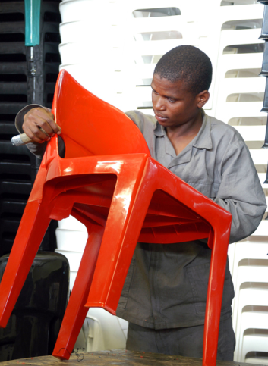
Who can benefit ?
Private entrepreneurs and commercially-run public sector enterprises
Investment funds and other financial intermediaries
ACP and EU Member States entrepreneurs
Large enterprises and MSMEs

Slide 25
EIB and EU: Collaboration in ACP through the EU Water Facility
Main objective of ACP-EU Water Facility: support to achieve water & sanitation MDGs
EUR 500m grants from 9th EDF and
Two competitive calls for applications 2004-07
Seven investment projects selected with EIB as applicant/co-donor (326m investments -109m EU grants leveraging 217m loans) - Senegal, Benin, Ethiopia, Malawi, Mozambique, Lesotho, and Madagascar
one technical assistance project – Water Project Preparation Facility (WPPF)
Notes:
In the ACP region the EU and the EIB has been cooperating closely through the ACP-EU Water Facility. The EUWF main goal is to contribute towards the achievement of the MDGs targets on water and sanitation in the ACP region. A total of EUR 500 million was made available as grants to water and sanitation projects, via a two competitive call for proposals.
This has resulted in seven project applications either supported or submitted by the EIB as lead donor to be accepted. The EC grants allocated to these projects amount to EUR 109m (25% of the total grant amount available under the Water facility), and further leveraged EUR 130m in soft loans from EIB, as well as EUR 87m in loans and grants from other donors.
The water and sanitation projects in Ethiopia, Mozambique, Madagascar, Benin, Lesotho, Malawi, and Senegal) are typical of the new EIB approach: while they build on the Bank’s traditional strengths of co-financing investments that are technically, economically, and environmentally sound; they also incorporate a number of innovative aspects, including the objective of universal coverage, focus on social inclusion, support of partnerships with NGOs and local private sector, and strengthening the operational capacity and commercial performance of water service providers.
An important element of these projects is to use the blending of grants and loans to support pro-poor aspects of projects such as affordability and expanding coverage to previously unserved peri-urban and slum areas.
In response to a significant need to support upstream project preparation activities, including institutional and policy development, to create bankable projects that can attract financing, the EIB has launched a €3 million ACP Water Project Preparation Facility co-funded by the ACP-EU Water Facility, to fund technical assistance for the preparation of sound water and sanitation projects

Slide 26

ACP-EU Water Project Preparation Facility
Help to achieve the MDGs for water & sanitation
Support the objectives of the ACP-EU Water Facility:
  ownership,
  innovation,
  integrated project approach
  equality of access: poorer & more vulnerable communities
Increase the effectiveness of ODA
EUR 3m* facility: fund technical assistance
for preparation of sound water & sanitation projects
  * 2008-2010
Notes:
3m, period 2008-10, 2.25m eu, 0.75m eib

Slide 27
Water Project Preparation Facility: Basic Facts
Budget EUR 3m (75% ACP-EUWF, 25% EIB)
Duration 3 years 2008-10
Managed and supervised by EIB
Technical Assistance for project preparation activities
All TA contracts procured and supervised by EIB
Currently in the process of procuring consultants to prepare 5 projects in Ghana, Zambia, Rwanda, and Burundi
Also supporting the project preparation studies in Kisumu and Mwanza via the UN-Habitat Lake Victoria Watsan Initiative

Slide 28
ACP-EU Water Project Preparation Facility
Technical assistance to support:
  Country needs assessment
  Project identification
  Preparatory studies for specific projects
  Facilitating & structuring the project’s financing
  Groundwork for project implementation
promote co-financing opportunities between stakeholders

Slide 29




EU-Africa Infrastructure Trust Fund
Eligibility Criteria
  Support cross-border/regional infrastructure projects
  Targeted infrastructure sectors:
        Energy
        Transport
        Water & Sanitation
        Telecommunications / IT

Slide 30
EU-Africa Infrastructure Trust Fund
Forms of grant support
  Interest rate subsidies on medium- and long-term loans
  Technical assistance, notably:
  project preparation & project-related capacity building
  One-off grants for social or environmental components
  Early-stage insurance premiums to cover country risks

Slide 31
EIB INTERVENTIONS IN ACP: TWO EXAMPLES
Peri-urban WatSan, Malawi
Maputo Water Project, Mozambique
Notes:
Infrastructure investments, capacity building, operational efficiency, close coop with organisations+local communities to extend services
EIB with loan + interest rate subsidy
Loan to malawi, blantyre and lilongwe
Project conditions: tariff policy, ol-loan to water boards, water sector reform, arrears a/r

Slide 32
Peri-urban WatSan, Malawi
Significant EIB involvement in the preparation of project;
Increase: access to water for an additional 723,000 people and basic sanitation for an additional 468,000 in two cities (Lilongwe and Blantyre);
Two-fold PSP-approach:
  1) incentive-based service contract to address the O&M inefficiencies and investment needs; and
  2) small local concessions for the provision of services through kiosks and associated public sanitation facilities.
Active involvement of NGOs in project structure/design (key partner: WaterAid);
Creation of a revolving fund to make connections affordable;
Blending of grants and loans: total costs EUR 31.8m, of which 1.5% from GoM, 48.5% ACP-EUWF (grant), and 50% EIB (loan).
Notes:
PSP: Public service provision

Slide 33
Peri-urban WatSan, Malawi (cont’d)
Main problems: i) Highly inefficient water supply system; ii) Large poor population un-served; iii) Low affordability
Main goals: More water to the un-served at minimum cost
Concept of the project based on 2 components: i) works for efficiency gains; ii) extension of network in poor areas => transfer the drinking water saved to the un-served population
Conditions to succeed/partnership with: i) private company under a PPP to support the public utility on efficiency (O&M + rehabilitat. works); ii) NGOs to support peri-urban works+Op)
The project: 31 M € investment, 50% EIB soft loan, 50% EC grant to supply water to 723 000 un-served pop. (half by 735 kiosks) and basic sanitation to 470 000 pop. (all by VIP latrines) in close coordination with water utility and community

Slide 34
Maputo Water Project, Mozambique
First-time access to water for over 500,000 people
Financiers, led by EIB, set up harmonised procedures on procurement, disbursements and approvals;
Two-fold PSP delegate management approach:
  strengthen the ongoing PSP lease contract;
  support informal small scale service providers (SSSPs) - lease contract between FIPAG and SSSPs, awarded through competitive bidding; use OBA to facilitate new connections
Blending of grants and loan: total investment EUR 95 M - funded by EIB loan (31%), ACP EUWF, AFD, FMO, GoM grants(59%)
Notes:
Maputo: pop 1.7m, 48% in absolute poverty; 95m project cost, 31m eib;
100bp risk pricing, 3% IR subsidy, 25 (5) yr loan, borrower Rep Moz, HIPC, min 35% concessionality, actually needs 47% to viability. EIB exposure to RoMZ also considered, other loans by WB also considered (eg debt/service ratio)
EuWf 25m
FIPAG the promoter, responsible for water provision in 9 cities, under mgmgt contracts except lease contract for Maputo

Slide 35
Maputo Water Project, Mozambique (cont’d)
Before the project (2006)
Only 38% of the 1.8 million population is properly served
Of 0.7 million served, 80% are in the urban “cement” area with water 12 hr/day, only 20% in peri-urban with standpipes
UFW = 65%, illegal connections (25%)
Investment needs to increase coverage of > 100 M €
No capacity to pay more for the cost of services (very poor)
Lack of sewerage and basic sanitation, groundwater at risk

Slide 36
Maputo Water Project, Mozambique (cont’d)
With the project
  The main objectives
Increase availability of water (24 hr) to served population
Expand services to larger population (MDGs)
Reduce UFW both technical and commercial losses
Make the services affordable to all the users
  The results (expected for 2011)
100 M € funds of which 30% is EIB soft loan and 70% grants
Coverage from 38% to 85% of which half are poor & un-served
UFW reduced to 30% + average tariff kept at current 0.6 €/m³
NGOs joined with + 7 M € grants for reticulation & sanitation
Notes:
Arrears a problem,
Internal mgmt weaknesses
WB et al ratios to respect
212m cost of project, 42% by eib, 34% by gov,t
Upgrade and rehab of existing water plant, network restructure and rehab, extension of water supply to informal settlements, new water treat,ment plan, capacity building
Conditions precedent

Slide 37
Summary of EIB’s Approach to WatSan Projects in SSA
Build project preparation capacity and ownership
Harmonise procedures;
Support PSP – as a policy option, not an inevitability; local private sector; use of OBA;
Partner with NGOs;
Support to secondary cities; peri-urban and informal areas;
Facilitate pro-poor access to water and sanitation services (universal coverage);
Strengthen utilities’ implementation capacity and operational performance.
Key is Blending of loans & grants

Slide 38
POINTS TO RETAIN
EIB matches commercial-term loans with other instruments to create soft-loans
(often required by concessionality-IMF)
Economic vs Financial Rate of Return
EIB always co-finances

Slide 39
EIB ACP Contacts

Slide 40
Investing in the Water Sector in the ACP: feasible, challenging, and rewarding in the long-term
For more information:
http://www.eib.org
http://www.eib.org/projects/regions/acp/index.htm
info@eib.org
Tel: +352 43 79 22 000
Fax: +352 43 79 62 000

Slide 41
REGIONAL OFFICE CONTACT DETAILS
European Investment Bank
East & Central African Representation
Nairobi Office
Africa Re Centre, 5th Floor, Hospital Road
PO Box 40193, KE-00100 Nairobi
Tel: +254 20 273 52 60/1
Fax: +254 20 271 32 78

Slide 42
Thank you !

