Slide 1
Public Investment Management:
Linking Global Trends to National Experiences
-
The Evolution of International Best Practices
Pasquale Scandizzo scandizzo@uniroma2.it
Mauro Napodano mauronapodano@tin.it

Slide 2
Content
Page
2
4
11
18
31
Introduction
Capital budgeting and Government accounts
Performance management evaluation
A recent development in evaluation: the Real Option Methodology
Some general conclusions

Slide 3

This presentation is based on the analysis contained in the book
‘Public Investment Management: Linking Global Trends to National Experiences’
Abstract: This book focuses on the need to "put the management in charge" of the implementation of public investment and public policies, in order to render as flexible as possible the project response to the unforeseen changes in the environment, in a world where uncertainty and irreversibility dominate. In particular, the book reviews the attempts from several countries to:
(i) Empower managers to move away from ex-ante controls, while increasing accountability through continuous monitoring and evaluation of performance;
(ii) Make project design more flexible through modularity and sequencing;
(iii)Assess projects not as a product but as a process of value creation, and as a part of an overall national policy strategy;
(iv) Introduce a medium term expenditure framework to lengthen the public financial commitments and ensure financial predictability in the budget process.
The book published by VDM Verlag, New York and London, 2010 is available at
http://www.amazon.co.uk/Public-Investment-Management-National-Experiences/dp/3639313003

Slide 4
Page
2
4
11
18
31
Introduction
Capital budgeting and Government accounts
Performance management evaluation
A recent development in evaluation: the Real Option Methodology
Some general conclusions

Slide 5
Capital budgeting and Government Accounts (G. A.)
Government accounts (G.A.) are afflicted by a twofold shortcoming:
they are short-sighted and lack time perspective, since budgets are generally for one year, with only limited perspective on a three year horizon.
accounts are specialized for liquidity management and do not address either the question of income nor the question of wealth accounting in any significant manner

Slide 6
Government Accounts as tools of management
G.A. have been mostly used to expand parliamentary control over the budget by trying to incorporate a crucial phase of financial and economic management within the legislative process
to control spending of the executive branch;
to transfer a significant part of the economic power of the state into the political process, mainly through its “pork and barrel” mode.

Slide 7
Government Accounts from a technically point of view
in most advanced countries, the public budget
is still a so called “authorization “budget
This type of budget is completely non recognizant of the inter-temporal nature of capital expenditure
Wealth and capital accounting is limited to financial assets and liabilities and is a consequence of current accounting of issuance of paper on the part of the government in form of bonds or money

Slide 8
In order to be financed investment projects are
required to pass a cost benefit test:
the process of authorizing the budget and managing the ensuing expenditure flows is thus,
in practice completely independent from the estimate and the evaluation of the project
cash flows
This independence extends
on several dimensions and generates
a number of conflicts.
For example
The budget financial figures are typically inconsistent with the cash flows approved for the projects financed;
In spite of the theoretical multiyear nature of the authorizations for capital expenditure, government liquidity management in practice interferes with the planned flow of funds and impresses its own rhythm to project implementation;
In many cases, authorizations without projects are matched by projects without authorizations generating a standstill or, even worse, the artificial creation of non economic projects out of perceived availability of resources and political will.

Slide 9
G. A. as:
As an accounting tool, it fails to represent in any meaningful way the fair value of the underlying financial and economic magnitudes;
As a management tool, the present system of government accounts appears totally useless, since it centralizes in a particularly rigid way, economic and financial management in selected bureaucracies. In these bureaucracies, the mission of managing the budget is perceived as one of expenditure containment and control, rather than one of enhancing the performance of programs and projects.

Slide 10
The main problem is
in establishing an effective form of capital budgeting for public investment is the concern for fiscal profligacy and the possibility to classify as investment many forms of current expenditure.
  Whether an expenditure should be included in the capital budget,
  or inthe government budget as an investment cost, should follow
  the same rule.
  Investment implies a commitment of resources with the
  expectation of future benefits, i.e. higher rates of economic growth
  and/or better quality of life (i.e. research and development, capital
  expenditures for infrastructure, and education and training).

Slide 11
Page
2
4
11
18
31
Introduction
Capital budgeting and Government accounts
Performance management evaluation
A recent development in evaluation: the Real Option Methodology
Some general conclusions

Slide 12
Performance Management Evaluation
Public managers, in practice, use a double system of accounts.
They use a formal set of accounts, that ensures that the budget chapters to which their expenditures are assigned are coherent with the allocations provided by the financial bill.
They develop a second set of accounts, of more substantial, if “shadowy” nature, that can be utilized to monitor more effectively project expenditure on the basis of principles of effectiveness and economic efficiency.
What are the main tenets of performance management evaluation (PME)?
To construct an information system on the basis of analytical input accounts, including, in particular, labor of various skill categories and functions, and intermediate inputs
To correspond that each procedure (and ultimately each project) is responsibility of a single officer, who is accountable for it.
To offer managers and supervisors a reading of the project “performance accounts” in real time, thus giving them the possibility of effective implementation, correcting manoeuvres and other interventions to improve project performance.

Slide 13
Performance Management Evaluation
The scope and the range of questions addressed by PME are vast and so are its possibilities of use
Because the ultimate performance of a project is the realization of its intended (and perhaps unintended) outcomes, however, most of the PME idea apply in the larger area of evaluating the project on the basis of its final and proven effects.

Slide 14
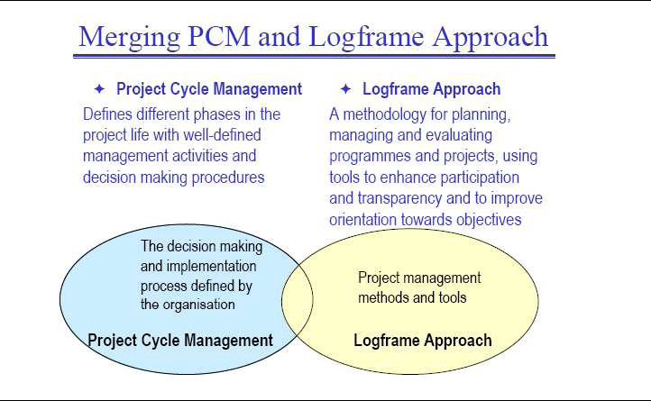
Merging PCM and Logframe Approach

Slide 15
The Project Cycle and the Logical Framework
Programming
Identification
Appraisal
Financing
Implementation
Evaluation

Slide 16
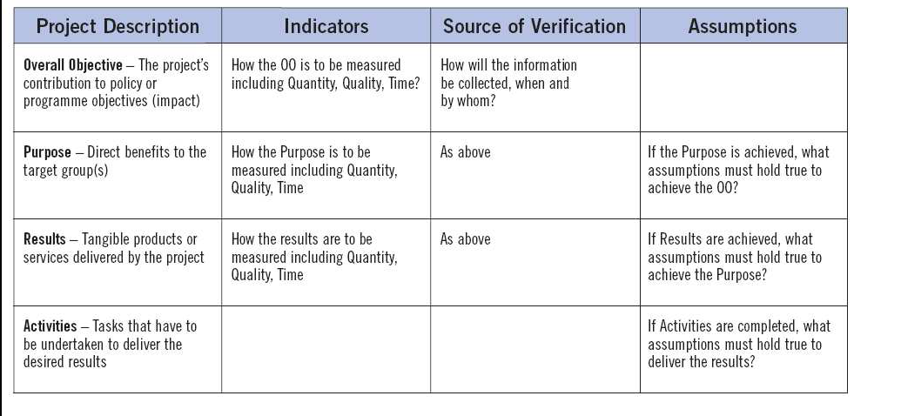
The Logical Framework

Slide 17
The Logical Framework
In practice, the emphasis put on consistent design and consequent impact assessment not only deflates somewhat the importance of the CBM approach, but tends to generate contrasts and some time conflicts with the concern of impact assessment during and after project implementation.
The nature of CBM evaluation, furthermore, is more technical, its background more distinctively theoretical and its reports lengthier and less transparent and “absorbable” by managers and bureaucrats. The EU has thus attempted to reduce these conflicts by using the project cycle process (PCP), already developed within the cost benefit – economic evaluation framework, as an integrating tool.

Slide 18
Page
2
4
11
18
31
Introduction
Capital budgeting and Government accounts
Performance management evaluation
A recent development in evaluation: the Real Option Methodology
Some general conclusions

Slide 19
A Recent Development in Evaluation: the Real Option Methodology
a recent development is the increasing application of Extended Cost Benefit (ECB), i.e. of CBA extended to consideration of the so called real option values.
This type of evaluation is based
    on a multi-stage investment or policy problem under uncertainty. The decision maker is faced with an irreversible (or costly to reverse decision) about the direction of the economy.

Slide 20
Appraisal of Infrastructure Investment
The EUNET project (EUNET 1998) concluded that the most common forms of appraisal in use in the EU member states for transport infrastructure are cost-benefit analysis (CBA) and multi criteria analysis (MCA).
The table shows the Impacts included (partly or all) in infrastructure appraisal in different EU countries

Slide 21
Appraisal of Infrastructure Investment
Best practices in this evaluation include social accounting matrices and input output methods and, at times, computable general equilibrium models.
An additional dimension of infrastructure evaluation is given by the combination of consensus building and environmental impact assessment.
Because of its public nature and its important relationship with every day activity, decision making about infrastructure increasingly enters the deliberative aspect of democracy.
  an increasing attention to integrate the evaluation part into
  the whole decision process that surrounds investment

Slide 22
A Recent Development in Evaluation: the Real Option Methodology
  For example
  to build a new highway or port
  The policy decision
  destroys the option to wait for more nformation
  to emerge, for example on directions of the world economy
  The policy decision
  creates new options for the economy, for example, through increased stability
  The investment decision destroys the option of using
  the resources elsewhere but opens options for future development

Slide 23
A Recent Development in Evaluation: the Real Option Methodology
Cost-benefit analysis is based
on discounted cash flows (DCF) and net present values (NPV) of benefits and costs generated by the project.
compresses in a single scenario the information available on the project and accounts for uncertainty by considering possible deviations from such a scenario.
Real option theory is incorporated in project evaluation in the method of extended net present value (NPVE).
Use appears increasingly popular in capital budgeting and other business applications, adds to the value created by the project in terms of expected cash flow, the value created (or destroyed) in terms of rights and opportunities

Slide 24
A Recent Development in Evaluation: the Real Option Methodology
Benefits and costs:
are a subjective approach to the decision-making problem.
They depend, in particular, on the hypothesis that the utility function of the decision maker has been identified or reduced, in the simplest case, to the increase of expected values at market or economic prices.
The theory of real options:
assets with uncertain returns can be evaluated by utilizing the observed market values of a matching asset or asset combination, with the same expected return and volatility.
it possible to attribute a value to options, on the basis on a single observable market-wide parameter—the risk free interest rate, and of only three asset specific parameters: (i) the expected cash flow, (ii) the volatility and (iii) the expiration time for the option.

Slide 25
A Recent Development in Evaluation: the Real Option Methodology
For example, the development of an expansion plan to provide electrical energy provides the opportunities, i.e. the right, but not the obligation, to produce a certain amount of electricity at subsequent dates.
The value of the expansion plan is thus equal to the NPV of the amount of electricity that will be produced plus the value of the option to produce more or less than what is expected, according to the circumstances.
In a similar way, the construction of a transport infrastructure, that can accommodate different flows of traffic, generates an expected value plus an option value deriving from the opportunity to employ more or less of the available capacity.

Slide 26
Real Option and Policy planning
The real option approach has several implications for government operations. These implications concern both policies and projects at the two levels of planning and evaluation. For policies, the methodology of real options implies that risks and opportunities are given more systematic attention in considering alternative courses of action.
The impact of uncertainty on the timing and the sequencing of policy actions, in particular, appear to be worth of consideration far beyond what has been generally taken into account in the traditional way of formulating and planning economic policies.
Development strategies, for example, may be almost invariably considered as sequences of stages, each characterized by one or more key policy choices, and by waiting and expansion policies related to each other through the particular sequence that may be selected (Knudsen and Scandizzo, 2002).
Choosing one path of development over another thus implies a unique set of risks and opportunities that arise both from the stages involved and from their order in the path.

Slide 27
Real Option and Policy planning
Policies are rather considered programs of action coordinated over time
Policies should thus be formulated in a way that allows governments and policy makers to suggest timely corrections and even reversal of the course previously established if information is acquired to that effect. Learning by doing and additional information, in other words, should be used to reduce irreversible effects and resource commitment of policies that prove to be wrong or incorrectly formulated.

Slide 28
Real Option and Project work
For project work, option theory is specially relevant for public infrastructure from several points of view.
Real option methods provide a framework to evaluate policy changes and programs that, by encouraging the evaluation of opportunities created and foregone, strengthens the link between aggregate government strategies and specific projects.
The concept of real option, in fact, widens the set of benefits and costs that characterize a project, by considering the risks and opportunities that the project would create and destroy, in the context of alternative aggregate policies and according to alternative designs and implementation paths.For a public project, the net creation of opportunities for the private sector may indeed be the dominant benefit and reason to adopt the project
The value of the institutional arrangements, a characteristic much commented upon in project documents, but seldom considered as an endogenous feature of the project, may enter as a very important set of real options
.

Slide 29
Real Option and Project work (continued)
The option approach highlights the importance of management flexibility, thus suggesting that project design should allow for features such as over-capacity, in built expansion/ contraction options, modular structure and sequencing.
Project evaluation is also bound to undergo a profound change by the application of the new methodology On one hand, in fact, the consideration of the waiting option implies a systematic evaluation of the possibility of delaying the project as a key project alternative. On the other hand, the other relevant project alternatives may be simultaneously considered as options that would be destroyed by project adoption. Project evaluation may thus consider, in a more systematic way, the qualitative and quantitative impact of preferring the project to all its relevant alternatives, including the delaying one.
Multi-Phase Program Financing: The objective of this instrument, the Multi-Phase Program Financing (MPF) is to provide systemic and longer-term support of a far-reaching investment program, which by the nature of its complexity could take more than one project cycle to complete. The underlying principle of MPF is that in many instances a sustained effort (beyond the traditional 4-5 year project) is needed in a particular area, sector or sub-sector in order to make a difference in addressing pervasive development problems.

Slide 30
Real Option and Project work
The application of the options method to these types of loans is especially appropriate as the idea behind these operations is that as the first phase is being executed (irreversible investments being made), information is being gained so as to determine the best course of action to be taken in the future. At the end of each phase a number of options are presented to the planner and the options method provides a framework under which to determine the most appropriate course.

Slide 31
Page
2
4
11
18
31
Introduction
Capital budgeting and Government accounts
Performance management evaluation
A recent development in evaluation: the Real Option Methodology
Some general conclusions

Slide 32
Some General Conclusions
A minimal set of budgetary rules thus includes an accounting re-foundation of the public budget on a cash flow and balance sheet base, with explicit connection between the budget chapters and individual investment programs (or projects, when they are so large that they can be considered tantamount to programs).
A minimal set of result oriented evaluation practices should include performance evaluation and indicator based impact analysis to monitor the evolution of the environment and the success of public programs in the sectors where the P.A. operates with the greater responsibilities (e.g. health, education, national security, infrastructure).
A minimal set of economic evaluation practices should include cost benefit tests in all crucial phases of the project cycle, as well as tests of financial and environmental sustainability. Experimenting with some of the newest extensions of evaluation from the point of view of a plurality of stakeholders should also be highly recommended.

