Slide 1

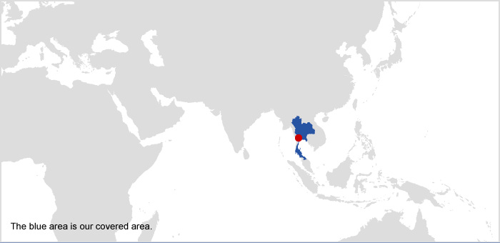

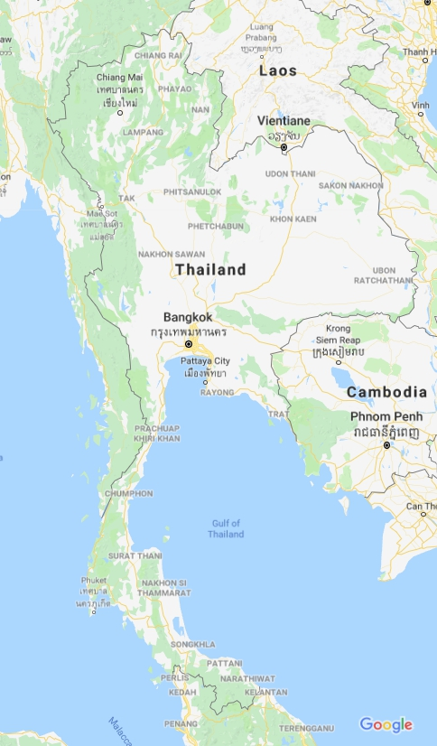


Chatchai INTATHA,
ONEP, Thailand
“Supporting SCP Implementation in Thailand: the role of the SWITCH-Asia Programme in addressing challenges”
HLPF, 13 July 2018, NYC
1
2
SCP
3
4

Slide 2
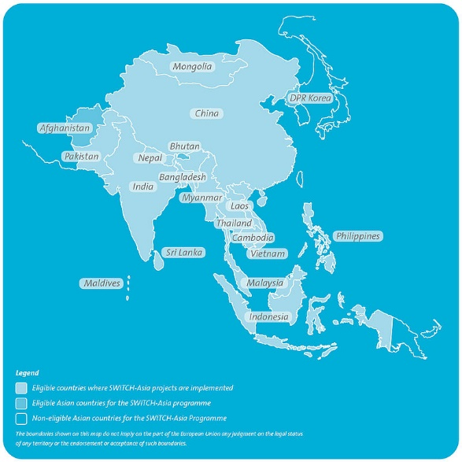
Supporting SCP implementation in Thailand: roles of
the SWITCH – Asia program in addressing challenges
2015
2012
The SWITCH Asia I
Notes:
The first project was supported from the EU under the SWITCH – Asia.

Slide 3

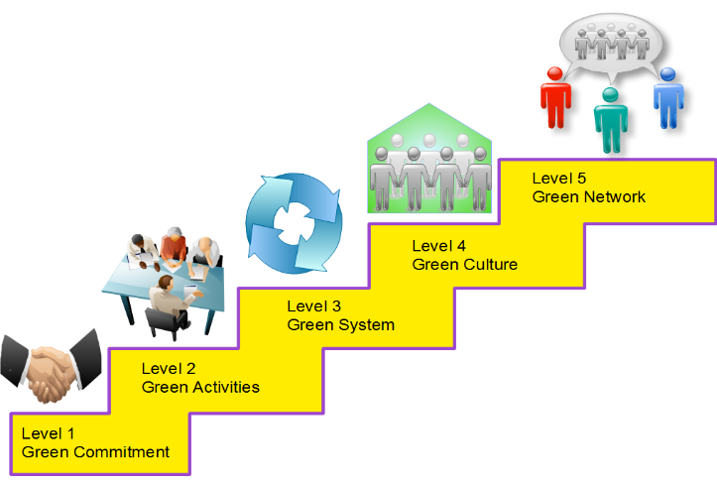


SCP Policy 4 components under
EU SWITCH ASIA
The Overall Project Objective
To support the Thai government in strengthening SCP policies.
1.
SCP
Policy Assessment& Monitoring
Green Public Pocurement
Green Industry
Awareness
2.
3.
4.
Notes:
Component 1 : SCP Policy Assessment and Monitoring
Objective
To strengthen the institutional framework for SCP in Thailand and
develop a national SCP monitoring system
Component 2 : Green Public Procurement
Objective
To promote Green Procurement among local authorities as well as build capacity for implementing the Green Procurement Policy
Component 3 : Green Industry
Objective
To promote Green Industry Mark among SMEs in order to demonstrate sustainable production principles in selected sectors
Component 4 : SCP Awareness
Objective
To increase SCP awareness among local authorities and to generate behavioural changes in local communities

Slide 4
Supporting SCP implementation in Thailand: roles of
the SWITCH – Asia program in addressing challenges
2015
2012
2016
The SWITCH Asia I
SCP Roadmap

Slide 5
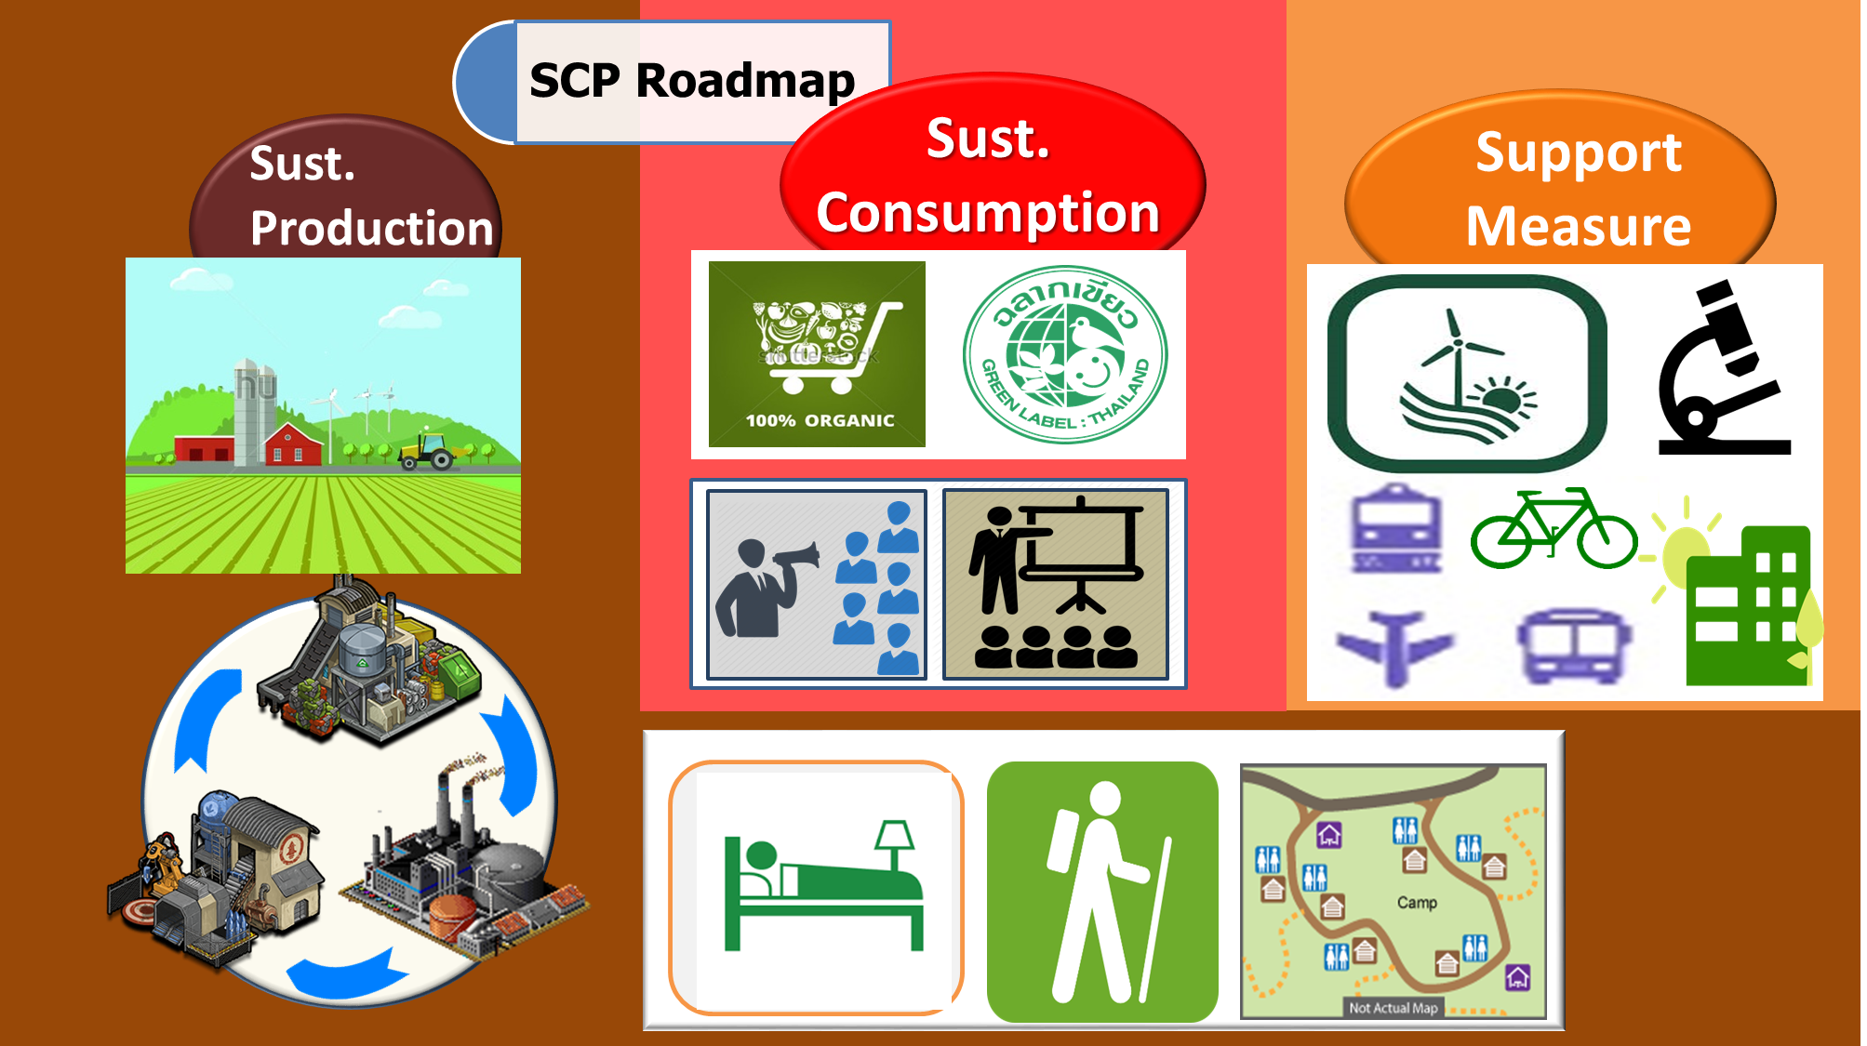
Notes:
The Second project supported by the EU was the SCP Roadmap under the Policy Dialogues Support Facility (PDSF). The outcome was

Slide 6
Supporting SCP implementation in Thailand: roles of
the SWITCH – Asia program in addressing challenges
2015
2012
2016
The SWITCH Asia II
The SWITCH Asia I
2018
2017
SCP Roadmap
2021
The Roadmap Approved
Localizing SCP
SCP partnership
Notes:
The SCP Roadmap was approved by the national committee for SD in 2017. Then the roadmap wants to be promoted and adopted by governmental agencies, business sectors and civil society to conduct activities related to the roadmap.

Slide 7





























Building Capacity of SCP for Local Authorities of Thailand
Sustainable Agriculture
Sustainable Tourism
SCP issues promoted.
Waste Reduction
at Sources
Education
Change Behavior
Alternative Energy
Green Area
Notes:
Building Capacity of SCP for Local Authorities of Thailand is one of the program localized to implement in local area by ONEP. The program focused on 7 SCP issues such as sustainable agriculture, sustainable tourism, waste reduction at sources, environmental education, alternative energy, green area and change behavior to be more green society.

Slide 8
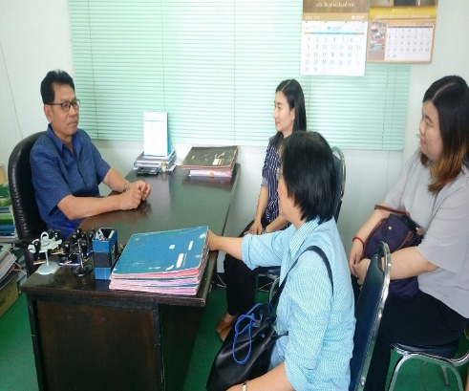

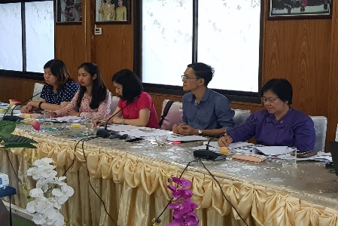

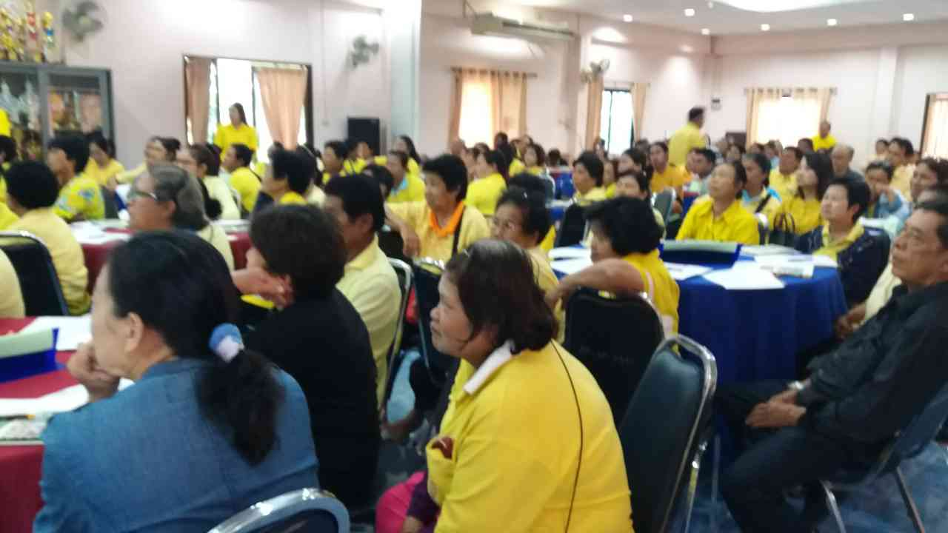
SDGs Localization 2018: Improving SCP capacity for Local Authorities
Selection
Collect data in the 4 LAs
LAs
4 LAs
Setup SCP Participatory Programs to improve
LA capacities
Location of LAs case study
1
2
Develop Guidelines to improve LAs capacities
3
4
Publish results to other LAs across the country
Notes:
Processes:
Selected 20 local authorities (LAs) that received the complimentary award from the Living Local Authorities Competition.
Surveyed and selected 4 LAs as the case study
Collected data in the 4 LAs through semi-structured interview/focus groups/separation of waste composition
Analysed the data and introduced appropriate SCP activities with the LAs
Conducted activities in the LAs such as training green office, waste separation at sources, raising awareness for students, developing environmental course related the local circumstances
Conducted SCP implementation guidelines for the LAs
Promoted and published the SCP guidelines which are composed of concept, knowledge, and activities for implementation in LAs in 4 regions across the country or 600 LAs.

Slide 9
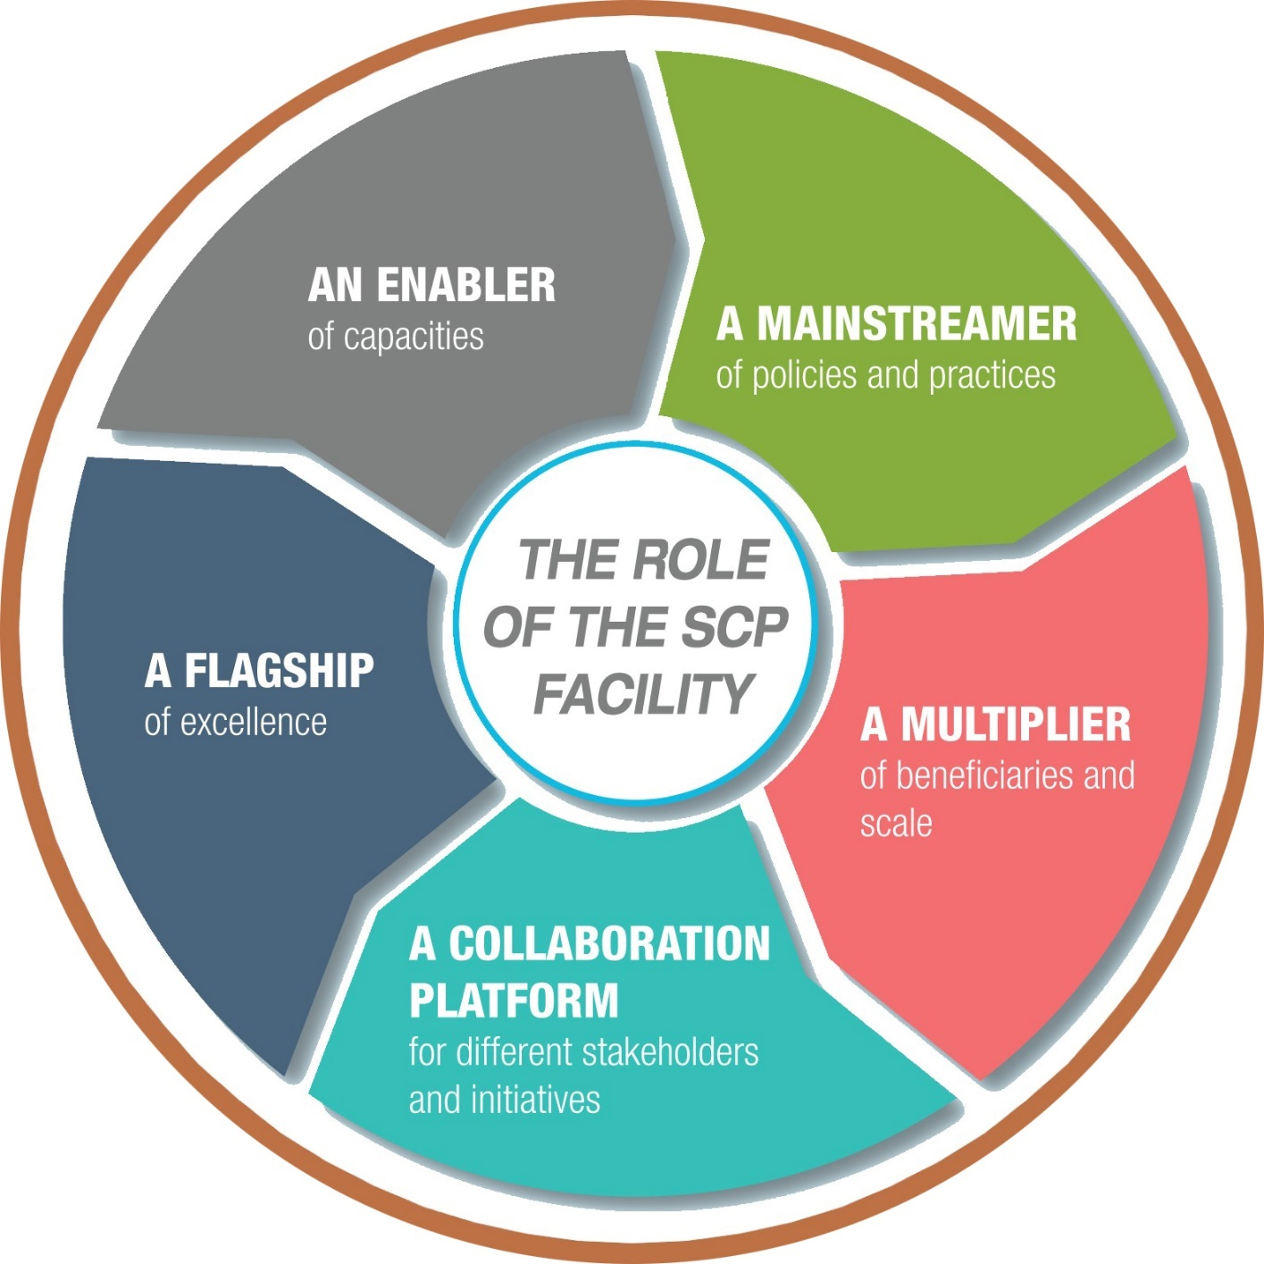


The SWITCH Asia SCP Facility
Scaling up
Replication
Localization
Transformative Delivery
Notes:
The SWITCH-Asia Facility will
Reinforce capacity of implementing line ministeries and subnational agencies to promote SCP
Support formulation and implementation of national policies on SCP by Asian governments on demand basis
Contribute to the overall effectiveness, sustainability and impact of the different programme components, inter alia via ensuring coordination of and communication between them
Increase awareness on SCP and knowledge distilled from the projects for wider replication
Increase interactions between SME/MSMEs and financial intermediaries
Enhance policy dialogue on SCP in Asia (national and regional), inter-alia via support to the policy advocacy component at the regional level.

Slide 10
THANK YOU
FOR YOUR ATTENTION

