Slide 1

The use of charters in the non governmental cooperation
Balancing between autonomy and alignment

Slide 2
3 Belgian examples
SDG – Charter
Charter on quality of medecins
Integrity Charter

Slide 3
Key Questions
Why do NGO’s volunteer to sign these charters?
What does this mean for their autonomy?

Slide 4

SDG Charter
To promote and to fulfill the Sustainable Development Goals together, bridge the gap between international development, the private sector and civil society.
more than 80 Belgian companies, CSO’s and representatives of the public sector that signed the Belgian SDG Charter for International Development
Shared commitment: Collaboration around five core themes
(1) health, (2) renewable energy, (3) digitalisation, (4) agriculture and nutrition and (5) sustainable enterprise.

Slide 5
aim of the SDG-charter:
To link private sector, authorities and CSO on the SDG’s so that Belgian private companies, development actors from the civil society and the public sector ultimately mutually reinforce one another in favour of sustainable and inclusive economic growth and development in our country but also in partner countries of the Belgian development policy,
Some critical reactions from NGO’s:
whose agenda are we executing? « instrumentalisation »?

Slide 6

2. Charter on high quality medicines
Initiated by Be-cause Health (the Belgian Platform for
International Health), supported by Belgian Government
Objective: better monitor the quality of pharmaceutical products in developing countries (1/4th = bad quality)
signed together with (+- 20) NGOs and other actors of the Belgian Official Development Aid (ODA), a declaration of commitment
L’Association pour la Promotion de l'Education et de la Formation à l'Etranger, L’Académie de Recherche et d'Enseignement supérieur, Artsen Zonder Vakantie Médecins Sans Vacances, La Société belge d'Investissement pour les Pays en Développement, Benelux Afro Center, La Chaine de l’Espoir Belgique,
La Croix-Rouge de Belgique Communauté francophone, La Coopération Technique Belge, Damiaanactie Action Damien, Handicap International, L'Institut de Médecine Tropicale d’Anvers, Lumière pour le Monde, Médecins du Monde Dokters van de Wereld, Oxfam Solidarité, Memisa Belgique Memisa België, Vlaamse Interuniversitaire Raad, Vétérinaires Sans Frontières Dierenartsen Zonder Grenzen, Wereldsolidariteit Solidarité Mondiale & Mutualités Chrétiennes

Slide 7
22% of Belgium’s ODA in the health sector → purchase of medicines
= Belgian priority + Agenda 2030
With this commitment, Belgium becomes the first bilateral donor and the first Member State of the European Union to propose a response to the question of the quality of pharmaceutical products. Our country’s good practices are looked at as being both innovative and inspiring by other EU Member States.

Slide 8
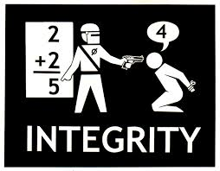
3. Integrity Charter
- Long before the scandals emerged
2016
Principle foreseen in
new legal framework
2017
Policy management guideline
Jan 2018
Integrity Task Force
May 2018
Charter

Slide 9
Follow up
- Minister De Croo has decided now to make the integrity rules for all NGOs stricter, after consultation with the sector.
-All other Belgian development cooperation organizations such as Enabel, Bio and the directorate general for development cooperation and humanitarian aid (Ministry of Foreign Affairs) will have to sign the charter.
-The charter will engage all organizations to adopt an own elaborated ethical code and to invest in raising awareness and in training/education on integrity.
-Integrity Task Force has worked on a plan for common trainings, on the creation of a central contact point, and on a framework contract for integrity advice available for all actors

Slide 10
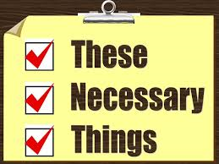
Was this necessary?
Meinie Nicolai (Artsen zonder Grenzen), Régine Debrabandere (Plan International België) en Eva Smets (Oxfam Solidariteit)
“NGOs are not angels. But the public may hold us accountable to higher ethical standards”
Nicolas van Nuffel advocacy officer CNCD-11.11.11:
  “Necessary, without a doubt, useful in any case. It is the role of the state to set boundaries, especially when there are abuses. We welcomed this initiative in a very positive way. We contributed to the reflection with the minister”

Slide 11
Eva Smets, directrice générale d’Oxfam-Solidarité
  « "It's a good measure. The government is there to set standards. However, some NGOs and some humanitarian actors already had an ethical code, which has been the case for several years at Oxfam-Solidarité. The charter was not imposed, or invented by the Minister. In consultation with the sector ".
- DGD/Minister:
« Changing world demands changing mentalities and methods: adaptation to current societal demands. »

Slide 12

CONCLUSIONS of NGO’s (so far)
PRO
CONTRA
  Equal standards for everyone
  Some actors are going even further; demand all their employees to sign an internal ethical code
  Easily accepted by the sector, because « it ‘s in their DNA »???
No principal objection
But some practical means are still missing: trainings, independant hotline for whistleblowers,…but they are foreseen!

Slide 13
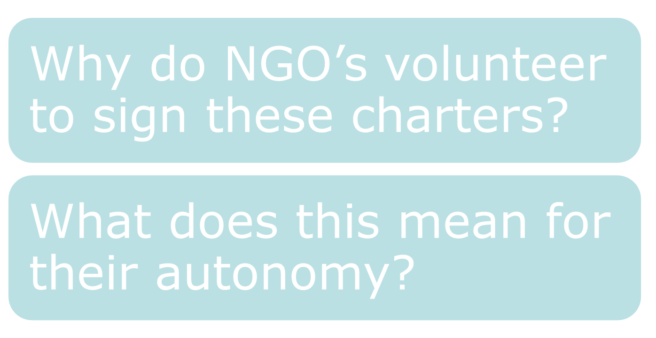
Answers to the key questions

Slide 14
1. Why do NGO’s want to sign these Charters?
Normative elements « values, part of their DNA»
Creation of a positive image / legitimacy
Pressure from society, donors and media
Peer pressure
Organisational advantages: improved management, more efficiency, increased professionalism
Not limited to adressing scandals of sexual abuse, but also contains other elements (fiscal, financial integrity, ecological impact…) → Not only a question of « doing the right thing », but also « doing things right »
- Positive influence on employees’ efficiency + personal identification with organisational values

Slide 15
2. Autonomy versus alignment
Very often NGO’s look at the relationship like this:
autonomie alignment
competition between the two concepts:
more organizational autonomy means sacrificing focus and implies less organizational alignment;
more alignment means less autonomy and increased command & control (from political/Administration level)

Slide 16
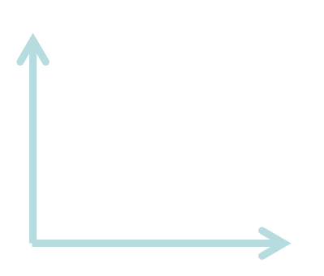
Autonomy versus alignment
Stephen Bungay “The Art of Action” → misconception! The two ideals are not in competition with each other but should exist in unison. Alignment through transparency enables increased autonomy.
autonomy
alignment

Slide 17
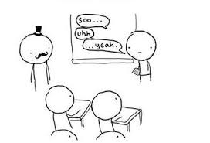
GENERAL CONCLUSIONS

Slide 18

Use of charters: bridging the gap?
Charters can help to bridge this gap and facilitate both alignment and autonomy.
Donors get the overall alignment, progress tracking and predictability they need, while at the same time NGO’s can work the way that best suits them within the framework of a basic Declaration of Commitment, at their own pace
PRO / CONTRA
It’s not magic. Since it’s only on a voluntary basis, implementation is hard to impose.
Charters came to life after long and participative process of negotiations with the sector. The practices of multiple NGO’s are aggregated, while simultaneously overall vision and goals are made transparent to everyone.
Soft law?

Slide 19


Slide 20
Sources
https://favrohub.com/autonomy-and-alignment-theyre-not-mutually-exclusive-5657531de11e
https://www.youtube.com/watch?v=te-oSAgdtxA
https://diplomatie.belgium.be/en/newsroom/news/2018/compulsary_ethical_codes_all_ngos
https://diplomatie.belgium.be/en/newsroom/news/2017/quality_pharmaceutical_products_in_developing_countries
https://diplomatie.belgium.be/en/newsroom/news/2016/belgian_companies_ngos_and_public_sector_sign_belgian_sdg_charter
https://www.mo.be/interview/ngo-s-zijn-geen-engelen-maar-het-publiek-mag-ons-wel-aan-hogere-ethische-standaarden?utm_campaign=emo&utm_medium=newsletter&utm_source=emai
l

