Slide 1
Dialogue & Dissent in perspective
June 2018
Dr. Jelmer Kamstra

Slide 2

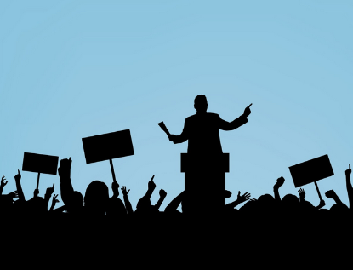
On development
Notes:
The D&D policy framework special
Social Transformation logic while Managerial approach is dominant
Important to know both perspectives to understand tensions
Different views on: development, role of civil society, role of donors

Slide 3
On development
Managerialism
linear, technical process, can be planned & controlled realize tangible quantifiable results requires the ‘right’ set of management tools universally applicable

Slide 4
On development
Managerialism | Social transformation
linear, technical process, can be planned & controlled realize tangible quantifiable results requires the ‘right’ set of management tools universally applicable | diffuse political process change unequal power relations requires local ownership context-specific
D&D

Slide 5
On civil society’s role
Managerialism
complementary to state and donors instrumental: value for money CSOs are effective and efficient service providers citizens are customers who use performance indicators to hold CSOs and government accountable

Slide 6
On civil society’s role
Managerialism | Social transformation
complementary to state and donors instrumental: value for money CSOs are effective and efficient service providers citizens are customers who use performance indicators to hold CSOs and government accountable | autonomy crucial for development intrinsic value political role for CSOs citizens are rights holders who use CSOs to claim their rights
D&D

Slide 7
On donor support
Managerialism
donors take the lead donors ensure value for money professional CSOs short term contractual relations performance indicators control

Slide 8
On donor support
Managerialism | Social transformation
donors take the lead donors ensure value for money professional CSOs short term contractual relations performance indicators control | local CSOs take the lead donors provide financial, institutional and moral support legitimate CSOs long term partnership relations process tracing trust
D&D

Slide 9
Linear development
Economic focus
Market based solutions
Top-down
Universally applicable
Control / value for money
Political struggle
Emancipatory
Anti Western hegemony
Bottom-up
Context-specific
Trust /solidarity
On development
Managerialism
Social transformation
On civil society
Conflicting logics
On donor support

Slide 10
On development
Sure about intervention
Fast feedback
Unstable context
Stable context
Experimentation
& iteration
Not sure about intervention

Slide 11
Criticism on donor support
Managerial approaches have led to:
    One size fits all solutions
    Lack of ownership / autonomy
    Lack of embeddedness
    Mission drift
    Lack of legitimacy
    Donor dependence

Slide 12
How does D&D navigate this tension?
Focus on political role of CSOs
Partnership approach
Flexible M&E

Slide 13
Political role of CSOs - ToC summary
Inclusive sustainable development
in terms of access to rights and services, gender equality, fair trade,
etcetera
Improved laws, policies, norms, attitudes and practices
change on paper & change in behaviour
Towards improved laws, policies, norms and practices
agenda setting, framing and/or creating space to engage
Civil society Engagement
advocacy initiatives
Civil society strengthening on L&A
capacity & legitimacy

Slide 14
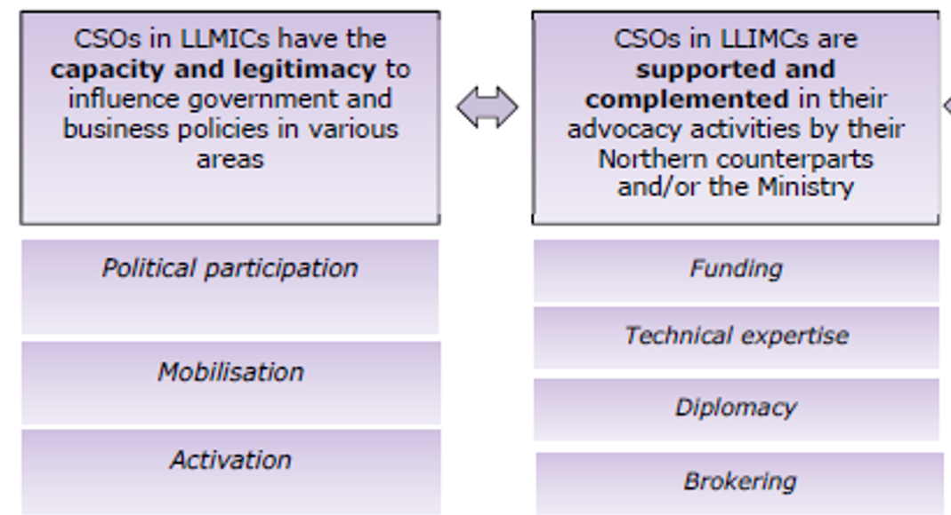
Partnership: shared goals, different roles

Slide 15
Flexible M&E
ToC instead of logframe
Explain and question underlying assumptions
Emphasis on continuous learning and adaptation
Inception phase & context study for local input and embeddedness
Bottom-up instead of top-down result framework
Mixed methods: A strong story (ToC) is needed to interpret and explain the numbers

Slide 16
Measuring results - process
Quantitative |  | Qualitative
Bottom-up, summary of 25 result frameworks
Identify common / most important indicators
Link to ToC
6 core indicators (voluntary, container variables, IATI)

Slide 17
Measuring results – quantitative indicators
# | of…(coordinate with thematic departments)…
# | of laws, policies and norms implemented
# | of laws, policies and norms blocked, adopted, improved
# | of times CSOs succeed in agenda setting, influencing the debate and/or creating space to engage
# | of advocacy initiatives carried out by CSOs, for, by or with constituency
# | of CSOs with increased L&A capacities
# | of CSOs included in SPs programmes

Slide 18
Measuring results - process
Quantitative |  | Qualitative
Bottom-up, summary of 25 result frameworks |  | Design ToC together with CSO partners and Ministry
Identify common / most important indicators |  | Inception phase – context studies, power actor analyses (including gender), contextualized ToC
Link to ToC |  | Annual 8-pagers, reflection on ToC
6 core indicators (voluntary, container variables, IATI) |  | Mid-term, end-term, NWO assumptions programme, partnership research

