Slide 1
Safeguarding Update
5 Assurances Sought
NGO’s, UN & Multilaterals, Suppliers
NGO Analysis
New Safeguarding Due Diligence
Ongoing Next Steps

Slide 2
Safeguarding Update
Environment is preventative and protects
Safeguarding Policy
Clarity on Allegations
Organisational Culture
Referral of Concerns

Slide 3
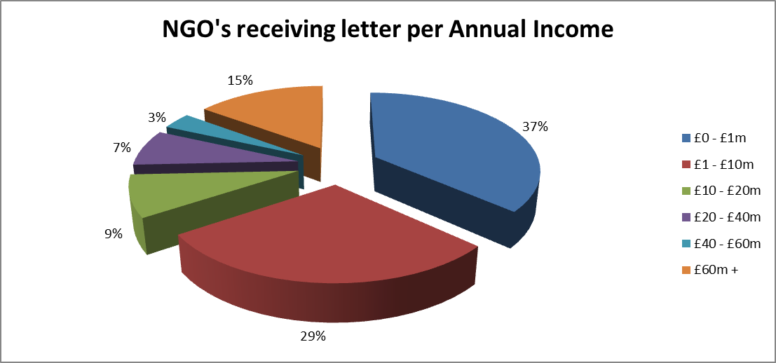
NGO’s per Income

Slide 4
NGO Analysis – RAG Ratings
Green RAG rating - assurance against all 5 areas
Amber RAG rating - assurance providing a minimum of 2 of the 5 areas
Red RAG rating – assurance in 1 or less of the 5 areas

Slide 5
NGO Analysis – Quality Control Evidence
Scoring Criteria
21 NGO’s scored a 1 (Evidence of meeting all 4 of the indicators)
114 NGO’s scored a 2 (Evidence of meeting 1, 2 or 3 of the quality indicators)
17 scored a 3 (No evidence of meeting any of the indicators)

Slide 6
NGO Analysis – RAG Results
179 responses
79%
142 NGOs - rated as Green
37 NGOs - rated as Amber
0 NGOs - rated as Red
21%
0%

Slide 7
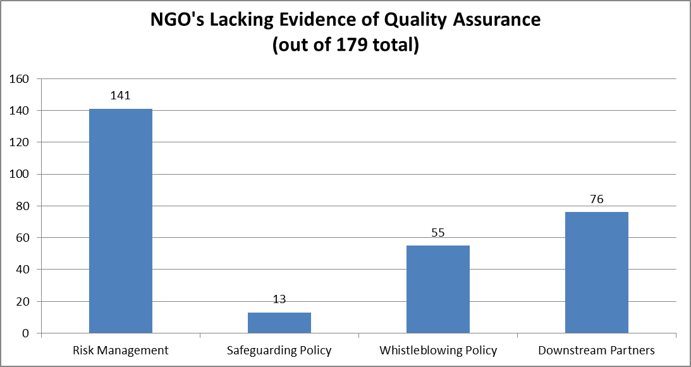
NGO Analysis

Slide 8
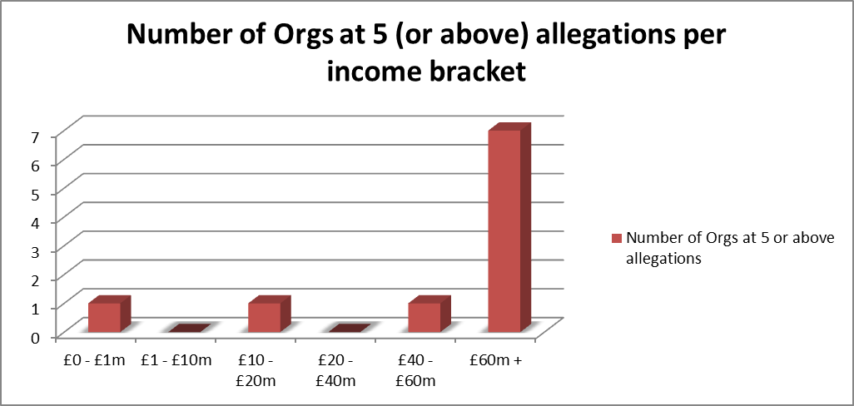
NGO Analysis: Under-reporting? Misunderstanding?
Correlation between Safeguarding & Whistleblowing?

Slide 9
New, Enhanced & Specific Safeguarding (PSEA & H)
Due Diligence
All NGO’s receiving grants and contracts
UN & Multilaterals – central assurances
Commercial Suppliers

Slide 10
Minimums & Approach
Pilot & External Feedback
Must meet all 6 safeguarding (PSEA & H) due diligence areas
Risk-based approach
Informing Partners
Clinics, Training, Annual Reviews & PMC

Slide 11
Safeguarding (PSEA & H) Due Diligence

Slide 12
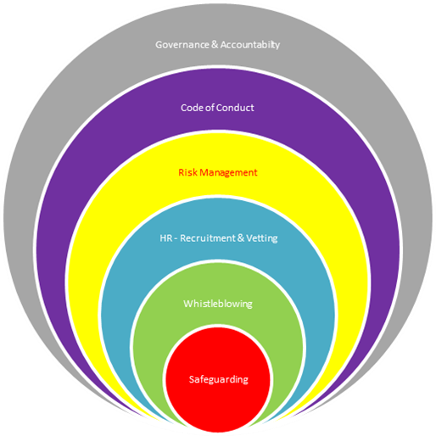
Interdependency of Safeguarding (PSEA & H)

Slide 13
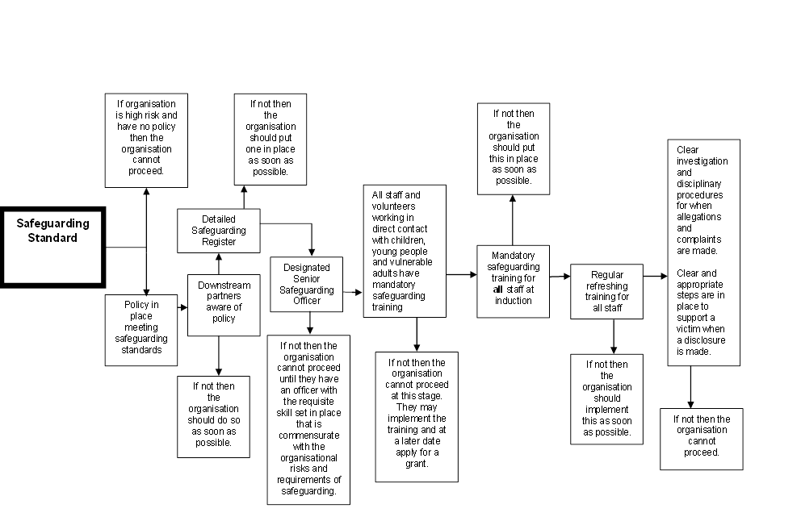
Safeguarding (PSEA & H) Flow Chart

Slide 14
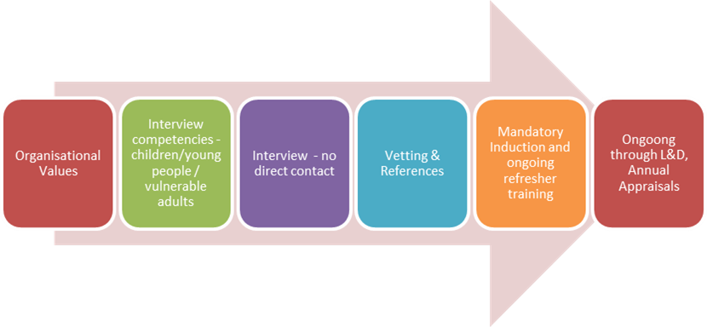
HR Recruitment Process

Slide 15
Ongoing Next Steps…
Permanent DfID Safeguarding Unit
4 policy expert working groups –
  Ensuring accountability systems that prioritises beneficiaries and survivors
  Shifting organisational culture to tackle power imbalances and gender inequality
  Improving safeguards across the employment cycle; and
  Ensuring full accountability through rigorous reporting and complaints mechanisms
CC and IDC inquiries reporting in Autumn on Oxfam & SCUK
October Safeguarding Conference

