Slide 1
Agricultural Extension: update and perspective on EU funded food security programmes in South Sudan
Presented at Food Security and Livelihood Cluster Meeting,
11th July, 2018
Tayo Alabi_EU TA Agronomist Extension

Slide 2
Outline of Presentation
Overview of EU Food Security and Rural Development Programmes
Role of Technical Assistance
Agricultural Extension: Common Understanding
Extension issues identified and the basis
Common approaches in use by EU Food Security funded partners
Some of what we have done (Accomplishment)
Upcoming Extension Support Activities
Suggested new set of guidelines
Suggestions for Agriculture Working Group

Slide 3
Overview Food Security and Rural Development
Programmes EUD South Sudan
National Effort for Agricultural Transformation (NEAT)
EU Food Security and Rural Development Programmes in Greater Bahr el Gazal
FSTP
SORUDEV
Greater Equatorial/ Upper Nile
FSTP + ProAct
Pro Act
ZEAT BEAD
SORUDEV SSR
ZEAT BEAD 2
National
New Actions
Regional
Actions
National Effort for Agricultural Transformation (NEAT)
EU Food Security and Rural Development Programmes in Greater Bahr el Gazal
FSTP
SORUDEV
Greater Equatorial/ Upper Nile
FSTP + ProAct
National
Regional
Actions
Pro Act
ZEAT BEAD
SORUDEV SSR
ZEAT BEAD 2
New Actions
Notes:
Zonal Effort for Agricultural Transformation – Bahr el Ghazal Effort for Agricultural Development (ZEAT-BEAD)

Slide 4
Role of EU Technical Assistance (TA)
TA Role:
Monitoring of the individual projects of the EU's rural development programmes is ensured.
Overall coherence of all EU's Rural Development Programmes/ (Decisions) is ensured in line with overall programme objectives;
Effective coordination of all activities, agencies and stakeholders involved is ensured, best practices are harmonised and promoted.
Team Leader. Agronomist Extension Services Specialist. M&E Specialist. IT Specialists and a host of ST Experts.

Slide 5
Agric Extension: Common Understanding
Traditional role of extension
To take information (usually research findings) from Source (the research institutes and academic institutions) to the Users (Rural families)
Is to be a bridge between the Source and the Users
The new understanding
A systematic process of working with producers or communities to help them acquire relevant and useful agriculture or related knowledge and skills to increase farm productivity, competitiveness and sustainability…
Deliver the information in the best possible way (using different channels + Tech)
Develop the right messages and avoid noise
Make farmers active participants, persist and be consistent
Give feed back to researchers and to the general stakeholders

Slide 6
Extension issues identified
The importance of enhancing and promoting agricultural extension in all EU funded food security projects are based on:
Farmers capacity to produce sufficient food is weak and this in part contributed to the global food crisis of 2007-2008
Poorly trained extension staff, insufficient and lack of the infrastructure to support extension delivery (including institutions of training and research)
Technology and improve practices are needed to boast yield and productivity
Introduction and proper use intermediate technologies to improve farmers production and productivity is needed
A need for NALEP to be popularised (nationwide among state staff, among staff and farmers) in South Sudan

Slide 7
The role of private or community based extension and the need for market oriented extension delivery service.
Certification and licensing of extension practitioners
Harmonization of all training manuals and materials in use by partners
Need for introduction and adoption of approaches that will improve production, improve market, improve income, improve nutrition and sustainability which could also include innovations and addresses emerging issues
The need to continue to monitor how the projects funded by the EU progress with their implementation approaches and methods
The need for continuously think of approaches that responds to emerging issues such as climate smart agriculture, resilience (particularly resilience agriculture) etc.

Slide 8
Common Extension approaches in use by EU Food Security funded partners
Farmer Field School (FFS incorporated with VSLA), Agro Pastoralist Field School (APFS), Fisher Folk Field School (FFFS) Pastoralist Field School (PFS), Pastoralist Livelihood and Education Field School (PLEFS)
Group approach (extension group/ production group /marketing group etc.)
Outreach approach (with a whole range of methods like - lead farmers /farmer promoters; demo plots; farmer field days; farmer demonstrations, mass awareness campaign among others)
Community Based Approach (Extension delivered by Community Based extension workers / Community Health Animal Workers)
Farmer led extension approach (extension through lead farmers and collaboration between individual farmers)
Block farm model (Blocks of often more than 100 farms having a central demo plot and being serviced by a Community Based Extension Worker)

Slide 10
Notes:
Source: Study of agricultural extension components of EU-funded rural development projects in South Sudan

Slide 11
Some of what we have done
Monitor implementation of partner projects and the delivery of extension and general agronomic practices (ongoing)
Organise quarterly reviews meeting for partners
Harmonised training manuals and produced a set of extension guides for Crops, for livestock production and a general guidelines for FFS, VSLA, Agrodealership , Ox ploughing and community mobilization.
PLEF training in the cattle camp communities are ongoing
Popularize, summarise, publish and distribute the NALEP documents
Study of agricultural extension components of EU-funded rural development projects in South Sudan

Slide 12
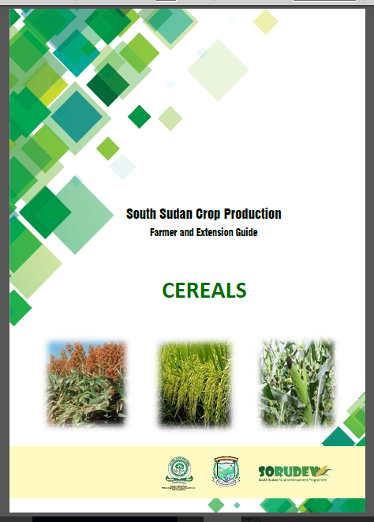
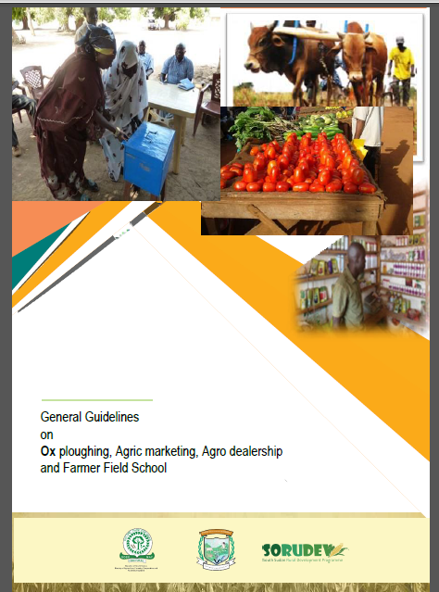
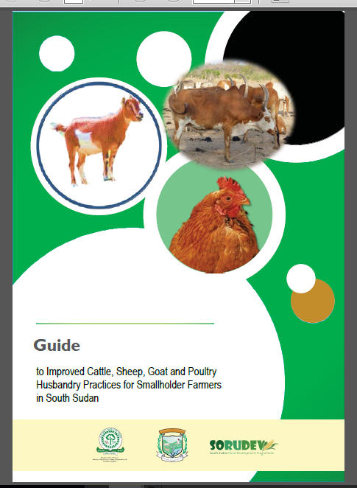
Guides and Guidelines Published

Slide 13
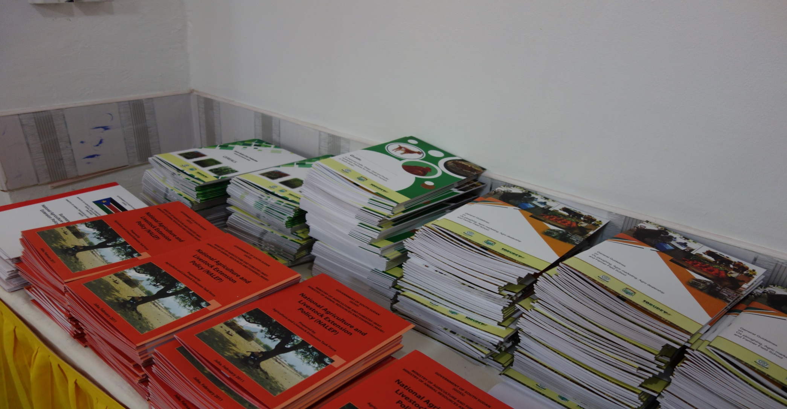
Printing and Distribution of booklets

Slide 14
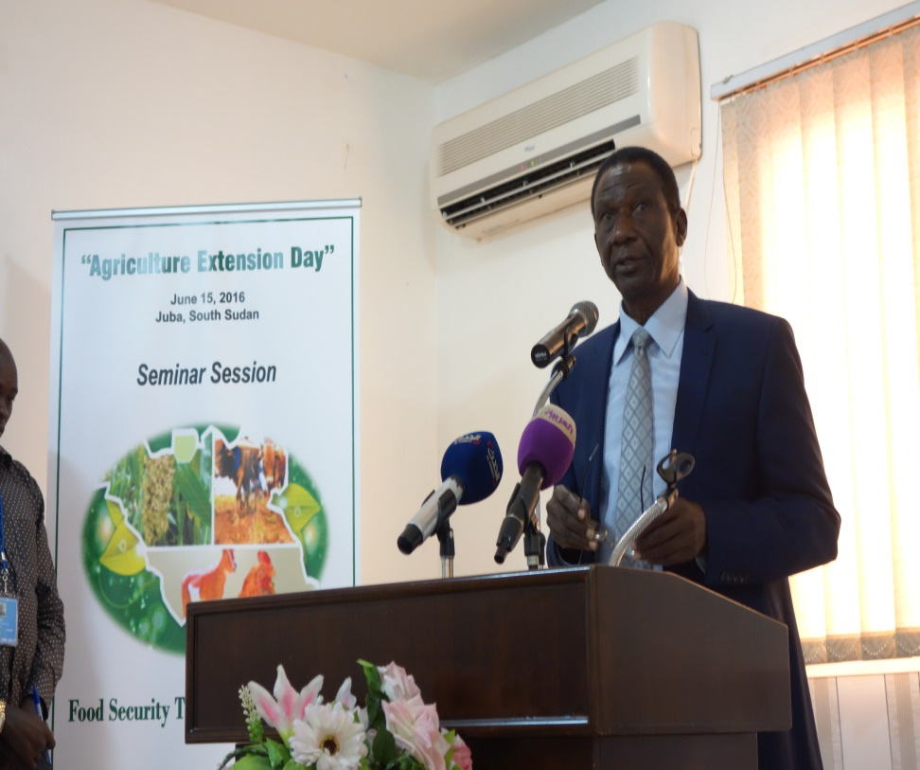
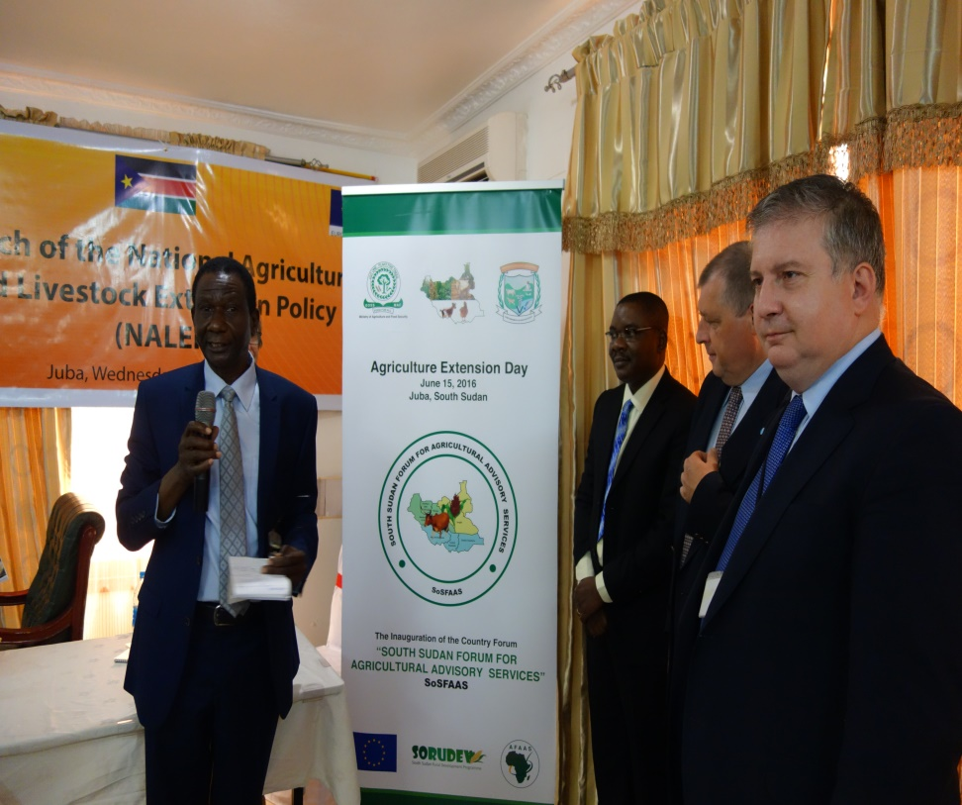
Launch of Extension Day and SoSFAAS
June 15, 2016 in Juba South Sudan

Slide 15
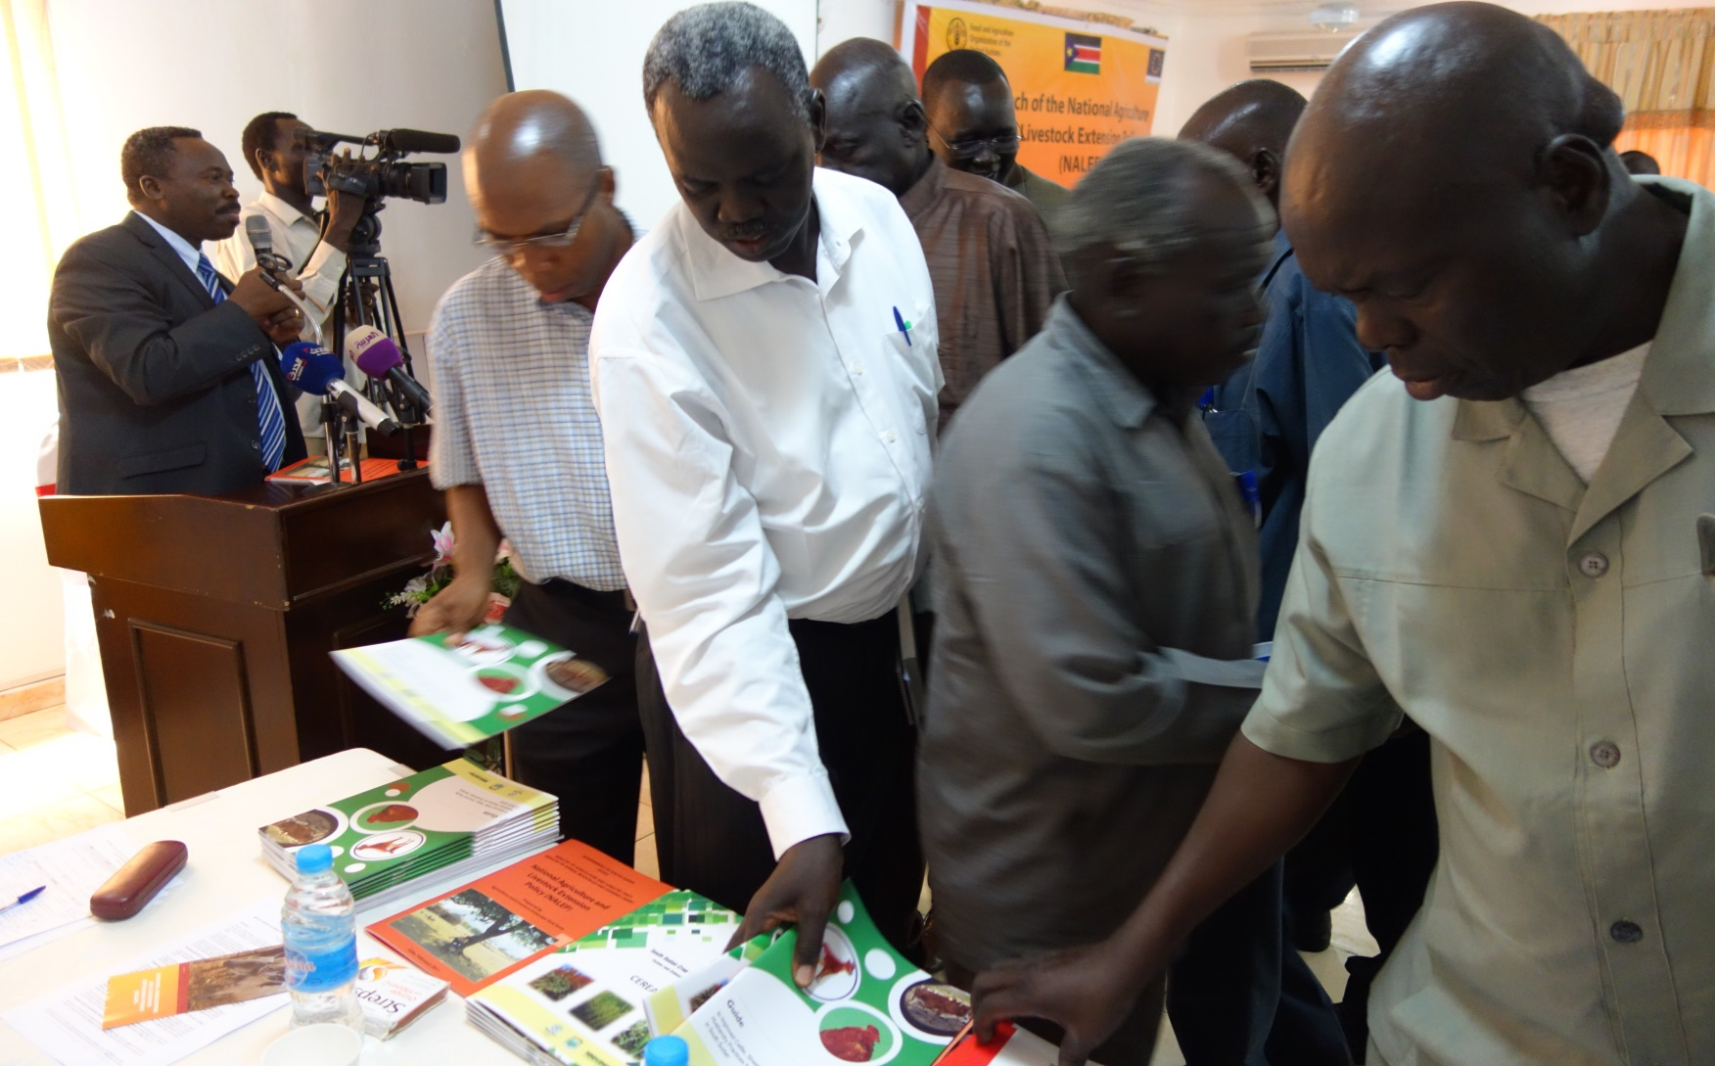

Slide 16
Trainings are already undertaken for FFS and VSLA
Support the functioning of CTC and YATC by asking partners to send and sponsor government officials for courses ( now moribund again)
Created the www.Capacity4Dev.eu webpage of the EU website for sharing project documents and materials
Support the reactivation of SoSFAAS
In the process of producing new guidelines to support the delivery of extension. For this write shops and validation sessions will be organised

Slide 17
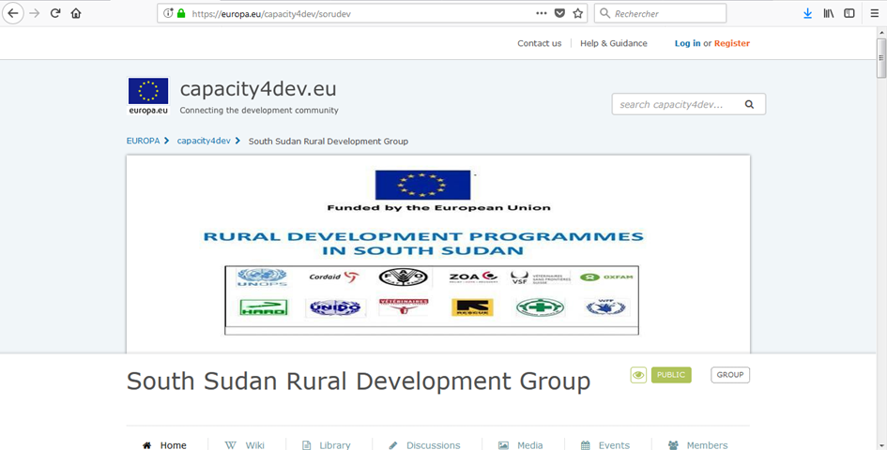
www.capacity4dev.eu

Slide 18
Upcoming Extension Support Activities
Extension Monitoring visits to FAO Cross Border project (July), FAO PLEF and Cordaid (August, September) during which assessment of use of guides and guidelines will take place. All implementing partners already.
Revision of the current guides and guideline and possible production of 2nd edition
Development/ Harmonization of and printing of extension approaches - through write shops again to encourage ownership of the materials
Training on use of training manuals
Distribution of printed booklets

Slide 19
Suggested new set of guidelines
Seed Production Techniques
Participatory planning methods
Participatory extension approaches and methods
Training manual on leadership, group dynamics and group management
Value chain assessment
Small business management
Record keeping and simple bookkeeping.
Milk handling
Vegetable gardening
Water for production
Post-harvest and storage
Any other emerging enterprises/technologies

Slide 20
Examples of training manuals produced ZEAT BEAD Partner

Slide 21
Suggestions for Agriculture Working Group
Distribution of the current Extension Guidelines
Involvement of the working group members in the validation and review of current and new guidelines
Hold policy dialogues and awareness
Task force on specific issues Support the South Sudan Forum for Agricultural Advisory Services (SoSFAAS)
Active participation of members at the Agriculture Extension Day Events including Seminars and presentation of research works (June 16)

Slide 22
Commemoration of the World Food Day Programme (October 16)
Commemoration of the World Environment Day with emphasis on Tree planting activities (June 6)
Capacity building training for member partners on areas of interest
-Market Information System
-Climate Smart Agriculture techniques
-REFLECT training to enhance literacy and numeracy
-Yield Assessment Techniques

Slide 23
Thank you for your attention

