Slide 1
Finance
Day 1 Finance
What constrains finance? – looking beyond the money
Sustainability in adverse conditions – value chains, mechanisms, technology
Conquering constraints – cooperation and coordination

Slide 2
Cross cutting challenges
Day 3 Cross cutting challanges
Water MDGs – update on the debate
Water and rights – the rights based approach
Climate change adapation – water as a vector for CCA
Transboundary water - lessons learnt

Slide 3
Sanitation innovations
Day 2 Sanitation innovations in practice
Demand – lessons at scale from the CLTS experience
Supply – harnessing market forces
Enabling environment – the role of the public sector
Economic case for sanitation – is it worth it? If so, is it done? If not, why not

Slide 4
Day 1 re cap
Constraints - looking beyond the money
Conducive investment environment is needed to attract funding and avoid waste
Water is a low risk, low return business – which implies a stability that is missing
Efforts are needed within policy, institutional reform and capacity building
Tension between environment and investments – credibililty threatened
Sequence of Process – Projects – Dialogue is crucial – quality matters
Pragmatic approach needed
Sanitation and IWRM
Multi actor and multi level complications
Externalities – no clear who benefits
Sanitation and IWRM are late comers
Coordination and collaboration between donors and financiers
Consistent messages are needed
Blending of grants and soft and hard loans is complex
Greater benefit needs to be made use of scarce grant funds
Role of information
Most countries do not know how much funding the sector gets or where found
Information allows coordination - reduces the risks

Slide 5
Water and sanitation EC-EIB seminar
Purpose
To take stock of current sector challenges, deepen understanding and explore new opportunities and innovations
Structure
Day 1 Finance
Day 2 Sanitation innovations in practice
Day 3 Cross cutting challanges
Web link for presentations
http://capacity4dev.ec.europa.eu/wg/regional-water-seminar-brussels-july-10

Slide 6
Day 2 re cap
Demand - 33 countries
Mobilising the self interest, demand and resources of the communities – CLTS shows it is a scalable reality
External intervention and resources – a light touch – less is more
Funds (subsidy) for public hardware and household software
How to make it financeable – to connect communities to banks – is it needed?
Supply – Vietnam - Malawi
Mobilising the self interest of the private sector - Profit is not a bad word
Information the main reason why the market is not working (customers do not know the cost – suppliers are not aware of the market)
There are some failures because it is a service not a product, there is little justification for research and technical development, marketing allows other suppliers to free ride
Market approach works better in urban than rural or remote areas
Connecting banks and communities

Slide 7
Day 2 re cap cont’d
Enabling environment – south africa - senegal
Enabling environment is necessary but not sufficient.. working with the clients and understanding demand (SA)
Carrot and stick (blue and green drop certification) – citizen power and the power of information (SA)
Example of the full flush toilet and the toilet war - subsidy “conditionalities” (SA)
Did the free basic services work? free basic services /formality killed the CBO model.
Regulation about tariffs on public taps and water vending in place but not enforced so due to monopolies the price is very high (S)
Private sector solution should be country specific (S)
Stability of the SWAp and the enabling environment (S &SA)
Economic case
Sanitation is a good buy – but partner countries and donors do not respond - -why?
Themes
Subsidies – often do damage – separate between hardware and software subsidies
Level of ambition, tendency to create O&M back log - rehabilitate
Linkage of these innovative approaches to funding bodies
Role of information in market failures

Slide 8
On front desk
Evaluation forms
Map for restaurant

Slide 9
Day 2 demand – supply - environment
Accelerated sanitation and hygiene
SUPPLY SIDE
  Technology & cost
Access to sanitation Facilities
Sanitation as a business
DEMAND SIDE
  Generation of demand
Hygiene & sanitation promotion
Behavior change
ENABLING ENVIRONMENT
  Policies, coordination,
Regulation, monitoring
Incentive environment
Capacity building

Slide 10
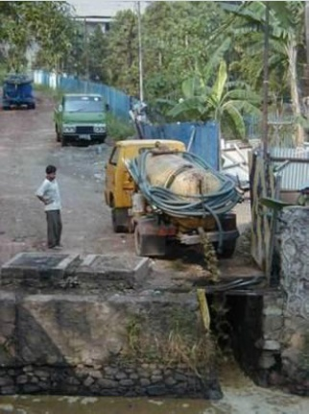
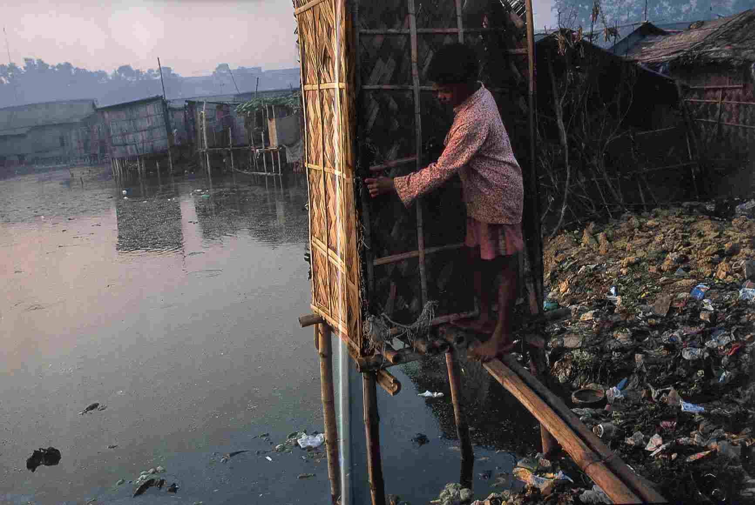

Slide 11
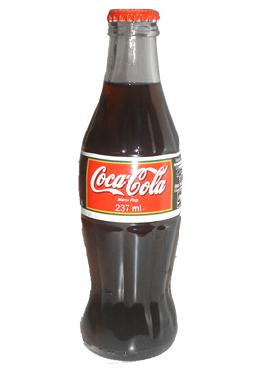

Slide 12

Notes:
1.6 million people die every year from diarrhoeal diseases (including cholera) attributable to lack of access to safe drinking water and basic sanitation and 90% of these are children under 5, mostly in developing countries (WHO http://www.who.int/water_sanitation_health/mdg1/en/index.html)

Slide 13


