Slide 1
Experience in Supporting the Highland Water Forum in Jordan
21 March 2011
Nour Habjoka
GIZ Water Programme

Slide 2
Background
Depletion of Amman-Zarqa and Azraq aquifers
Growing competition for scarce water resources
Highland agriculture increasingly under pressure from within Jordan and from donor side

Slide 3
Rationale for stakeholder involvement
Groundwater aquifers are common pool resources and need appropriate institutional arrangements to be managed sustainably
Stakeholder participation is essential for the sustainable management of common pool resources
Evaluations of the situation in the Highlands show that stakeholder participation is one most important lever

Slide 4
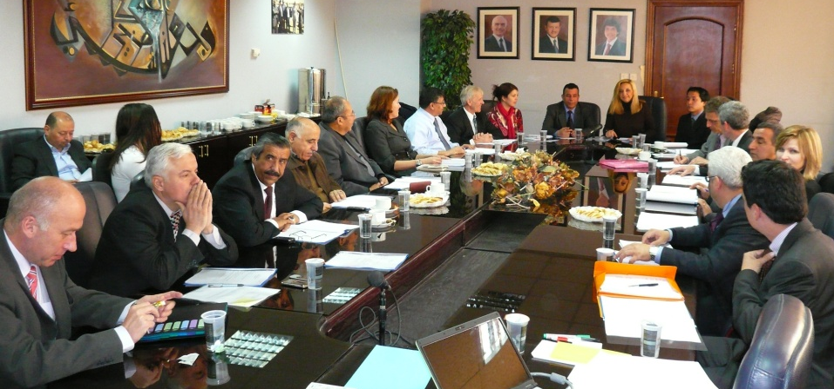
Objective
HWF aims to contribute to the MWI groundwater Action Plan for sustainable groundwater management
  Timeframe is 2011-2013
  Describes activities, measures, and milestones
  Defines activities to be implemented in the Highlands area,
  Bottom-up: elaborated
  together with the
  stakeholders.

Slide 5
Organisational Structure
3
Prime Ministry
align:
monitoring
activities, approves and allocates funds
Steering Committee (MoWI, WAJ, MoA, RWC, 1 Fund representative)
mandate
1
Highland Water Forum
(60 key stakeholders, MoWI, WAJ, MoA)
2
5
Advisory Board (universities, NGOs, think tanks, donors, etc.)
link and support:
makes proposals, provides input to the work of the Forum
finance:
provides funds for implementing
the roadmap
Financing structure
(donor: GTZ, KfW, USAID, WB, EU, etc.)
facilitate:
prepares background information, elaborates proposals of the Forum, commissions studies, provides technical support
4
Highland Water Secretariat

Slide 6
Steps of Stakeholder Involvement
A. Prepare
Stakeholder Analysis
    Applying state-of-the-art tools (e.g. Social Network Analysis) to find out:
    Who are the key stakeholders in the agricultural sector?
    How does the stakeholder network look like?
    How can it be utilized to mobilize stakeholders?
Stakeholder Selection
    Select key stakeholders from the agricultural sector
    Select stakeholders from other sectors (urban water demand, industry, environmental protection)

Slide 7
Steps of Stakeholder Involvement
B. Operationalise
Institutionalize: Establish an institution for a stakeholder dialogue on the problem of groundwater over abstraction in the Highlands (➔Highland Water Forum)
Facilitate: Provide technical, scientific and financial support for the work of the Highland Water Forum (➔Highland Water Secretariat)
Link: Ensure involvement of universities, NGOs, think tanks, donors (➔Advisory Board)
Align: Ensure compliance with the objectives of the Water Strategy and other policies(➔Steering Committee)

Slide 8
Steps of Stakeholder Involvement
C. Sustain
Implement: A practical Action Plan, including milestones, activities and impact indicators will allow for practical implementation
Finance: Engage donors to assure sufficient funding for Action Plan implementation (➔Highland Financing Structure)

Slide 9
Results allow for:
A fair and balanced stakeholder selection
Representation of most farmers in the highlands through the Forum members
A transparent and scientifically proven selection procedure
An effective and efficient dialogue process

Slide 10
Action Plan
Follows a strategic programme approach that goes beyond disconnected projects
Mainstreams best-practices with the overall goal of overcoming groundwater depletion and developing ways of sustainable resource management.

Slide 11


The goal is
The current groundwater abstraction to reach the safe yield.
Impact
Impact
Inducing Change
Target Group:
Water-governing institutions
Rewarding Efforts:
Target Group:
Water users (esp. farmers)
Finance
Finance
Finance
Finance
activities
activities
Financing Structure:
instruments to encourage and implement change
Support
Stakeholder Dialogue :
instrument to ensure social acceptance
Recommend
Recommend
Activities:
Support
Activities:
HWF Secretariat

Slide 12
Highland Water Action Plan
1st Field of intervention
Legal and institutional framework conditions
4th Field of intervention
Community development
3rd Field of intervention
Alternative income opportunities
2nd Field of intervention
On-farm water efficiency
5th Field of intervention
Support the Highland Water Forum
Selection is based on:
  Stakeholder Dialogue recommendations
  MoWI recommendations
  bi-lateral donor consultations
  Studies of the Highland Water
Notes:
The five pillars are preliminary. We suggest them for further testing and investigation

Slide 13
1 process - 4 phases
phase 1: consultation
Preparation, feasibility studies, capacity development
phase 2: pilot
testing projects on a pilot level
“fail early to learn quickly”
phase 3: up-scaling
phase 4: roll-out
Evaluate pilot results, programme development
Mainstreaming of successful projects, programming
Notes:
Phase 1: Testing technical, legal, economic conditions and the water impact of the project ideas
Phase 2: better word would be prototyping
Phase 4: We must think beyond projects
Programming of thoroughly tested projects

Slide 14
Benefits of this approach
Comprehensive approach, not individual projects
Stakeholder engagement and participation
Alignment with Jordanian Water Strategy
Following principles of Paris Declaration and Accra Agenda for Action

Slide 15
Next steps
Engage the stakeholders in regular meetings to contribute to the Action Plan
  Elaborate Policy Recommendation papers,
  Facilitate meetings and field visits
Elaborate Azraq Action Plan with clear timelines, milestones and activities
  Complement MWI strategy and actionplans
Establish the Highland Water Financing Structure
  In close consultation and cooperation of donors of the Jordanian water sector.

