Slide 1
Updated EU Aid for Trade Strategy
Introduction
Annual TPSD Seminar - 8 October 2018
Bertrand JOLAS
DEVCO C.4
Private Sector and Trade
bertrand.jolas@ec.europa.eu
Notes:
10 years down the road, the EU and MS are updating their joint AfT strategy
We’ll see why and how.

Slide 2
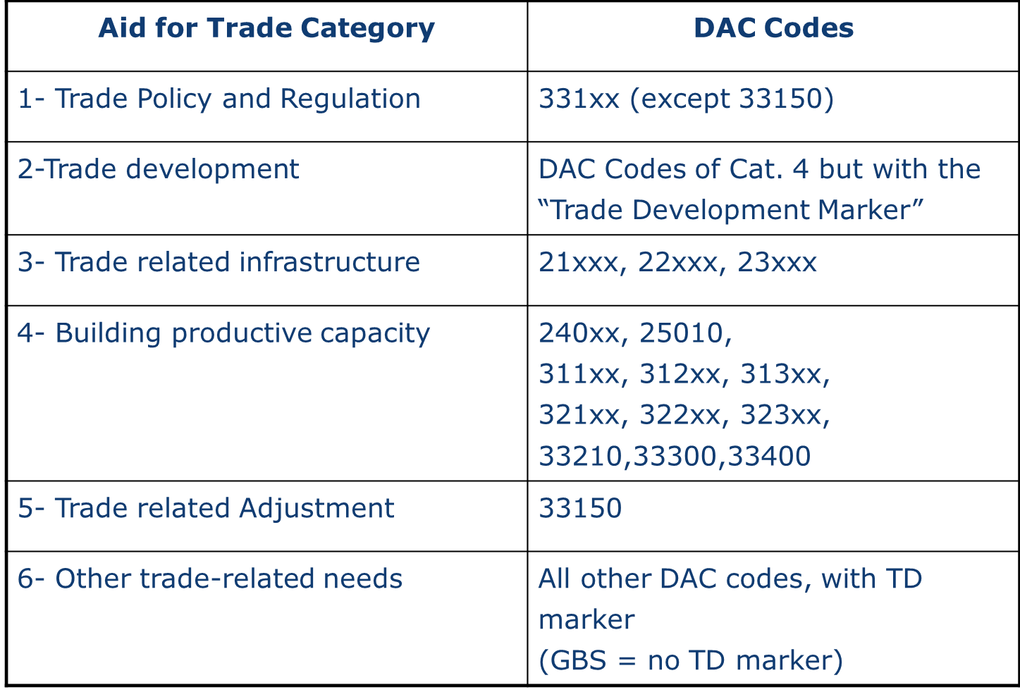
In total, nearly
100 DAC codes
trade policy
trade facilitation
Total Aid for Trade
TRA
transport
« Wider » Aid for Trade
energy
telecom
business, PSD
financial services
forestry
fishing
agriculture
tourism
mining
construction
industry
Notes:
FIRST, LET’S RECALL WHAT IS COVERED UNDER THE CONCEPT OF AFT
SO YOU SEE, IT IS VERY WIDE
1. Technical assistance for trade policy and regulations (pdf). In the CRS, five purpose codes are used to cover "trade policy and regulations" activities, in contrast to the 20 TCBD codes. These five sub-categories are: (a) trade policy and administrative management; (b) trade facilitation; (c) regional trade agreements; (d) multilateral trade negotiations; and, (e) trade education/training.
2. Economic infrastructure (pdf). Aid commitments for trade-related infrastructure are proxied in the CRS by data under the heading "economic infrastructure". This heading covers data on aid for communications, energy, transport and storage. To know how close the CRS proxies are (e.g. how much of the hypothetical energy project relates to trade), the CRS data must be compared with donors' knowledge of the specific features of their infrastructure aid.
3. Productive capacity building (pdf) (including trade development). Data on commitments of aid for productive capacity building exist under the CRS category "building productive capacity". Since the first monitoring exercise, the CRS allows components of a productive capacity building project to be marked (using the "trade development policy marker") as relevant to trade development. It identifies trade development activities within the broader aid-for-trade category of building productive capacity (i.e. activities marked as contributing "principally" or "significantly" to trade development).
4. Trade-related adjustment (pdf). This category identifies contributions to developing country budgets to assist the implementation of trade reforms and adjustments to trade policy measures by other countries, and alleviate shortfalls in balance-of-payments due to changes in the world trading environment.
5. Other trade-related needs. The CRS covers all ODA, but only those activities reported under the above four categories will be identified as aid for trade. Data on "other trade-related needs" cannot be gleaned from the CRS. To estimate the volume of such 'other' commitments, donors would need to examine aid projects in sectors other than those considered so far - e.g. in health and education - and indicate what share, if any, of these activities have an important trade component. A health programme, for instance, might permit increased trade from localities where the disease burden was previously a constraint on trade. Consequently, accurately monitoring aid for trade would require comparison of the CRS data with donor and partner countries' self-assessments of their aid for trade.

Slide 3
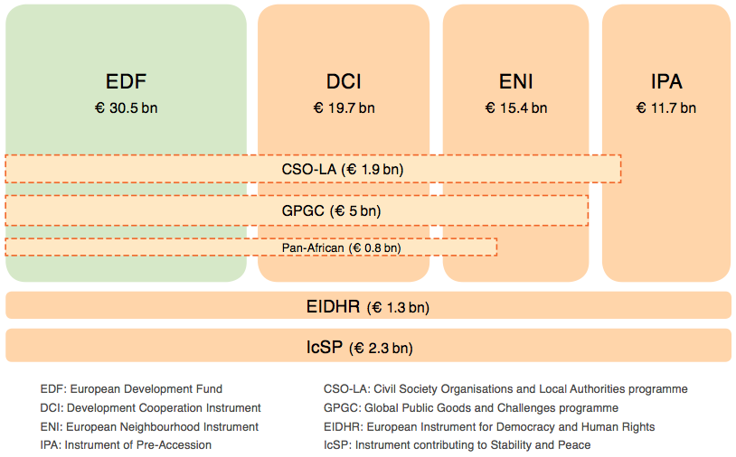
Not a project, not a budget line.
Aid for Trade all accross EU and MS developing instruments
33% falls under the Aid for Trade definition
Member States instruments

Slide 7
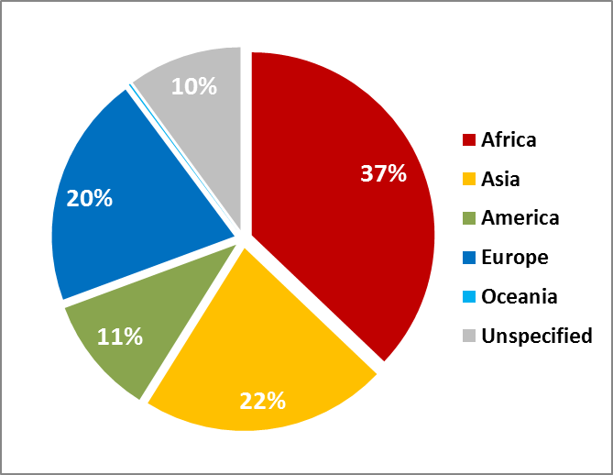
EU Aid for Trade by geography

Slide 9
1
2007 AfT Strategy: A quantitative success, but LDCs still in the margins of international Trade and insudstrialisation
Target | Achievement
TRA: € 2 billion annually by 2010 Major AfT donor | Achieved in 2008 In 2016 → € 3,5 billion AfT in 2016: € 13.5 billion (global leader: >30%)
AfT to LDCs to increase | Relative AfT absorption decreased
> 50% of TRA increase | 64%
General EU/MS progress. Continuous effort.
 | Input-based
1.Increasing the collective volumes of EU AfT
2. Enhancing the pro-poor focus and quality
3. ACP-specific angle
4. Aid effectivness principles
5. Monitoring and Reporting

Slide 10

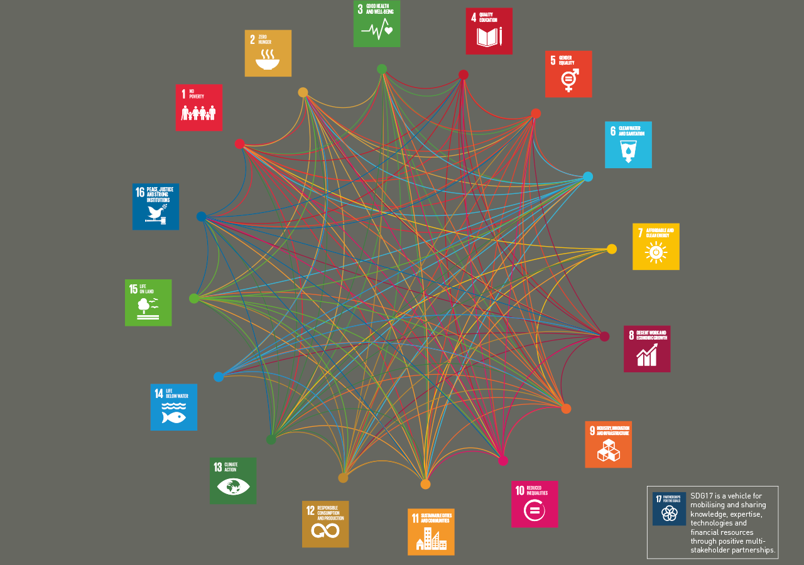
2
Source: International Council of Mining and Metals
Notes:
SO WHAT HAS CHANGED THAT MAKES AN UPDATE NECESSARY
FIRST: A new development paradigm (Agenda 2030): Interdependence of the SDGs, ODA not the only MoI, also Trade

Slide 11
new European Consensus on Development
« Coordinate cooperation programmes with trade policy tools »
« Combine skills and resources of the PS «
« integrated actions that can create co-benefits and
meet multiple objectives coherently »
« Give more prominance to key drivers
with cross-cutting transformative potential »
FTAs, GSP
Private Sector Engagement
Bilateral, regional, blending…
Investment: EIP
Notes:
THE VISION FOR IMPLEMENTING THIS NEW PARADIGM HAS IS BEING TRANSLATED INTO EU POLICY
The New European Consensus on Development provides that the EU and its Member States will
coordinate development cooperation programmes with trade policy tools in support of the implementation of the provisions in trade agreements relating to trade and sustainable development.
combine the skills and resources of the private sector with supportive trade policies and instruments, Aid for Trade and economic diplomacy, which will promote inclusive and sustainable economic growth(…).
It also acknowledges that the 2030 Agenda is highly interconnected and that attention is to be paid to integrated actions that can create co-benefits, giving more prominence to key drivers with cross-cutting transformative potential like investment.

Slide 12
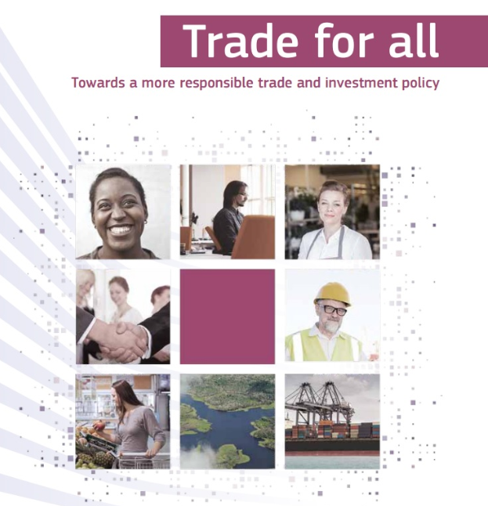
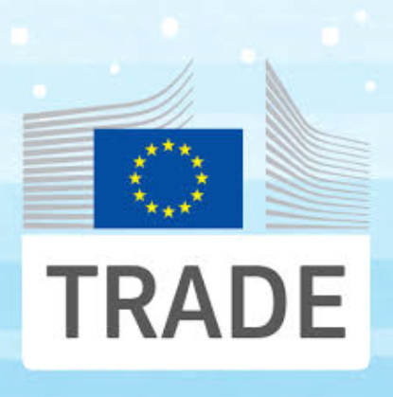
3
Calls for AfT to support Trade and Sustainable Development in EU FTAs, GSP+… including :
Labour rights, environment, CSR, fair and ethical trade, responsible supply chains.
Notes:
SECOND: A NEW EU TRADE POLICY LIVING UP TO EU VALUES, AND CALLING AFT TO ADDRESS ENVIRONMENTAL AND SOCIAL DIMENSIONS OF SUSTAINABLE DEVELOMENT, ALONG WITH ECONOMIC DEVELOPMENT.

Slide 13
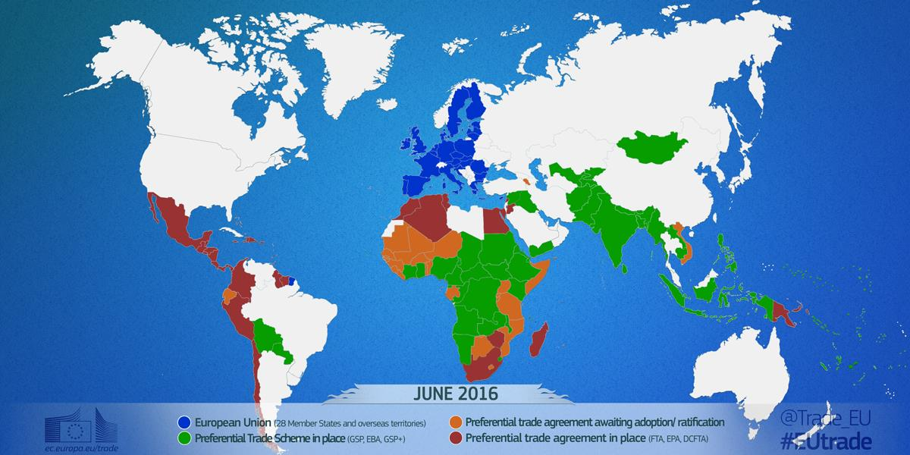
4
Notes:
THIRD GAME CHANGER: THE GROWING NUMBER OF FTAS WITH DEVELOPING COUNTRIES
with preferential trade agreements with 56 developing countries, in force in 2016 or about to be ratified, and more than 80 countries covered by EU's preferential trade schemes (GSP, EBA, GSP+), EU trade instruments are major determinants of EU relationship with developing countries.
They offer ways of combining Aid – FTAs – Investment that were not possible before

Slide 14
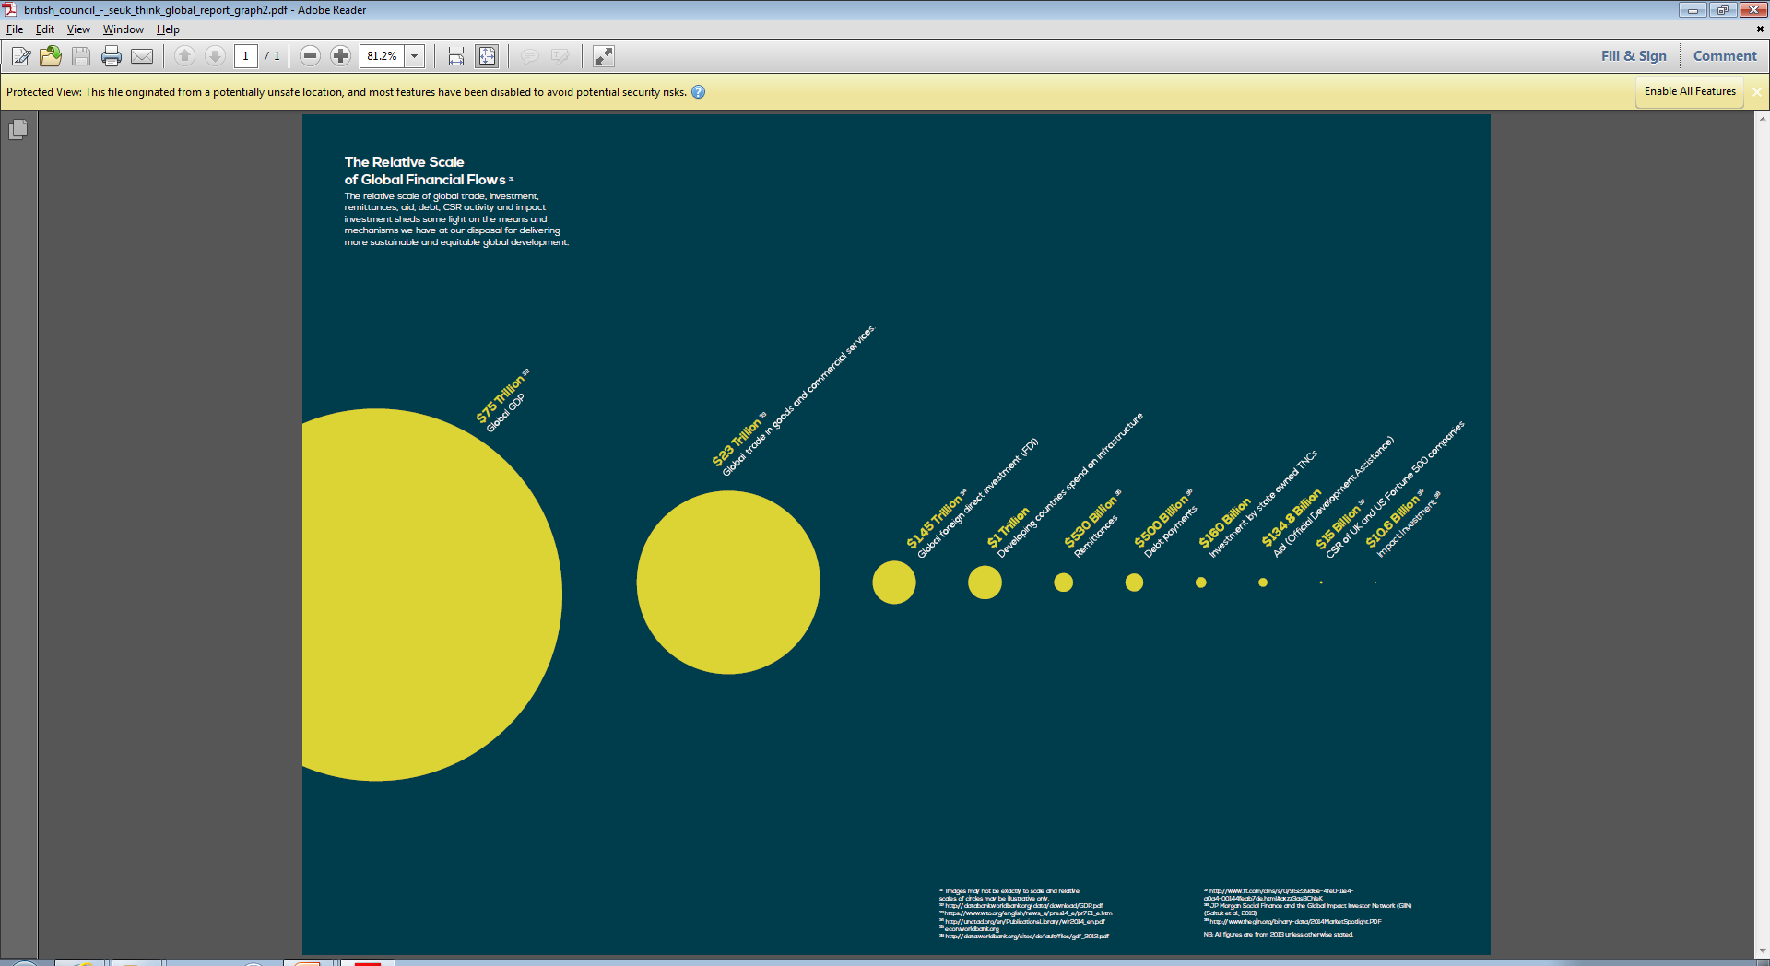

Overarching narrative
impact
AfT
Trade
Aid to better play its catalytic role in unlocking the developmental potential of bigger drivers of inclusive and sustainable growth
(trade, investment, private sector)
Source: The British Council
Notes:
This illustration shows the relative scale of global financial flows sheding light on the mechanisms for delivering sustainable development.
It reminds us that ODA can only be a catalyst in making trade and investment enablers of sustainable development, and that is how the updating of the AfT strategy is being approached.

Slide 15
EU Aid for Trade Strategy
WTO-led
Aid for Trade
Initiative
response
Commission Communication COM (2017) 667
of 13 November 2017
+
Council Conclusions 15573/17
of 11 December 2017

Slide 16
Dimensions of an Updated AfT strategy:
Embracing Inclusiveness and Sustainability
Incorporating inclusiveness and sustainability while addressing the traditional and emerging trade and productive capacity needs.
Reducing fragmentation
Enabling an informed and effective Aid delivery through further interconnection of actors (Private Sector Engagement), policy instruments (such as EU FTAs) through integrated responses (EIP).
A more differentiated approach
Tailoring differentiated approaches
for increased relevance and results
A more dynamic monitoring and reporting
Better assessing and communicating
EU AfT impact and results
Notes:
TO ADDRESS THESE THREE GAME CHANGER AND STEER THE SIGNIFICANT EU AFT TOWARDS Inclusive and Sustainable Economic Growth in line with the 2030 Agenda, THE UPDATING PROCESS COVERS THE FOLLOWING DIMENSIONS
ALTHOUGH THE UPDATING OF THE STRATEGY WILL ALSO LOOK IN TO THE TRADITIONAL TRADE-RELATED TOPICS, THE BULK OF WHAT NEEDS TO BE IMPROVED TO LEVERAGE IMPACT AND RESULTS IS IN THE DELIVERY PROCESS
REDUCING FRAGMENTATION OF OUR AID INSTRUMENTS, OUR POLICIES
WITH COUNTRIES GRADUATING FROM EU AID, AND WITH POOREST AND FRAGILE COUNTRIES STILL STRUGGLING, OUR AFT NEEDS TO DIFFERENTIATE IS APPROACHES: LDCs first need to increase and diversify their productive capacities, enhance infrastructure. In situations of conflict and fragility, Aid needs to prioritise peace-promoting economic development by activating drivers yielding quick socio-economic gains and political inclusion. Support to graduated or more advanced countries shall be articulated around mutual interest drivers like FTA implementation.
Ongoing processes such as DEVCO's Corporate Results Framework, OPSYS and TOSSD should be followed and supported. A new measure proposed and is provisionally entitled: total official support for sustainable development (TOSSD) (Addis Ababa Action Agenda (AAAA) (para 55) and OECD DAC HLM 2014), aiming at better promoting the monitoring and review of resource flows aligned to support the 2030 Agenda

Slide 17
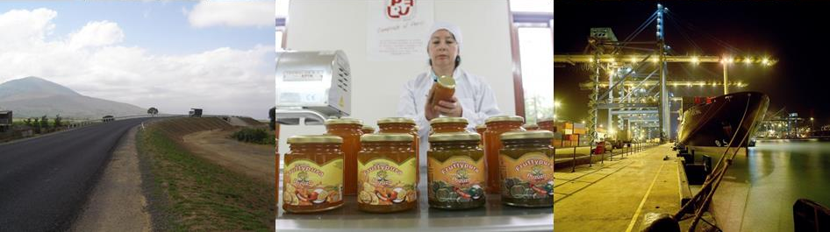
Thank you!

Slide 18
Spare slides

Slide 19

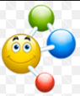
Gathering intelligence on the developmental opportunities offered by FTA/GSP
LOCAL PRIVATE SECTOR / Government Authorities
DG TRADE
DG AGRI
DG SANTE
…
EU integrated response combining EU instruments (bilateral, regional, blending → EIP)
Scaled-up impact
AfT
FTA
Notes:
SO HOW TO GO ABOUT THESE THREE GAME CHANGER AND STEER THE SIGNIFICANT EU AFT TOWARDS Inclusive and Sustainable Economic Growth in line with the 2030 Agenda?
ALTHOUGH THE UPDATING OF THE STRATEGY WILL ALSO LOOK IN TO THE TRADITIONAL TRADE-RELATED TOPICS, THE BULK OF WHAT NEEDS TO BE IMPROVED TO LEVERAGE IMPACT AND RESULTS IS IN THE DELIVERY PROCESS
Gathering the necessary intelligence for an informed Aid delivery (programming and implementation)
If you have an FTA, do you participate in Sub-Committees?
If you have a GSP, do you link EU support to helping the partner country seize market access opportunities offered by GSP?
3. Integrated EU response
Combining the EU intruments (bilateral, regional, blending, etc)

Slide 20
Why?
New opportunities
for Development policy
for a more strategic use
of FTAs
as drivers for sustainable economic development
result from a negotiation
mutual interests
The EU has concluded more FTAs with developing countries than ever before
binding nature
higher leverage for reform
business expectations to seize opportunities
prioritization, incentives for reform and investments
A concrete denominator for coherence and integration of EU instruments/response
Increased impact
Notes:
39 FTAs
90 countries covered by GSPs

Slide 21
DISCUSSION
 | EPA/FTA | EBA/GSP | EDFIs | PS
Addressing trade and productive capacity needs in your DEL | To what extent is your AfT able to help your host country seize market access opportunities offered? |  | To what extent is your AfT able to combine with blending or EDFI’s interventions to provide integrated responses? | To what extent is your AfT dialogue with Government fed by PS needs?
Aid (AfT)
PS
Investment
Trade
Notes:
I would welcome having your views on the following, both in terms of challenges and good stories…
…….
We are aiming at finalising a SWD for during this Semester. The Council might then wish to issue conclusions that will complement the joint nature of the updating.

