Slide 1
Experience in Supporting the Highland Water Forum in Jordan
21 March 2011

Slide 2
Background
Depletion of Amman-Zarqa and Azraq aquifers
Growing competition for scarce water resources
Highland agriculture increasingly under pressure from within Jordan and from donor side

Slide 3
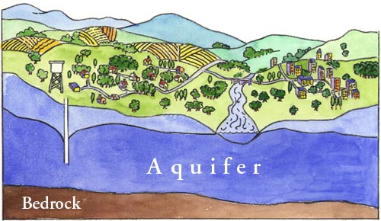
Rationale for stakeholder involvement
Groundwater aquifers are Common Pool Resources

Slide 4
Rationale for stakeholder involvement
Groundwater aquifers are common pool resources and need appropriate institutional arrangements to be managed sustainably
Stakeholder participation is essential for the sustainable management of common pool resources
Evaluations of the situation in the Highlands show that stakeholder participation is one most important lever

Slide 5

Objective
HWF aims to contribute to the MWI groundwater “roadmap” for sustainable groundwater management
  Timeframe is 2011-2013
  Describes activities, measures, and milestones
  Defines activities to be implemented in the Highlands area,
  Bottom-up: elaborated
  together with the
  stakeholders.

Slide 6
Organisational Structure
3
Royal Water Committee /MoWI
align:
monitoring
activities, approves and allocates funds
Steering Committee (MoWI, WAJ, MoA, RWC, 1 Fund representative)
mandate
1
Highland Water Forum
(60 key stakeholders, MoWI, WAJ, MoA)
2
5
Advisory Board (universities, NGOs, think tanks, donors, etc.)
link and support:
makes proposals, provides input to the work of the Forum
finance:
provides funds for implementing
the roadmap
Highland
Water Fund
(donor: GTZ, KfW, USAID, WB, EU, etc.)
facilitate:
prepares background information, elaborates proposals of the Forum, commissions studies, provides technical support
4
Highland Water Secretariat

Slide 7
Steps of Stakeholder Involvement
A. Prepare
Stakeholder Analysis
    Applying state-of-the-art tools (e.g. Social Network Analysis) to find out:
    Who are the key stakeholders in the agricultural sector?
    How does the stakeholder network look like? How can it be utilized to mobilize stakeholders?
Stakeholder Selection
    Select key stakeholders from the agricultural sector
    Select stakeholders from other sectors (urban water demand, industry, environmental protection)

Slide 8
Steps of Stakeholder Involvement
B. Operationalise
Institutionalize: Establish an institution for a stakeholder dialogue on the problem of groundwater over abstraction in the Highlands (➔Highland Water Forum)
Facilitate: Provide technical, scientific and financial support for the work of the Highland Water Forum (➔Highland Water Secretariat)
Link: Ensure involvement of universities, NGOs, think tanks, donors (➔Advisory Board)
Align: Ensure compliance with the objectives of the Water Strategy and other policies (➔Steering Committee)

Slide 9
Steps of Stakeholder Involvement
C. Sustain
Implement: A practical roadmap, including milestones, activities and impact indicators will allow for practical implementation
Finance: Engage donors to assure sufficient funding for roadmap implementation (➔Highland Water Fund)

Slide 10
Stakeholder Analysis
  Who are the key stakeholders in the agricultural sector?
  How to make sure, that all stakeholders are represented in the dialogue?
  Who are groundwater stakeholders from other sectors (urban water demand, industry, environmental protection)?

Slide 11
Stakeholder Analysis
Field interviews with 214 farmers in the wider Azraq Basin area
2 teams of 6 people for 2 months
Statistical Analysis
Result: 20 farmers representing most other farmers in the highlands
Method: Social Network Analysis

Slide 12
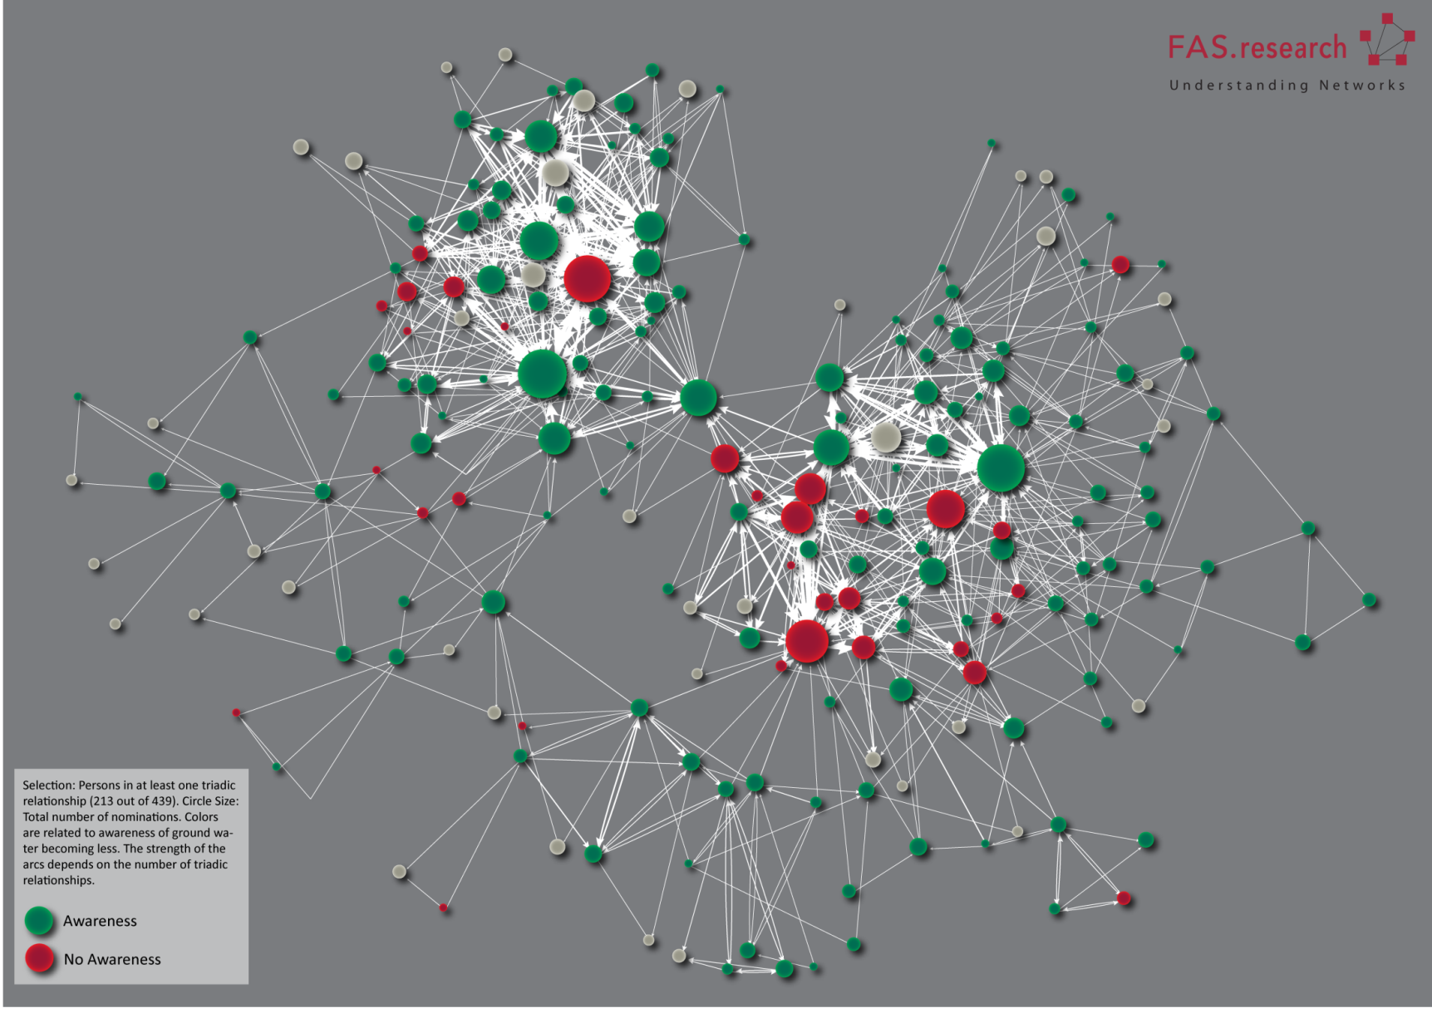
How are they connected?
Who are their representatives?
Network example from the Social Network Analysis

Slide 13
Results allow for:
A fair and balanced stakeholder selection
Representation of most farmers in the highlands through the Forum members
A transparent and scientifically proven selection procedure
An effective and efficient dialogue process

Slide 14
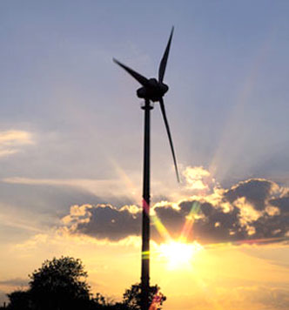
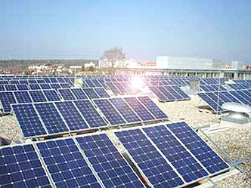
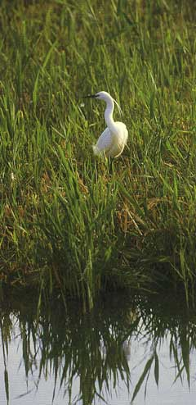
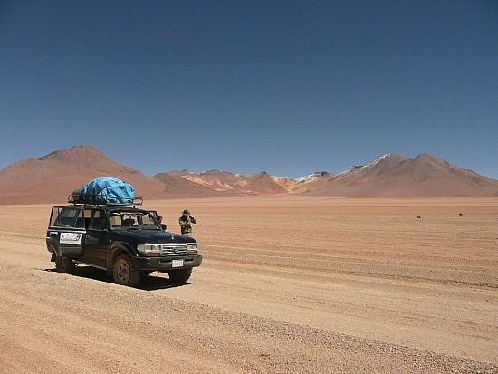

Action Plan
Follows a strategic programme approach that goes beyond disconnected projects
Mainstreams best-practices with the overall goal of overcoming groundwater depletion and developing ways of sustainable resource management.

Slide 15
The goal is to reach the safe-yield
i.e. the current groundwater abstraction needs to be reduced by approx. 200%
Impact
Impact
Inducing Change
Target Group:
Water-governing institutions
Rewarding Efforts:
Target Group:
Water users (esp. farmers)
Fund:
instruments to encourage and implement change
Activities:
Set up a cross-sector committee for data collection and management
Cooperate with Environmental Rangers
Support well-closing procedures
Etc…
Finance activities
Finance activities
Activities:
On-farm water efficiency
Alternative Income Opportunities (energy, tourism)
Open pillar for community based initiatives
Stakeholder Dialogue:
instrument to ensure social acceptance
Recommend
Recommend
Activities:
Facilitate dialogue rounds
Ensure communication between decision-makers and dialogue
Contact donors / set up donor highland task force
Elaborate general concept (structure of Fund)
HWF Secretariat

Slide 16
Benefits of this approach
Comprehensive approach, not individual projects
Stakeholder engagement and participation
Alignment with Jordanian Water Strategy
Following principles of Paris Declaration and Accra Agenda for Action
Has been endorsed by Royal Water Committee, Prime Minister Office issued order to align involved ministries

Slide 17
Next steps
Engage the stakeholders in regular meetings to contribute to the Action Plan
  Elaborate Policy Recommendation papers,
  Facilitate meetings and field visits
Elaborate Azraq Action Plan with clear timelines, milestones and activities
  Complement MWI strategy and actionplans
Establish the Highland Water Fund
  In close consultation and cooperation of donors of the Jordanian water sector,
  Upcoming workshop in Mar 2011.

