Slide 1


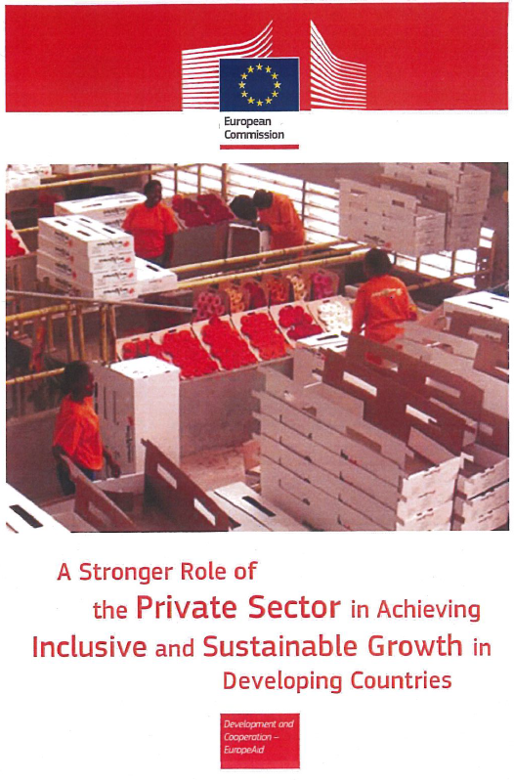
Private sector in EU aid policy
Decent job creation
PS mainstreaming
Women, Youth, HR
Diagnostics and results measurement
2017
Aid for Trade
2018
Towards a more efficient financial architecture for investment outside the EU
2018
A new Africa – Europe Alliance for Sustainable Investment and
Jobs
2017
EU Communication
"For a renewed impetus of the Africa-EU Partnership"
2017
New Consensus
on Development
2016
Global Strategy on Foreign and Security Policy
2015
Addis Ababa declaration
on financing
for development
2015
UN Paris Agreement on Climate Change
DRM
Billions to trillions…
2016
Commodities
Super Cycle
Low
2015
Trade for All
2014
A Stronger Role
of the Private Sector
ODA limits
Inequality/Poverty
Demography
Climate Change
Trade/GVCs
Digitalisation
Geopolitical
2015
Europe Migrant Crisis
2011
Agenda for change
2008
Financial Crisis

Slide 2

Jobs for poverty reduction
Private Sector as a Partner
Market Development approach
Structured Dialogue (HQ & Del)
Systematic Public Private Dialogue
Blended finance (to continue)
Leverage on-going process
EU's role in global governance

Slide 3
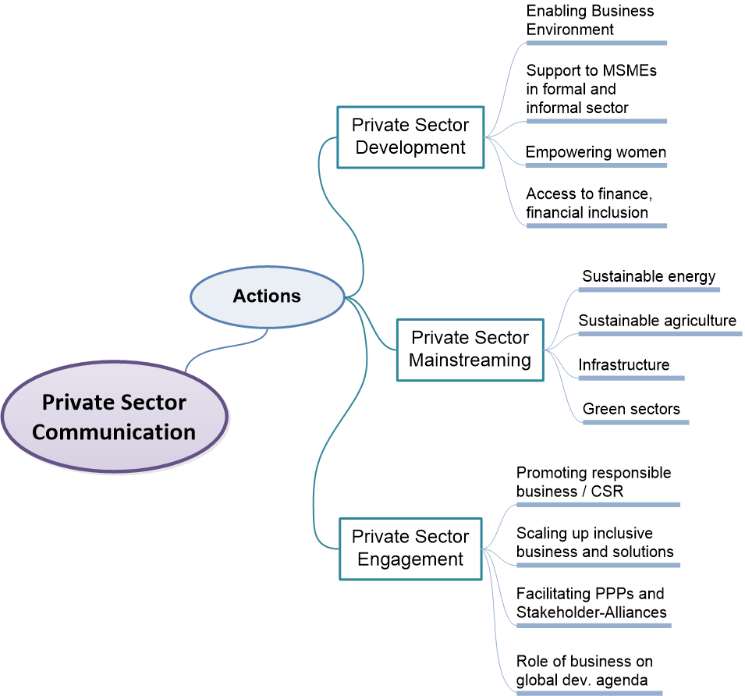
Actions on PSD and PSE
Private Sector Communication
Actions around Private Sector

Slide 5
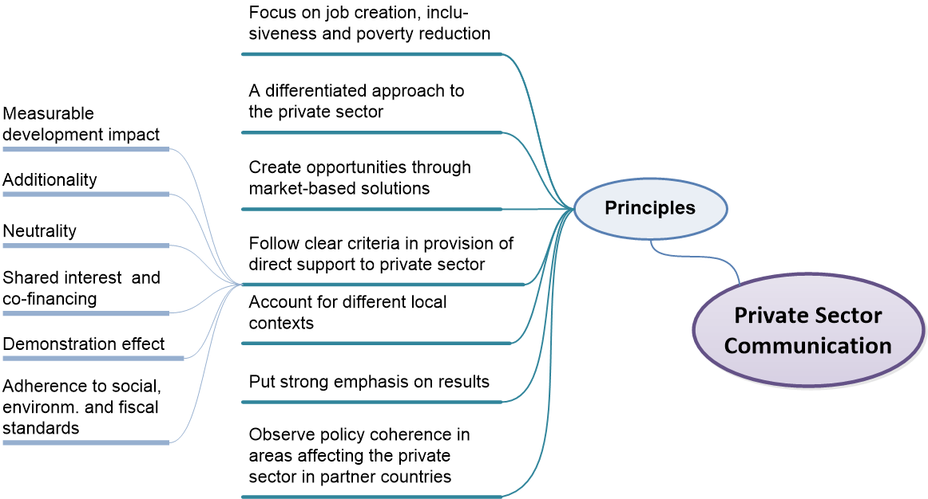
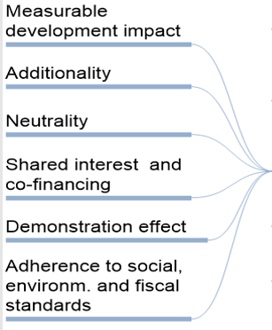
Private Sector Communication
Principles & Criteria for Private Sector Support
Notes:
5
DEVCO C4
5

Slide 6









Higher exposure/'specialization' of EU teams on the ground with key private and political economy actors in a specific economic setup/sector ('political economy' including fragile states).
EU 'ownership' of the 'key messages' from existing diagnostic studies (economic climate, investment, business financial, sectoral issues, trade etc.).
Sector specific knowledge is better framed with understanding of dynamics around investment climate, business enabling environment, value chain contexts and processes;
Better understanding/systematic (and political) follow up of crucial links of the policy and regulatory environment.
Higher visibility towards outside parties regarding the Delegation's role as a knowledgeable broker of trade and private sector dynamics.
Better insight and advice regarding links between trade, investment, private sector and economic growth with youth employment, gender, sustainable jobs.
More 'surgical' design of where the mobilization of EU resources provide max. leverage for the partner country, its institutions, markets and society (sectors, Aid4trade, budget support).
Support greater visibility and communication of what EU stands for and how it acts in support of Agenda 2030 principles.

Slide 7
brain functions
Lack of clarity on what is expected as 'end game' (EIP input, programming, PCD etc) from structured dialogue, demarcation of boundary conditions for private sector engagement.
Restrictions from mandate/mission statement of the Delegation, job descriptions, day to day workload priorities and resource availability
Availability of flexible financial and technical resources for 'structured dialogue'.
EU ownership and synthesis of existing diagnostic studies (economy, financial, sectoral, trade etc.)
Cooperation/collaboration with EU MS, IOs etc.
Parietal lobe
frontal lobe
intelligence
reasoning
language
sensation
movement
intelligence
reasoning
personality
occipital lobe
temporal lobe
vision
speech
behavior
vision
hearing
cerebellum
brain stem
balance
coordination
hormones
fertility

Slide 9
70. Successful implementation also requires forging stronger partnerships beyond
governments. The EU and its Member States will expand partnerships with the private sector, civil
society, including trade unions and employers' organisations, multilateral organisations, academia,
diaspora groups and others. They will continue to support capacity building of relevant stakeholders.
72. The EU and its Member States recognise the key role of the private sector as an engine for
long-term sustainable development and the need to engage with them through structured
dialogue and shared development objectives. The EU and its Member States will develop practical
partnership arrangements that are collaborative, transparent and open for business and other
stakeholders' participation. They will support sustainable and ethical business practices and create
incentives for private sector investment in global sustainable development.

Slide 10
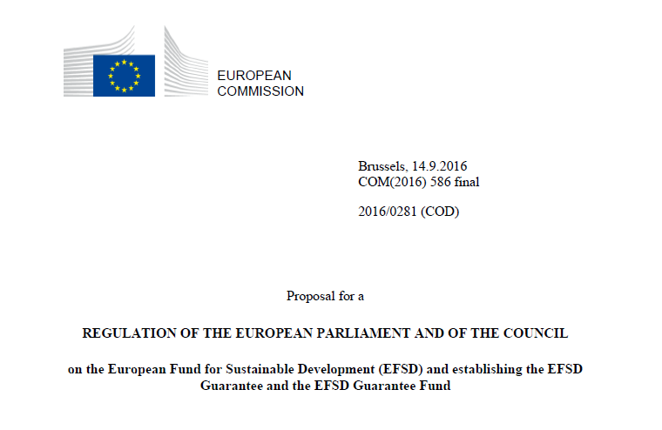
(P.2 1 & P. 26)…..and finally a range of dedicated thematic, national and regional EU development cooperation programmes combined with structured political dialogue targeted at improving the investment climate and overall policy environment in the countries concerned (pillar 3)….

