Slide 1
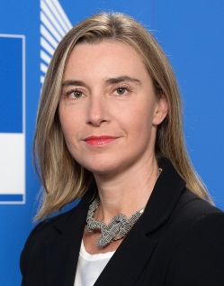
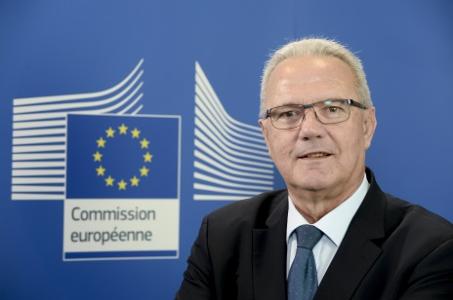
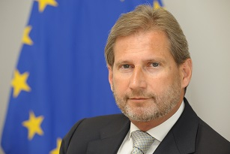
Why we act?
"Less than 10 per cent of Foreign Direct Investment in Africa goes to fragile regions – those that need it the most. We want our External Investment Plan to become a powerful engine of more inclusive and sustainable growth."
Federica Mogherini
High Representative of the Union for Foreign Affairs and Security Policy
/ Vice-President of the Commission
"Our External Investment Plan marks a new approach for eradicating poverty and achieving inclusive sustainable development. By leveraging in particular private finance, our contribution of €4.1 billion will leverage up to €44 billion of investments which otherwise would not happen."
Neven Mimica
Commissioner for International Cooperation and Development
"It is in Europe's own interest that we all work to ensure sustainable and balanced economic growth in our partner countries. Involving the private sector and securing the most conducive environment for it to thrive will support these efforts."
Johannes Hahn
Commissioner for European Neighbourhood Policy and Enlargement Negotiations
#EIP #InvestGlobal

Slide 2
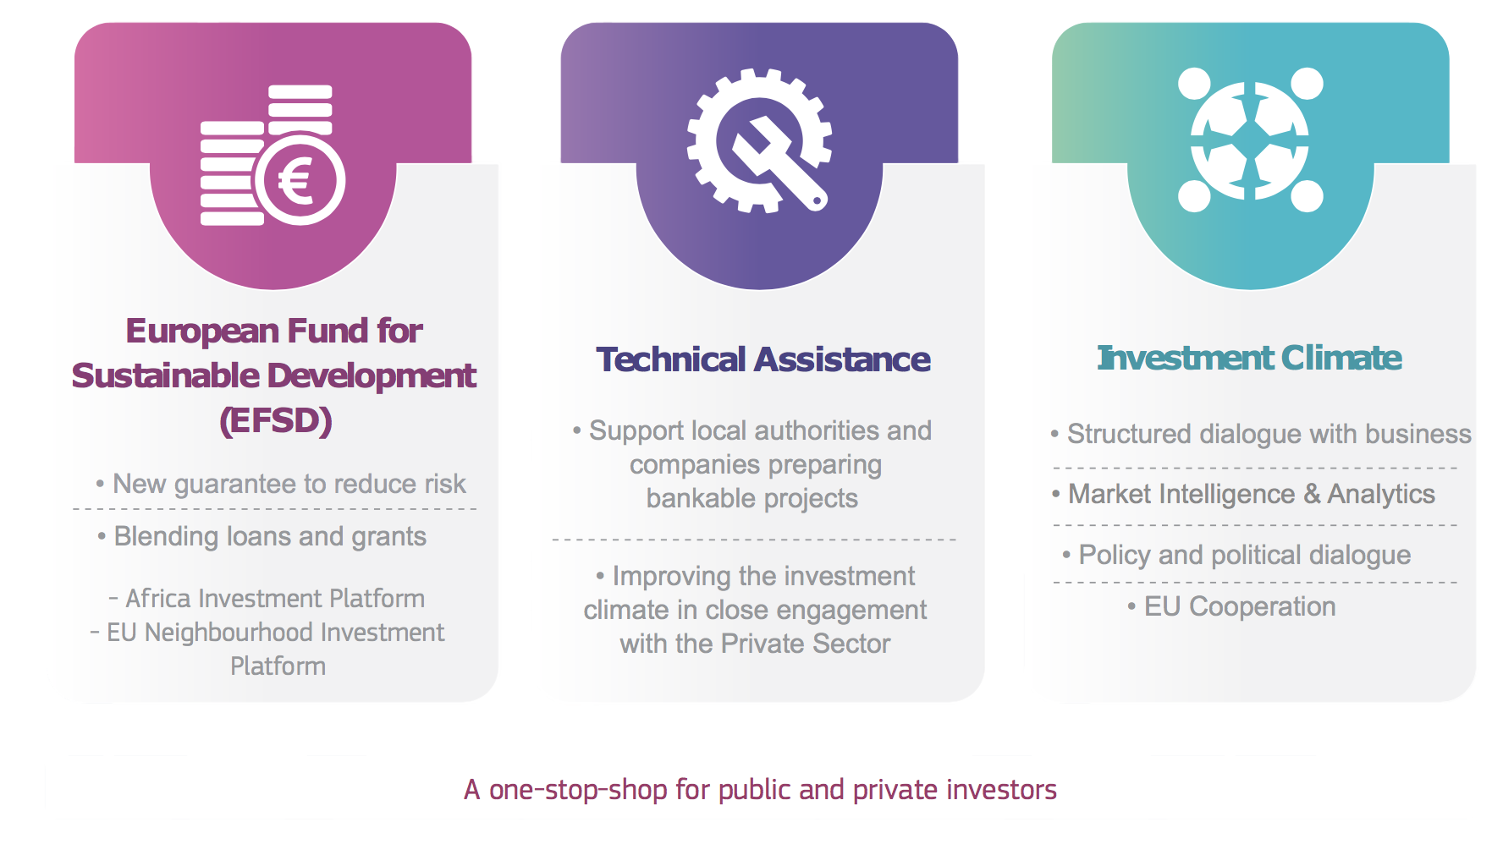
Notes:
The External Investment Plan was adopted on 28 September 2017.
It is based on three pillars working hand in hand: (1) the new European Fund for Sustainable Development (EFSD); (2) stepping up technical assistance, and (3) supporting reforms and economic governance to improve the investment climate and business environment.
It is promoting job creation to enable young jobseekers to make a living in their country of origin, so to alleviate some of the root causes of migration.
The External Investment Plan provides for the first time a specific, coherent framework to promote investment,
…and is leveraging up to EUR 44 billion of financing from Financing Institutions (FIs) and the private sector.
Provides a specific, coherent overall framework to promote investment, leveraging funds from the EU, its Member States (MS) and other donors and financing from Financing Institutions (FIs) and the private sector.
in our partner countries, by building on our country and regional-level political and policy dialogue, on EU cooperation instruments and by providing analysis on investment constraints, with our Delegations in the lead. This pillar will ensure synergies with relevant EU external actions and policies, such as on good governance, migration, economic diplomacy and Economic Partnership Agreements as well as coordination with other partners' interventions, in particular Member States.
A dedicated web portal will be operational shortly. It will serve as 'one-stop-shop' to those interested in being involved with the EIP. The web portal will be the first point of entry for requests to access the EFSD and technical assistance and it will also provide information on ongoing actions under EFSD in Africa and the Neighbourhood.

Slide 3
Connecting the dots Solar energy in Nigeria
Potential EIP funded blending operations:
100MW PV solar plant in Bauchi State
1GW PV solar plant in Jigawa State
95MW PV solar plant in Katsina State
Nigeria Energy Support Programme (NESP)
EU vehicle for addressing investment barriers in renewable energy
Implementation by GIZ
Supports development of competitive bidding mechanism for renewable energy
Support to market development and business models
Energy Platform of Nigeria (EPoN):
Dialogue forum on renewable energy policy reform
Involves Government, industry and development partners
Supported by NESP
Identifies bidding mechanism as constraint to investment in solar sector
Notes:
An example of “connecting the dots”
- Investment with potential blended operations, that can be increased through the EFSD Guarantee (new EIP tool) Investment Pillar 1
Nigeria Energy Support Programme (NESP) is TA Pillar 2
Energy Platform of Nigeria is a structured public-private-donor dialogue for IC reform Pillar 3

Slide 4
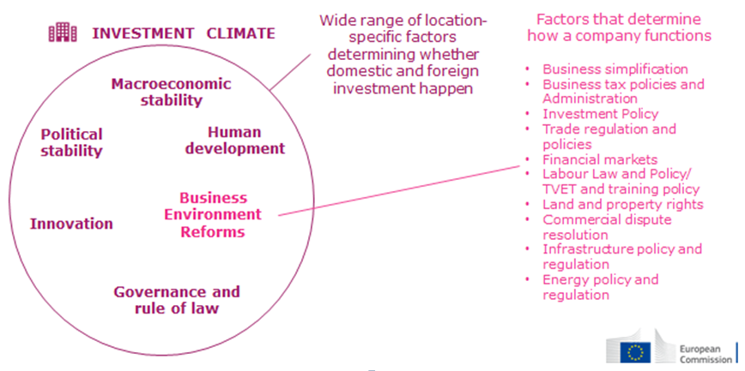

Slide 5
Delegations steer the EIP at country level
.Existing diagnostic sources
.Jobs and Growth Compacts
Country analysis
Expand scope of policy dialogue
Structured dialogue with the private sector (SB4A)
Public / Private dialogue
Investment climate policy reforms
.Present the EIP and its philosophy on IC and BEE
.Involve Gov. Partners (NAO, key Ministries…)
.Adapt and streamline IC/BEE reform agenda in EU cooperation portfolio
Sustainable Business for Africa platform (SB4A): structured dialogue with PS
Identify key PS constraints
.Leverage dedicated structures (EUCCs)
.Promote and broker wider investment partnerships
.Facilitate PP dialogue to improve IC and .BEE along identified priority reforms
Notes:
Delegations are at the core of Pillar 3, and in particular the implementation of SB4A, they ensure the whole process is consistent and monitor and evaluate it (more on M&E later)
1. Country analysis
Use existing diagnostic sources from other international organizations (WB Group, IMF, UNCTAD, UNIDO, ITC…), analysis developed during the formulation and implementation of budget support programmes, actions in support of the focal sectors, political and trade reporting...
Jobs and Growth Compacts are good syntheses detailing:
Policy and regulatory framework for PSD and investment
How EU support will target this framework
VC and job-creating sectors diagnostics and opportunities
Dialogue with EU MS, EU business and local private sector (Implementation of SB4A)
EU ongoing support to PSD, VC and BE and possible future “EU response to foster job creation and industrialisation
2. Expand the scope of the on-going policy dialogue with the partner country with more emphasis on presenting the EIP and its philosophy around supporting the Investment Climate (IC) and Business Enabling Environment (BEE).
3. Develop the Structured Dialogue with the Private Sector
4. Reinforce Public Private Dialogue for Investment Climate / Business Enabling Environment and broker wider investment partnerships
5. Explore ways to adapt and streamline the IC/BEE reform agenda in your cooperation portfolio and daily work.

Slide 6
Structured Dialogue with business: SB4A – Theory & Practice
Inputs
Outputs
Facilitated by EU Delegations
Our analytical basis:
Jobs&Growth Compacts,
Value chain mapping, investment climate studies, etc.
(SB4A Guidance note:10 key elements)
Sustainable Business for Africa
SB4A:
Identify key investment constraints together
Get business perspective
Test your analyses and proposed solutions
New ideas & opportunities
Create ownership for action
Build partnerships
…
Better informed Political Dialogue
Prioritised and targeted actions to attract private investment
Improved analysis to support competitiveness
Feedback on reform needs
Possibility to refine strategies
Information on market and value–chain opportunities
Joined-up approaches
…
Local and EU
Business
Other analyses: WBG, UN, ITC, other IOs, IFIs, WEF, CSOs,…
Country Government
(from the beginning)
Country's strategies:
Development, Investment, Industrialisation, SMEs, Innovation…
Plug-in: WBG, IOs, Member States, CSOs,,
Meso-level actors, other actors …
Notes:
A reminder of the structure. The course will detail Pillar I and Pillar III elements.
Remind that they work hand in hand and that TA serves both.

Slide 7
https://ec.europa.eu/commission/external-investment-plan_en
Notes:
How can businesses engage in the EIP?
Through eligible (pillar assessed) Intermediary Financial Organisations in order to access the new guarantee and the investment support through regional investment platforms.
Structured private/public dialogue to identify and remove key constraints to investment.
One-stop-shop and web portal will ensure a single entry point.

