Slide 1
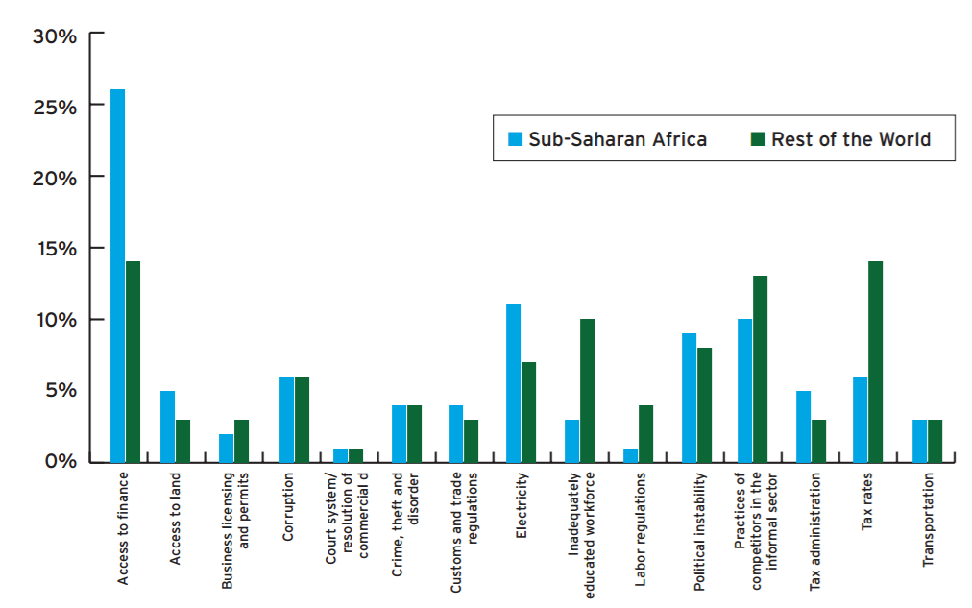
Access to Finance
The main challenge for enterprise development

Slide 2
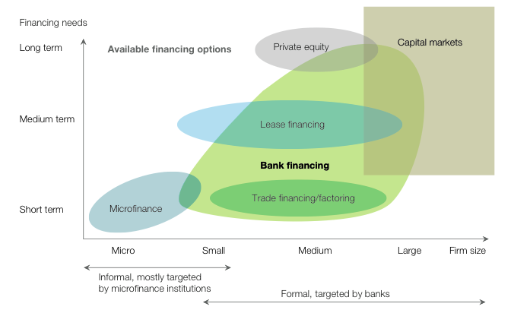
Access to Finance
Different needs, different products, different providers
Notes:
DIFFERENTIATED APPROACH
SIZE, STAGE OF GROWTH, FORMAL OR INFORMAL

Slide 3
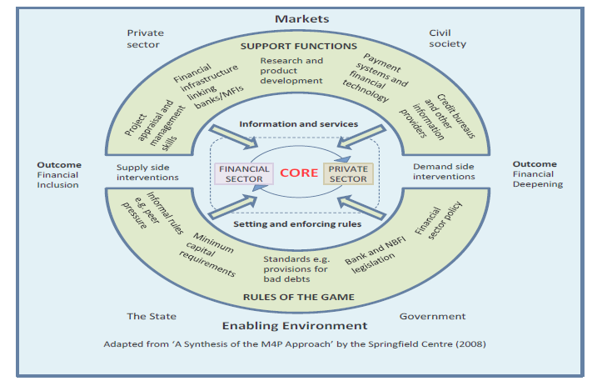
Access to Finance
What can a donor do?

Slide 4
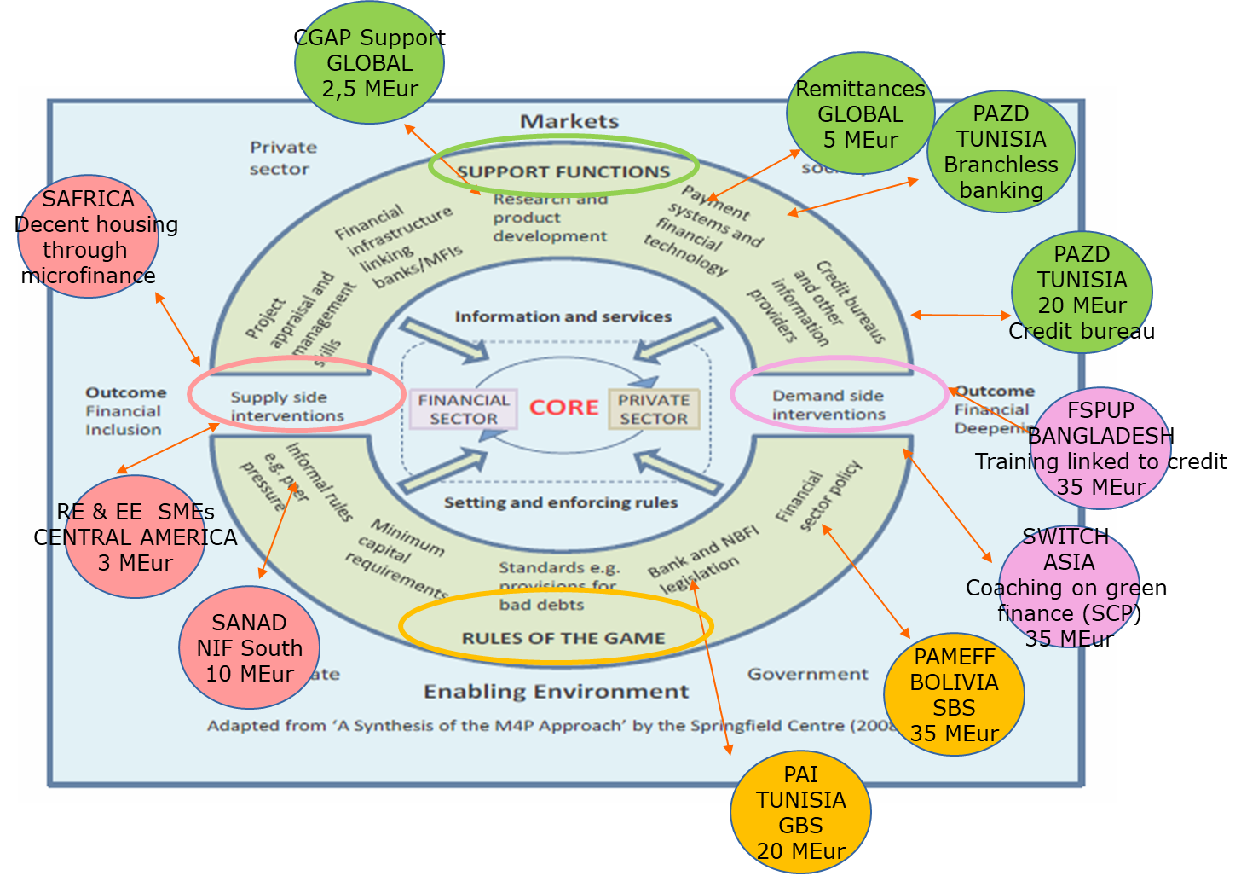
Access to Finance

