Slide 1
Private sector in EU aid policy
2017
Aid for Trade
2018
Towards a more efficient financial architecture for investment outside the EU
2018
A new Africa – Europe Alliance for Sustainable Investment and
Jobs
2017
EU Communication
"For a renewed impetus of the Africa-EU Partnership"
2017
New Consensus
on Development
2016
Global Strategy on Foreign and Security Policy
2015
Addis Ababa declaration
on financing
for development
2015
UN Paris Agreement on Climate Change
2016
Commodities
Super Cycle
Low
2015
Trade for All
2014
A Stronger Role
of the Private Sector
2015
Europe Migrant Crisis
2011
Agenda for change
2008
Financial Crisis
Notes:
These elements (need for investment to attain SDGs and tackle jobs deficit / migration issues in Africa) are incorporated in the EIP, and that stems from progressive policy evolutions.
The EIP comes as the final product of an evolution that includes a series of external events and paradigm shifts, that are reflected in a series of policy documents.
The overall developmental agenda is reflected in the SDGs. One key difference with the MDGs is that those were to be attained primarily through the ODA, while the SDGs represents a much more ambitious goal (and more expensive-from billions to trillions-) that can only be attained by mobilising all other financial flows available.

Slide 2
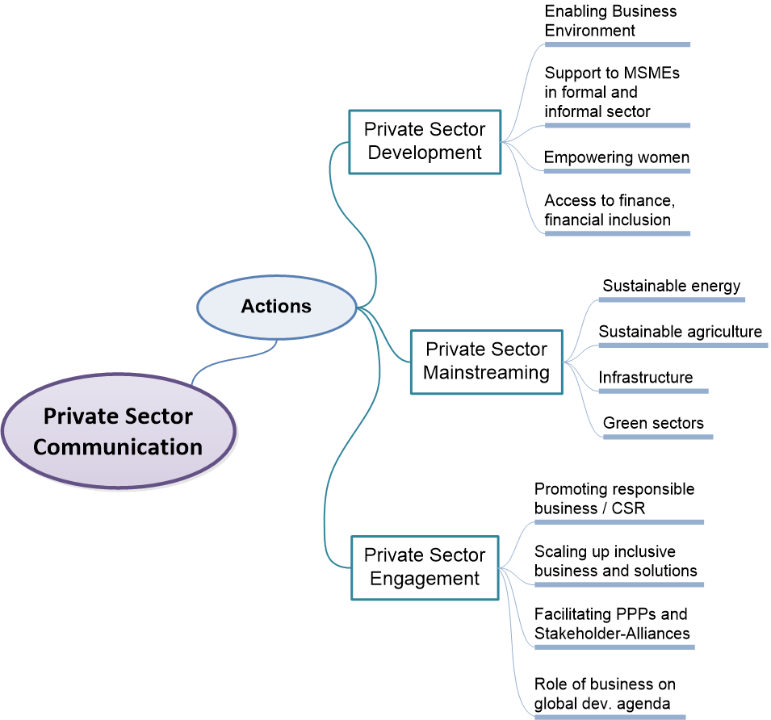
Actions on PSD and PSE
Private Sector Communication
Actions around Private Sector

Slide 3
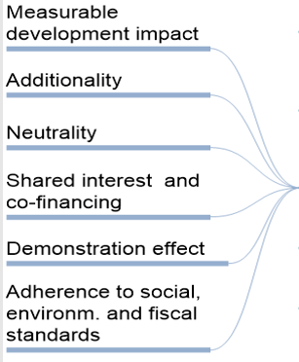
Private Sector Communication
Principles & Criteria for Private Sector Support
Notes:
3
DEVCO C4
3
The Communication proposes a framework of principles and criteria that can guide any institution – in Europe and beyond – in its approach to support of private sector operations and engagement for development.
We believe that such a common framework can help to enhance the effectiveness and development impact of our engagement with the private sector by increasing clarity and transparency on roles, expectations and accountabilities in public-private collaboration, and can contribute to better coordination of private sector development support programmes and partnership initiatives.
The principles are therefore meant to guide the engagement of the EU and Member States with private sector actors to ensure that development and commercial objectives are aligned in mutually reinforcing ways
In fact, we already apply many of these principles in our engagement with, and support of, the private sector. For instance, in the framework of the intra ACP MF programme.
[… if asked]
Further criteria apply to the provision of direct support to private sector actors.
Clear criteria have to be assessed and applied in all decisions when, as a public donor, we give direct support to a private enterprise or a financial intermediary in the framework of our external aid programmes (through direct grants or subsidised business development services, or in the form of guarantees, insurance or concessional finance), in order to:
guarantee development impact and sustainability:
avoid market distortions
Mitigate reputational and fiduciary risks of the EU, as a public donor
At the end we want to show the added value of the intervention for development when working with a private actor.
These criteria are necessary tools to make an overall assessment of the intervention.

