Slide 1
Business Environment and Investment Climate
INVESTMENT CLIMATE
Legal, regulatory, policy and institutional frameworks
Business registration
Business tax policies and administration
Investment Policy
Trade regulation and policies
Financial deepening
Labour Law and Policy/ TVET and training policy
Land and property rights
Commercial dispute resolution
Insolvency
Overall regulatory quality
A wide range of location-specific factors determining whether domestic and foreign investment happen
Innovation
Business
Environment
Political
stability
Macroeconomic stability
Governance and rule of law
Human development
Notes:
Clarification of the terms.
To help understand the diagnostic and reform tools later.

Slide 2
Tools for analysis and reform
Jobs and Growth Compact
Policy and regulatory framework for PSD and Investment
Value chains and job creating sectors
Dialogue with member states, EU business and local PS
EU on-going support to PS and possible future EU response
Notes:
The Jobs and Growth Compact (exercise required by the Geo Units for each EUD) describe the situation of a country in terms of:
Policy and regulatory framework
Key value chains and job creating sectors
How is the dialogue
HANDOUT Tanzania J&B Compact
Explain
which sectors and value chains have the highest potential for job creation and economic growth in the country
what are the key constraints to target and unlock the potential (access to energy, access to markets, value chains development, business enabling environment, regulatory framework)
how to address these challenges effectively with an integrated multi-sector approach targeting in parallel enabling and backbone sectors, economic capacity and policy constraints
how can the EU support the development of such integrated approach in 2017-2020
QUESTIONS. Is it useful, what challenges do you have to face to do it, time, ressources, lack of info….

Slide 3
Tools for analysis and reform
EIP Pillar III Action Plan
I - Investment Climate analysis
Positive factors and opportunities -- Challenges
II - Investment Climate actions
Challenges discussed in policy dialogue with the government
State of play of Structured Dialogue with business
Ongoing Pillar III Actions
Linking IC with Pillar III Actions
III - Action Plan
IC Driver -- IC Challenge identified -- Description of Priorities
Notes:
The Jobs and Growth Compact (exercise required by the Geo Units for each EUD) describe the situation of a country in terms of:
Policy and regulatory framework
Key value chains and job creating sectors
How is the dialogue
HANDOUT Tanzania J&B Compact
Explain
which sectors and value chains have the highest potential for job creation and economic growth in the country
what are the key constraints to target and unlock the potential (access to energy, access to markets, value chains development, business enabling environment, regulatory framework)
how to address these challenges effectively with an integrated multi-sector approach targeting in parallel enabling and backbone sectors, economic capacity and policy constraints
how can the EU support the development of such integrated approach in 2017-2020
QUESTIONS. Is it useful, what challenges do you have to face to do it, time, ressources, lack of info….

Slide 4
Tools for analysis and reform
Business Environment Reform Toolkit: Leveraging Existing Data
Pre-Diagnostic Phase: Determine scope of diagnostic
What Level (regional, national, local, sectoral)?
Research
Review available global data, indices and reports
Stakeholder Consultation
Key informant interviews with public and private sector stakeholders
Developing Recommendations
Which functional areas of policy / regulation?
Which Cross-cutting issues?
Conduct country level research
Focus groups
Meetings with other donor partner programmes
Analysis of each functional area of policy / regulation
Preliminary recommendations for interventions
Apply available tools and other resources for functional / technical areas
Notes:
No new data collection—this is about combining existing data and reports with in-country stakeholder consultation. BER toolkit is currently being developed. We will be presenting BER in more detail this afternoon.

Slide 5
Tools for analysis and reform
Business environment reform defined
Business Environment: 1 of the 6 elements of the broader Investment Climate
Business Environment Reform (BER): “Policy, legal, regulatory and institutional reforms to improve the functioning of markets and reduce transaction costs and risks associated with starting, investing in, operating and closing a business” (World Bank)
BER can and should take place at multiple levels:
Regional
National
Sub-National
Specific sectors, industries or value-chains
Key Role of World Bank’s annual “Doing Business” Report

Slide 6
Tools for analysis and reform
BER Functional Areas
Business Registration, Licensing & Permitting
Labour Law and Policy/ TVET
Business Tax Policy and Administration
Land and Property Rights
Investment Policy
Commercial Dispute Resolution
Trade Facilitation
Insolvency
Access to Finance / Financial Deepening
Overall Regulatory Quality

Slide 7
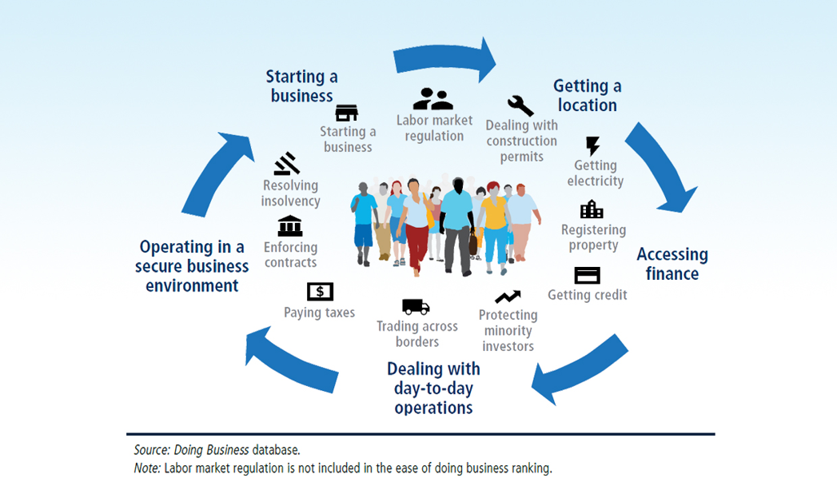
Tools for analysis and reform
World Bank “Doing Business” Indicators

Slide 8
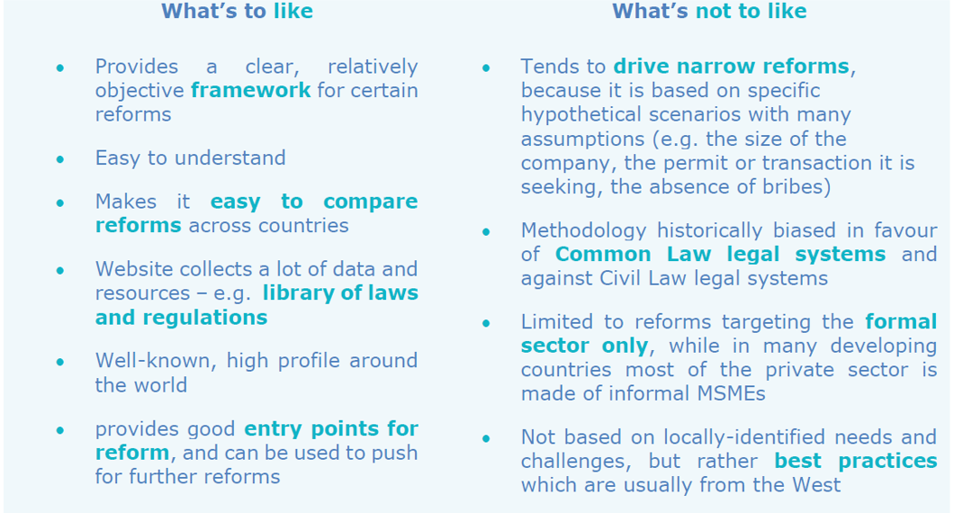
Tools for analysis and reform

Slide 9
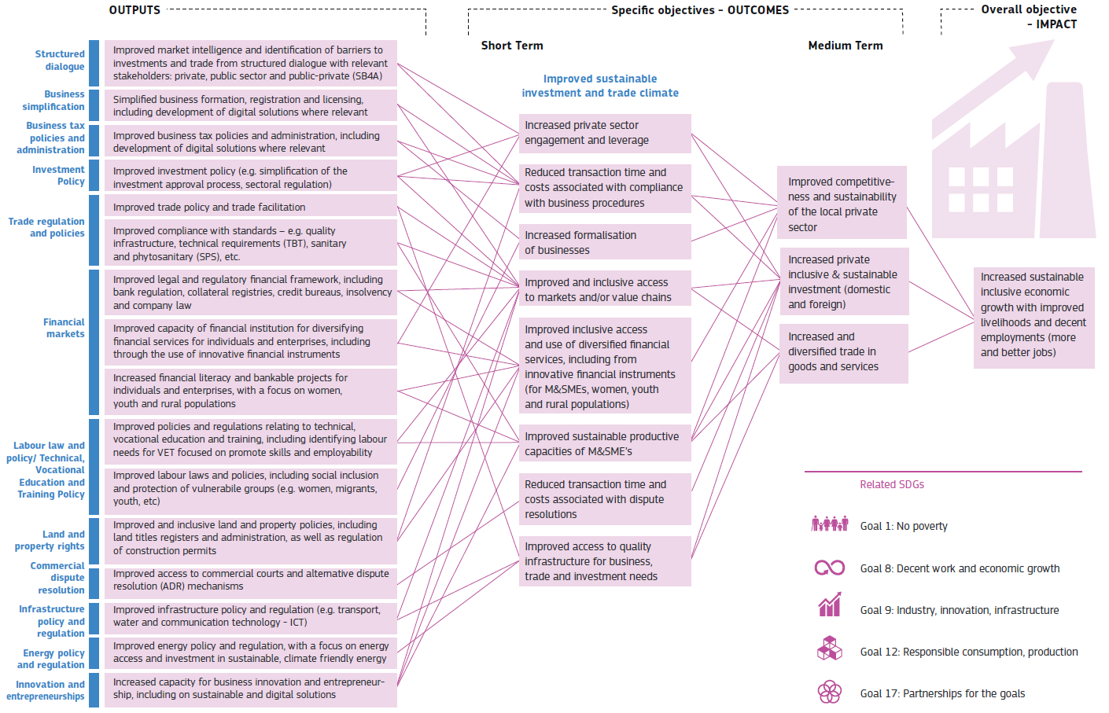
Tools for analysis and reform
BER Results Chain

