Slide 1
Environment Aspects of the European Neighbourhood Policy (ENP): Water Focus
Alessandra Sensi
EuropeAid Co-operation Office
Centralised Operations for Europe, the Middle East and the Mediterranean

Slide 2
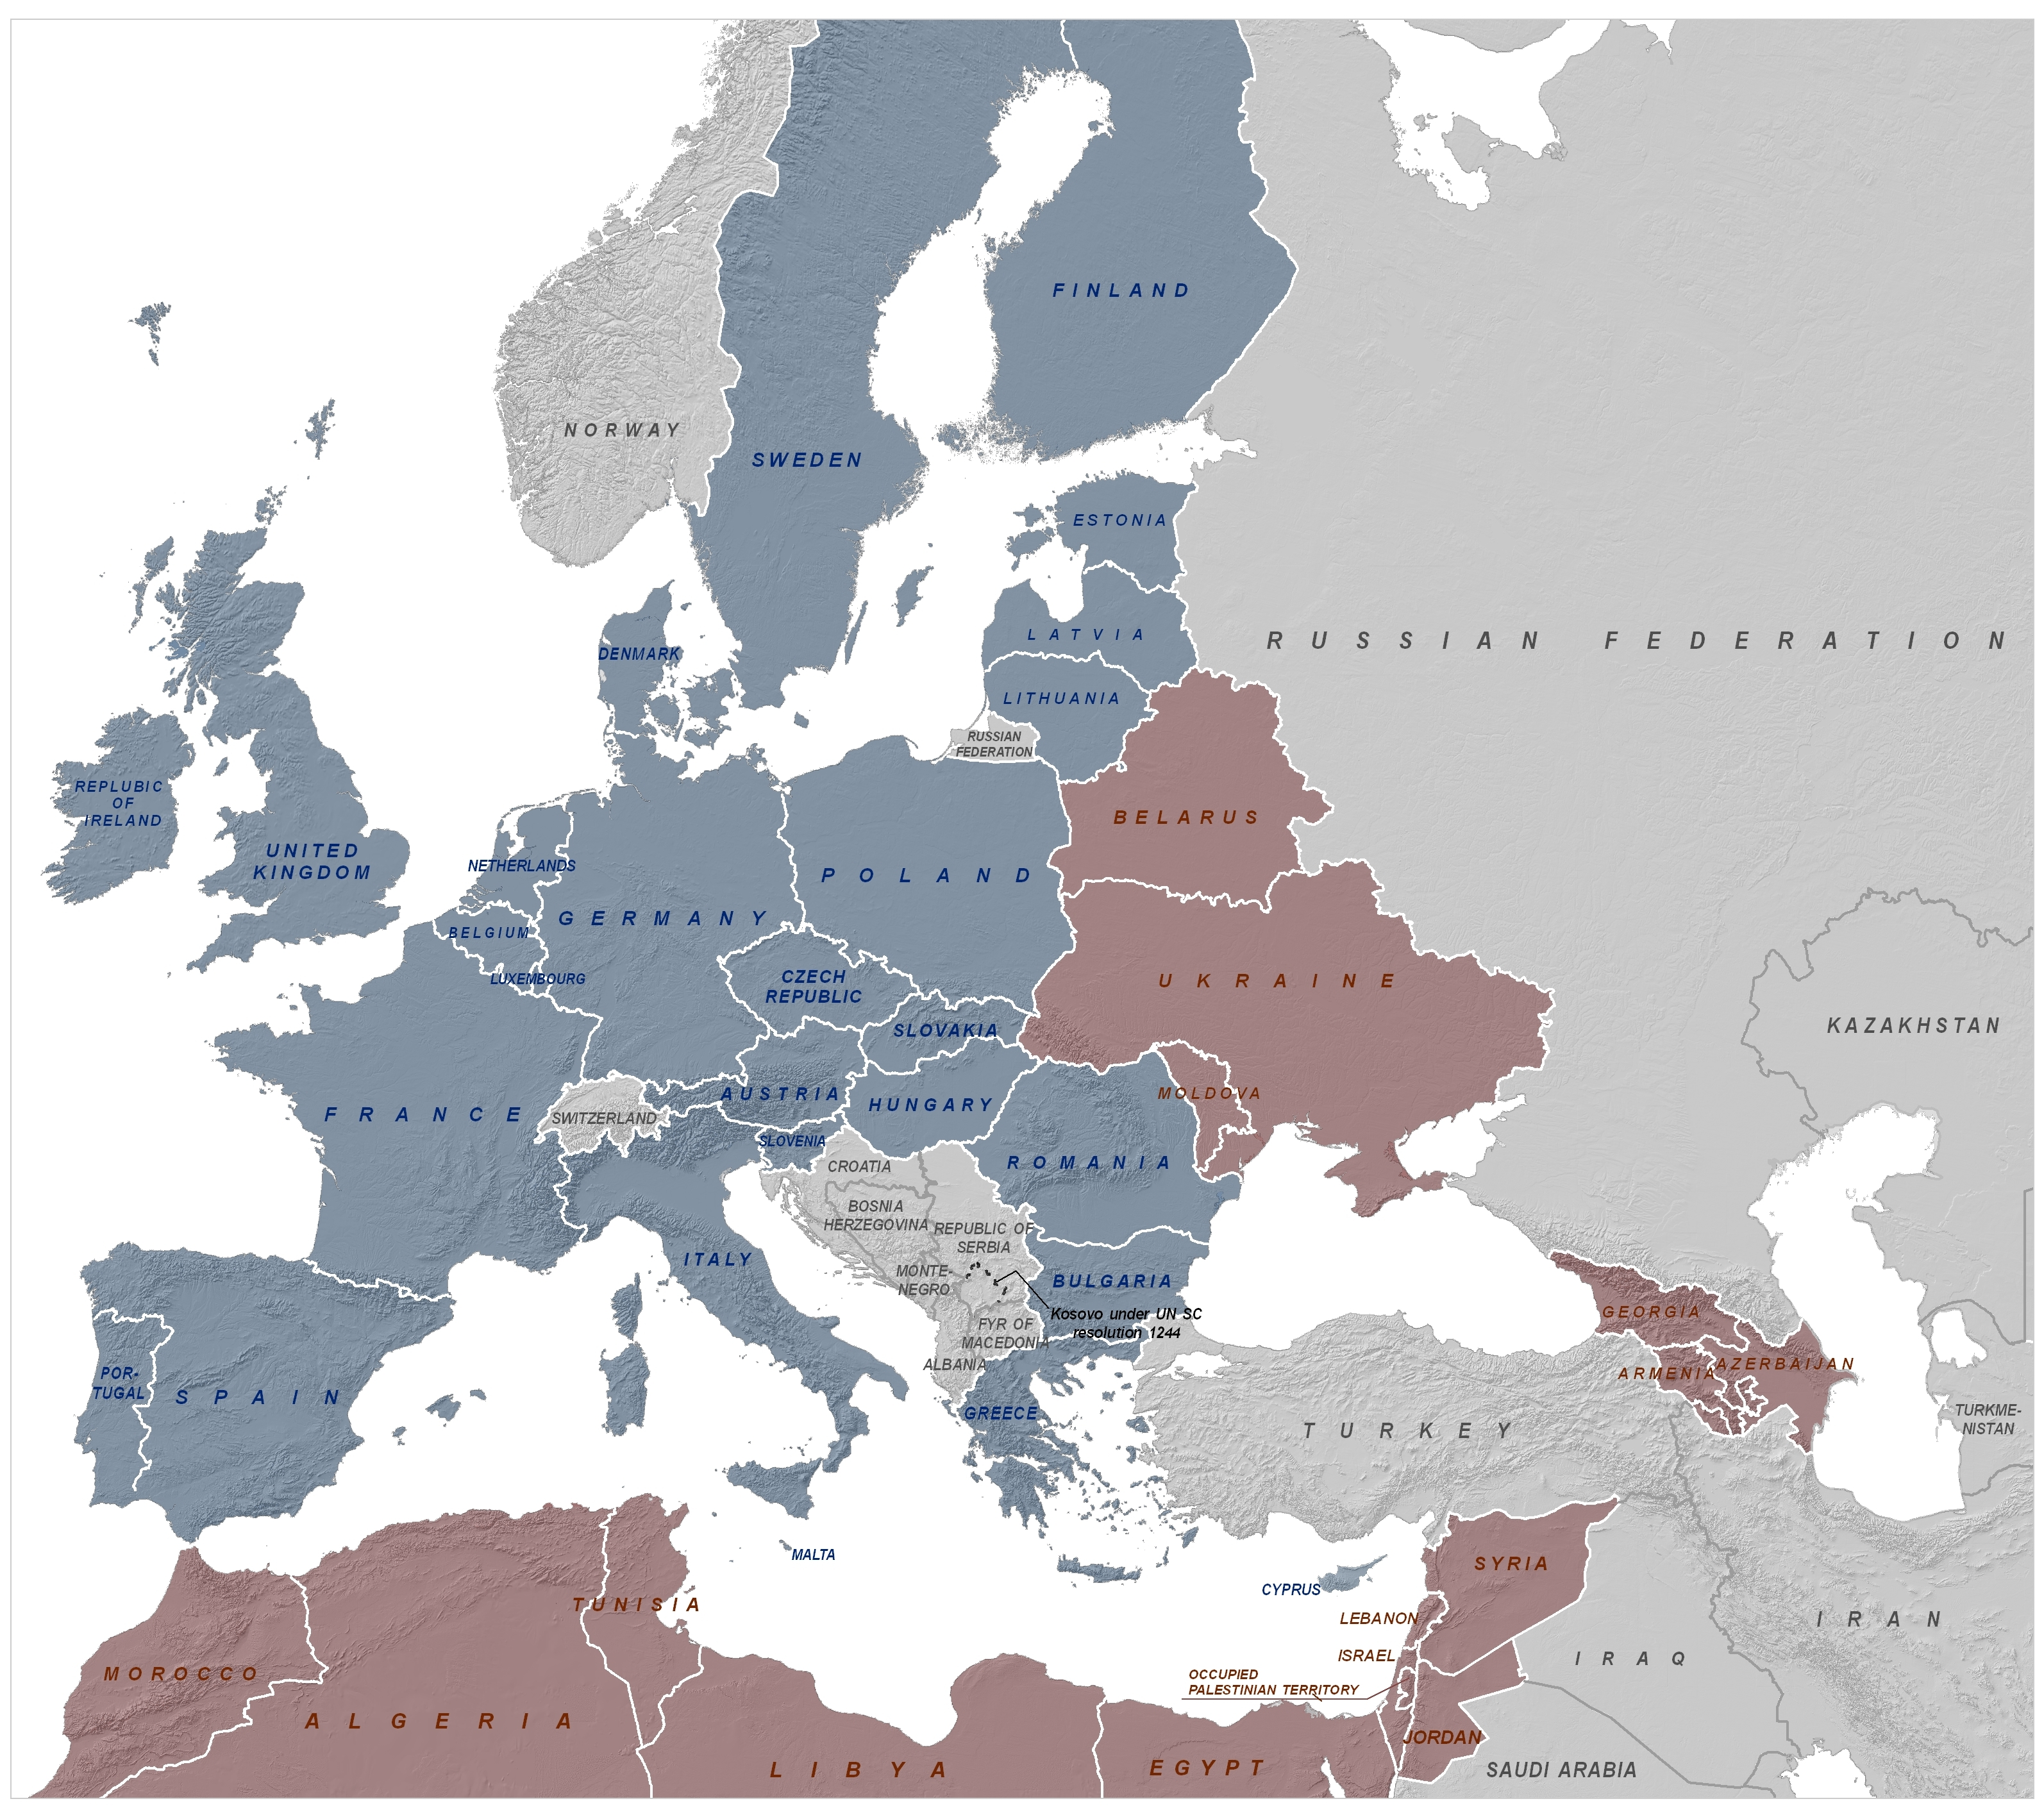
Reminder: The ENPI region

Slide 3

EC financial support
2007-2013
European Neighbourhood & Partnership Instrument (ENPI):
Almost €12bn
More flexible, policy-driven instrument
Supporting priorities agreed in the ENP Action Plans
Simplified approach for cross-border co-operation
Technical assistance: institutional capacity-building
Plus increased EIB lending mandate: €12.4 bn (€8.7 bn for Mediterranean & €3.7 billion for Eastern Europe / Southern Caucasus / Russia)
ENP currently under revision and new financial perspectives under discussion

Slide 4
ENPI financial support
COFINANCING
Member States, IFIs,
Partner Countries
ENPI
South
ENPI
East
Notes:
Neighbourhood Investment Facility: € 700 m (2007-2013)+ EU Member State contributions

Slide 5
ENPI Funding opportunities for Environment/water related focus (1)
Geographical programmes:
Bilateral -Country Programmes (main bulk of ENPI funding)
- environment priority in some programmes
Regional programme
ENPI South
    € 30 m for environment in 2011 (5 m for CC, and the remaining for NR)
    ENPI Est
    € 19 m for environment in 2011.
Interregional Programme,
- sustainable development is a priority area
Cross-Border Programme,
- environment is a priority area

Slide 6
Activities and policy drivers in the
SOUTH

Slide 7
Regional Environment Programme - ENPI South
Union for the Mediterranean (UFM) and related environmental policy drivers:
- Horizon 2020 (www.h2020.net)
- draft Strategy for Water in the Mediterranean
(http://www.ufm-water.net)
Approximation to the EU acquis (Barcelona Convention, Marine Strategy Framework Directive, etc)
Other overall drivers: the Millennium Development Goals

Slide 8
H2020 initiative for the
Depollution of the Mediterrean Sea
by the year 2020:
A transboundary cooperation initiative
by definition

Slide 9


Recap on Horizon 2020 Background (1)
Euro-Med, Barcelona Declaration 1995
10th Anniversary of the Barcelona Process in 2005
Announcement of “Horizon 2020 Initiative”
Endorsed in Cairo in 2006
Under the Union for the Mediterranean in 2008

Slide 10
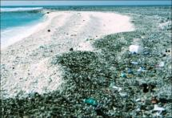
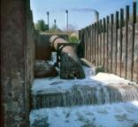
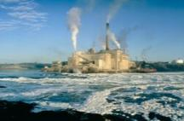
Recap on Horizon 2020 Background (2)
Top sources of Mediterranean pollution :
responsible for up to 80% of pollution
in the Mediterranean Sea
• municipal waste
• urban waste water
• industrial emissions

Slide 11
Recap on Horizon 2020 Background (3)
Horizon 2020, which is part of the Euro Mediterranean Partnership (EU) Barcelona Process, known also now as UfM, would build on existing institutions and results, filling gaps where it could bring added value. It operates within the framework of existing and developing policy instruments.
This process supports the implementation of the commitments undertaken in the framework of the Barcelona Convention (UN):
MAP’s Strategic Action Programme (SAP) to address pollution from land-based activities (SAP MED)
the Mediterranean Strategy for Sustainable Development (MSSD), launched by the Mediterranean Commission for Sustainable Development (MCSD) established under the United Nations Environment Programme Mediterranean Action Plan (UNEP/MAP)

Slide 12
Relation with UNEP/MAP: privileged partnership
last update on the collaboration within H2020 and the Med Partnership (GEF sponsored)
- Joint work programme
- Strategic Cooperation Agreement (under approval)
- Ecosystem based approach and Climate Change

Slide 13
Recap on Horizon 2020 Initiative (5)
A 2007-2013 Road-Map, adopted in 2006, focuses on the following four pillars:
Identification of investment projects to reduce the most significant sources of pollution.
Identification of capacity-building measures to help neighbouring countries create national environmental administrations that are able to develop and police environmental laws.
Use of the EC’s research budget to develop greater knowledge of environmental issues relevant to the Mediterranean and ensure this is shared.
Develop indicators to monitor the progress/success of Horizon 2020.
EIB/EC
MIO-ECSDE/EC
EEA/EC

Slide 14
H2020 Components and corresponding projects
Pollution Reduction Investments
Capacity Building
Review, Monitoring
Research
Mediterranean Hot Spot Investment Programme – Project Preparation and Implementation Facility
(MeHSIP)
Mediterranean Environment Programme
Shared Environmental Information System
(SEIS)
ENPI Regional
Hot Spot inventory for the W. Balkans and Turkey as complementary to the MeHSIP

Slide 15
ENPI Funding for Environment
water focus (2)
Horizon 2020
Investment component implemented by the EIB with other IFIs support

Slide 16
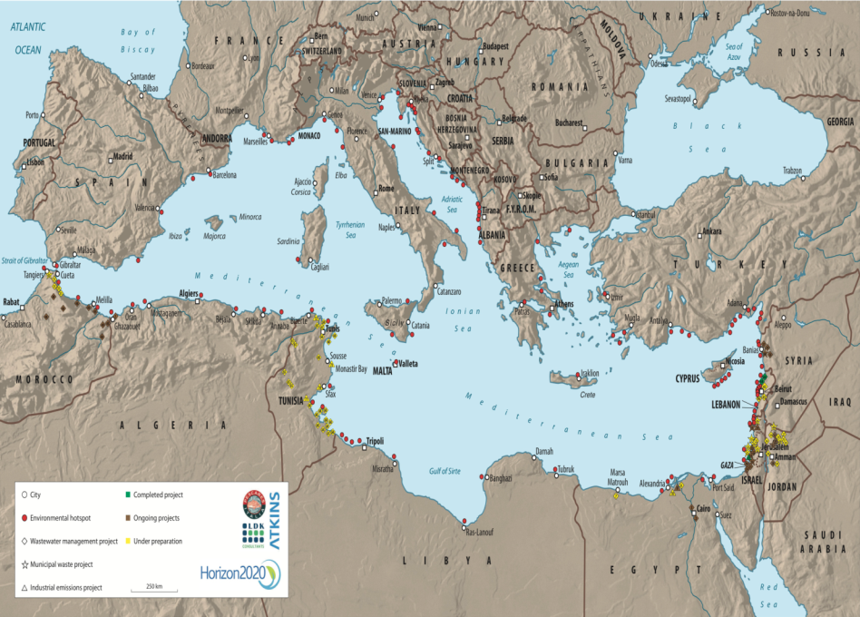
Notes:
16
Hot spots identified by the UNEP MAP and WHO study

Slide 17
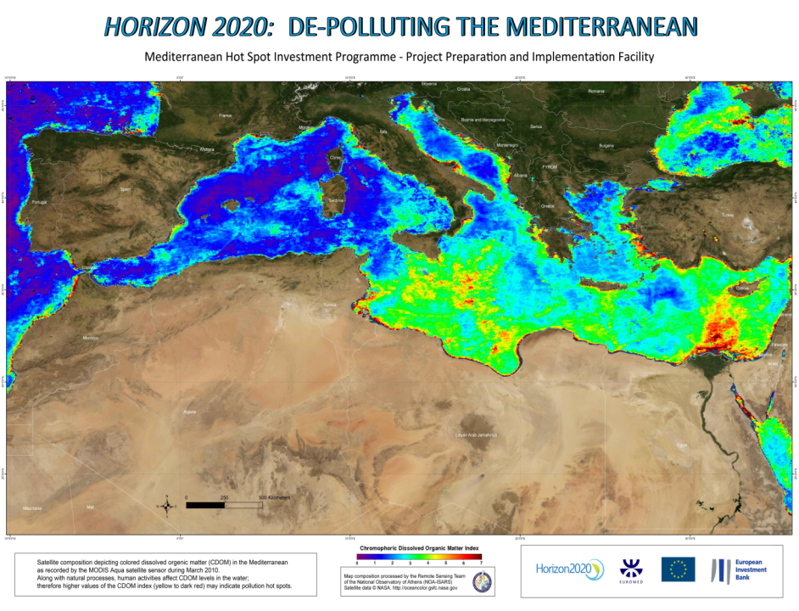
Notes:
17
Satellite Map developed through Remote Sensing technology aiming to identify Pollution Concentration Loads in the Mediterranean Sea
Shows nutrients’ enrichment which indicates chlorophyll production (cannot be used as a proof of pollution loads) and as you can see from the map, the east part does not benefit from circulation as the western part
(Chromophoric Dissolved Organic Matters Index)
Source: MODIS Aqua Satellite Centre

Slide 18
^{[1]} Inclusion to 1st Wave is subject to further investigations during first half of 2010.
Wave 1 Projects
Nr. | Country | Sector | Project | Cost M Eur
15 | Israel | SW | Netanya Landfill Mining and Reclamation | 50
38 | Jordan | SW | Integrated Solid Waste management Project (Al-Ekaider) | 35
46 | Lebanon | WW | Al Ghadir Water & Wastewater | 59
53 | Morocco | SW | Integrated Solid Waste management - Tangier | 30
72 | Tunisia | Integrated (IE/SW/WW) | Integrated intervention program for de-pollution of Lake Bizerte | 61
MeHSIP-PPIF

Slide 19
Progress on WAVE 1 Projects
8
Today
Phase I
Phase II
A
B
C
D
E
Project Identification and pipeline Analysis
Define Scope for Wave 1 Projects
Prepare Tender Documents for Implementation
Conduct Feasibility Studies
Project Implementation
10 months
18 - 24 months
36 - 48 months
Consultations with:
Gov Counterpart
IFIs
EIB
EU
Approval of Feasibility Study
Appraisal
Loan Ratification
END of MeHSIP-PPIF
16/12/2010
MeHSIP-PPIF
Notes:
19

Slide 20
^{[1]} Inclusion to 1st Wave is subject to further investigations during first half of 2010.
Wave 2 Projects
Nr. | Country | Sector | Project | Cost M Eur
6 | Egypt | WW | Wastewater Treatment (15 villages in Kafr El-Sheikh) | 80
7 | Egypt | WW | Water and wastewater expansion (Marsa Matrouh) | 87
10 | Egypt | IE | Hazardous waste treatment facility | 25
28 | Jordan | WW | Box culvert (40km) for wastewater conveyance (Zarqa/Amman) | 50
29 | Jordan | WW | Construction of WWTP (4000 m³/day), sewer pipelines (80km) and pump stations (Azraq) | 70
New | Syria | SW | Integrated Solid Waste Solutions for the Coastal Cities | tbc
 | Tunisia | IE | Stop all discharges of phosphogypsum in the Mediterranean Sea and Rehabilitation of the Industrial Site (Gabes) | 200
22/01/2011
MeHSIP-PPIF

Slide 21
Progress on WAVE 2 Projects
10
Today
Phase I
Phase II
A
B
C
D
E
F
Project Identification and Pipeline Analysis
Define Scope for Wave 2 Projects
Project Implementation
Prepare Tender Documents for Implementation
Follow up on Wave 2 Projects
Conduct Feasibility Studies
10 months
12 - 15 months
18 – 20 months
Consultations with:
Gov Counterpart
IFIs
EIB
EU
Move to D Depending on Availability of FUNDS
END of MeHSIP-PPIF
16/12/2010
MeHSIP-PPIF

Slide 22
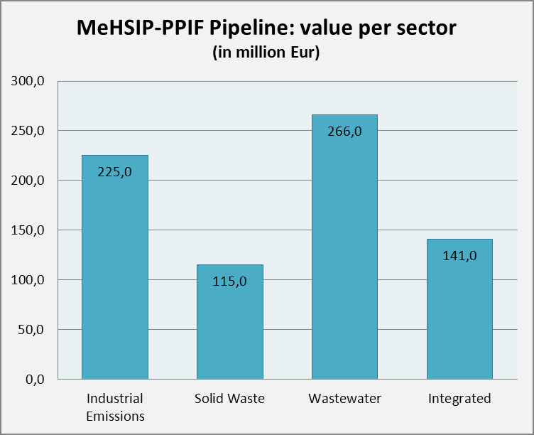
MeHSIP-PPIF Pipeline: estimated project values
Investment projects > 25mill
Notes:
- NAPs did not include Jordan (as it does not border directly with Med)

Slide 23
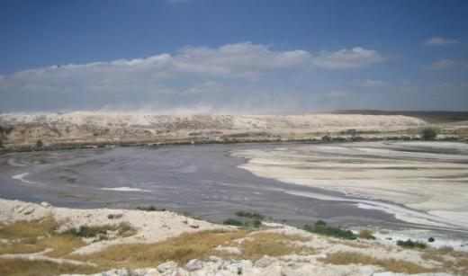
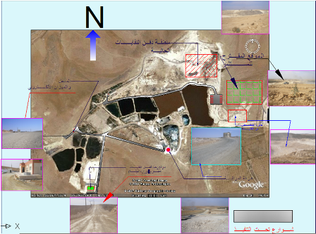
Case of transboundary impact to deal with:
wastewater into the Nar al Yarmuk River
JORDAN:
AL-Ekaider Integrated SW Management -
Open dumping
To introduce proper Solid Waste Management practices through:
  propose a technical solution for closing and rehabilitating the uncontrolled dumpsite
  investigate alternative solutions for discharge of different wastewater streams
  propose Environmentally sound practices concerning disposal of olive oil mill wastewater
  propose necessary infrastructure separation of waste streams, recycling/recovery options
  conduct Financial and institutional analysis for the feasibility of the project including EIA
Notes:
23

Slide 24
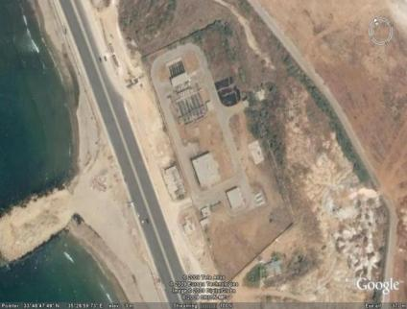
LEBANON:
2010 0281 - Lebanon - Al Ghadir Water & Wastewater
Component 1: Preparation of a revised Feasibility Study
Revisions of Legal and Institutional framework
Assessment of the Existing situation of Water supply and Sanitation in the project area
Analysis of Demand (future projections)
Definition of design criteria
Identification of possible technical options
Economic and financial analysis
Environmental Impact Assessment
Component 2: Horizontal support to improve Water Supply services provided in the Al-Ghadir Drainage Area
  integrate provision of improved water supply services to the population (no-regret Investment through better willingness to pay)
25/06/2010
MeHSIP-PPIF
Notes:
24

Slide 25
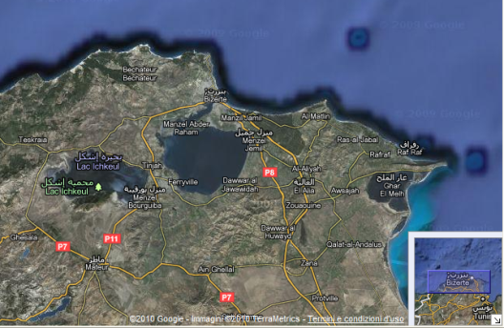
TUNISIA:
2010 0217 - Tunisie - Depollution Int. Bizerte
Rehabilitation and upgrading of sanitation networks and extension of collective treatment system (Wastewater Treatment Plant)
Sustainable management of Solid waste in rural areas (Solid Waste)
Improvement and monitoring of the Lake ecosystem (Nature conservation)
Environmental upgrading of El Fouladh industrial plant (Industrial Emissions)
25/06/2010
MeHSIP-PPIF
Notes:
25
Reconciliation of Lake Bizerte to the Mediterranean
Adjacent to Bizerte the lake and wetlands of Ichkeul National Park are an important stopping-over point for hundreds of thousands of migrating birds each year. Among the lake's visitors are ducks, geese, storks, and pink flamingoes. The park has been on the UNESCO list of World Heritage Sites since 1980, and between 1996 and 2006 the park has also been on the group's list of World Heritage Sites in danger. Dam construction on the lake's feeder rivers has produced major changes to the ecological balance of the lake and wetlands.
Project has four components
Rehabilitation and upgrading of sanitation networks and extension of collective treatment system (WWTP)
Sustainable management of Solid waste in rural areas
Improvement and monitoring of the Lake ecosystem
Environmental upgrading of El Fouladh industrial plant

Slide 26
Horizon 2020
MEP- Mediterranean Environment Programme
Capacity Building (5 m - 4m for the South and 1m for WB+Turkey)

Slide 27
Summary of the capacity building activities that have taken place since the inception phase
Urban Waste Water
3 sub-regional trainings: “Advances in Urban Waste Water Management in Coastal Areas (Sep-Oct 2010, Delft, Netherlands) [Promo Video] (80 participants from 14 countries)
1 sub-regional training: “The organic waste cycle - a resource efficient model” (Dec 2010, Cairo, Egypt) (34 participants from 9 countries)
1 sub-regional workshop: “Effective involvement of civil society in H2020 implementation” (Dec 2010, Cairo, Egypt) (82 participants from 21 countries)
1 regional & 1 national training: “Desalination and Environment” (Nov 2010, Barcelona, Spain) & (Feb 2011, Tel Aviv, Israel)
Municipal Solid Waste
Industrial Emissions
Environmental
Mainstreaming
Sub-regional with a transboundary cooperation accent:
Israel, Palestine, Jordan

Slide 28
Capacity building activities that will take place until July 2011
Urban Waste Water
Municipal Solid Waste
Industrial Emissions
Environmental
Mainstreaming
10 national:
Jordan, Lebanon, Albania, Montenegro, Morocco, Algeria, Tunisia(2) ,
oPt, Syria
1 regional:
Lebanon
1 national:
Turkey
2 study visits to EU countries
2 regional:
Cyprus
Morocco
6 national:
Morocco, Croatia, Montenegro, Albania,
oPt,
Lebanon
4 national:
Albania, Morocco,
Tunisia, Lebanon
1 sub-regional:
Bosnia & Herzegovina
2 regional:
Jordan or Cyprus, Croatia

Slide 29
Planned study visits till July 2011
Study visit (3 days) on Integrated Solid Waste Management integrating Waste to Energy (WtE) & anaerobic digestion options, to state of the art facilities in Europe (Holland, Belgium, etc.) (3 days - 10 Lebanese officials).
Study visit to Belgium on Management of waste from electronic and electrical equipment. Participants will be from Albania, Algeria, Egypt and Montenegro.

Slide 30
Horizon 2020
c) SEIS-Shared Environmental Information System (EEA, € 5.7 m for the South and the East; also interregional)
SEIS covers South and East, as well as West Balkans and Turkey, and EU 27

Slide 31
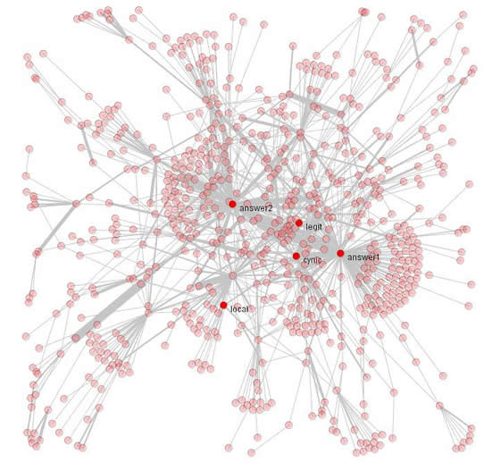
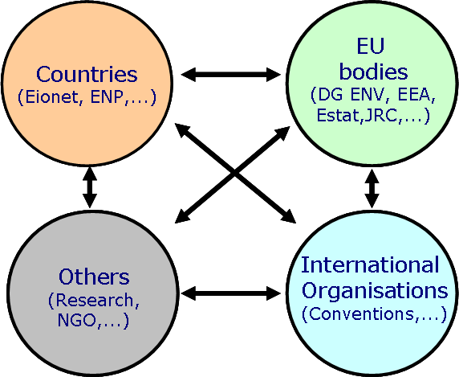
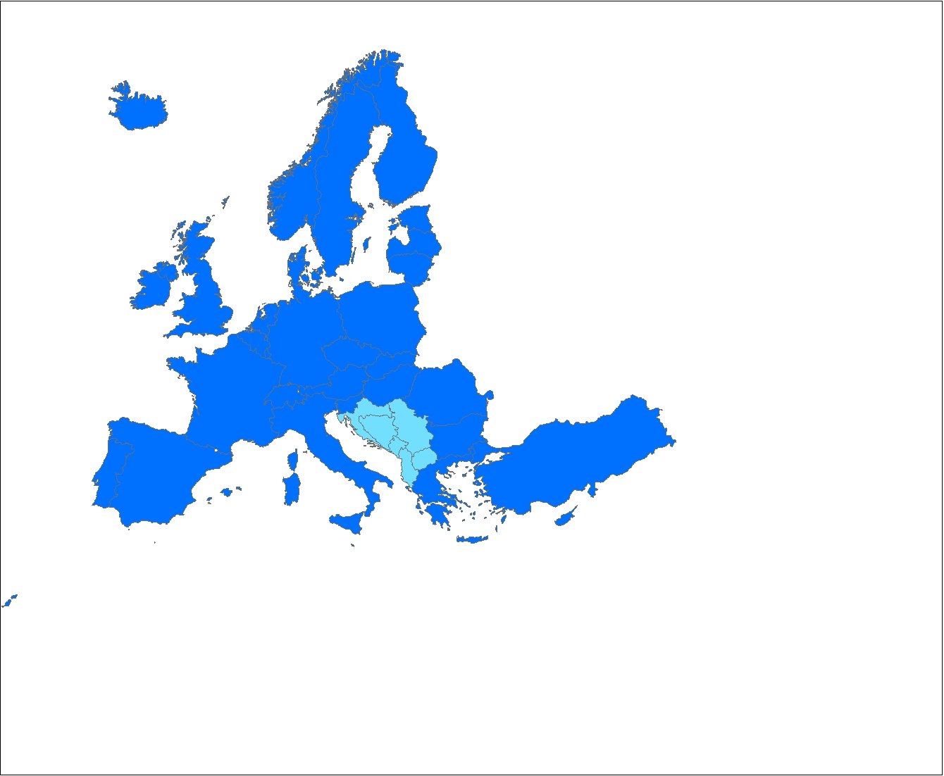
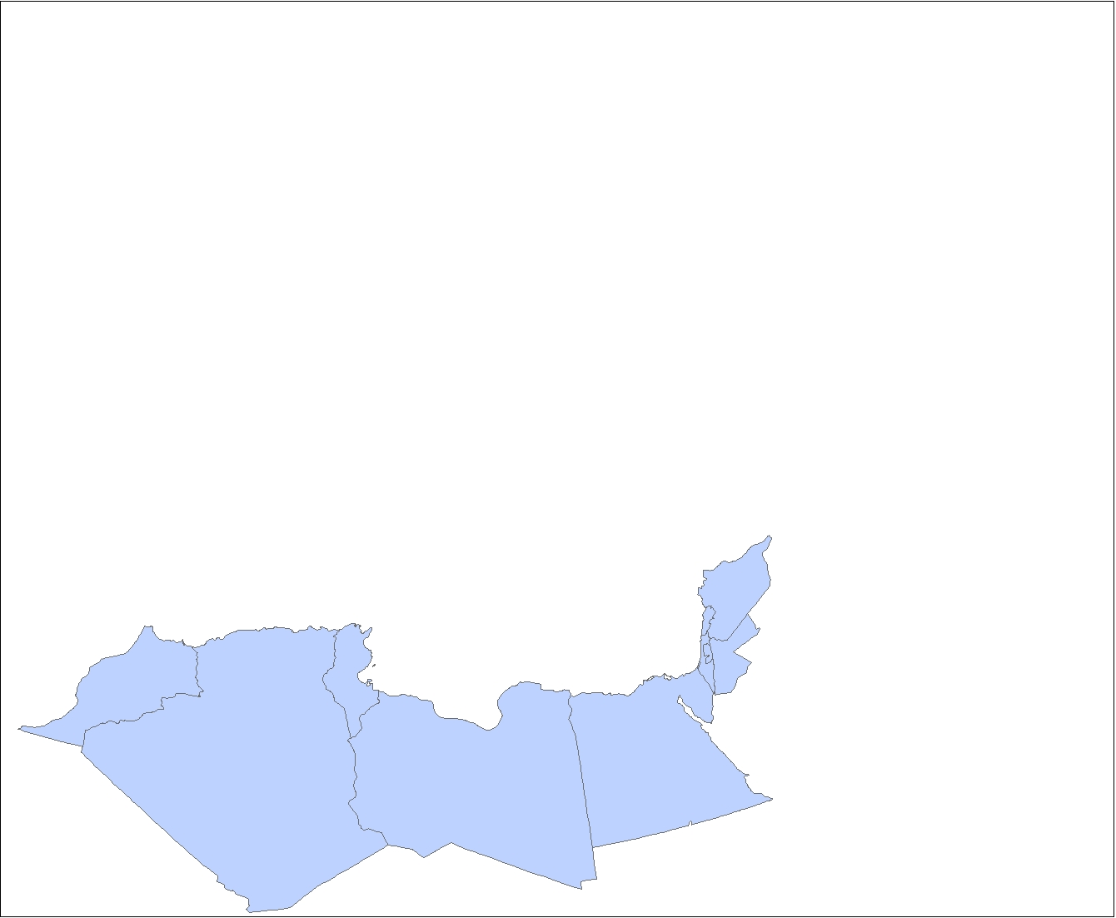
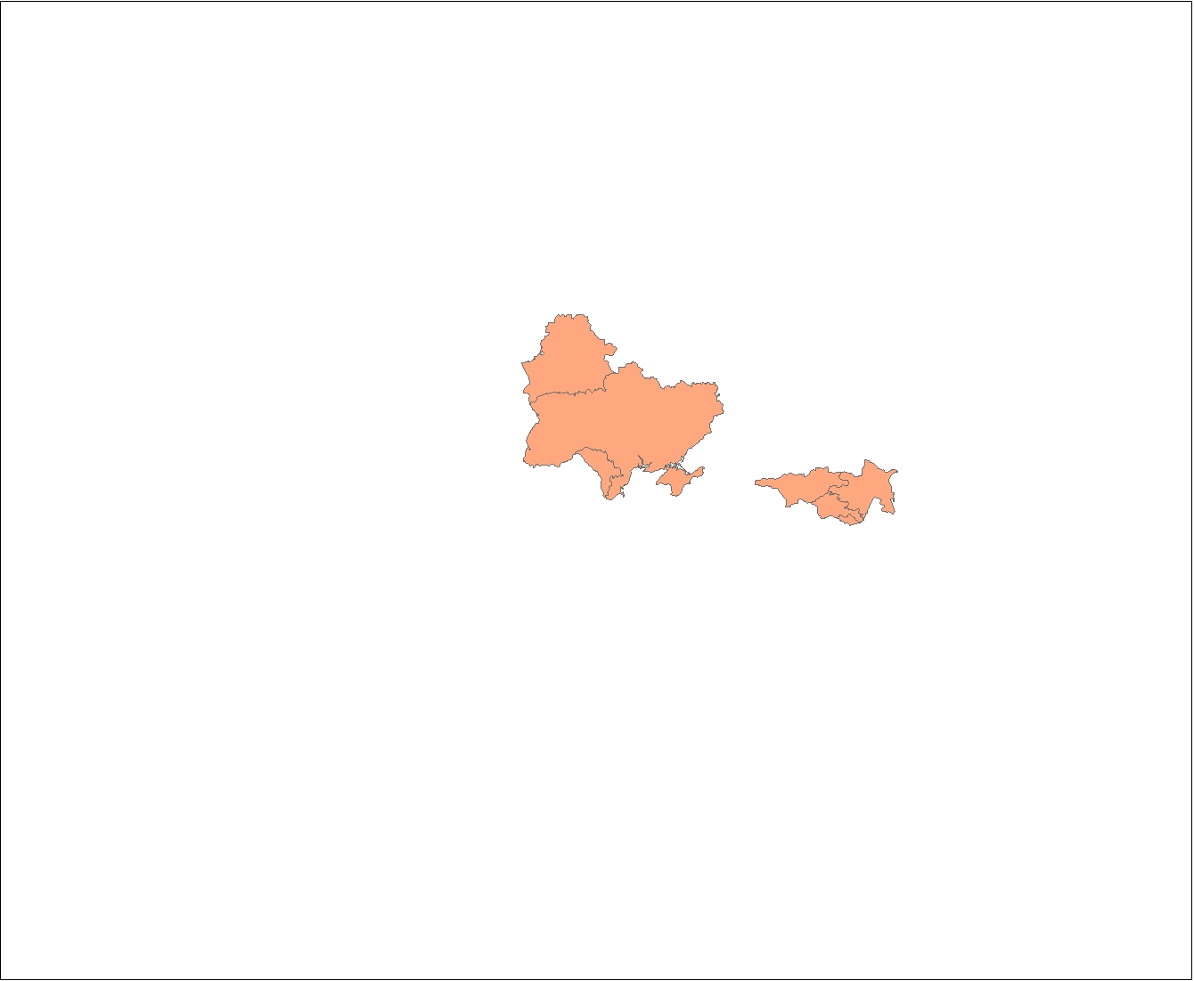
Transboundary cooperation needed for SEIS to be operational
“Towards a Shared Environmental Information System”
Commission Communication COM(2008)46
“[…] efforts will be made to ensure that SEIS will be open to participation
from accession candidate and neighbouring countries.”

Slide 32

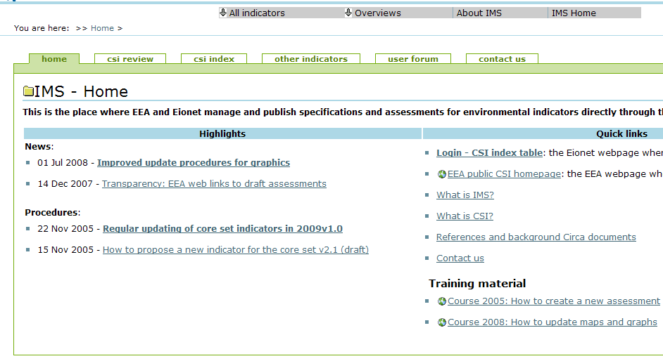
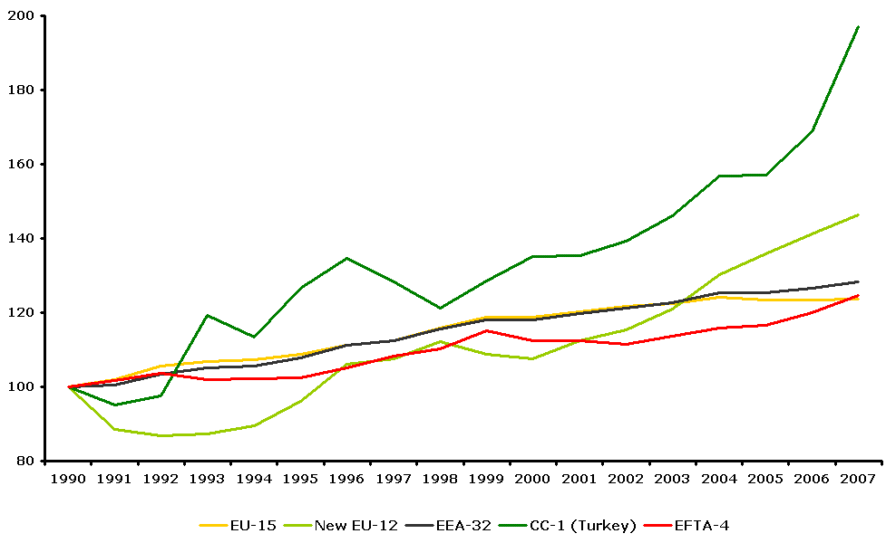
Example Content
Streamlining indicators
core set of indicators
EEA 32+6 CSI
EU Mediterranean Countries
ENP South
West Balkans
ENP East + Russia
H2020 CSI
EEC/CA CSI
32

Slide 33

Activities 2010
Inception period
Consultation
ENP countries
Implem.
EEA-IPA
EEA
Review indicator work (EEA CSI, WB CSI)
UNEP/MAP
SEIS State of play Project
Report
Agreement on priorities
ENPI-SEIS
UNECE
SEIS State of play Project
Report
COUNTRIES
Identify relevant networks (NFPs)
Other projects
Map relevant projets and identify synergies
Timeline
1 January
November
33
Notes:
33

Slide 34
RESEARCH component
7th Research Framework Programme
to mobilse results of the 6th and 7th FP
Identify the research gaps/needs
MIRA (http://www.miraproject.eu)
MELIA (http://www.meliaproject.eu/

Slide 35
Regional Environment Programme - ENPI South
Policy driver:
- draft Strategy for Water in the Mediterranean (http://www.ufm-water.net)

Slide 36
SWIM – Sustainable Water Integrated Management
Support Mechanism (€ 6.8m, launched in 2010)
Demonstration projects to promote integrated approaches in the fields of IWRM, and in relevant sectors of the H2020, and ICZM (15 m, call for proposals – just launched).
Priority areas
- Effective water governance for IWRM
- Water and climate change
- Water Demand Management and Efficiency
- Water financing
- H2020 priorities

Slide 37
The EC-Funded Sustainable Water Integrated Management (SWIM) Project
Support Mechanism
7 Mi Euro, 2011-2014
SWIM-SM
Demonstration Projects
15 Mi Euro, Call in 2011
SWIM-DM
Overall objective:
To promote actively the extensive dissemination of sustainable water management policies and practices in the region given the context of increasing water scarcity, combined pressure on water resources from a wide range of users and desertification processes, in connection with climate change.

Slide 38
The SWIM Program Bridges
Partners Countries & EC Initiatives
Related to Water & Pollution
SWIM Partner Countries:
Algeria, Egypt, Israel, Jordan, Lebanon, Morocco, the occupied Palestinian territory, Syria and Tunisia
Sustainable Water Integrated Management (SWIM)
Dynamic interaction
Mediterranean Component of EU Water Initiative (MED EUWI)
UfM Draft Strategy for Water in the Mediterranean (SWM)
Horizon 2020 Initiative to de-pollute the Mediterranean Sea

Slide 39
Interregional programme- CIUDAD: “Cooperation in Urban Development and Dialogue”
Policy Drivers:
- 2008 Communication on the involvement of local actors in development cooperation
- Based on the results of similar initiatives (MED-ACT, MED-PACT)
Specific objective: Improve local and regional government capacities in the fields of:
  Use of good governance principles
  Sustainable, integrated and long-term urban development planning
€ 11 m. Call for proposals, - € 3 m. Technical Assistance

Slide 40
Other projects under the thematic programme (DCI)
Addressing climate change in the Middle East and North-Africa (MEDA) region (implemented by the WB, € 1.5 m )
Analysis for ENPI countries on social and economic benefits of enhanced environment protection. (€ 1.2m)
Development of a Mediterranean Marine and Coastal Protected Areas (MPAs) Network (€ 2 m joint management with UNEP/MAP)
EUWI-MED (€ 1m.)
Transboundary issues on two pilot projects:
a) Buna/Bojana coastal area (Albania and Montenegro)
b) Jordan River

Slide 41
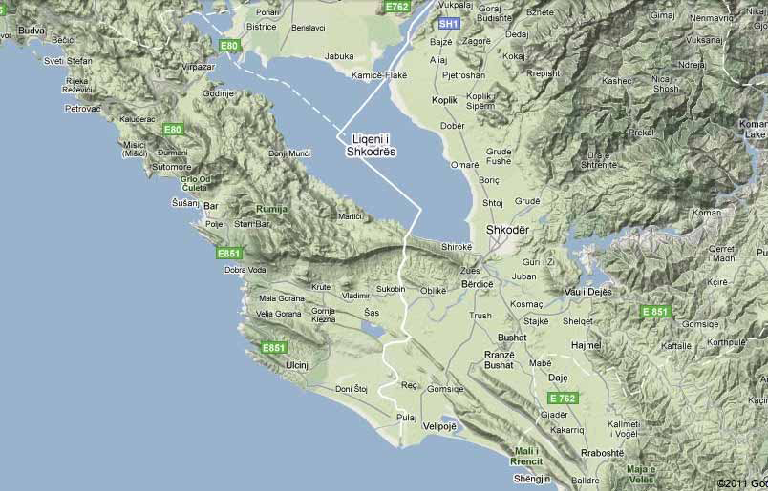

Slide 42
Activities and policy drivers in the
EAST

Slide 43
Regional Environment Programme - ENPI East
Eastern Partnership and related environmental policy drivers:
- Governance (environmental information)
Other overall drivers: the Millennium Development Goals

Slide 44
Regional Environment Programme - ENPI East
Water related projects
Water governance (13 m under preparation, of which 4,5m for the BS; 8,5 international rivers)
SEIS, Shared Environmental information System 5 (2.7m)
EUWI EECCA Project (€ 4 mill)
- Transboundary River management phase II- Kura river (3.2 m)
Transboundary cooperation

Slide 45

EU Project: Trans-Boundary River Management Phase II for the Kura River basin – Armenia, Georgia, Azerbaijan
Kura River Project (started in 2008 – end 2011)
To help Georgia, Armenia and Azerbaijan to improve river water quality in the Kura River basin through transboundary cooperation and adoption of the river basin management approach
To improve capabilities of environmental authorities and monitoring establishments in Georgia, Armenia and Azerbaijan in water resources management in the Kura River basin

Slide 46
EU Project: Trans-Boundary River Management Phase II for the Kura River basin – Armenia, Georgia, Azerbaijan
Key Activities:
Pilot projects: Draft river basin management plans (RBMP) for 5 pilot river basins using EU Water Framework Directive methodology
Joint Transboundary River Monitoring Programme to harmonise sampling and analysis procedures
Proposals for improvements in the data structures and information flows to facilitate decision making
Training and technical guidelines incl. EU Study Tour for the beneficiaries’ staff from the project countries
Public awareness raising of the priority transboundary water issues in the Kura-Aras River basin

Slide 47
EU Project: Trans-Boundary River Management Phase II for the Kura River basin – Armenia, Georgia, Azerbaijan
To help Partners understand the project, the EU Water Framework Directive methodology the following key documents translated to Georgian, Armenian and Azeri, printed and delivered to the Beneficiaries:
EU Water Framework Directive
EU Floods Directive
WFD Technical Guidance: Identification of Water Bodies
WFD Technical Guidance: Analysis of Pressures and Impacts
Introduction to Biological Monitoring of Water Quality

Slide 48
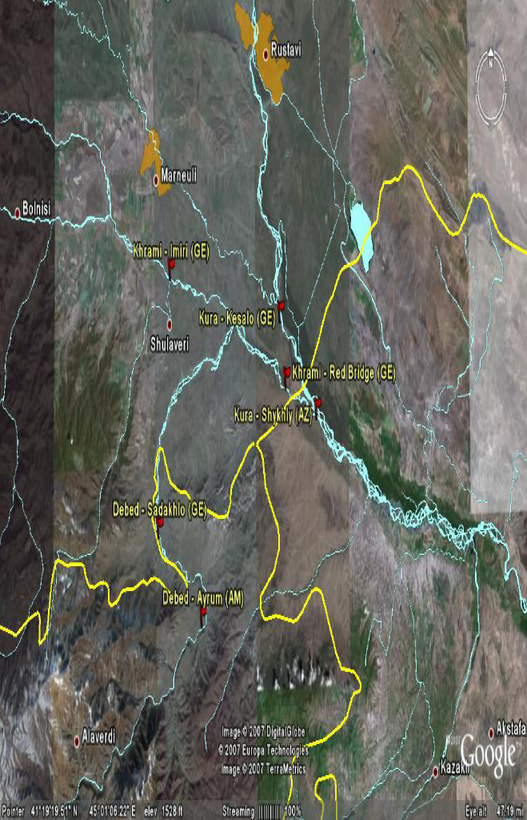
EU Project: Trans-Boundary River Management Phase II for the Kura River basin – Armenia, Georgia, Azerbaijan
Stations for Joint Transboundary River Monitoring

Slide 49
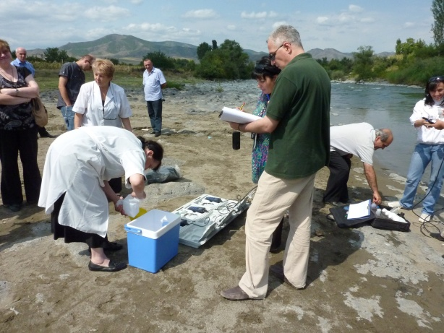
EU Project: Trans-Boundary River Management Phase II for the Kura River basin – Armenia, Georgia, Azerbaijan

Slide 50

Thank you - have you got any questions?

