Slide 1
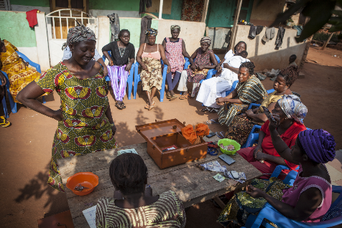
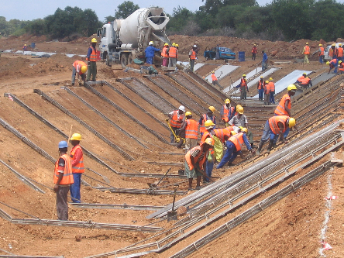
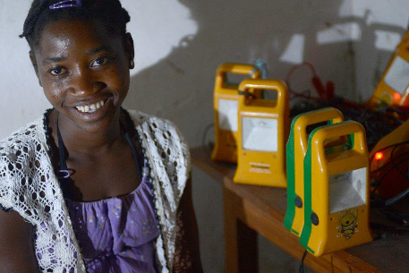
An Integrated Approach – The example of the EIP

Slide 2

Why do we act - The investment gap
Estimated global investment gap in key SDG sectors, 2015-30
Trillions of USD, annual average
1.4
3.9
2.5
Total annual
Investment
needs
Current Annual
Investment
Total
Investment gap
Source: World Economic Forum (2015)
Notes:
Global investment gap
Currently Africa invests 23.5 per cent of GDP but that would need to increase to 37 per cent otherwise it will face an investment gap of US$11.4 trillion by 2040. Africa’s domestic private sector will struggle to finance this shortfall alone, and realistically will only be able to contribute up to US$1.8 trillion of the gap.

Slide 3

EU policy reflects the new paradigm
Agenda 2030: Sustainable Development Goals
Addis Ababa Action Agenda on Financing for Development
The 2017 European Consensus on Development
EU Communication "The Stronger Role of the Private Sector in Achieving Inclusive and Sustainable Growth in Developing Countries"
EU Communication "For a renewed impetus of the Africa-EU Partnership“
EU Communication on “a new Africa – Europe Alliance for Sustainable Investment and Jobs”

Slide 4

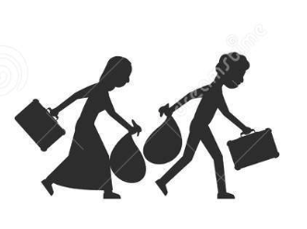



What are our goals?
Improve
Investment
climate
Contribute to
Sustainable
Development
Tackle root
causes of
migration
Encourage private
Investments
Focus on jobs and growth

Slide 5
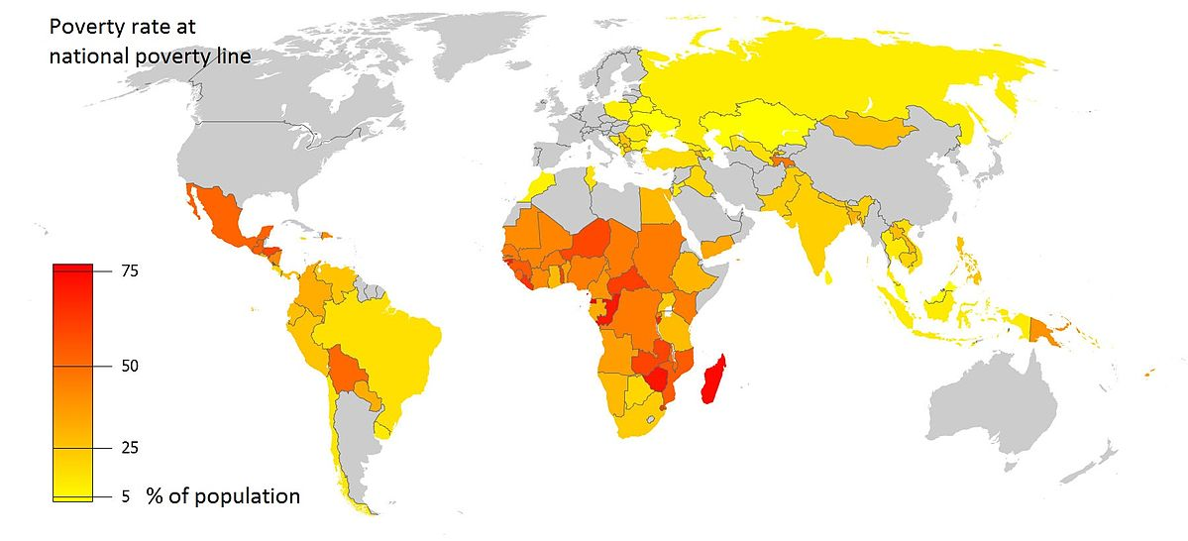
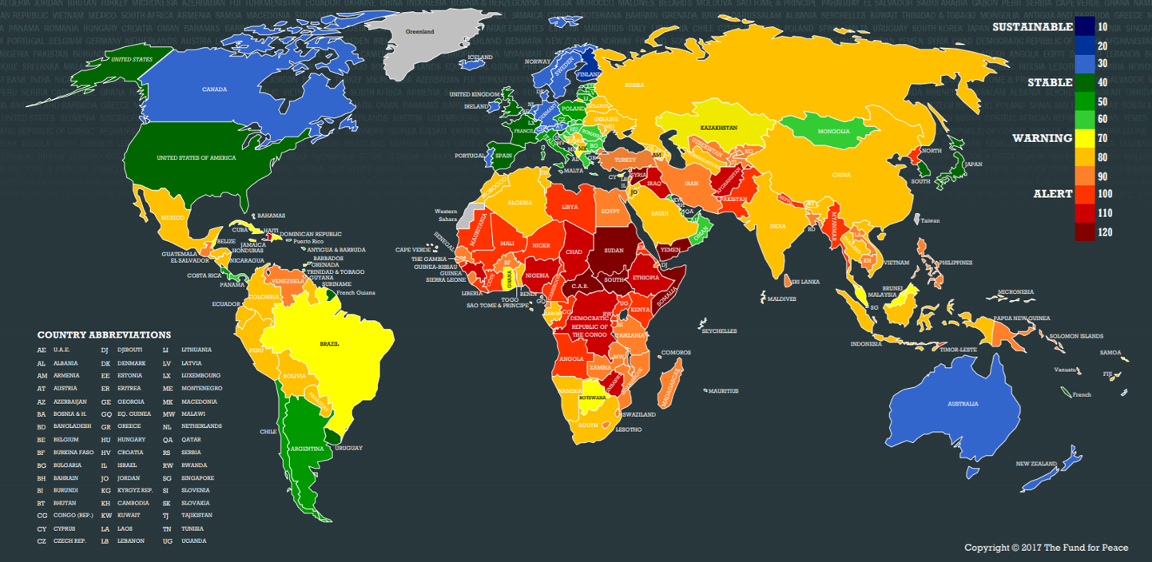
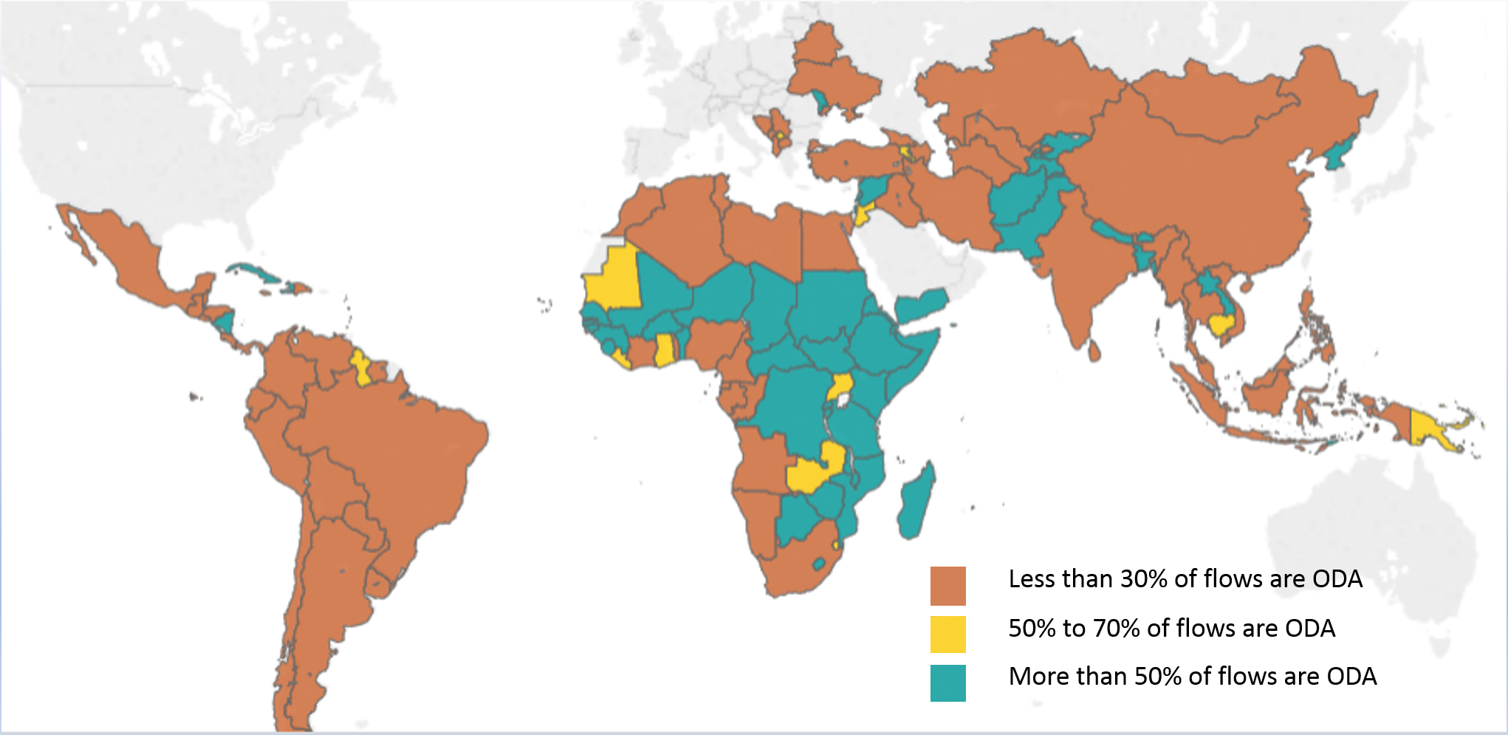
Where do we act? ODA, Poverty and Fragility
Notes:
The majority of fragile states are in Sub-Saharan Africa: at the bottom of the World Bank’s Doing Business rankings.
Starting a business in African fragile states is 3 times more expensive than in non-fragile states, and 7 times more expensive than in middle income countries.
Country risk is high and puts investment risk beyond private (and many times public) investors risk threshold.
The challenges facing businesses and investors in FCAS are unique and can be broken down into four categories, and vary in terms of severity across FCAS:
Economic: reduced foreign and local investment, sectoral shifts, damaged infrastructure, illicit taxation and extortion, the legacy of war economy, and informality.
Political and security related: low legitimacy and capacity of the state, residual violence, and a lack of a functioning judicial system.
Social: tensions between communities, weak and disrupted networks, low trust and psychological trauma.
Demographic: high number of female headed households, a large number of incapacitated and injured combatants, health issues, population displacement, employee flight and low education.

Slide 6
Where are we now?
EIP is already delivering
Funds committed for blending operations since 2017
Guarantees approved
Estimations for 2020
Tools/Actions implemented to develop Pillar 3
…and has ambitious plans for the future
Funding requested for 2021-2027
Better architecture for investment outside EU
Global geographical reach
Notes:
The EU's ambitious investment plan will encourage investment in our partner countries in Africa and in the EU Neighbourhood region. It will promote inclusive growth, job creation, and sustainable development and so to tackle some of the root causes of irregular migration. The EIP is adapted to the specific needs of partner countries and builds on the very successful model used within the EU through the "Juncker Plan" that has provided already more than 200€ billion of investment.
A particular focus will be given to those fragile countries where private financial flows have declined across developing countries since the 2008 financial crisis. Only 6% of the overall FDI to development goes to Fragile countries 2012. Of those investment as ,much as 72% is concentrated in ten resource-rich countries .

Slide 7
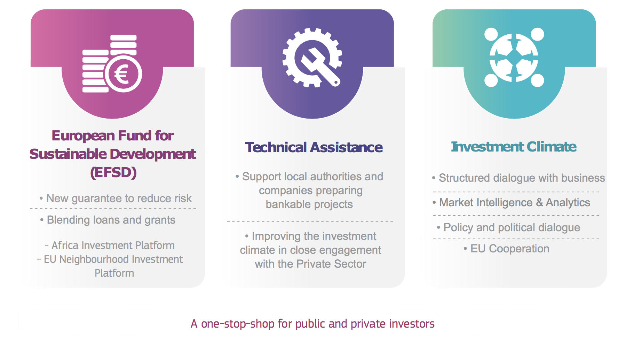
An integrated approach
Notes:
The External Investment Plan was adopted on 28 September 2017.
It is based on three pillars working hand in hand: (1) the new European Fund for Sustainable Development (EFSD); (2) stepping up technical assistance, and (3) supporting reforms and economic governance to improve the investment climate and business environment.
It is promoting job creation to enable young jobseekers to make a living in their country of origin, so to alleviate some of the root causes of migration.
The External Investment Plan provides for the first time a specific, coherent framework to promote investment,
…and is leveraging up to EUR 44 billion of financing from Financing Institutions (FIs) and the private sector.
Provides a specific, coherent overall framework to promote investment, leveraging funds from the EU, its Member States (MS) and other donors and financing from Financing Institutions (FIs) and the private sector.
in our partner countries, by building on our country and regional-level political and policy dialogue, on EU cooperation instruments and by providing analysis on investment constraints, with our Delegations in the lead. This pillar will ensure synergies with relevant EU external actions and policies, such as on good governance, migration, economic diplomacy and Economic Partnership Agreements as well as coordination with other partners' interventions, in particular Member States.
A dedicated web portal will be operational shortly. It will serve as 'one-stop-shop' to those interested in being involved with the EIP. The web portal will be the first point of entry for requests to access the EFSD and technical assistance and it will also provide information on ongoing actions under EFSD in Africa and the Neighbourhood.

Slide 8



Connecting the dots - Solar energy in Nigeria
Only half of population have access to electricity
System failures across energy supply chain
Favourable conditions for development of solar energy
But hampered by opaque licencing processes
Potential EIP funded blending operations:
100MW PV solar plant in Bauchi State
1GW PV solar plant in Jigawa State
95MW PV solar plant in Katsina State
Energy Platform of Nigeria (EPoN):
Dialogue forum on renewable energy policy reform
Involves Government, industry and development partners
Supported by NESP
Identifies bidding mechanism as constraint to investment in solar sector
Nigeria Energy Support Programme (NESP)
EU vehicle for addressing investment barriers in renewable energy
Implementation by GIZ
Supports development of competitive bidding mechanism for renewable energy
Support to market development and business models
Notes:
An example of “connecting the dots”
- Investment with potential blended operations, that can be increased through the EFSD Guarantee (new EIP tool) Investment Pillar 1
Nigeria Energy Support Programme (NESP) is TA Pillar 2
Energy Platform of Nigeria is a structured public-private-donor dialogue for IC reform Pillar 3

Slide 9

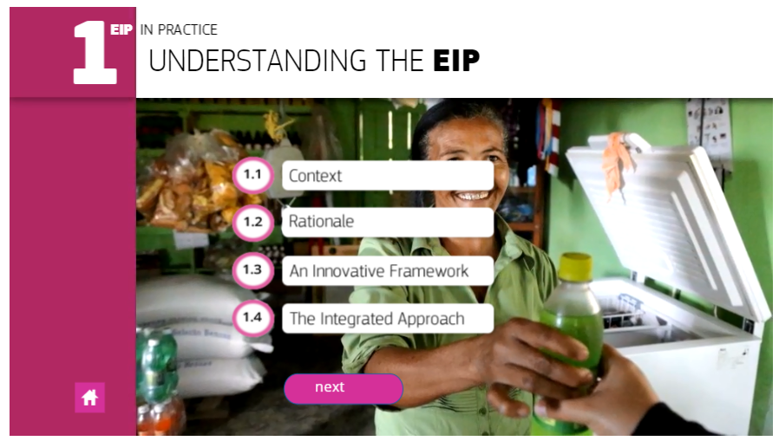
The EIP in practice presentation
Notes:
EIP in Practice Module 1 is the general presentation of what the EU is doing to incorporate the new paradigm as per the previous conference.
The quiz at the end indicates what is new.
Debate on whether the EIP seems to be adapted to the new environment, on its feasibility, potential challenges in terms of execution (Pillar I done by the DFIs while Pillar III is done by the EUDs), of actual impact…
While the debate is being open, transition onto the next slide and interview of N. Mimica.

Slide 10
EIP Pillar I - EFSD

Slide 11
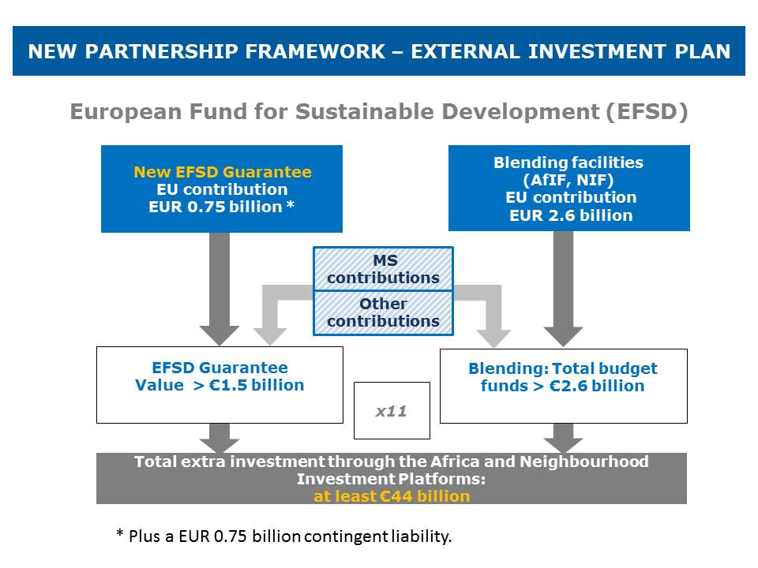
Pillar I: EFSD resources
Notes:
EUR 400 million from the EDF general reserve
EUR 350 million from the general budget of the Union: 100 million from ENI, 250 million from the contingency margin of the multiannual financial framework.
EUR 750 million contingent liability to be covered by the general budget of the EU
TOTAL 1,500 million EFSD guarantee
The EUR 2.6 billion available under the regional (Africa & Neighbourhood) investment platforms will be mobilised from existing cooperation instruments for the Neighbourhood and Africa.
EUR 1,600 million from EDF NIPs, RIPs (estimation)
EUR 840 million from ENI
EUR 160 million from DCI
TOTAL 2,600 million for blending
Taking into account the EU blending and regional experience, it is estimated to leverage at least EUR 44 billion of investments, assuming a leverage ratio of 11.
Defensive point: Taking into account the more challenging environment in Africa, the expected leverage for the EFSD guarantee is lower than for EFSI (11 instead of 15).

Slide 12
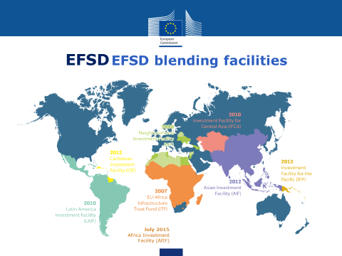
EIP Pillar I - EFSD
12

Slide 13

Blending is defined as …..
Blending. What is it?
THE STRATEGIC USE OF A LIMITED AMOUNT OF EU FINANCIAL SUPPORT TO MOBILISE FINANCING FROM PARTNER FIs AND OTHER SOURCES (Incl. THE PRIVATE SECTOR) TO ENHANCE THE DEVELOPMENT IMPACT OF INVESTMENT PROJECTS
LEVERAGE
Partner FI
financing
Grant
13

Slide 14
Blending. When?
Projects have issues:
  Affordability problems
  Poor financial performance
  Perceived risk/market failure
  Pricing issues
  Multi-component
  And/or
Countries are:
  Too ‘rich’ for all-grant (LMICs, MICs)
  Too poor for all-commercial loan (DSF concessionality & limits)
  And/or
Actors:
  Financiers have constraints and specific policy objectives
  Beneficiaries ‘shop’ for best deal
  Capital intensity
  New technology
  Pioneering new approach
  Issues beyond sponsor
  Public goods
14

Slide 15
Blending. How?
5 FORMS OF FINANCIAL SUPPORT… | …WHICH CAN ELIMINATE A KEY PROBLEM
Direct Investment Grant | Reduce cost to end users or beneficiary country by partly financing the total investment cost
Interest Rate Subsidy Grant | Reduce cost to end users or beneficiary country by reducing interest cost and/or avoiding IMF debt-ceilings (not a favoured tool for EU)
Technical Assistance Grant | To boost management, speed, project design, feasibility/preparation and quality i.e. address risks
Risk Capital | To address perceived high risk by providing funding which absorbs some of this risk and thereby lowers investors' risk perception (often with the objective of mobilising private capital)
Guarantee | To address perceived high risk by partly guaranteeing certain types of investments (often with the objective of mobilising private capital)
15
Notes:
EU approach not in favour of interest rate subsidy and explain why
Explain well the difference between risk capital and a guarantee

Slide 16
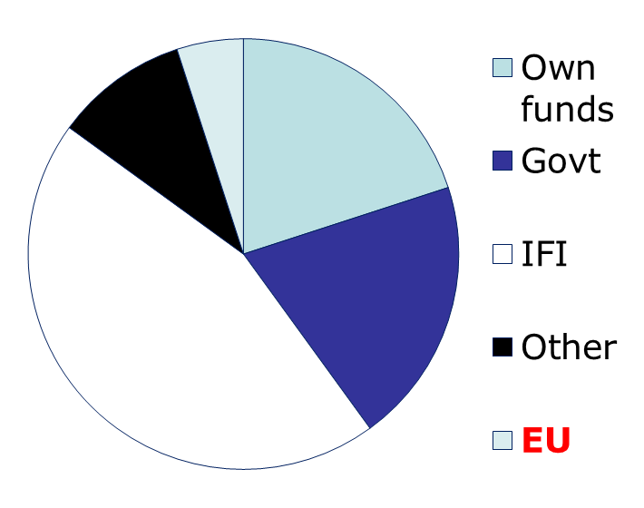
The EU support is part of a financing package
Blending. Who?
Project financing mix
Equity/Own funds (beneficiary)
Government Financing
Finance institutions (IFIs) Loans ++
Other (Grant donors and/or Private)
EU Financial Support
Average EU grant size €5-10 million
16

Slide 17
3 ‘types’ of partners, always a LEAD FI
Blending. Who?
Multilateral European Finance Institutions (e.g. EIB,…).
European National development finance institutions from Member States (e.g. AFD, KfW, AECID, CDP, FMO…)
Regional and other multilateral banks: can act as lead (e.g. AfDB in AfIF; IaDB, CDB in CIF), as co-financiers in others.
‘Lead’ FI
(entrusted
with budget implementation tasks)
Supporting FIs
17

Slide 18

The role of Delegations in blending
Identification of priority sectors through programming
Identification of pipeline in coordination with FIs present in country
Allocation of NIP/RIP resources to blending operations
Assessment and validation of blending proposals
Signature of PAGODA agreements
Monitoring implementation with FIs
Notes:
The EU's ambitious investment plan will encourage investment in our partner countries in Africa and in the EU Neighbourhood region. It will promote inclusive growth, job creation, and sustainable development and so to tackle some of the root causes of irregular migration. The EIP is adapted to the specific needs of partner countries and builds on the very successful model used within the EU through the "Juncker Plan" that has provided already more than 200€ billion of investment.
A particular focus will be given to those fragile countries where private financial flows have declined across developing countries since the 2008 financial crisis. Only 6% of the overall FDI to development goes to Fragile countries 2012. Of those investment as ,much as 72% is concentrated in ten resource-rich countries .

Slide 19
EIP Pillar I - EFSD

Slide 20
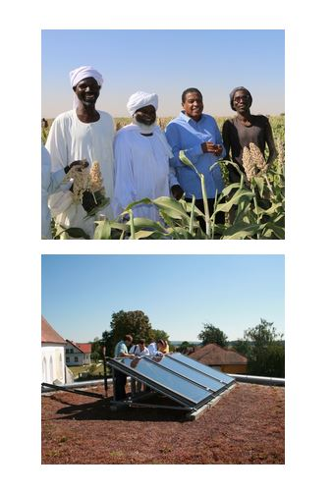
EFSD Guarantee
A risk mitigation mechanism
to stimulate investments in Africa and in the Neighbourhood
Will leverage additional financing, in particular from the private sector (crowding in), by reducing the risk associated with specific operations
A guarantee capacity for credit
enhancement will ultimately benefit
the final investments and allow risk sharing
with other investors, notably private actors
Will provide liquidity from its guarantee fund (liquidity cushion)
Notes:
Partial first-loss guarantee for investments (in credit or equity) by eligible counterparts such as international financial institutions, development banks and private sector investors
Will leverage additional financing, in particular from private investors, by reducing risk.
The EFSD guarantee fund will provide the liquidity in case the EFSD guarantee is called upon to cover for losses occurred under the guarantee agreements.
Will be endowed by the EU budget and the EDF as well as possibly other contributors.

Slide 21
EFSD Guarantee Eligibility criteria
Article 9 of the EFSD Regulation:
Consistency with EU policies:
  Sustainable development
  Migration
  Environmental considerations
  Address market failures or suboptimal investment situations:
  Additionality
  Complementarity with other initiatives, clearly distinct, in particular from the external lending mandate operations managed by the EIB
  Economically and financially viable, taking into consideration fragile & heavily indebted countries
  Respect the principles of development effectiveness
  Focus on youth and women empowerment

Slide 22

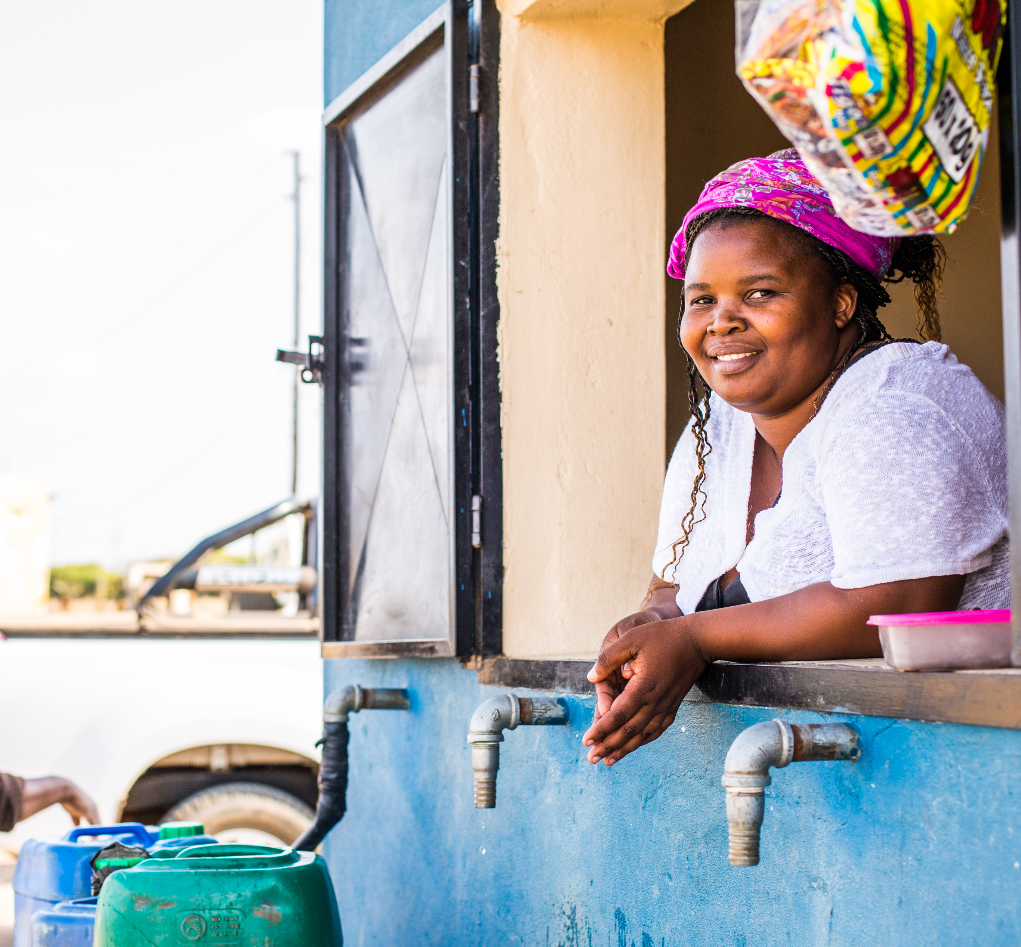

EFSD Guarantee 5 investment windows
- Sustainable Energy and Sustainable Connectivity
- Micro, Small and Medium Enterprises (MSMEs) Financing
- Sustainable Agriculture, Rural Entrepreneurs and Agroindustry
- Sustainable Cities
- Digitalisation for Sustainable Development
  Cross-cutting objectives: local currency financing, focus on fragile states, not-distorting market competition
First 12 PIPs will be discussed in session 5.4
22

Slide 23
EFSD Guarantee. Application process and assessment
STEP 1:
drafting a Proposed Investments Prog.
under a specific Investment Window
INVESTMENT WINDOW
IFI Proposal
EDFI Proposal
Priv. Sect. Proposal
STEP 2:
Submission of the proposals
EFSD Secretariat – One Stop Shop (Pre-screening)
G-TAG (Financial Assessment)
STEP 3:
assessment
Operational Board of the RIP (Opinion)
DECISION BY THE COMMISSION
STEP 3:
Signature of Guarantee Agreements
COM – IFI
Guarantee Agreem.
COM – EDFI
Guarantee Agreem.
COM – Priv. Sect.
Guarantee Agrem.
STEP 4:
Financing phase
Final Beneficiaries
Final Beneficiaries
Final Beneficiaries
Final Beneficiaries
Final Beneficiaries
Final Beneficiaries
Other (mainly private) investors

Slide 24
EFSD Guarantee – Role of Delegation
Delegation our "boots on ground". Similar to blending
We will ask IFIs to inform and coordinate with EUD on project identification and implementation.
Gather market intelligence on investment opportunities
Watchdog: EU Policies, SDG compliance, Standards, Safeguards (decent jobs, environmental, women and youth)
Receiving companies, turning their ideas into bankable projects and linking them up with IFIs implanting PIPs under investment window of EFSD guarantee.
24

Slide 25
EIP Pillar 2. Technical Assistance
Notes:
The External Investment Plan was adopted on 28 September 2017.
It is based on three pillars working hand in hand: (1) the new European Fund for Sustainable Development (EFSD); (2) stepping up technical assistance, and (3) supporting reforms and economic governance to improve the investment climate and business environment.
It is promoting job creation to enable young jobseekers to make a living in their country of origin, so to alleviate some of the root causes of migration.
The External Investment Plan provides for the first time a specific, coherent framework to promote investment,
…and is leveraging up to EUR 44 billion of financing from Financing Institutions (FIs) and the private sector.
Provides a specific, coherent overall framework to promote investment, leveraging funds from the EU, its Member States (MS) and other donors and financing from Financing Institutions (FIs) and the private sector.
in our partner countries, by building on our country and regional-level political and policy dialogue, on EU cooperation instruments and by providing analysis on investment constraints, with our Delegations in the lead. This pillar will ensure synergies with relevant EU external actions and policies, such as on good governance, migration, economic diplomacy and Economic Partnership Agreements as well as coordination with other partners' interventions, in particular Member States.
A dedicated web portal will be operational shortly. It will serve as 'one-stop-shop' to those interested in being involved with the EIP. The web portal will be the first point of entry for requests to access the EFSD and technical assistance and it will also provide information on ongoing actions under EFSD in Africa and the Neighbourhood.

Slide 26
EIP Pillar 2. Technical Assistance
Support Pillar 3
Market intelligence, Investment Climate Analysis, Dialogue
Government Reforms
Capacity building and value chains upgrading
Pillar 2
Investment pre-identification phase
Investment preparation
Investment phase
26
Support Pillar 1

Slide 27
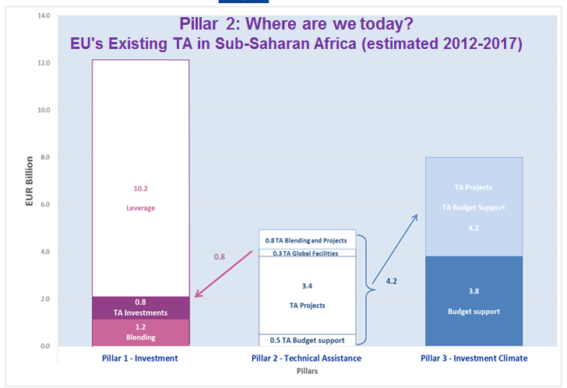
EIP Pillar 2. Technical Assistance
Notes:
TA:
- to be used as a bridge between (sector) policy dialogue and investment (two ways)
* investment informing reform agenda (and TA to support the elaboration or implementation of the reforms agenda)
* reform agenda addressing key issues in sectors of high investment needs
to be used to build capacity // reform per se is not enough // passing a law or regulation is not a guarantee that it will be implemented
Technical assistance for project preparation can be requested and financed via pillar 1. In the last years more than 500 million EUR have been made available via the EU blending facilities to finance project preparation or support for project implementation. It is expected that at least a similar amount will be used in the next years via the two regional platforms in this regard.
In addition technical assistance to improve the investment climate and broader policy environment in partner countries will be financed via cooperation programmes which are part of pillar 3. The Commission with EEAS and EU delegations will ensure a close coordination and integrated approach in this regard.
Technical Assistance for Pillar 3
- Integrated approach to address the macro (policies and regulation), meso (intermediary agencies) and micro (enterprise) level.
- Support to developing effective institutions and legal frameworks.
- Support to public-private dialogue, business fora, investment/export promotion agencies
Promoting access to finance, skills, business development services, market information, infrastructure for SMEs
A priority of the EIP is to provide strengthened support for project development. Technical assistance can help local authorities and companies to develop a higher number of bankable projects and make them known to the international investor community. Technical assistance can also support partner countries in developing more effective institutions, legal frameworks, and policies to promote economic stability and inclusive growth. Training through practical policy-oriented courses, hands-on workshops, and seminars strengthens officials' capacity to analyse economic developments and formulate and implement effective policies.

Slide 28


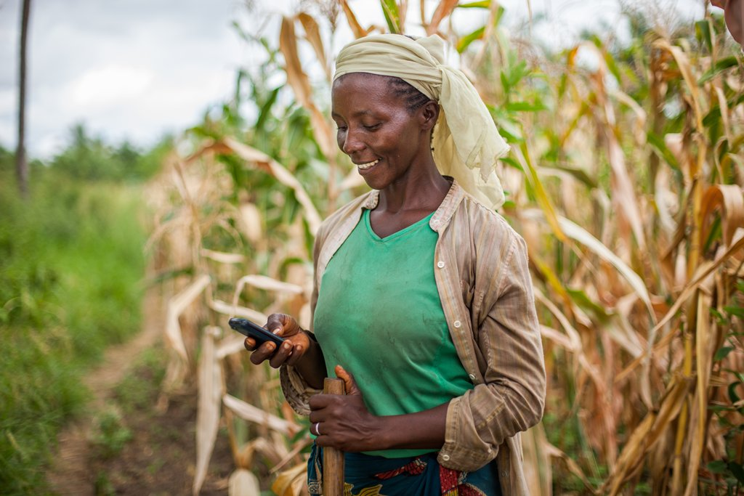

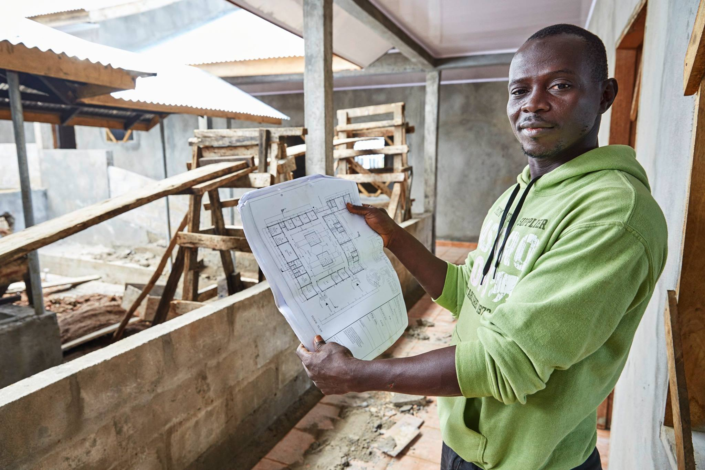
Examples of Private Sector related TA and Investment activities under Intra-ACP Programme (2016-2017)
EIP Pillar 2. Technical Assistance
Fit For Market: Strengthening
competitiveness and sustainability
of the ACP horticultural sector
Support to business friendly and inclusive
national and regional policies and strengthen
productive capacities and value chains
Promoting scalable and sustainable solutions to enhance Financial Inclusion in ACP Countries
Increased Access to Finance for Enterprises, in particular SMEs
Promote ACP-EU private sector development knowledge management
Supporting horticultural value chains - 350 individual requests for support received from 30 ACP countries
Digitalization & Financial services
Policy & Regulatory Support
Scaling Digital Financial Models
Boost Africa (EIB-AfDB): 60 million,
EURIZ (AFD-SIDA):
25.8 million
…….
Business ACP
Support at macro, meso and micro level with emphasis on strategic value chains
€ 6 m
€ 20.3 m
€ 34.7 m
€ 25 m
€ 190 m

Slide 29
EIP Pillar III – Investment Climate
Notes:
The External Investment Plan was adopted on 28 September 2017.
It is based on three pillars working hand in hand: (1) the new European Fund for Sustainable Development (EFSD); (2) stepping up technical assistance, and (3) supporting reforms and economic governance to improve the investment climate and business environment.
It is promoting job creation to enable young jobseekers to make a living in their country of origin, so to alleviate some of the root causes of migration.
The External Investment Plan provides for the first time a specific, coherent framework to promote investment,
…and is leveraging up to EUR 44 billion of financing from Financing Institutions (FIs) and the private sector.
Provides a specific, coherent overall framework to promote investment, leveraging funds from the EU, its Member States (MS) and other donors and financing from Financing Institutions (FIs) and the private sector.
in our partner countries, by building on our country and regional-level political and policy dialogue, on EU cooperation instruments and by providing analysis on investment constraints, with our Delegations in the lead. This pillar will ensure synergies with relevant EU external actions and policies, such as on good governance, migration, economic diplomacy and Economic Partnership Agreements as well as coordination with other partners' interventions, in particular Member States.
A dedicated web portal will be operational shortly. It will serve as 'one-stop-shop' to those interested in being involved with the EIP. The web portal will be the first point of entry for requests to access the EFSD and technical assistance and it will also provide information on ongoing actions under EFSD in Africa and the Neighbourhood.

Slide 30
Investment Climate
A wide range of location-specific factors determining whether domestic and foreign investment happen
Legal, regulatory, policy and institutional frameworks
Business registration
Business tax policies and administration
Investment Policy
Trade regulation and policies
Financial deepening
Labour Law and Policy/ TVET and training policy
Land and property rights
Commercial dispute resolution
Insolvency
Overall regulatory quality
INVESTMENT CLIMATE
Innovation
Business
Environment
Political
stability
Macroeconomic stability
Governance and rule of law
Human development
Notes:
Clarification of the terms.
To help understand the diagnostic and reform tools later.

Slide 31












Third Pillar Building Blocks
Country analysis: sectors, value chains, investment climate, competitiveness
Structured dialogue
with business
Policy and political dialogue with partner countries;
EU Cooperation
Cross-cutting issues
Youth
Synchronise, fine tune, streamline reform agendas, EU country support (Projects, Programmes, Budget support, VC upgrading,TA resources….
Gender
Enhance market intelligence and understanding , and proposing of investment opportunities, in key sectors and value chains
Bring in private sector perspective on investment climate and business constraints
Digital
Social and Environmental issues
Coherence and complementarity
Key role of EU Delegations
Notes:
So how do we concretely approach the 3rd pillar ? How do we promote a conducive investment & business climate ?
We have the policy and political dialogue + programmes and capacity building in support of the reform agenda, both supported by diagnostics/analysis and structured dialogue with the private sector. → idea to have an evidence based dialogue
Structured dialogue with business
Inform policy dialogue on the business environment with genuine business inputs on key constraints
Unite the voice for the European and local private sector – advocacy, networking and exchange of information
Locally facilitated by EU Delegations
Sectors: "Sustainable Energy and Sustainable Connectivity"; "Micro, Small and Medium Enterprises (MSMEs) Financing"; "Sustainable Agriculture, Rural Entrepreneurs and Agroindustry"; "Sustainable Cities"; and "Digitalisation for Sustainable Development".
Strategic advice
Analyse and address constraints, support reforms, improve value chains
Intelligence: regulatory environment, judicial security, contract enforcement, investment protection, skills, market intelligence, land tenure, access to finance, etc
Broader investment climate (financial markets, rule of law, political stability, logistics, infrastructure, etc)
Address Value Chain specific constraints
Policy and political dialogue with partner countries
Role of EU Delegations
Enable business to operate formally, increase the level of investment and innovation, encourage the creation of jobs
Reduce business costs
Reduce risks and uncertainty
Addressing anti-competitive behaviour and opening up markets
Coordination and coherence
Linking support to investment with investment climate improvements at country level
Different Aid modalities in 3ed pillar (project, budget support, sector approaches)
Policy coherence for development – EPAs, sustainability, …
Key role for EU Delegations, MS, partner countries: joined-up approaches
Include the cross-cutting themes, indicating their core importance. Youth, with the African population pyramid creating 18 million unfulfilled jobs requests per year. Gender with the impact of girl education on improved general capacity (and a step towards demographic transition). Digitalisation as a way to leapfrog key infrastructure and services (mobile banking)

Slide 32
Training Objectives
Tools for analysis and dialogue
Jobs and Growth compact and Investment Climate Annex 1
Standard analyses: Country fiche, Action programme…
Budget support guidelines
BER Toolkit
Reference Document 10
Notes:
Building Block 1, Country analysis, presents the analysis tools that are available and used, with their specificities. The idea is to use existing frameworks, not to reinvent the wheel and add work.
The analysis done for Budget support (BS) proposals already gives some indications and the latest BS guidelines do indicate which piece of info is useful for BE analysis (see below)
Then there is the Jobs & Growth compact, a targeted analysis now required for each EU Delegation by the Geo Units.
Then the Toolkit...
From the BS Guidelines.
Info sources are already there, in particular in preparing the Budget Support (where IC is included in new guidelines)
4.10. Investment and the business environment Investment, whether it is public, private, through a public-private partnership or ‘blending’ operation under the forthcoming External Investment Plan, requires a number of enabling factors.
Budget support can play an important role, particularly in relation to the macroeconomic and budgetary framework, the investment and business environment, and sector policies and institutions.
The macroeconomic and budgetary framework should provide a predictable, stable and sustainable basis for investment planning.
Sound macroeconomic policies promote growth by providing a more secure environment for public and private sector investment decisions.
At the same time, investments can have a macroeconomic impact, particularly where they involve direct or contingent liabilities for the public sector.
Support to investment needs to keep in mind public debt sustainability, given that the public debt/GDP ratio has risen significantly in many countries since 2011 due to expansive investment policies, the emergence of new donors and relatively favourable conditions on financial markets.
A sound Medium Term Fiscal Framework is crucial to avoid unsustainable debt accumulation. It is also important to consider the structure of public debt and the capacity of the country to serve it over the medium term.
Strengthening public finance management can address critical issues which directly affect investment.
Public investments or blending operations should be aligned with partner country policies, i.e. included in Public Investment Plans (PIP), prioritized and costed properly. An effective and rule-based selection of projects with a realistic project pipeline is essential to avoid implementation disruptions due to a shortage of funds. Similarly a well-functioning expenditure chain and the capacity to manage large complex projects is needed.
A competitive and transparent procurement system is crucial to ensure investment quality and value for money. At the same time, public procurement offers business opportunities to the private sector. Proper maintenance systems need to preserve the quality of public assets over time and avoid premature deterioration.
Policy dialogue can make sure that the maintenance of investments is included in national budget planning and that appropriate asset monitoring is being performed.
Good quality of public accounting systems are a basic requirement for effective asset monitoring. Diagnostic tools such as the PEFA and PIMA (Public Investment Management Assessment) can be used. Budget support can also address issues related to the investment climate at national, sub-national or sector level, particularly business policies, regulations and their enforcement.
Budget support can address sector-specific issues, including subsidy policies, licensing and regulations, strengthening markets and competition, or developing expertise in understanding, minimizing and allocating risks (e.g. project risks, demand risks, macroeconomic risks or renegotiations risks) to the public or private party best placed to bear them.
Budget support represents a key tool to leverage and promote investment by directly addressing market failures and market risks that affect the investment climate. It is therefore important to exploit synergies and complementarities with other tools such as blending, in order to increase the effectiveness of EU assistance. Following the experience under the EU blending framework and in particular in view of the launch the External Investment Plan (EIP), these synergies shall be reinforced. The EIP aims to ensure coherence between financing operations and other aid modalities such as budget support under its proposed third pillar which promotes a conducive investment climate in partner countries. Investments under the EIP create incentives for sound sector policies and create opportunities for dialogue with the private sector. Budget support can complement this through a combination of financing, policy dialogue and capacity building, complemented by specific performance indicators for variable tranches, to address impediments to investments and improve sector policies and the business environment of the partner country.
To harness these synergies, the parallel use of budget support and blending instruments in focal sectors should be encouraged where feasible, and coordination between Delegations and finance institutions should take place at an early stage.

Slide 33
Jobs and Growth WHY?
Shift of paradigm => focusing on Africa's potential and mobilizing more private sector investment + boosting job creation.
  Grasp key challenges in the region => weak economic diversification, capital – intensive economies, limited job creation, overwhelming informal sectors, major skills and infrastructure gaps, under-developed private sector, unfavorable business environment, weak financial supervision and financial inclusion, demographic challenges and illegal migration etc.
Plethora of EC Tools to be used => EIP 1st pillar with blending, guarantees, budget support, economic diplomacy, G20 Compacts with Africa, projects aimed at increasing competitiveness, trade facilitation, private sector development and dialogue with the private sector, EPA (Economic Partnership Agreement)

Slide 34
Policy and regulatory framework for private sector development and investment
Value chains and job creating sectors – diagnostics and opportunities
Dialogue with EU MS, EU Business and local private sector
EU on-going support to private sector development, value chains and business environment and possible future “EU response” to foster job creation and industrialisation.
1
2
3
4

Slide 35
Main conclusions - Policy and Regulatory Framework
=> Multiple strategies and action plans DESPITE THAT national and regional markets are dysfunctional
  => Overwhelming presence of the State in the region but limitations as to how much the State can do ➔ need for private sector investment
  => Poor dialogue between
  the government and the private sector
  => Stagnant business climate and competitiveness
  => High informal sector (80-90%)
  - Who are the stakeholders (formal and informal), in which sectors?
  - Who are the national entrepreneurs and their enterprises ?
  - What are the interests in each potential sector (“hidden constraints”)?
  - Why business climate is stagnant?
Work at two levels: sector or value chain and business environment.
More Political Economy Analysis needed

Slide 36
Tools for analysis and reform
EIP Pillar III Action Plan
I - Investment Climate analysis
  Positive factors and opportunities -- Challenges
II - Investment Climate actions
  Challenges discussed in policy dialogue with the government
  State of play of Structured Dialogue with business
  Ongoing Pillar III Actions
  Linking IC with Pillar III Actions
III - Action Plan
  IC Driver -- IC Challenge identified -- Description of Priorities
Notes:
The Jobs and Growth Compact (exercise required by the Geo Units for each EUD) describe the situation of a country in terms of:
Policy and regulatory framework
Key value chains and job creating sectors
How is the dialogue
HANDOUT Tanzania J&B Compact
Explain
which sectors and value chains have the highest potential for job creation and economic growth in the country
what are the key constraints to target and unlock the potential (access to energy, access to markets, value chains development, business enabling environment, regulatory framework)
how to address these challenges effectively with an integrated multi-sector approach targeting in parallel enabling and backbone sectors, economic capacity and policy constraints
how can the EU support the development of such integrated approach in 2017-2020
QUESTIONS. Is it useful, what challenges do you have to face to do it, time, ressources, lack of info….

Slide 37










Tools for analysis and reform
BER Functional Areas
Business Registration, Licensing & Permitting
Labour Law and Policy/ TVET
Business Tax Policy and Administration
Land and Property Rights
Investment Policy
Commercial Dispute Resolution
Trade Facilitation
Insolvency
Access to Finance / Financial Deepening
Overall Regulatory Quality

Slide 38
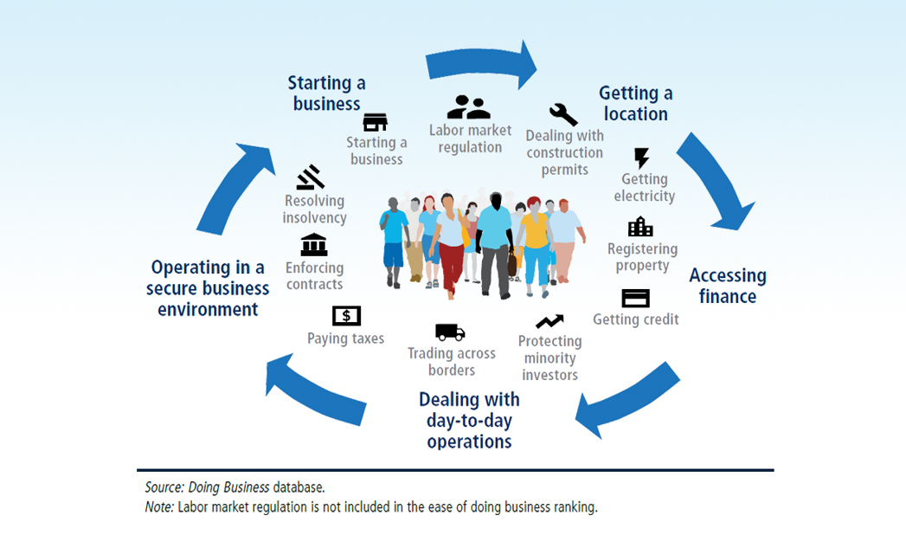
Tools for analysis and reform
World Bank “Doing Business” Indicators

Slide 39
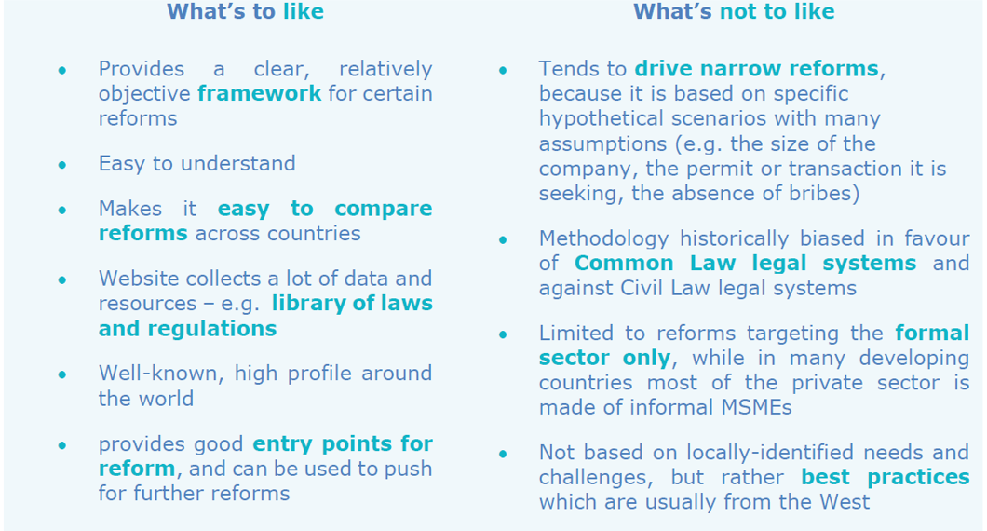
Tools for analysis and reform

Slide 40
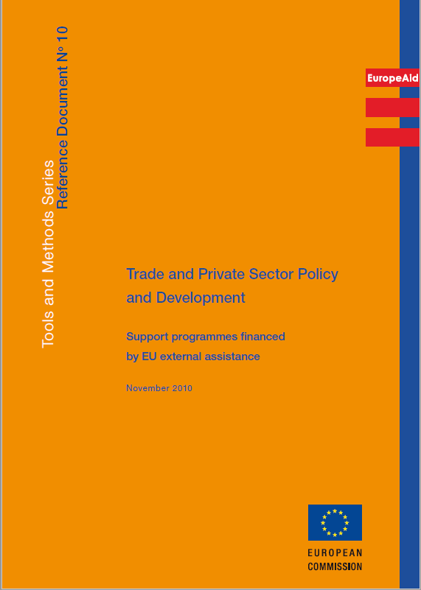
Reference Document 10 – Trade and Private Sector Policy and Development
Overall context
TPS in the context of EU external policies
Specific policies related to TPSD
Delivery methods
Cross cutting issues
TR 1 Trade Policy and Trade-related Adjustment
TR 2 Trade Facilitation
TR 3 Quality Infrastructure
TR 4 Intellectual Property Rights
TR 5 Business Enabling Environment
TR 6 Investment Promotion and Facilitation
TR 7 Access to Finance
TR 8 Competitiveness
TR 9 Business Development Services
TR 10 Doing Business with the Poor
TR 11 Engaging the Private Sector for Development
Notes:
Document from 2010 being updated
One new thematic review on Private Sector Engagement

Slide 41
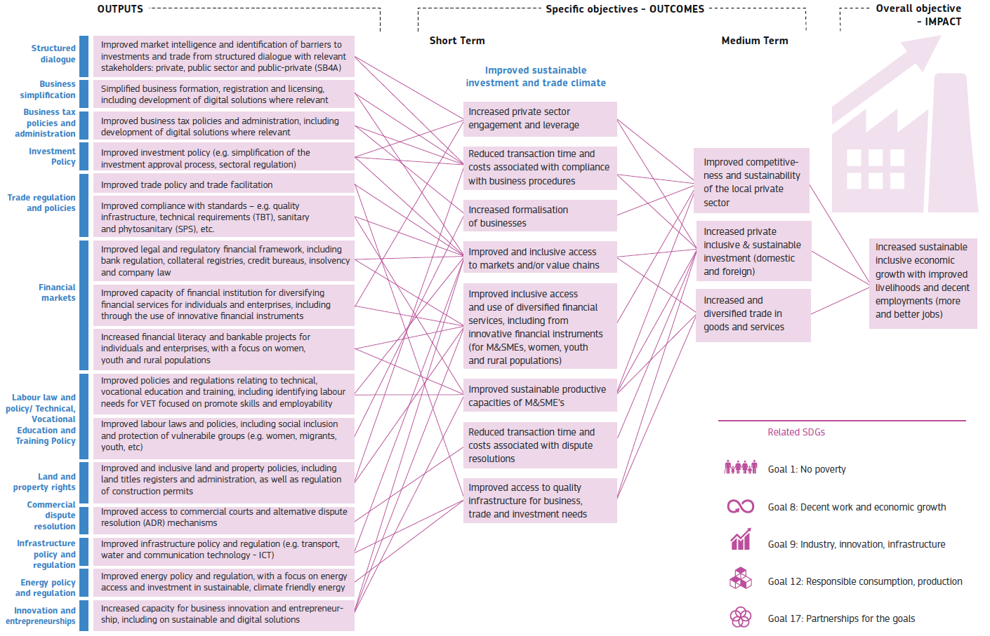

Tools for analysis and reform
BER Results Chain

Slide 42
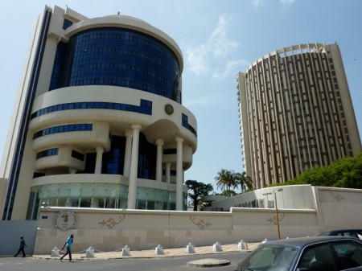









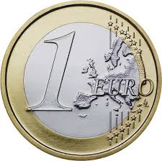
EIP Pillar III– Role of Delegation
?
.Use ongoing TA projects to support structure dialogue and addressing of investment climate constraints
.Build on existing Budget Support dialogue and actions related to investment climate
.Mobilise institutions using our funds (DFIs, NGOs…)
.Coordinate actions within EUDs in support of investment climate improvements
Notes:
Specific indications on what the EUDs should do:
Use existing initiatives, TA projects, dialogue in the framework of budget support to reinforce the IC
Align the various existing analyses (J&G, SB4A) done by request of the Geo or other units, and in the framework of EPA or others, to inform the EIP approach
Talk to MS, EDFI, INGOs and other stakeholders and implementors of our contributed funds
Talk to local stakeholders, regulatory, local authorities, banks, trade associations...
Funding for the IC activities? Your funds… Projects can be launched (cf Tanzania)

Slide 43
Resources
EIP Website
One-Stop-Shop
Application form for ideas
Outreach programme
Training sessions
Contacts
43

