Slide 1
10 actions to deliver concrete results
A new Africa-Europe Alliance for Sustainable Investment and Jobs, COM (2018) 643 final
#1 Boosting strategic investments via blending and guarantees
#2 Identifying the most promising value chains and the opportunities for manufacturing and processing at national and regional level via the Jobs and Growth Compacts
#3 Establishing sectoral groups of African and European public, private and financial operators and academia on a sectoral basis before the end of this year to examine and support strategic developments in critical economic areas such as digital economy, energy, transport and agriculture
#4 Supporting education and skills development at continental level
#5 Supporting skills development at national level to match skills to strategic development choices for each country

Slide 2
10 actions to deliver concrete results
#6 Strengthened dialogue, cooperation and support on the investment climate and business environment
#7 Supporting African Continental Free Trade Area
#8 Strengthening trade between the EU and Africa with the long-term perspective of creating a comprehensive continent-to-continent free trade agreement between the EU and Africa
#9 Supporting both intra-African connectivity and strategic linkages between the EU and Africa
#10 Mobilising an important package of financial resources
https://ec.europa.eu/commission/sites/beta-political/files/soteu2018-factsheet-africa-europe_en.pdf

Slide 3
Towards a more efficient financial architecture for investment outside the European Union, COM(2018) 644 final
Reinforced European financial architecture for development finance
Increase coherence – EU instruments
More collaboration EU partners
New guarantee of 60 billion for next MFF
EFSD+
https://eur-lex.europa.eu/legal-content/EN/TXT/?qid=1537437410425&uri=CELEX%3A52018DC0644

Slide 4
Structured Dialogue with the private sector
EU Joint Communication to the EP and the Council for a renewed impetus of the Africa-EU Partnership, 4th May 2017, JOIN(2017) 17 final

Slide 5
Right business framework to attract possible and sustainable investments
Fostering entrepreneurship, SMEs, start-ups, skills and vocational training
Infrastructure, both hard and soft, including digital economy
EU-Africa Trade relations and promoting intra-African trade (CFTA and Common African market)
Greater efforts towards a sustainable blue economy
6th EU-Africa Business Forum (Abidjan, November 2017)
"Investing in Job creation for Youth"
Business Declaration
5th EU-Africa (political) Summit: " Mobilizing investments for African structural sustainable transformation". Focus on quality jobs, youth and women entrepreneurship, sustainable energy, agribusiness and digitalisation
Right business framework to attract possible and sustainable investments
Fostering entrepreneurship, SMEs, start-ups, skills and vocational training
Infrastructure, both hard and soft, including digital economy
EU-Africa trade relations and promoting intra-African trade (CFTA and Common African market)
Greater efforts towards a sustainable blue economy

Slide 6
What is the
Sustainable Business for Africa Platform (SB4A)
Actions to reinforce existing and create new structured dialogue processes with the private sector. To be included in existing relevant programmes and new.
Sub Saharan and Northern Africa
Understand and promote priority investment climate reforms to create decent jobs for youth and women -in coherence with Jobs and Growth compact at country level-
Improve policy and political dialogue
Design better EU cooperation (for instance, an agricultural value chains programme or an access to finance component)
Coherence and synergies between the three pillars of the EIP
Notes:
HANDOUT SB4A guidance note

Slide 7
Structured Dialogue with stakeholders on investment climate: SB4A
IC Analysis
Jobs & Growth Compacts,
Value chain mapping, investment climate studies, etc.
(SB4A Guidance note:10 key elements)
Systematic dialogue on relevant
investment climate matters
Local and EU Businesses
Business/sectoral associations
Cooperatives
Womens' and Young' associations
EU MS
IFIs
Local financial entities and investors
Other donors
Government/s
With government: Policy dialogue at different levels
Programme level dialogue
Budget support dialogue
Programming
Recurrent discussions with EU MS
Other analyses: WBG, UN, ITC, other IOs, IFIs, WEF, CSOs,…
Country's strategies:
Development, Investment, Industrialisation, SMEs, Innovation…
Notes:
A reminder of the Flow of IC 3 components (slides 9 and 10)

Slide 8
Delegations can access TA support from HQ
Trade and Private Sector Development Facility (TPSD)
Tradecom II
Other support faciliites in preparation in DEVCO
8

Slide 9
At a glance
Thematic Facility
AAP 2015 – GPGC –HUM
2 M Eur
2017 – 2020
Objective: Support DEVCO and EUDs implementing EU policies and related to private sector and trade
Global scope with strong focus on supporting the EIP implementation
Managed by: Unit C4 Laura Atienza
Implemented by: DAI
Team: 3 Key experts and non key experts
Main target group: EU Delegations
Demand driven

Slide 10
Areas of expertise

Slide 11
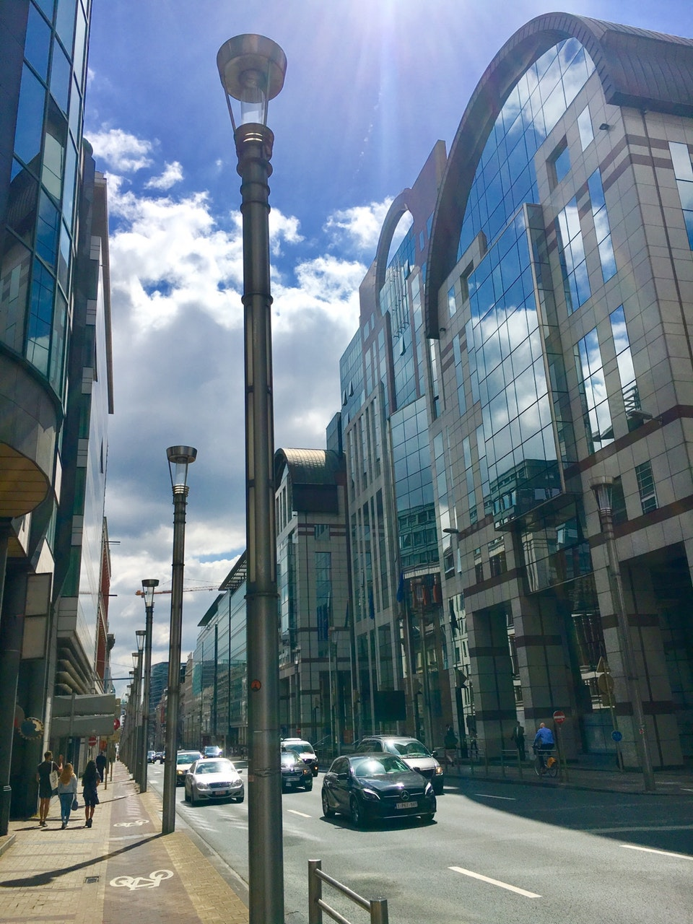
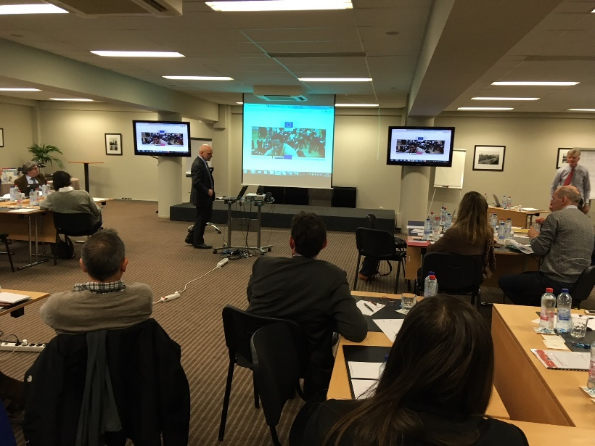
Thematic support

Slide 12
Support missions to EU Delegations
EUD Djibouti, 2017 Recommendations for implementation of an SME incubator
EUD Nepal, 2017 Identification of EU-Nepal trade facilitation and economic capacity building programme
EUD Jamaica, 2018
Feasibility study for establishing an EU Chamber of Commerce
EUD Ethiopia, 2017
Mapping EU business and EU investment and sectors analysis
EUD Tanzania, 2018 Aquaculture value chain
EUD Central Africa, 2018 Operationalisation of the EIP
EUD Malawi, 2018 Operationalisation of the third pillar of the EIP. Promotion of the structured dialogue through the establishment of an EUCC
EUD Benin, 2018
Analysis on operationa-lisation of the EIP and developing a sustainable strategy for the EUCC
EUD Mauritius, 2018 Operationalisation of the EIP
EUD Madagascar, 2018 Operationalisation of the EIP
EUD Swaziland, 2018
EIP scoping mission. Support to the private sector/EUCC
EUD Angola, 2018
EIP scoping mission and pre-identification of PSD programme
EUD Mozambique, 2018 Operationalisation of the EIP
Energy & Agri value chains
EUD Botswana, 2018 Operationalisation of the EIP
Past / on-going missions
Missions under preparation

Slide 13
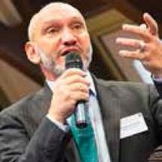
Request for mission
Chris Brown
Team Leader
Key Expert 1
Emmanuel Moyart
Key Expert 2
Mathilde Gaston-Mathé
Key Expert 3
Click here
DEVCO-TPSDE-FACILITY@ec.europa.eu

Slide 14
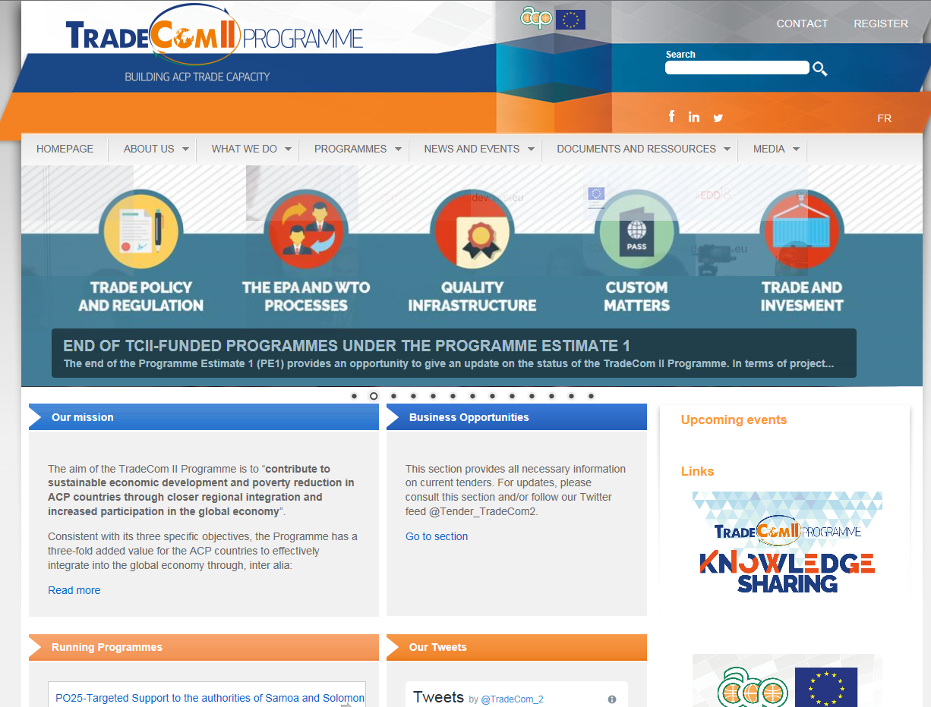
Other TA support from HQ
2. Tradecom II

Slide 15
At a glance
Up to 100.000 euro – Rapid response facility- ask now!
Examples:
Capacity building on customs to CARICOM
Legislative and institutional strengthening in Zambia
Renforcement des capacités commerciales au Sénégal: facilitation des échanges, acces au marché, mesures de défense commerciale
Thematic Facility
2016 – 2020
Managed by: DEVCO/C4, Elisabetta SARTOREL
Implemented by: AESA
Budget: 34,8 meuro
Main target group: ACP Countries entities
Demand driven

Slide 16
Other support facilities in preparation
Sustainable Investment Climate and Value Chains Programme.
Sub-Saharan Africa. 10 m euro
EUD demand driven facility. Support to macro level analysis. “Fee for service” with the WB.
TA Facility for improving the business environment and wider investment climate through structured dialogue:
ACP Countries. 10 m euro.
EU Delegation and RECs demand driven facility. Support to Meso and Micro level interventions. Implementation through EU MS agencies (GIZ, France Exper, British Council, Lux-Dev and SNV)
Support to business friendly national and regional policies and strengthen value chains:
ACP Countries. 34.7 m euro.
Joint and coordinated intervention at country and regional level. 3 IA:
WB. Macro level (regulatory and policy). 12 m €
UNIDO. Meso level (Investment promotion). 8 m €
ITC. Micro level (strengthening and support to VC). 14,7 m €
Contact in C4: Miguel Campo + Laura Atienza
FWK Lot 6 Blended Finance
16

Slide 17
SB4A examples

Slide 18
SB4A examples
A sustained dialogue with the private sector and relevant stakeholders involved in formal, informal businesses, vocational training, employment creation, leads to more relevant development cooperation programmes
At the SB4A "table" we can discuss about different priorities at national level, for instance
Support vocational training programmes together with businesses to do a better match (see example of Ivory Coast hereunder)
Support investment climate improvement programmes at national level together with government and businesses (see example of Tanzania here below)

Slide 19
Rural incubators + rural access to finance programmes to be supported by the EU and involving businesses and public entities
Cooperatives/rural associations status and development programmes + access to finance
Rural electrification programmes and related required policy reforms

Slide 20
Tanzania: New programme of Investment climate support
Following extensive consultations with €3 million a range of business associations, the Action will support with : i) an improved business environment through enhanced capacity of the private sector for dialogue on the business climate with the government; ii) better export capacity and increased market attractiveness of Tanzania through the strengthening of services provided by the business associations operating in Tanzania.
This Action is an aid for trade initiative aiming at supporting business associations in: i) strengthening the private sector's capacity of engagement with the authorities to better structure an effective national public-private dialogue on the overall business environment in Tanzania, in order to clearly identify joint business environment issues on both sides and define a process with clear actions and timelines.

Slide 21
This should contribute to simplify the complex regulatory framework which hampers the development of the private sector in Tanzania; ii), reinforcing its capacity to provide services and information to promote exports to the EU or to attract European investment in Tanzania. These combined actions are expected to contribute to inclusive growth through stimulating local entrepreneurship, attracting foreign investors, creating jobs and promoting industrialisation.
This action will focus on the priority areas of taxation, immigration and skills development.
This action is consistent with other EU programmes in Tanzania, particularly the Sector Reform Contract on Economic and Fiscal Governance, which will support the government on tax policy and reforms.
This action will also build on the very successful launch of the study funded by the EU "European Investment in Tanzania: how European investment contributes to industrialisation and development in Tanzania".

Slide 22
Exemple: Programme d'appui à la relance de la formation professionnelle et à l'insertion des jeunes (PROFORME), Cote d'Ivoire
Du 1er avril 2012 au 31 octobre 2018.
Objectif: Renforcer l'employabilité des jeunes et à leur assurer une formation professionnelle de qualité, tout en promouvant l'emploi décent en Côte d'Ivoire.
EUR 28,5 millions. Mis en œuvre par ONUDI
- Actions:
(1) Appuie la réforme et le fonctionnement du système de formation professionnelle;
(2) Offre des formations qualifiantes adaptées aux jeunes et ex-combattants;
(3) Réhabilite et équipe 11 centres de formation professionnelle dans le pays.
Notes:
Il met l'accent sur le pilotage et le fonctionnement du système, le renforcement des capacités des acteurs, la dispensation de formations qualifiantes, la réhabilitation et l'équipement de 10 centres de formation professionnelle (dont deux écoles régionales d'agriculture) et de l'Institut Pédagogique National de l'Enseignement Technique et Professionnel (IPNETP). Ce dernier est notamment chargé d'assurer des prestations de formation professionnelle continue au bénéfice de formateurs d'organismes de formation publics ou privés et des prestations de conseils, d’expertise, de production pédagogique et d’application industrielle au profit de partenaires extérieurs publics ou privés.

Slide 23
- 8 vagues successives de formations qualifiantes ont été menées à bien dans plus de 18 filières couvrant plus de 50 métiers.
- Plus de 7.500 apprenants, dont 14% de femmes ont pu en bénéficier, parmi lesquels on compte 2600 ex-combattants.
- La huitième vague de formation qualifiante agropastorale, déconcentrée en milieu rural, a été destinée à 1.600 femmes et jeunes.
- Sur les 7 premières vagues, 70% ont pu s'insérer en entreprise ou à leur propre compte. A travers un appui budgétaire, on devrait suivre le taux d'insertion des diplômés (indicateur).
- Les formations sont développées en partenariat avec les secteurs public et privé.
- Renforcement des capacités de 1.200 cadres du Ministère en charge de l'Enseignement Technique et de la Formation Professionnelle
- Réforme de la gouvernance du secteur de l'enseignement technique et de la formation professionnelle: encore à finaliser. Le nouveau modèle devrait impliquer plus le secteur privé.

Slide 24
Programme de Blending Exemple: Programme de Compétitivité et commerce au Maroc et en Tunisie
- Composantes BEI et BERD. Contribution UE de EUR25 m pour BEI et EUR25 m pour BERD.
- BEI: (1) lignes de crédit de long terme a entités financières locales pour augmenter l'accès au financement dans certaines chaines de valeur: manufacture et agriculture au Maroc; huiles végétales, fruits et légumes en Tunisie; (2)Facilité de partage de risque couvrant une garantie de première perte; (3) Facilité d'appui expertise pour les institutions financières et pour les MPMEs.
- BERD: (1) Analyses sectorielles et diagnostiques sur les problèmes de compétitivité des entreprises par chaine de valeur; Analyse du cadre réglementaire; (2)Acces au financement en agriculture, manufacture et services, logistique/distribution et secteur TIC, pour 200 MPMEs; (3) Appui technique a 600 MPMEs.

