Slide 1
Experiences with Transboundary River Basin Management in Eastern Europe, Central Asia and the Middle East
Gert Soer, team leader ‘Support to MED EUWI project’
Regional Water Seminar, Dead Sea, 21-24 March 2011

Slide 2
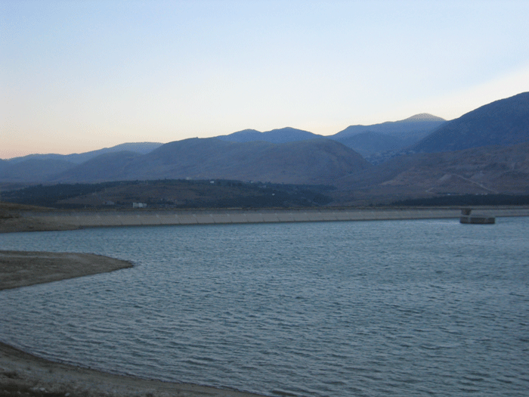
Activities of the Project “Support to MED EUWI”
Country dialogues on Integrated Water Resources Management:
Egypt, Palestine & Lebanon
Support to the Joint Process WFD-EUWI
Working groups
Pilot projects (Buna/Bojana & Jordan River)
Regional Water Seminar, Dead Sea, 21-24 March 2011

Slide 3
Activities in the Joint Process
Sebou pilot project in Morocco on water economic issues
2007-2008
Five working groups on water management issues
2003 until now
Litani river pilot project in Lebanon on organizational issues
2008-2009
Pilot project on RBM organisation in the Jordan River basin
starting 2011
Pilot project on integration of ICZM and IWRM in Buna/Bojana
starting 2011
Regional Water Seminar, Dead Sea, 21-24 March 2011

Slide 4
Case studies
Central Asia; Aral Sea catchment; Syrdarya and Amudarya rivers (1996 and later)
Lithuania/Latvia; Transboundary management of the Venta and Lielupe river basins (1999)
Russian Federation: Water management in the Oka river basin (2000-2001)
Ukraine/Slovakia/Hungary/Rumania: Flood protection in the Tisza river basin (2004-2005)
Israel/Jordan/Lebanon/Palestine/Syria: Jordan river basin (2011)
Regional Water Seminar, Dead Sea, 21-24 March 2011

Slide 5
Some characteristics
Regional Water Seminar, Dead Sea, 21-24 March 2011

Slide 6
Aral Sea basin
New freedom after fall of the Soviet Union: Failure of the water allocation system
Nuclear waste in upper reaches; calamity risk during flooding
Upstream-downstream conflict between electricity generation and irrigation
Increase in salinity in lower reaches (up to 2,000 mg/l) due to irrigation return water
No economic value of water
Regional Water Seminar, Dead Sea, 21-24 March 2011

Slide 7
Aral Sea basin – management structure
Coordination between 5 riparian countries (water users) takes (since 1993) place in the “Interstate Commission for Water Coordination of Central Asia (ICWC)”
ICWC is supervising BWOs Syrdarya and Amudarya who are responsible for operation and capital investment; the BWOs are jointly financed by the 5 riparian states
Each year again ICWC must lobby for funds with the Governments of the 5 riparian states (yearly inter-government meeting)
BWOs depend on governments budget assignments and has no “own” income
Regional Water Seminar, Dead Sea, 21-24 March 2011

Slide 8





Example of management structure - Aral Sea
Scientific and Information Center (KAZ, TJK)
operational branches
ICWC meeting (ministers)
BWO Syrdarya (UZB)
Training Center
(UZB)
ICWC SECRETARIAT
(TJK)
BWO Amudarya (UZB)
Coordination Metrological Center (KGZ)
Donor Consultative Group
Regional Water Seminar, Dead Sea, 21-24 March 2011

Slide 9
Venta/Lielupe basin
Nutrient rich wastewater (urban and agriculture) in upper branches of the rivers
Sensitive area with respect to eutrophication (natural river flows, Gulf of Riga, Baltic Sea)
In the beginning little consultation between the two countries on upstream/downstream issues
Latvia
Lithuania
Regional Water Seminar, Dead Sea, 21-24 March 2011

Slide 10
Venta/Lielupe basin– management structure
National River Basin Commissions for each river
Technical protocol (treaty) between Lithuania and Latvia on the management of the river basins (2003)
Joint River Basin Commission under WFD since 2006
In practice joint management of the river basins on both side of the border (operation and planning)
River Basin Commissions have own income (like in France) and subsidize capital investments (in their own country)
Regional Water Seminar, Dead Sea, 21-24 March 2011

Slide 11
Example of management structure - Venta / Lielupe rivers
Democratic stakeholder structures
Minister meeting (when needed)
River Basin Commission Lithuania
Scientific Centers
Transboundary River Basin Commission
River Basin Commission Latvia
Environmental Agencies
European Commission
Regional Water Seminar, Dead Sea, 21-24 March 2011

Slide 12
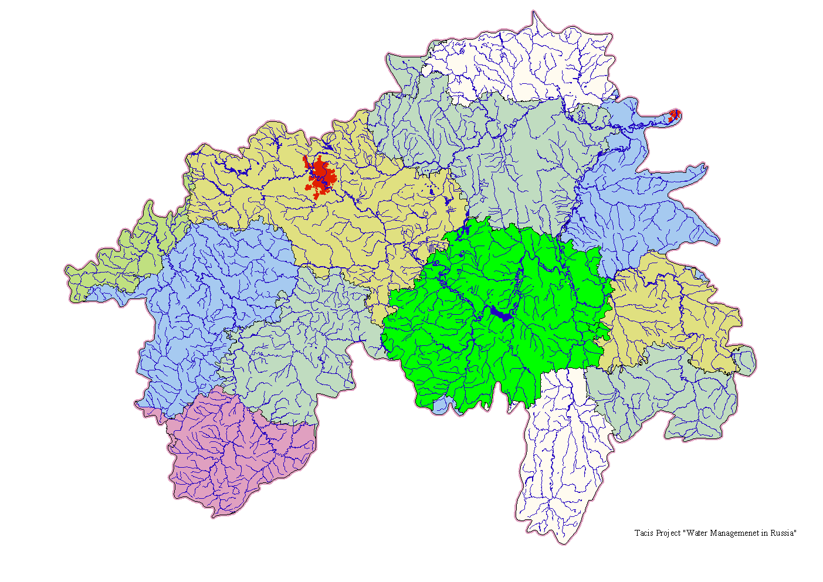
Oka river basin
Sufficient water resources
Mainly water quality problems (toxic components, BOD) causing problems for drinking water supply
Upstream-downstream conflict between polluters and water users
Polluters are not paying for damage
Decision-making system does not deliver; existing river basin organizations are mainly scientific and planning, but planning is not implemented
Regional Water Seminar, Dead Sea, 21-24 March 2011

Slide 13
Oka river basin– management structure
The river basin has been managed by the BWO Moscwa and Oka since the 1950s
An Oka River Basin Committee was established in 2001 with participation of stakeholders
A new Water Code was finalized by the Duma (Russian Parliament) in 2006 giving new authority to the River Basin Committee with respect to planning
Regional Water Seminar, Amman 21-24 March 2011

Slide 14
Example of management structure – Russian Federation
Prime Minister
Ministry of Natural Resources
Basin Water Council (stakeholders)
Federal Technical Services
BWO Moskva-Oka (operational unit)
Technical Services of federal subjects
Regional Water Seminar, Amman 21-24 March 2011

Slide 15
Tisza river basin
Canalization of upstream river channels leading to flooding problems downstream
Inadequate water storage capacity in upstream areas
Engineering solutions (build dikes ever higher) instead of resilient flood management
Inadequate flood warning system upstream-downstream
Water quality calamities from mining activities in Rumania (cyanide spill January 2000)
Concentrations of heavy metal and organic micro-pollutants in sediment exceed standards

Slide 16
Tisza river basin– management structure
Bilateral agreements since 1955
International Commission for the Protection of the Danube River (ICPDR) since 1994
After Serbia joined the ICPDR, the Tisza group (riparian countries) have signed a MoU in 2004 on transboundary cooperation
Four of the five riparian states are EU countries, the fifth (Serbia) is not
An analysis report has been prepared in 2007
A joint river basin management plan was planned for 2009 but has not yet been completed (there was a draft in 2010)
No real Joint River Basin Commission with delegated authority (yet)
Regional Water Seminar, Amman 21-24 March 2011

Slide 17
Example of management structure – Tisza river
ICPDR
Donors
Tisza Group
(Governments and other organizations)
Stakeholders (water users, NGOs, scientists)
Operation and implementation by the countries
Line ministries
Regional Water Seminar, Amman 21-24 March 2011

Slide 18






Example of management structure - Mekong river
COUNCIL (ministers)
Donor Consultative Group
JOINT COMMITTEE (high ranking technicians)
National Mekong Committees; line agencies
MRC SECRETARIAT
Regional Water Seminar, Amman 21-24 March 2011

Slide 19
1997 UN Convention on International Watercourses
Jordan, Lebanon and Syria ratified this convention; Palestine declared to sign and ratify when they become a state. Israel did not sign or ratify the convention
Obligation to cooperate
Obligation not to cause significant harm
Equitable and reasonable utilization
Obligation to protect and conserve the ecosystems
Regional Water Seminar, Dead Sea, 21-24 March 2011

Slide 20
Jordan River
Proposed river basin consultation structure
Government of Jordan
bilateral consultations
Government of Israel
consultations
GLOWA
Palestinian Authority
MED EUWI
consultations
EXACT
Joint consultations
FOEME
Government of Lebanon
technical support
European Commission
Arab
Jordan River Basin Initiative
consultations
Secretariat
Government of Syria
Other donors
Regional Water Seminar, Dead Sea, 21-24 March 2011

Slide 21
Jordan River
Purpose of the consultations
Inventory of water resources and uses using uniform assessment methods
Inventory of pressures on water resources
Inventories of measures in the pipeline to relieve pressures
Discussion on equitable division of water resources
Development of alternative scenarios to relieve pressures and make resource allocation more equitable
Revision of transboundary agreements if needed
Regional Water Seminar, Dead Sea, 21-24 March 2011

Slide 22
Thank you for your attention!
Regional Water Seminar, Dead Sea, 21-24 March 2011

