Slide 1
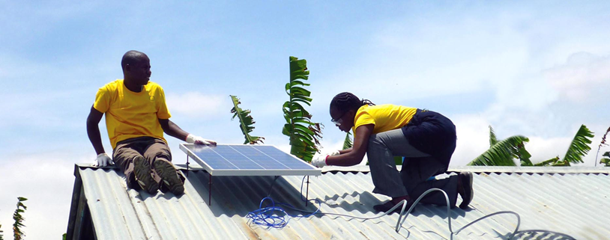
Sweden’s experiences from mobilizing additional financing for development purposes with guarantees
Brussels 9 October 2018
Erik Korsgren
Head of Loans and Guarantees Unit

Slide 2
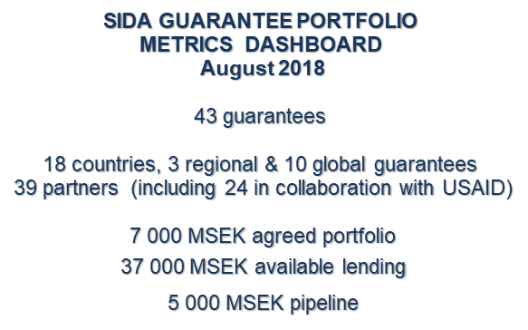
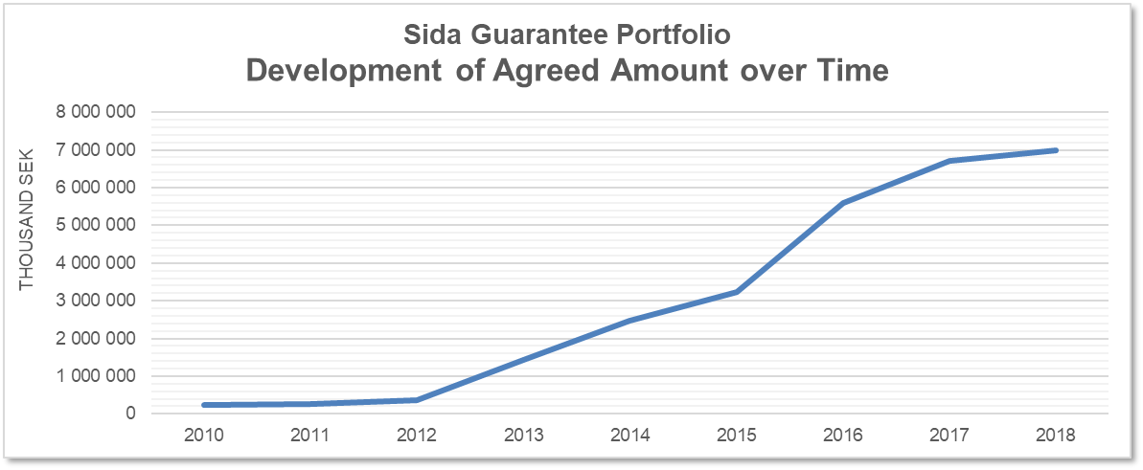
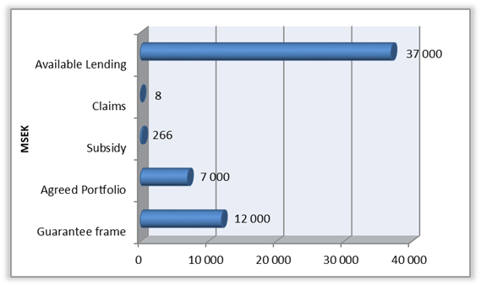
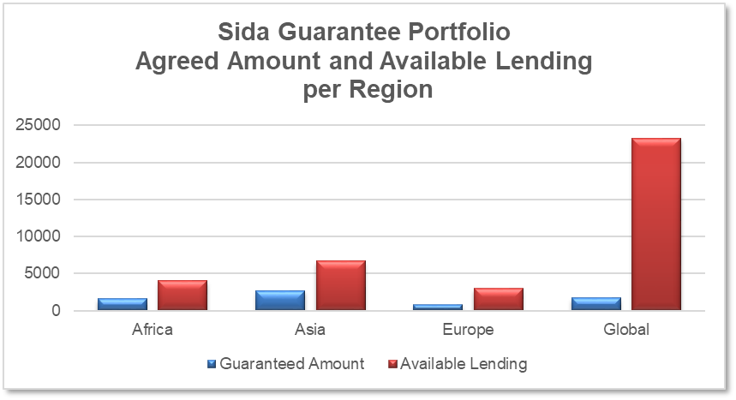
1 Euro = 10 SEK

Slide 3
Sida’s approach to Gender Mainstreaming
Methods to be used separately or jointly
Mandatory
INTEGRATION of gender equality
GENDER ANALYSIS
Identify HOW
Strategy to close the Gender Gaps
TARGETED
RESULTS
DIALOGUE
on Gender Equality
Country and programme/project level
All methods are equally important

Slide 4
Tanzania Horticultural Association (TAHA) – MSEK 43
Private Agricultural Sector support (PASS) Trust- MSEK 180 (guarantee)
The Agricultural Markets Development Trust Fund (AMDT)
– MSEK 48
COSTECH/SIDO)- MSEK 18,3
Coffee Farmers Alliance Tanzania (CFAT-II) – MSEK 11,5
Start – Implementation – Goal – Follow up
by Joyce Tesha and Gisela Strand, Learning week 16 August, 2018
Notes:
Sida-S and Embassy agreed to work together to strengthen gender mainstreaming in ongoing programmes, new approach:
Gender help desk/ Contracting local gender consultant… Workshop in October 2017 and follow up march 2018. Coaching in between by consultants.
So the five partners are… Umbrella organisation.. Trust fund working… providing capacity, financing etc to implementing partners… These organisations are accountable that their partners adhere to the requirements of gender mainstreaming .
Starting with a workshop with the five partners - 3-4 from each organisations representing CEO, M&E in Dar-es- Salaam 2-3 days,,, then coaching session by local consultants and then another workshop six month later.

Slide 5
PASS Blended Finance Model
Re-guarantee
Equity
Risk sharing fees
BANKs
Commercial/ DFIs
Credit Guarantees
Equity
Leasing Finance Company
NON-BANK FINANCIAL INSTITUTIONS
(e.g. Microfinance)
Medium/Large Agribusiness private companies
Quasi Equity/Mezzanine Finance
Commercial debt instruments
BDS
Finance Lease
FARMERS
micro, small and medium enterprises (MSMEs)
Sector: Agriculture, Livestock & Fisheries

Slide 6
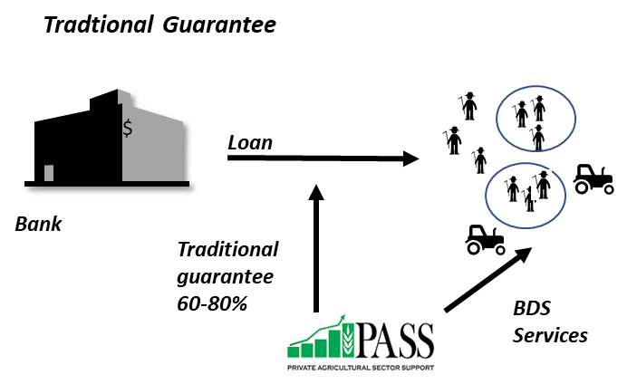
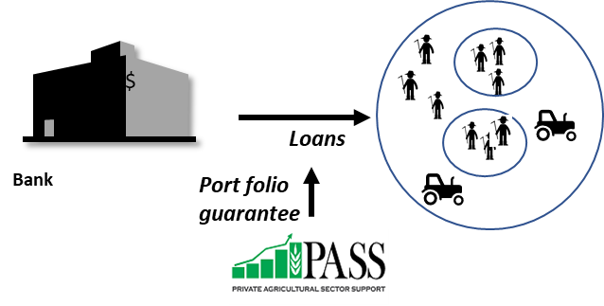
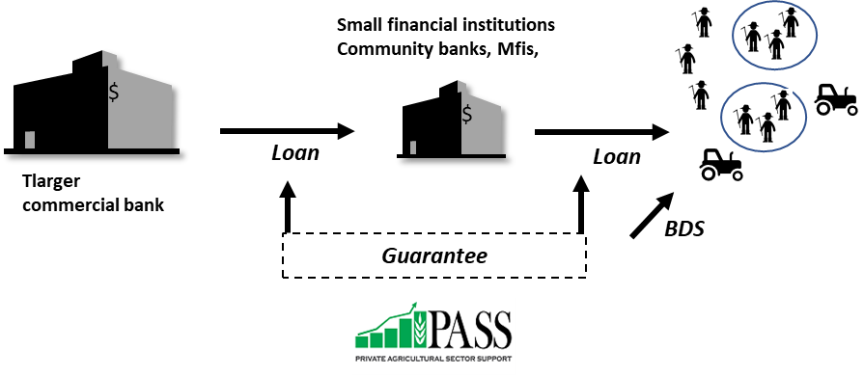
PASS Products and Services
Business Development Services:
Feasibility studies,
Business Plans Preparation,
Capacity Building to Farmers,
Farmer development services-group formation,
out-grower schemes & contract farming
AIC services
PASS Guarantee Products

Slide 7
Our Achievements
A total of 729,920 agricultural entrepreneurs benefited from PASS Guarantee between the years 2013 to 2017 with total loan amounts of TZS 404.1 billion (US$ 177 million).
In 2017 alone, PASS Trust supported a total of 170,974 individuals of which 80,358 (47%) were women.
The percentage of women has continued to increase compared from 45.3% in 2016 due to efforts made by PASS to make access to credit more inclusive.
The guarantee cover of up to 80% for women owned agricultural business compared to 60% ceiling for other businesses

Slide 8
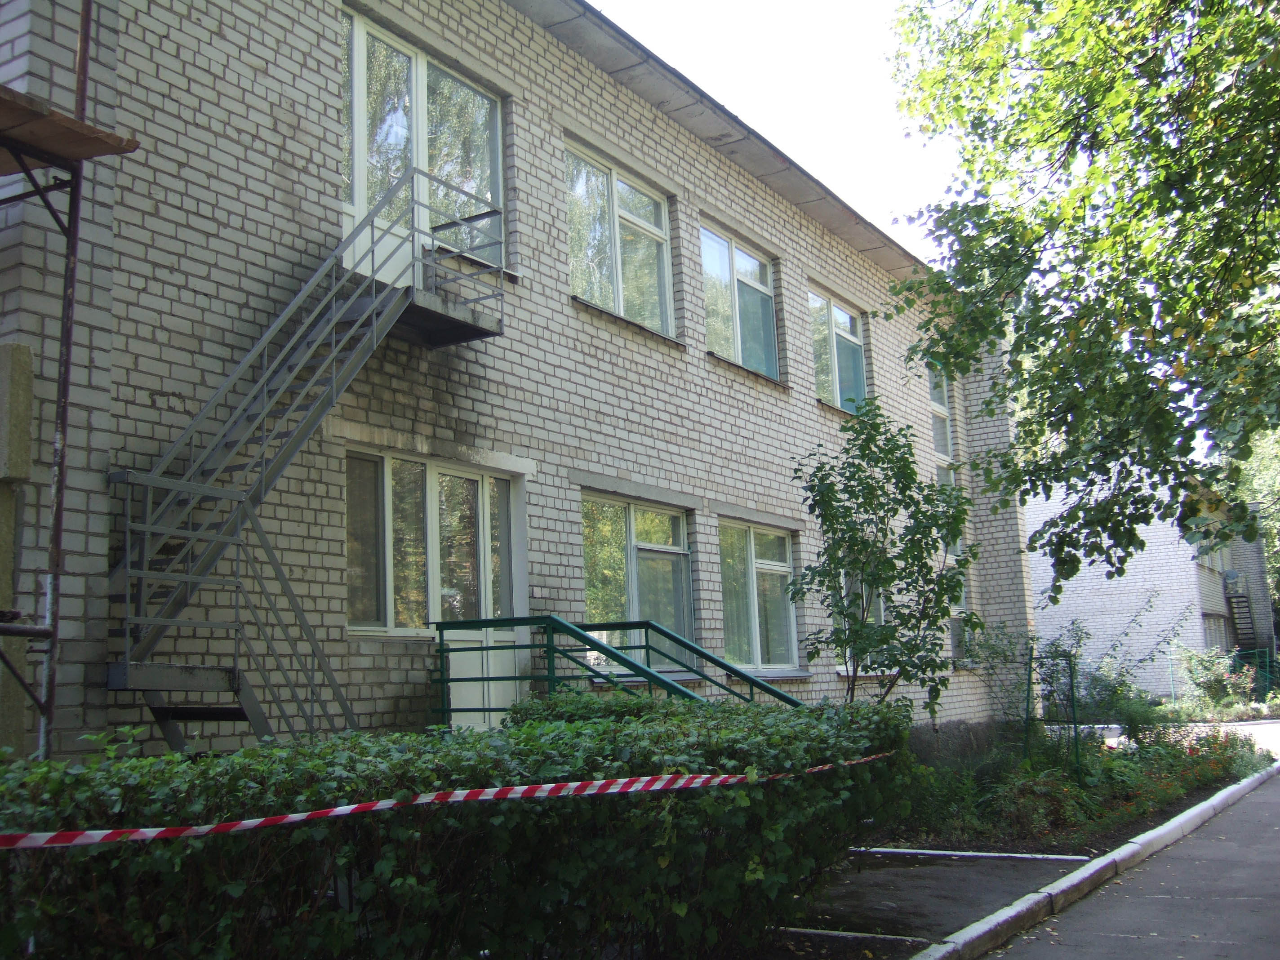
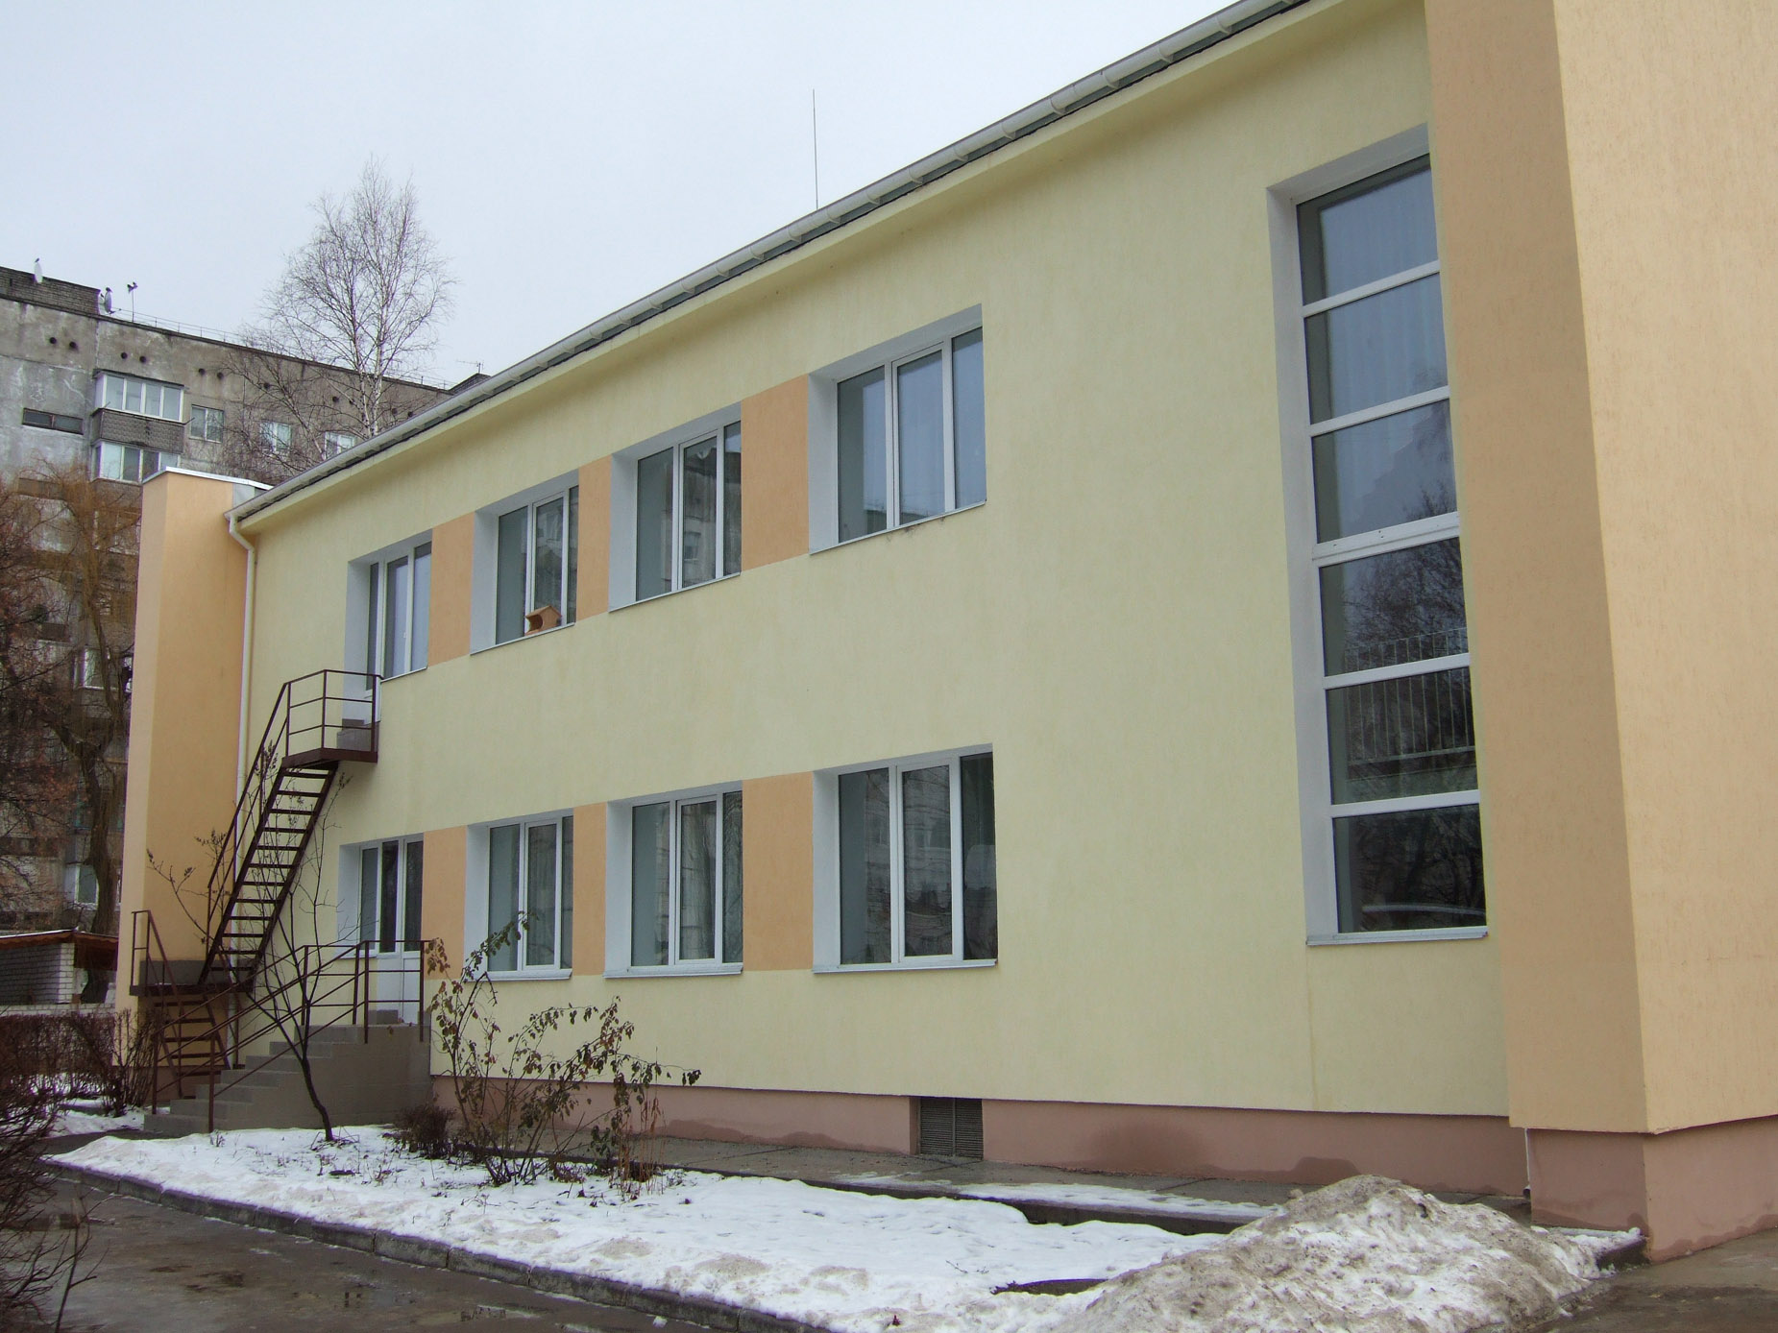
Nordic Environment Finance Corporation (NEFCO) 25 MEUR Guarantee – Energy efficiency investment in municipalities – 50 MEUR (Ukraine 2014-2029)
Key Impact Results
Additional lending up to 50 MEUR
Improved environment, reduced climate impact
CO2 reductions of some 150 000 tonnes/year (6 projects to date)
Integration with EU
More sustainable public services
Loans
Municipality
Municipality
Municipality
Guarantee Fee
Sida Guarantee 50% (pari passu)
Notes:
Nordic Environment Finance Cooperation
Objective: To contribute to more sustainable public services in areas such as water and sewage, waste management, energy efficiency and renewable energy in Ukraine, in 12-14 municipalities
Through risk sharing stimulate NEFCO to maintain a project pipeline of 25 MEUR
NEFCO has worked with municipal investments in Eastern Europe for around 25 years.
Sida today has five trust funds with NEFCO for consultancy services and investments, currently around 220 MSEK.
The recent crisis in Ukraine and the uncertain situation caused NEFCO to address its
Nordic owners, and also Sida and other partners for assistance in early 2014, possibly
through guarantees.
The discussions with Sida resulted in an agreement for a portfolio
guarantee for NEFCO covering 50 % of NEFCO loans for energy efficiency projects in
the municipal sector in Ukraine up to an amount of 25 MEUR that was agreed in
December 2014. in order for NEFCO to continue to be engage in sector and for country to implement the investments which Sida amongst others had been preparing.
NEFCO first adressed our colleagues for development cooperation in Eastern Europe, who put the question forward to the Unit for Loans and Guarantees.
20180406 Loans under cover Kiev Muncipal ESCO for public buildings 5 MEUR City of Zhytomyr Energy Efficiency in public buildings 3 MEUR
Lviv Sludge digester / Biogas Plant 5 MEUR Energy efficiency in Public Buildings Ivano Frankivsk 5 MEUR Energy Efficiency in public buildings in Chernivitski 5 MEUR
Energy efficiency in Public Buildings Ivano Frankivsk Phase 2, 4 MEUR
Terms Guaranteed amount max 25 MEUR, not to exceed 300 MSEK
Guarantee agreement valid – 16 December 2014 – 16 December 2029 Final date for placing loan under cover 31 December 2019
Fees Origination fee 1.2%/
Utilization fee 1.00% p.a.
(Estimated defaults 2.3% p.a.), and 1.5% for the extension (Sida subsidy of fee 8 125 000 SEK) + 3 740 000
The total expected reductions of CO2-emissions from these six
projects once completed is assessed to some 145,400 tonnes of CO2 per annum.
One lesson learned is that these projects take considerably longer time to complete than planned,
and so far it is only one project that is nearing completion - the Kiev public building
project, which is expected to be completed by the end of 2017.
In two of the projects, implementation has been affected by bankruptcy of the borrowers'
servicing bank, but in both cases the losses were covered by the borrower and its
Ukrainian gurantor. Consequently, this situation did not result in any losses for NEFCO.
This underlines the ability of NEFCO to continue its operation in Ukraine under
challenging conditions without losses.

Slide 9
KPWF – Payment Flows
Snr Bonds are issued to Institutional Investors at market rates
Jnr Bonds (bullet maturity and deferred interest) are subscribed by WSTF with NT funding; proceeds are deposited into DSRA
Issuer enters into Loan with WSPs
Loan proceeds are deposited in the Proceeds Account.
Upon meeting certain project milestones, proceeds are released to WSP (on instructions by the Trustee)
Loan P&I is paid in 9 monthly pmts;
On payment dates, funds from the DCA are released to pay bondholders
Cardano funds DSRA
Proceeds from junior bonds are placed in the DSRA
If there is a DCA shortfall, the trustee will draw on the DSRA
If the DSRA is exhausted, trustee draws from GuarantCo interest guarantee in case of Interest shortfall and USAID/SIDA in case of principal shortfall
Guarantco interest Guarantee
USAID/SIDA Principal Guarantee
Debt Collection Account (DCA)
d
Development partners (Cardano)
Debt Service Reserve Account (DSRA)
c
a
6
7
b
SPV Trust
Bond Holders
WSPs
3
Lender
Issuer
1
2
WSTF
5
Proceeds Account
4
2
NT/MoWI
Flow of Funds
Legal Relationship

