Slide 1
EC Reference Document:
Social Transfers in the Fight Against Hunger
Nicholas Freeland
Cécile Cherrier

Slide 2
Rationale
Hunger increasing as a result of global crises
Achievement of MDGs in doubt
Social transfers playing an increasingly important role in EC, MSs’ and partners’ response to food insecurity
Need for guidance and access to resources

Slide 3
Reference Document
EC Tools and Methods Series:
  Concept Notes offer a basic theoretical introduction to a concept
  Reference Documents seek to deepen the understanding of a concept and present good practices in order to stimulate discussions around the practicalities of aid
  Guidelines provide very practical guidance to EC staff for operationalising that concept through the phases of the operation cycle
Audience: Delegations, MSs, partners, HQ

Slide 4
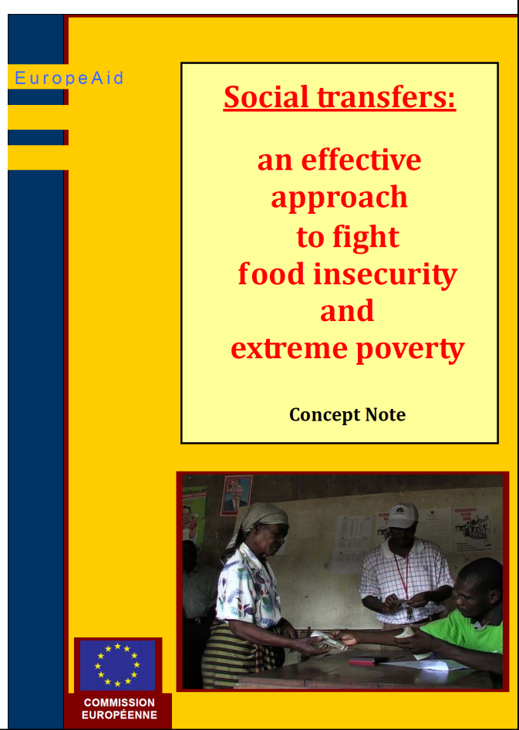
Concept Note
Seminar in Bruxelles – April 2008
Regional meetings
  Maputo
  Niamey
  Dhaka
  Dar-Es-Salaam
Concept Note released early-2010

Slide 5
Original workplan

Slide 6
Reference Document ToC
Chapters
1 Introducing social transfers
2 Conceptualising social transfers
3 Justifying social transfers
4 Using social transfers to fight hunger
5 Contextualising social transfers
6 Designing social transfers
7 Managing social transfers
8 Supporting social transfers
9 Financing social transfers

Slide 7
Contents
Chapter 1 – Introducing social transfers
1.1. Background and rationale
1.2. Scope and purpose of the Reference Document
1.3. Structure of the Reference Document
Chapter 2 – Conceptualising social transfers
2.1. Defining social transfers
2.2. Types of social transfers
2.3. Operational frameworks for social transfers
2.4. Policy framework for social transfers

Slide 8
Definition
Social transfers are non-contributory, publicly-funded, direct, regular and predictable resource transfers (in cash or in kind) to poor or vulnerable individuals or households, aimed at reducing their deficits in consumption, protecting them from shocks (including economic and climatic), and, in some cases, strengthening their productive capacity
Provision ➢ Prevention ➢ Promotion

Slide 9
Contents
Chapter 3 – Justifying social transfers
3.1. Poverty reduction and risk management
3.2. Economic growth and capital-based production
3.3. Political stability and state building
3.4. Social justice and human rights
3.5. Food security
Chapter 4 – Using social transfers to fight hunger
4.1. Social transfers to increase availability of food
4.2. Social transfers to improve access to food
4.3. Social transfers to improve nutritional adequacy of food intake
4.4. Social transfers to enhance crisis prevention and management

Slide 10
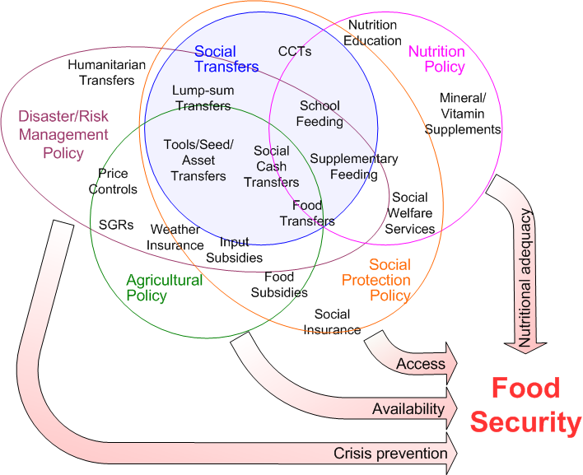
Conceptual basis

Slide 11
Contents
Chapter 5 – Contextualising social transfers
5.1. Nature and causes of food insecurity
5.2. Policy framework
5.3. Existing social transfer initiatives
5.4. Institutional context and capacity
Chapter 6 – Designing social transfers
6.1. Objectives
6.2. Targeting
6.3. Work requirement
6.4. Graduation
6.5. Transfer form
6.6. Benefit level
6.7. Delivery mechanisms
6.8. Conditionality

Slide 12
Contents
Chapter 7 – Managing social transfers
7.1. Cost, affordability and sustainability
7.2. Implementation
7.3. Monitoring and evaluation
Chapter 8 – Supporting social transfers
8.1. Policy dialogue
8.2. Capacity development
8.3. Financial resources
8.4. Implementation
Chapter 9 – Financing social transfers
9.1. Procurement and grant award
9.2. Common pool funds
9.3. Budget support

Slide 13
Contents
Annexe 1 – Glossary of terms
Annexe 2 – Further information and guidance
References
Plus:
  54 boxes
  25 resources

Slide 14
Emerging themes: Govt
Elaboration and support of a national vision
Use of existing national systems (eg financial, M&E)
Integration of different instruments and target groups in a comprehensive programme
Enshrining in legislation/constitution as a right
Engaging civil society, private sector, NGOs, beneficiaries in areas of comparative advantage
Links and synergies with other sectors and policies

Slide 15
Emerging themes: donors
Coalesce and collaborate around national vision (UN SPF; EC and MS)
Understanding of political economy and local concepts of vulnerability and food security
Funding through a single channel (BS; pool funds)
Funding of one-off start-up costs (ID systems; delivery; evaluation)
Provide long term commitments (>10 years)
Build in flexibility to allow index-linking
Underwrite ability to expand/extend national systems as a response to shocks
Develop training materials for use by national institutions

Slide 16
What next?
Obtain buy-in from MSs/partners for Ref Doc
Raise awareness and promote use of Ref Doc (e.g. seminars)
Provide training to EC (and MSs’) staff in social transfers, framed around Ref Doc
Provide technical support on social transfers (cp Nutrition Advisory Service)
Use Ref Doc as the basis for EC and MS joint interventions in selected countries
Continue to refine and improve Ref Doc

Slide 17
Pilot project to mitigate food insecurity through support for social transfers
Objective :
  Increase the impact, quality, sustainability and coverage of social transfer schemes to address poverty and hunger
Activities:
  Identification of 3-5 suitable countries:
    Food insecure
    Conducive institutions
    Political will for a national approach
  Advisory service exploratory missions and technical support
  Organisation of working seminars to foster collaboration

