Slide 1

Child Sensitive Social Protection in Africa
Gaspar Fajth
Social Policy Adviser
Eastern and Southern Africa Region
gfajth@unicef.org
Julie Lawson-McDowall
Social Protection Specialist
jlmcdowall@unicef.org

Slide 2

Development challenges in Eastern and Southern Africa
192 million children (0-17) 49% of total population
40% + children suffering from chronic malnutrition in 8 out of 20 countries in the East and Southern Africa Region
41% of population do not have improved source of drinking water
9.7 million out of school children (10-15% of all eligible school age children)
HIV/AIDS epidemic – 60% of global new infections
8.7 million children have lost one or both parents to AIDS
Nearly 1/5 of world’s maternal deaths (103,000 annually)
Under 5 mortality – 107 per 1000 live births; 1.5 million U-5 deaths (2009)
For every child
Health, Education, Equality, Protection
ADVANCE HUMANITY

Slide 3
How UNICEF used to work
Nutrition
Health
Water and sanitation
Child protection
Emergency interventions
Education
Social welfare
Source: UNICEF

Slide 4
How UNICEF works now
Social protection cuts across many sectors
Nutrition
Health
Water and sanitation
Child protection
Emergency interventions
Education
Social Protection →
Social welfare
Source: UNICEF

Slide 5
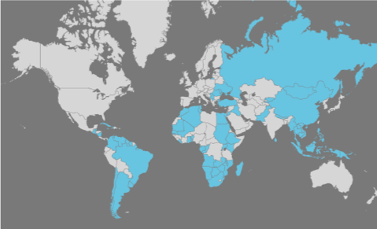
UNICEF work in Social Protection:
124 programmes in 76 countries

Slide 6
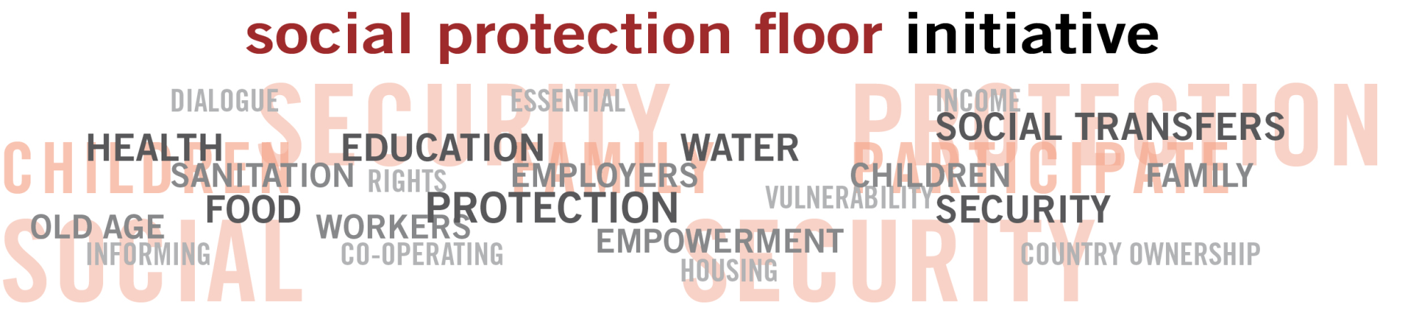


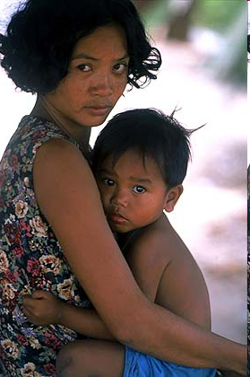
"The Social Protection Floor Initiative is a UN system-wide effort
to promote common priorities and solutions,
to ensure basic social guarantees for all"
Ban Ki-moon, UN Secretary General
Message on the World Day of Social Justice, 20 February 2010
Lead agencies
"The world does not lack the resources to abolish poverty,
It only lacks the right priorities”
Juan Somavia, ILO Director-General
Cooperating agencies
FAO, IMF, UNICEF,
UNAIDS, UNDESA,
UNDP, UNESCO,
UNFPA, UN-HABITAT,
UNHCR, UNICEF,
UNODC, OHCHR,
UN Regional Commissions,
UNRWA, WFP, WMO,
World Bank
and development partners

Slide 7
UNICEF and the Social Protection Floor Initiative
Means to ensure availability of:
Health services
Food
Education
Water and sanitation, housing
Other social services as defined by national priorities
Rights and transfers to guarantee access for:
Children
People in active age groups with insufficient income from work
PARENTS
Older persons and people with disabilities (e.g.pensions)
GRAND/
PARENTS

Slide 8
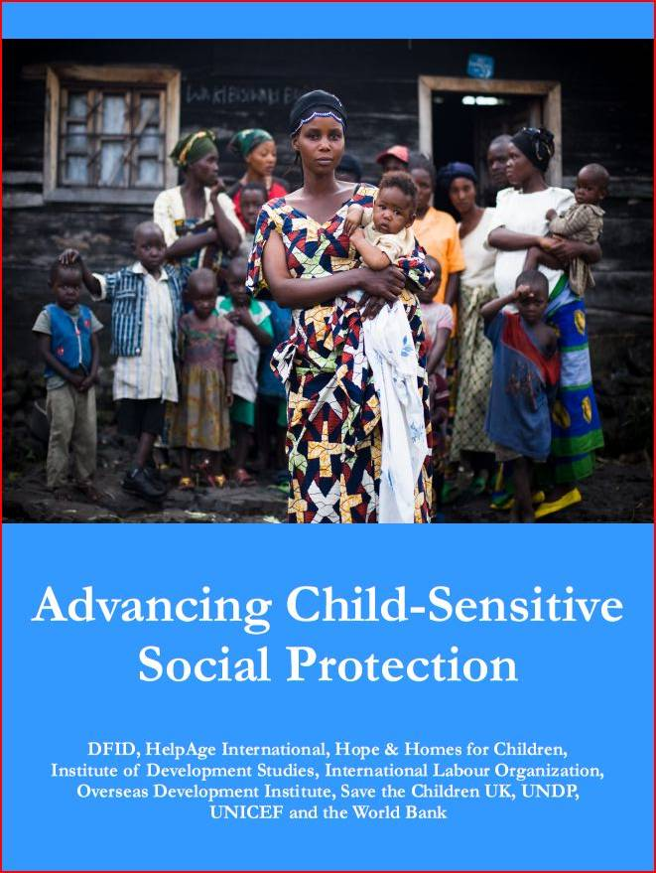
Principles of child sensitive social protection
Avoid adverse impacts on children
Intervene as early as possible to prevent irreversible impairment or harm to children
Consider the age and gender specific risks and vulnerabilities of children
Mitigate the effects of shocks, exclusion and poverty on families
Make special provision to reach children who are particularly vulnerable and excluded
Consider intra-household dynamics and the balance of power between men and women within the household and broader community
Include the voices and opinions of children, their caregivers and youth in the understanding and design of social protection systems and programmes.
www.unicef.org

Slide 9
Why Children particularly need Social Protection
Social protection is a human right
  The Convention on the Rights of the Child reaffirms children’s right to social security and access to services
  Children’s vulnerability and the vulnerability of their household (e.g. poverty) or community often overlap and compound each other
  Children are particularly vulnerable to instability e.g. loss of family care is a significant risk for children
  Traditional service delivery modes favour easy-to-reach, better-off children
Children’s complex physical, psychological , emotional and intellectual development create particular opportunities as well as vulnerabilities
  Short window opportunity
  High returns to investment
  Strong gains from combination of interventions

Slide 10
Childhood Vulnerability
  Biological, time-sensitive needs
    There is a “window of opportunity” in children’s physical and mental development beyond certain stages of development cannot be recuperated.
      In developing countries, the number of children under 5 years old who are have stunted growth is 195 million. Unlike weight, height cannot usually be caught up once nutrition improves.
      Children with iron and iodine deficiencies do not perform as well in school and when they grow up they may be less productive than other adults.
Michael Samson, 2008, based on Heckman & Carneiro, 2003 and Handa, 2007
For every child
Health, Education, Equality, Protection
ADVANCE HUMANITY
Notes:
There is a critical window of opportunity to prevent undernutrition – while a mother is pregnant and during a
child’s first two years of life – when proven nutrition interventions offer children the best chance to survive and
reach optimal growth and development.

Slide 11
Investing in children generates high returns: the evidence
Micronutrients for children
  the most productive global investment (Copenhagen Consensus, 2008)
  providing essential vitamins and minerals would cost $60 million per year and hold annual benefits above $1 billion: a 1500 per cent rate of return (Horton at al 2008)
Basic education
  the estimated rate of return to one additional year of schooling is 10 per cent on average globally even without counting the social benefits of better education (Psacharopoulos at al. (2004)
Infant and maternal nutrition – intergenerational effects
  evidence in rural Guatemala suggests that that for every 100 gram increase in maternal birth weight, her infant’s birth weight increased by 29 grams (Ramakrisnan at al 1999)
Early childhood development
  analysis of four early childhood and pre-school programmes indicates benefit-cost ratios range between 3.8-17.0 to one in the US (Schweinhart, L 2004)
  Indonesia Early Childhood Development Project suggests a ratio of 6 to 1 (World Bank 2009)
Child protection
  Children from socio-economically deprived families had a chance 700 times the average for placement in substitute care in the UK (Bebbington and Miles, 1989)

Slide 12
UNICEF and Social Protection in Eastern and Southern Africa
  Linkages between social protection interventions and basic social services
    HIV/AIDS, and child protection system reform
    9 country Children and AIDS regional initiative (CARI)
Strong emphasis on social cash transfers and national strategies
  Technical assistance
  Supporting pilot initiatives and system reforms
  Rigorous impact evaluations
    regional project: see www.cpc.unc.edu/projects/transfer
Policy, advocacy, program design and implementation
  Regional learning and sharing of experiences
  Ensuring focus on the poorest and most vulnerable

Slide 13
Support to social cash transfer programs
Old age pensions | Child grants/pov targeted | Pov/community based targeting | Combo
Lesotho | Namibia Evaluation | Malawi Implementation, impact evaluation | Rwanda (VUP) Implementation, impact evaluation
South Africa | South Africa Impact evaluation | Zambia Impact evaluation | Ethiopia (BOLSA) Design, advocacy, implem/evaluation
Namibia | Zambia Design, impact evaluation | Zimbabwe Design, advocacy, implem/evaluation | Pilots on the way
Botswana | OVC /community based targeting | Tanzania | Madagascar Design, advocacy
Swaziland Evaluation | Kenya OVC Design, implementation, impact evaluation | Kenya Hunger Experiment targeting | Angola Design, advocacy
Zambia | Lesotho Design, implementation, impact evaluation | Mozambique Design, impact evaluation | Uganda: Design, impact evaluation, experiment targeting
Notes:
In 11 we are involved in some kind of evaluation; in 8 rigorous impact evaluation.
In 8 participate in discussions on design
In 4 implementation
Advocacy in all of them

Slide 14
The EU Report lessons → How UNICEF can help?
Lesson 1: SP can reduce inequality, accelerate progress towards the MDGs
Lesson 2: Political will and programme ownership are key
Lesson 3: Ensuring financial sustainability is essential
Lesson 4: Success depends on institutional and administrative capacity
Lesson 5: Piloting, monitoring and evaluation help to build support and improve design
Lesson 6: Building on existing systems is crucial
Lesson 7: Synergies between social protection programmes and other investments
Lesson 8: Gender equality, women and social exclusion

Slide 15
Thank you!
gfajth@unicef.org
jlmcdowall@unicef.org

