Slide 1

Managing Risk, Promoting Growth: Developing Systems for Social Protection in Africa
The World Bank’s Africa Social Protection Strategy, 2011-2021

Slide 2
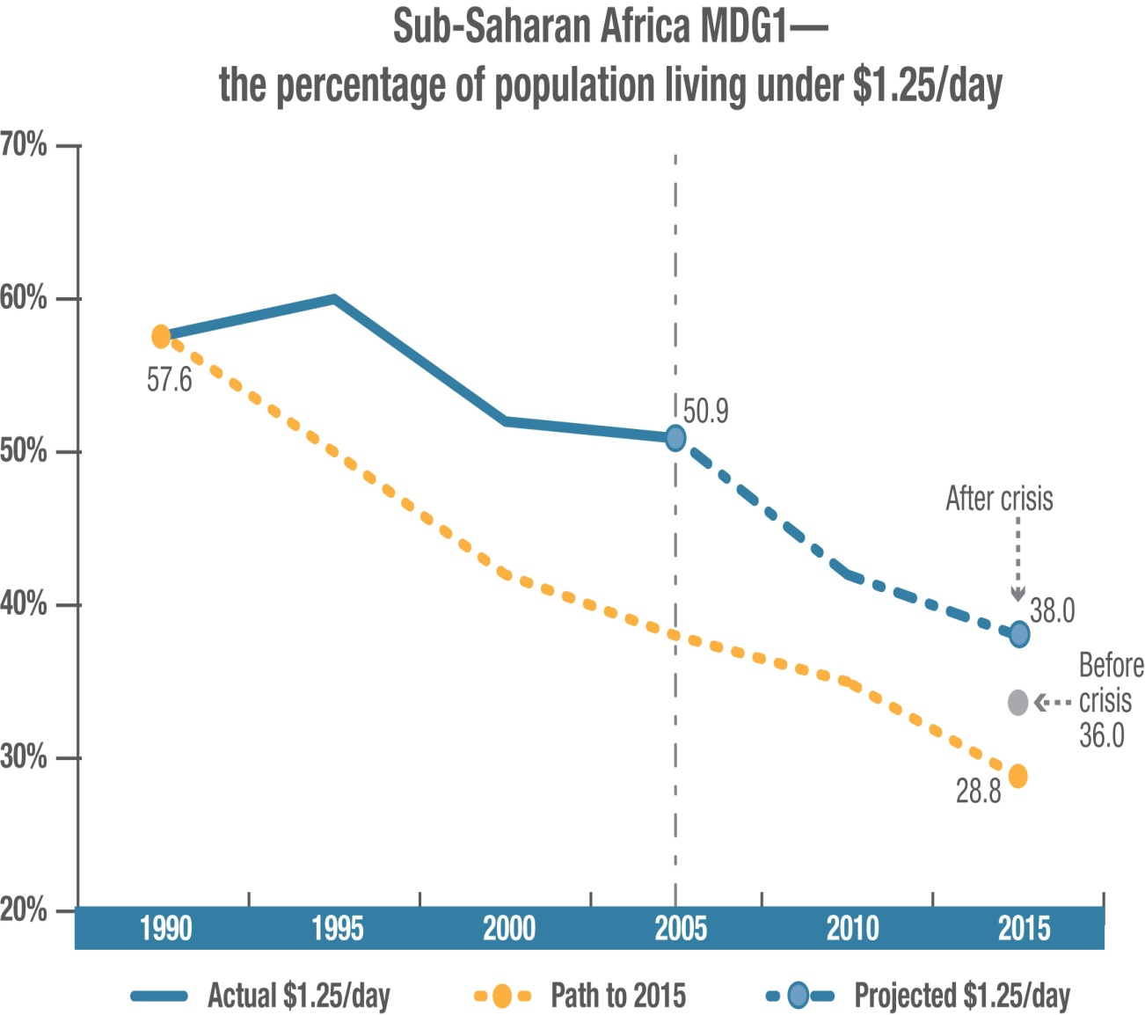
Challenges in the African context
Progress is threatened by:
  Slow employment creation especially for youth
  Increased volatility of the global economy
  New risks and sources of vulnerability, such as climate change

Slide 3
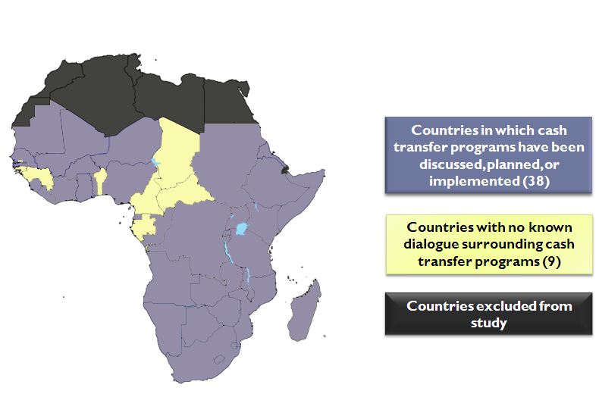
African context: SP opportunities
E.g. Widespread dialogue on cash transfers
SP strategies in at least one-third of countries
Every country experimenting with social protection
2008 crisis raised profile of the need for social protection
Strong set of donors supporting social protection

Slide 4
African context: SP delivering results
Building productive household & community assets:
  Malawi Social Action Fund public works led to a 27% decline in malnutrition rates among participating households
  Ethiopia’s PSNP beneficiaries experienced a 28.1% faster growth rate in livestock holdings than among non-beneficiaries
Expanding opportunities for productive employment:
  Youth training in developing countries have much more positive impacts
  Benin Social Fund credit increased or stabilized the incomes of roughly 100,000 people had
Reducing vulnerability:
  Countries with well-designed, operational safety nets respond most effectively to crises

Slide 5
The “3P” framework: A multi-dimensional approach
Promotion
of improved opportunities, livelihoods and better jobs
Protection
from destitution and human capital loss
Prevention
against income & expenditure shocks
Derived from the Social Risk Management Framework (World Bank 2001), Bonilla Garcia and Druat (ILO 2003), Devereux and Sabates-Wheeler (2004) and others

Slide 6
Focus: SP promotes productivity & growth
Macro: National Economy
contributing to broad economic growth
E.g. Deepens capital markets: pension funds provide capital to stock and bond markets;
Meso: Local Economy
contributing to local economic development & household productivity
E.g. Stimulates aggregate demand and local markets: countercyclical spending during downturns;
Micro: Household
contributing to household productivity
Increases entrepreneurial activities: by reducing the cost of downside risk;
Increases human capital and productivity: increased school enrollment, reduced malnutrition
E.g. Promotes social & political cohesion, enables reform: addresses worker dislocation
Accumulates and protects assets: avoidance of distressed sales of assets;
E.g. Improves functioning of the labor market: facilitates job mobility and increase ‘employability’
Economic Growth
Poverty Reduction
Making society more equitable through redistribution
by avoiding destitution and longer-term poverty traps

Slide 7
Focus: Consolidation & Harmonization
Government support instrumental for scale-up:
  Rwanda’s SP program covers 90% of the population
  Ethiopia’s PSNP covers over 7 million rural citizens, implemented through government systems with support from 9 development partners
  Kenya’s CT-OVC reaches over 100,000 households, supported by 4 development partners
Example: Where cash transfer programs in Africa are based

Slide 8
Focus: Scaling-up what works
Evidence-based policies and program design:
  Tanzania: Building a comprehensive safety net based on: Safety Net Assessment, pilot CCT and strong TASAF
  Niger: SP system based on pilot safety net & analysis
International good practices & innovation:
  Nigeria: Kano CCT for Girls’ Education will test the use of mobile phones for distributing transfers in a limited capacity environment
  Kenya: biometric systems are being used to improve registration and identification of beneficiaries
Knowledge gaps on labor markets, youth employment

Slide 9
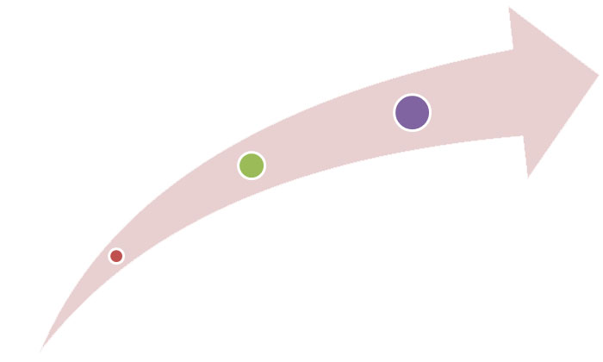
Focus: Moving to SP systems
Goal: Improving efficiency and efficacy of each program
Developing capacity countries
- Several functioning programs providing 3Ps, but limited capacity to coordinate across institutions
Goal: Harmonization of programs providing 3P functions
Better capacity countries
- Well-functioning programs across the board, but not fully coordinated
Goal: Building the basic programs to provide one or more 3P functions
Low capacity countries
- Few or no functional formal 3P institutions

Slide 10
Systems: Tailored to Country Context
Wide range of country and social protection system capacity and performance in Africa
To build appropriate SP systems:
  Economic level & exposure to risk
  Institutional capacity
  Fiscal framework & resource availability
  But, one-size does not fit all…national social protection strategies

Slide 11
The Role of the World Bank
Broaden and deepen understanding and promote innovation:
  Analytical work and policy advice,
  Facilitating south-south exchange, learning and experience
  Training
Create strong institutional partnerships:
  Convening authority
  Supporting partnerships & harmonization
Institutional development and capacity building:
  Building institutional capacity
  Technical Assistance (TA)
Lending to strengthen and support national social protection systems

