Slide 1

Managing Communities of Practice (CoPs) online
Making the best of Capacity4dev

Slide 2

Agenda
9.30-10.00 Welcome and introductions
10.00 -10.45 CoP foundations
- Developing a common understanding of CoPs - Exploring CoP benefits and barriers - Describing community maturity stages
10.45-11.00 Break
11.00-11.45 CoP strategic fit and purpose
11.45-12.45 Community Tactics
- Growth & Facilitation
12.45-13.30 Lunch break
Notes:
Today we will cover several aspects of CoP management.
we will start from more theoretical perspective and will clarify CoP definition and list key CoP benefits adn barriers. However, we will immediately start identifying the value of CoPs in the DEVCO context.
we will then introduce a conceptual framework that will allow us to identify components that you, as C4d group owners can manage and steer.
We then zoom into the practical part of the training. We take look at each individual component of our conceptual framework and present possible interventions.
We made the course applicable to your group. We have prepared a set of exercise that will allow you to develop a community management plan for your group. As we discuss various elements and interventions, you will have the opportunity to see how they could fit your group. At the end of the course you will have a first draft -- a skeleton if you oie -- of yout community management plan.
At the end we will discuss how this group can move forward. We hope this training is not a one-off, but a start of a joint travel down the CoP road.

Slide 3
Agenda
13.30-14.15 Community Tactics
- Content
14.15-15.00 Focus and plan 15.00-15.15 Coffee break
15.15-15.45 Metrics
15.45-16.00 Way forward
Notes:
Today we will cover several aspects of CoP management.
we will start from more theoretical perspective and will clarify CoP definition and list key CoP benefits adn barriers. However, we will immediately start identifying the value of CoPs in the DEVCO context.
we will then introduce a conceptual framework that will allow us to identify components that you, as C4d group owners can manage and steer.
We then zoom into the practical part of the training. We take look at each individual component of our conceptual framework and present possible interventions.
We made the course applicable to your group. We have prepared a set of exercise that will allow you to develop a community management plan for your group. As we discuss various elements and interventions, you will have the opportunity to see how they could fit your group. At the end of the course you will have a first draft -- a skeleton if you oie -- of yout community management plan.
At the end we will discuss how this group can move forward. We hope this training is not a one-off, but a start of a joint travel down the CoP road.

Slide 4

Exercise: Participant introduction
Introduce yourself to your pair
- Your name and unit
- Your interest in this training
- Your experience with online communities and groups
Notes:
10 mins exercise, 5 mins discussion, 5 minutes sharing in plenary.

Slide 5

Part 1: Introducing CoPs
CoP definition and examples
CoPs within DEVCO
Key benefits and challenges

Slide 6

What are CoPs?
“Groups of people who share a concern or passion for something they do and learn how to do it better as they interact regularly”
(Wenger)
Characteristics:
Domain
Community
Practice
Notes:
Communities of practice are not new phenomena: this type of learning practice has existed for as long as people have been learning and sharing their experiences. The term CoPs were used first time by Lave and Wenger in 1991 when they were researching situated learning. They originally used the term for mode of learning based on what might broadly be termed an apprenticeship model. They saw the acquisition of knowledge as a social process in which people participated in communal learning at different levels depending on their authority in a group.
The main surge in interest in CoPs and business came in 1998, when Wenger published the results of a ground breaking ethnographic study of a claims processing unit of a large insurance company. A CoP could now be defined in terms of three things.
Domain, or ”what it is about”: the focus of the CoP is a particular area of activity or body of knowledge around which it has organized itself. This is a joint enterprise in as much as it is based on a common or shared understanding that is continually renegotiated by its members.
Community, or “how it functions”: members are linked to each other through their involvement in common activities. It is this mutual engagement that binds the members of a CoP together in a single social entity.
Practice, or “what is produces”: The members of a CoP build up a "shared repertoire" of communal resources over time. Written files are tangible example of this although less tangible examples such as procedures, policies, rituals and idioms may also form part of the repertoire. They all together form a community practice.

Slide 7
What are CoPs (2)
CoPs can be diverse:
Online and/or offline
Internal and/or external
CoPs are different from networks and work teams
Notes:
Internet-based technologies provide convenient platforms for CoPs. However, it is important to remember that the term CoP refers to a set of connections among people, whether or not these connections are mediated by technological networks. Members use their connections and relationships as a resource in order to quickly solve problems and, share knowledge. This can happen in the same building, be fully virtual -- or be a hybrid where relationships develop both through a digital platform and in the physical environment, such as face-to-face meetings.
CoPs can be internal or external: they can be internal to an organisation and connect practitioners in a certain domain. In the case of C4d, these would be your internal or private groups. They connect only EC staff, or EC staff and stakeholders of a specific EC project (for example: Fisheries group in Cambodia). We also see internal EC groups that go beyond a specific project -- for example, Joint Programming group.
The groups can also be open to the external stakeholders. In some groups you want to engage with the experts in other organisations, such as other international agencies or civil society. This is the case in the majority of public groups.
Final point on difference with networks and teams. Team is a group of people brought together in a top-down way by an organisation. It exists primarily to deliver on a certain task or organisational goal. CoPs are self-steering. The CoP drive is the shared interests that can be unrelated to the organisational goals.
All communities of practice are networks in the sense that they involve connections among members. But not all networks are communities of practice. Networks are primarily viewed as sets of relationships and connections among participants. They primarily catalyse information flows and helpful linkages. CoPs involve developing a shared identity around an area of expertise.

Slide 8



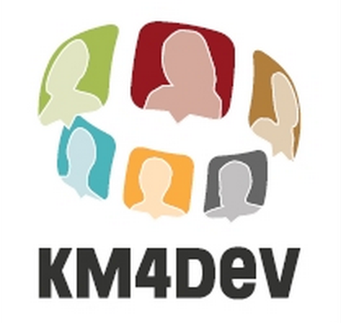
CoPs in development cooperation
Organisational (both internal and external)
Outside of the organisations
Notes:
Show:
World Bank: WBG Connect -- https://olc.worldbank.org/wbg-connect
FAO: FSN Forum -- http://www.fao.org/fsnforum/
UNDP: Global networks set up to serve as a bridge between bridge between HQ and the field. Knowledge Networks become institutionalized as part of the become institutionalized as part of the UNDP business plan in 2002. News updates, e-discussions, policy/practice guidance, practice workshops, responses to queries.
KM4Dev: group of KM practitioners in the development arena. Cross-institutional.

Slide 9

Capacity4dev Groups and LKDS
“The implicit and in particular the tacit knowledge of the staff, its wisdom and experience and on the other hand its capacity to learn and apply their knowledge according to the context that are the most important. This implies the importance of collaborative culture, knowledge sharing and transfer mechanisms including Communities of Practice (CoPs). (DEVCO LKDS)
➔ Capacity4dev Groups can be
an online space for your CoPs.
Notes:
CoPs are often an integral part of the knowledge management strategies and interventions. There are many ways to look at the KM, but one traditional distinction is between explicit and tacit knowledge. The KM interventions can be focused on “hard” aspects -- such as IT systems -- and “soft aspects. The CoPs are one of the key instruments to share the soft knowldge, the tacit knowledge that is in people’s head. A quote from LKDS demonstrates that this is exactly DEVCO thinking.
This strategic framework is a top-line DEVCO guideline that frames everything. It is then to each unit and project to translate it in its own objectives and to find the way in which it will make a meaningful contribution to the unit or project efforts.

Slide 10

Capacity4dev Groups support
Three levels
Basic: technical orientation,
help guide
Intermediate: tools for activating
(e.g. template e-mails), content structure advice
Advanced: CoP strategy development, coaching
Support from
MKS team and CoP expert

Slide 11

Individual CoP benefits
Keeping up to date with current thinking
Developing ideas together
Reputation
Networking and relationship building
Notes:
CoPs can be benefitial on personal and organisational level. We list here some generic main benefits that can apply to many communities:
Keeping up to date with current thinking: The conversations that can take place within communities bring experiences and knowledge to the surface. One of the best ways to surface these experiences is through asking questions and answering others questions, this is often the motor of community discussions. This allows members to be up-to-date in their field and even perhaps learn specific things that improve not just your knowledge but their capacities as well.
Developing ideas together: peers can cooperate to develop new ideas and knowledge . This can take different forms according to the type of community. Some communities develop their own knowledge base, a repository for their collective knowledge. Others work collaboratively on projects or research, and can also work collectively on contributions to inform policy development.
Reputation: CoP gives experts a possibility to profile yourself. Being active in a community can also help to establish your reputation in the field or identity as a practitioner, so on a personal level, communities can provide a strategic advantage as well.
Networking and relationship building: building relationships with your fellow practitioners or peers, discovering new partners from similar or different settings, with whom you have shared interest. Often just finding out who knows what in your field can be useful and communities can also be helpful to ensure newcomers find their way within the field.
Trust and confidence in the peers: Develeoping a sense of trust and camaraderie is fundamental to sharing openly -- for example problems with a project -- and asking difficult questions. Regular exchanges through a CoP help build reciprocal trust and hence create community fertile ground.

Slide 12
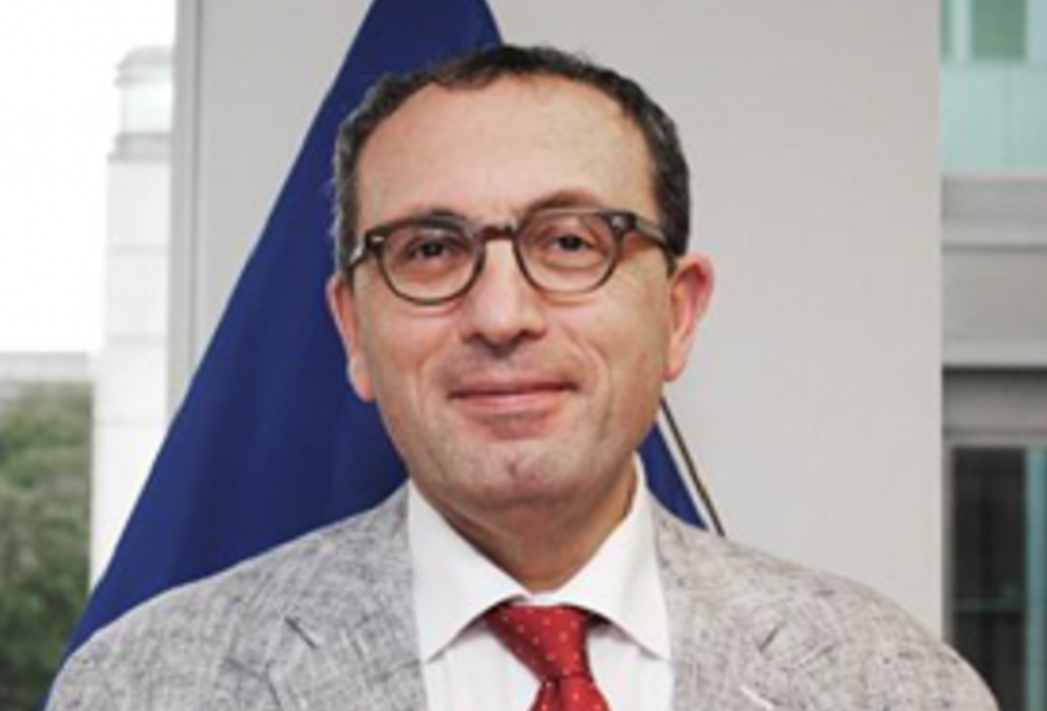
DEVCO organisational CoP benefits
KS space between DEVCO HQ, EUDs, other services and external partners
Increased efficiency
Evidence and knowledge lead to better decision-making
Empowered staff in HQ and EUDs
DEVCO reputation vis-a-vis other global actors
Notes:
KS space: Cross-learning among practitioners from EC, EEAS, MS, Donors, International Organisations, private sector, CSOs, Governments, Academia…Also: Consolidate multiple tools and communities of practice around a common environment
Increased efficiency: Support Thematic Expertise, Support good practice and innovation exchange / help identify specialists, bridge the silos – horizontal awareness.
A particular remark is needed regarding the efficiency claim. Are we really making DEVCO more efficient if there is a proliferation of groups? The point behind this entire list of potential benefits is not that each group will deliver each benefit. Some groups will indeed make operations more efficient. Others will connect members over a short period of time to discuss a project. This will depend of the purpose of each group, and we will look into that in our next section.
Inversely, creating a group without a clear purpose and understanding of the benefit will make the organisation less efficient, and the groups will not become integral part of work.
Also, consolidated knowledge nad institutional memory: high staff turnaround, short term contracts, increasingly outsourcing, mainly email. Also: Project sites : Capitalise on the huge knowledge and expertise that stems from the implementation of thousands of projects : today stays mostly with the consultants and NGOs implementing our programmes
Evidence: evidence-based policies. Also: Support Thematic Expertise, Support good practice and innovation exchange / help identify specialists, bridge the silos – horizontal awareness

Slide 13
Exercise: CoP benefits
Can you identify additional personal and organisational benefits specific to DEVCO?
Discuss in pairs.
Notes:
10 mins exercise, 5 mins discussion, 5 minutes sharing in plenary.

Slide 14
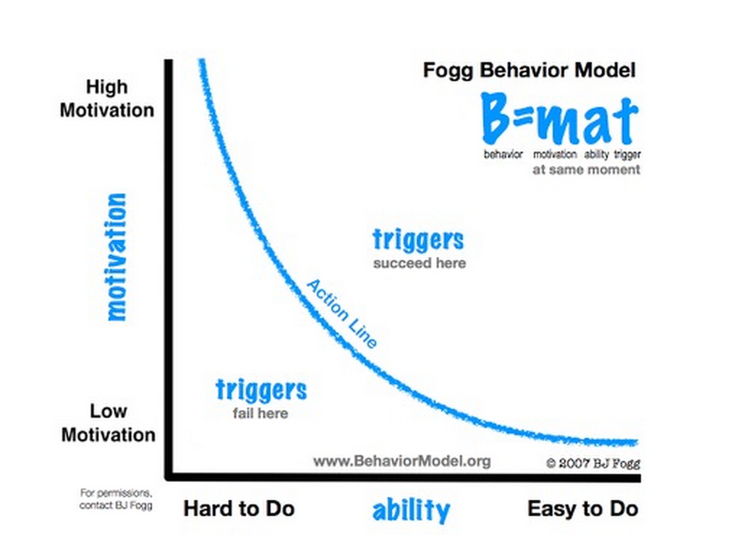
Way to look at the CoP dynamics: Fogg behavioral model
Notes:
(Finalise)
Motivation: there are many other reasons why people may not participate. The domain must be relevant and a priority to members. The value of participation usually needs to be recognized by the organization otherwise members will not bother. Members need to see results of their participation and have a sense that they are getting something out of it.
Ability: technology is not so important. A tool or technology is as good as it is useful to the people who use it. And a forum is simply a forum until it becomes occupied by a community of practice.

Slide 15
Key barriers to engaging in an online CoP
Motivation
No explicit understanding of CoP’s value added
“Communication apprehension” – it is difficult to ask question and share in public
Shifting membership (state of “flux”)
High workload and low prioritisation for knowledge sharing and Capacity4dev groups
No corporate incentives
Ability
Understanding the Capacity4dev platform

Slide 16
Exercise: CoPs barriers
Are you a member or do you manage a CoP (including on Capacity4dev) that is a “ghost town”?
What barriers have you identified, in addition to the ones we listed?
Discuss in pairs.

Slide 17

Part 2: Community maturity
Community maturity concept
Identify maturity stages of your community

Slide 18
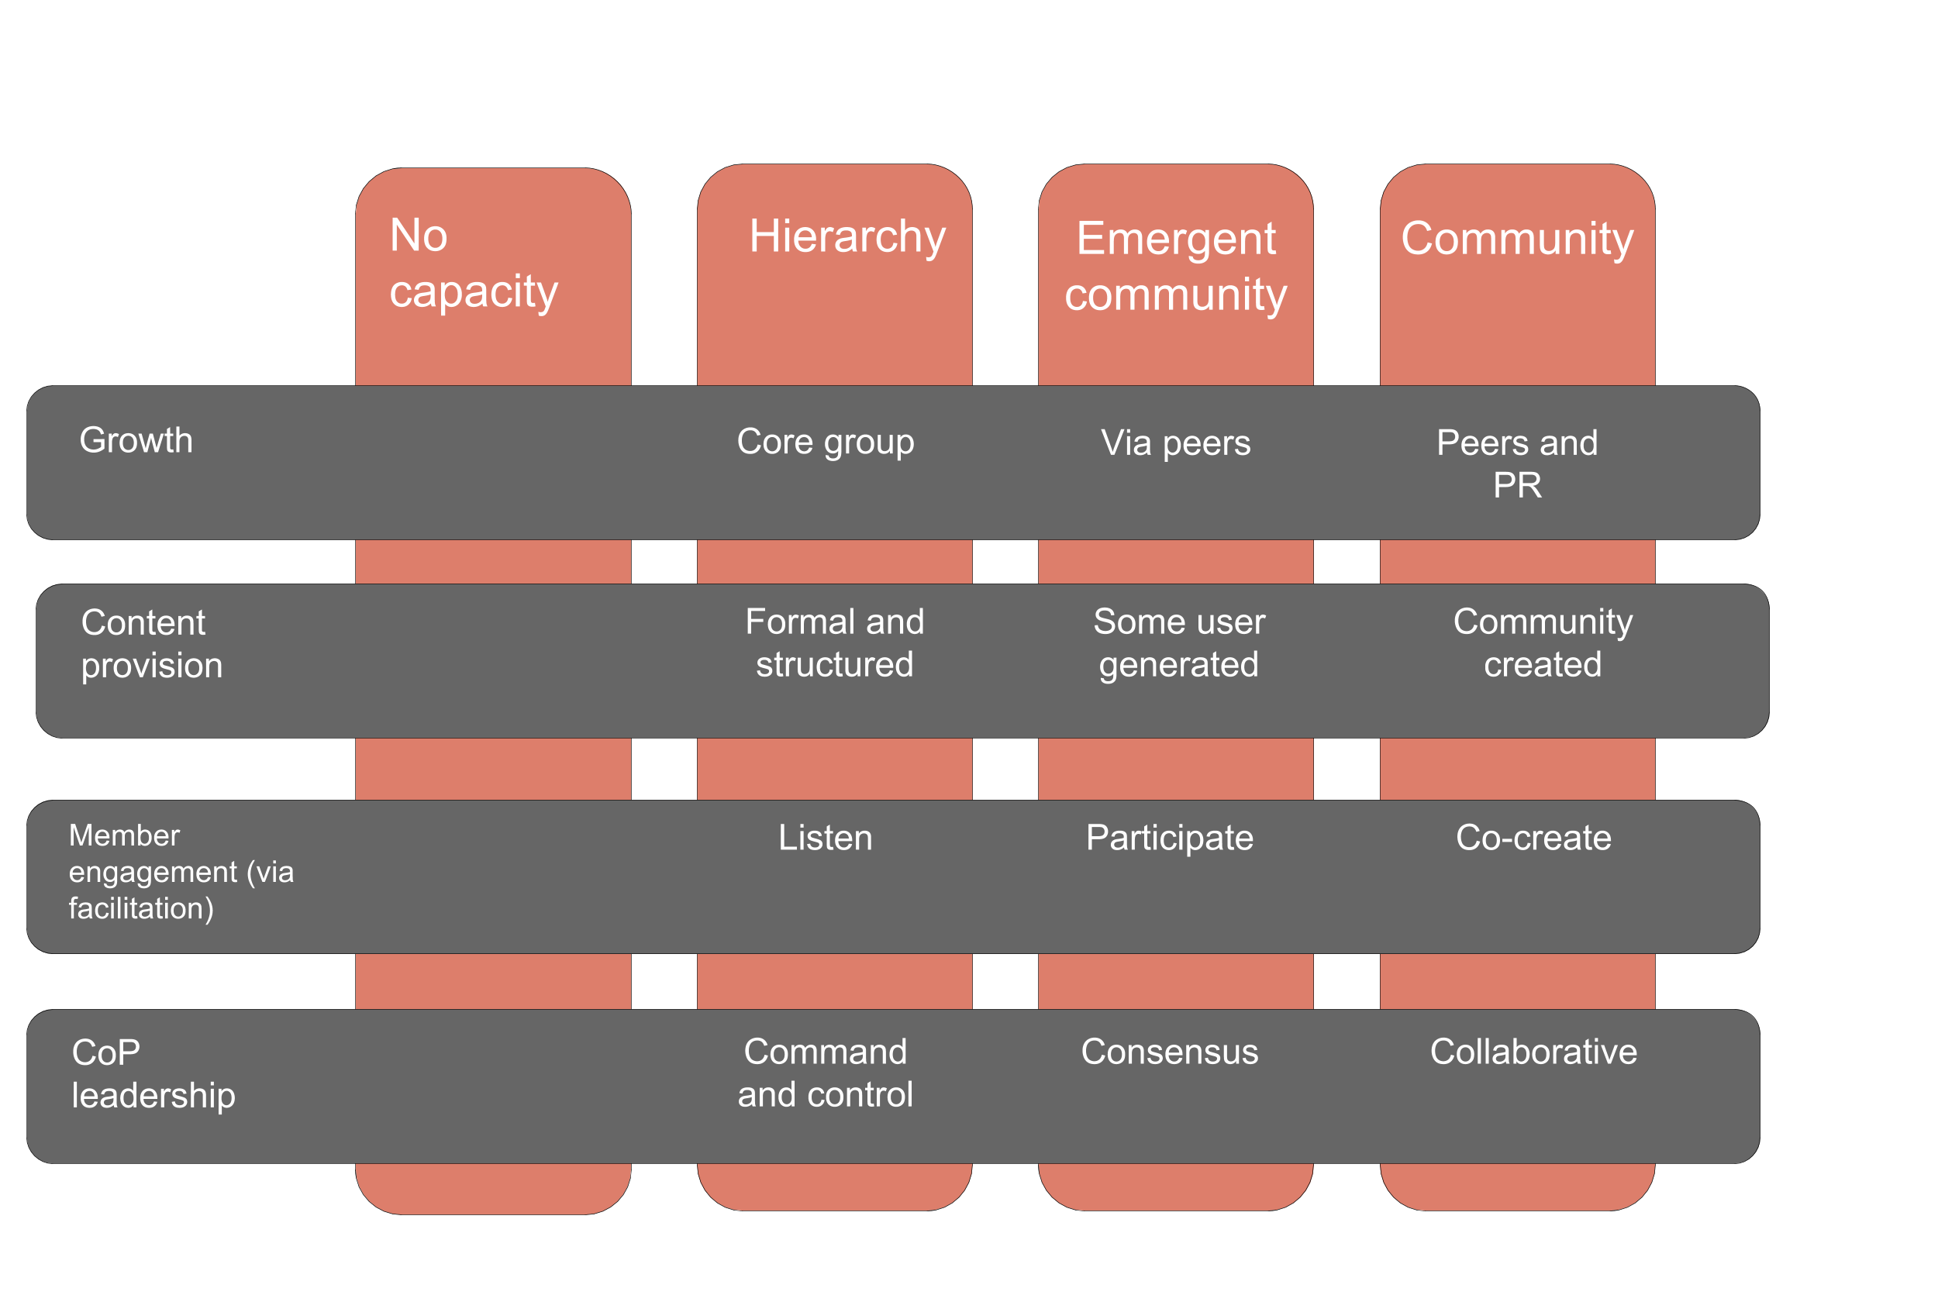
Community maturity stages
Based on: Community Roundatble community maturity model
Notes:
Explain the horizontal elements: areas of intervention that we will explore today.
Groups are not the same as CoPs: almost each CoP starts as a group managed by a strong centralised effort.
Each stage calls for a specific intervention. There is a sequence of interventions
Today we ocus of the training are the first two pillars

Slide 19
Exercise: identify stage for your group
Take a sticky, write your group name and identify the current stage for your group on the big poster.

Slide 20

Part 3: Strategic fit and purpose
Ensuring strategic fit
Purpose is the key success factor
Spell out the purpose of your community

Slide 21
Strategic fit: development goals
If not identified: you risk working alone and DEVCO might not understand the value of your group
Development goals and/or sector fit: how does the group helps your unit or DEVCO
advance towards DEVCO goals (New Consensus, etc.)
contribute to the sector
strengthen the overall impact

Slide 22
Strategic fit: organisation
Possible questions:
How does this community correspond to DEVCO development goals and what DEVCO is trying to do?
What would success look like? → understand expectations
What do we need from the group to deliver on DEVCO’s key challenges and most promising opportunities? → understand assumptions about knowledge in the long-term.

Slide 23
Involve members as well!
If not identified: members will not see what’s in it for them
Understand how the members define the goal of the community

Slide 24
How to elicit value for the members
Possible questions:
Why did you join this group? → understand value for the members
What would you like to see from the group, and why?
Who should be the key members of the community, and why?

Slide 25

Purpose
Inputs from DEVCO and members allow you to articulate purpose
Needs to be clearly stated and shared
Can be reiterated and validated periodically Example: ROSA
Designed by Freepik
Notes:
The first community enabler we’ll look into in more detail is purpose. It should be driving the design and planning of your community. Your community needs to add value to the work of its members, they need to know why they are there, how they can contribute, and what they can expect from the community. So the purpose not only needs to be clear but articulated and shared with members. And successful communities state and restate their purpose through different ways, for e.g. they clearly state the purpose of the online community on the Capacity4Dev; they articulate the ways in which the discussions, resources, activities, etc. of the community will serve the overall purpose of the community; they highlight unique ways in which participation in the community will inform practice.
An example: a FAO staff member was tasked back in 2006 to create a community on food security. She started going through three different iterations before actually settling on what the purpose should be, what type of members should participate, what they would get out of it, etc. This is now one of the most active of the network created by FAO, the FSN Forum.

Slide 26

Purpose: exercise
Community management plan: Write down your group purpose and discuss in pairs.

Slide 27

Part 4: Growth
Growth principles
Growth strategies

Slide 28
Growth is
Adding members
AND
Getting people involved
It is not about adding members just to bump the numbers

Slide 29
Growth strategies
1. Targeted
2. Peer referral
3. PR

Slide 30
Targeted growth -- tips (1)
Tip: Identify your core CoP members and build relationship.
Candidates:
EUDs: check focal EUD points. Anticipate moves. Example: Water and Sanitation group checks every 6 months its EUD contacts
Topic experts (internal or external) Example: when going public, IESF group identified key experts

Slide 31
Targeted growth -- tips (2)
Tip: include C4D group link and purpose in the signature. Example: Water and sanitation group
Tip: streamline all info sharing via C4d. Example: Water and sanitation group
Tip: extra mail when they join.
Example: KM correspondent welcome mail.

Slide 32
Peer referral and PR -- tips
Tip: ask core members to identify and invite people
Tip: profile group champions and “VIPs” (posting video interview)
Tip: communication campaigns on DEVCO channels, Capacity4Dev and social media.
EEAS (CC BY-NC-ND 2.0)

Slide 33
Growth – exercise
Community management plan

Slide 34
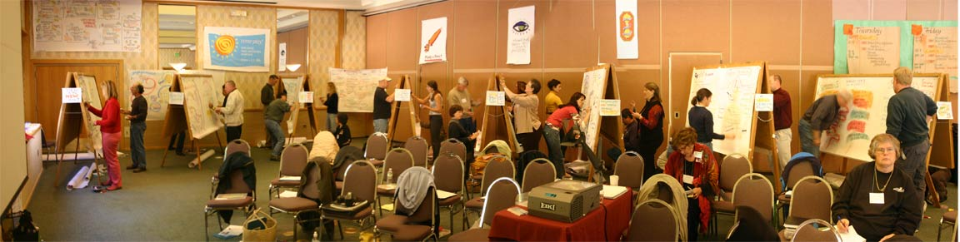
Peter Durand CC BY-NC-ND 2.0
Part 5: Facilitation
Facilitation functions
Facilitation strategies

Slide 35
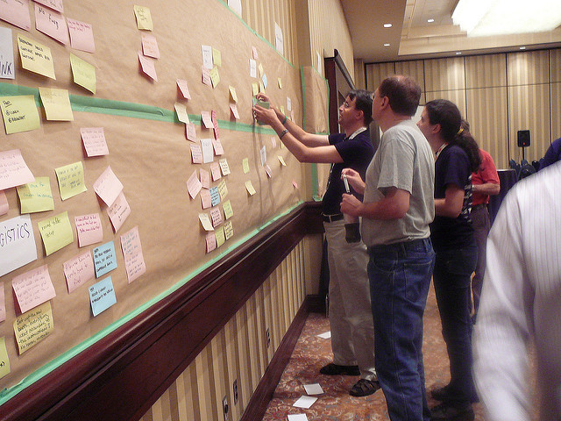
Why facilitation?
Online spaces do not guarantee people will contribute or collaborate.
Facilitation adds
Structure
Process
Community dynamics
Eric Lefevre-Ardant (CC BY-SA 2.0)
Notes:
that facilitation was an important enabler for communities. We also know that solely creating an online space like a C4d group it doesn’t mean that people will participate. This is where facilitation comes in by providing structure and process to help accomplish objectives and achieve the community’s purpose. Another important role of facilitation is to make sure that online interactions are done in a respectful way though healthy community dynamics.

Slide 36
Facilitation strategies
1. Reinforcing the purpose
2. Assessing members needs
3. Guiding and profiling members
4. Encouraging participation

Slide 37
Reinforcing the purpose -- tips
Tip: Restate purpose regularly
Possibly go beyond the “home page” -- include in signature, newsletter, “remind” the CoP every 2-3 months via blog post
Tip: concentrate activity (pages)
Merge groups
Show only few sections in the menu
Have a clear and logical structure of pages and library tags
Example: Policy Forum on Development Example: innov-aid

Slide 38
Assessing members’ needs - tips
Tip: Check regularly your member base and new members. New challenges? New projects?
Surveys or bilateral mails with key members. Share findings via
blog posts.
Carlo Scherer CC BY-NC-ND 2.0)

Slide 39
Guiding and profiling members - tips
Tip: “How to use this group” page.
Example: EYD2015
Tip: spotlight
- new members and experts
Example: IESF and UNEP interview in Biodiversity group
⇒ we can support with the video interviews!

Slide 40
Encouraging participation -- tips
Tip: highlight discussion and involve people
Prompt people individually if you think they can contribute to a discussion
“Question time”, “Speakers corner”, “Good practice” (IESF)
Tip: distribute tasks and leadership
Check if any member wants to lead (IESF)

Slide 41
Facilitation: exercise
Community management plan

Slide 42
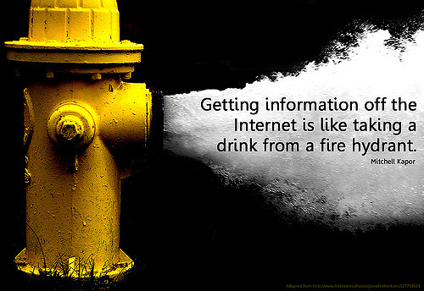
reeImages.com/harald wittmaack
Part 6: Content
How is content adding value?
Understanding content needs
Using different content types
Content planning

Slide 43
Why is content important?
Content can serve different objectives:
i. Bridge community domain and other domains
ii. Support community narrative and dynamics
You need to create content that is valuable for your community
Notes:
Content is everything online - papers, images, videos. Also, your members struggle with the information overload → provide meaningful content that will enable members to better understand the context of their work, reflect on what they do, innovate, learn, etc.
Providing content in CoP is not about providing a lot of content. News sites produce lot of content, but don’t build communities and relationship. When posting something, ask yourself: what is the value?
One way to think about the content is to image you are editing a local newspaper.
provide sense of belonging and attachment to a group of like-minded people.
break down the global impact for their local members.
promote local people.
build a social point of view → emotional bond.

Slide 44
Strategies for content provision
1. Understand content needs and habits 2. Provide meaningful content

Slide 45
Content needs - tips
Tip: ask members directly what content they need, and where they get it. Validate. Example: IESF

Slide 46
Curation - tips
Tip: Organise via Library. Could include:
Key EU documentation on a topic
List of calls for the next 6 months
Project documentation
Research papers
Reports from meetings
Example: innov-aid
Notes:
Goal: finding relevant content and presenting it in a meaningful way

Slide 47
Events - tips
Tip: overview of upcoming events
Tip: think “event cycle”. Example: ROSA
Pre-event: share logistical info, agenda, participants list and key background materials
During the event: if any live coverage during the event, share links. If you are there, ask people to input to the community (eg. short interview or blog post)
Post-event: short summary + share PPTs
Notes:
Goal: connecting your members to the relevant events How: via Events section

Slide 48
Blog - tips
Tip: post relevant announcements, news and analysis Example: Biodiversity group and “Larger than Elephants”
If you want people to comment on your posts, say it at the beginning.
Notes:
Goal: space for posting announcements and organising dialogue

Slide 49
Newsletter -- tips
Tip: develop a newsletter with the community updates. Ask members to provide inputs!
Examples: ROSA (focus on content curation), Policy Forum on Development (promoting members), IEFS (project updates from partners, written by the partners) At the same time, newsletters require effort to produce and read, and need to have a clear value added.
Notes:
Goal: profile community activities and/or curate key information

Slide 50
Content types -- final tips
Check the content you are providing with members
Be consistent, as it builds trust
Notes:
Ask a few key members to check what you plan to share. They might have extra ideas and share themselves!
Consistency: think journal, always same section at the same page → consistency and reliability

Slide 51
Content – exercise
Community management plan

Slide 52

Part 7: Focus and plan
Focusing and planning your interventions

Slide 53
Focusing and planning
What could you realistically do in the next 12 weeks?

Slide 54
Focusing and planning
In your community management plan you
captured your purpose and identified possible tips.
Let’s focus and plan
Step 1: taking into account limited time and resources, on which tips do you want to focus?
Step 2: plan your next 12 weeks
Notes:
Ask a few key members to check what you plan to share. They might have extra ideas and share themselves!
Consistency: think journal, always same section at the same page → consistency and reliability

Slide 55
Where do you want to be and how you plan to get there
Community management plan
Present and discuss 1-2 plans in plenary

Slide 56

Part 8: Metrics
types of metrics
key engagement and strategic relevance metrics

Slide 57
Two types of metrics
Metrics is: using data and feedback to measure health and progress of our group.
Engagement metrics
-> what is the activity and growth?
Strategic relevance and usefulness
-> how is community supporting overall development goals?
-> how relevant is the community for the members?

Slide 58
Key engagement metrics
Growth:
number of members who made contribution in the last 30 days (active groups)
number of new members in the last 30 days (static groups)
Activity:
total number of posts in the last 30 days (active groups)
number of resources uploaded in the last 30 days (static groups)

Slide 59
Strategic relevance and usefulness
Allows you to:
i. collect qualitative evidence
ii. connect with the purpose
Will be different for each group!

Slide 60
Strategic relevance and usefulness
Possible open questions
how useful is what you are getting from the CoP?
can you give us one example of when the CoP was particularly useful and why?
⇒ can be asked via survey, or one-on-one interviews
Possible rating scale questions around key
aspects, such as:
CoP timeliness, applicability, accuracy, etc.
⇒ can be sent via survey

Slide 61
Metrics
Think of one strategic relevance metric for your community

Slide 62

Part 9: Moving ahead
Discussing the way forward

Slide 63
Moving forward
How can we move forward together?
- CoP of C4D owners
- Coaching / advanced support
- Regular meetings to dig deeper into some of the aspects

Slide 64

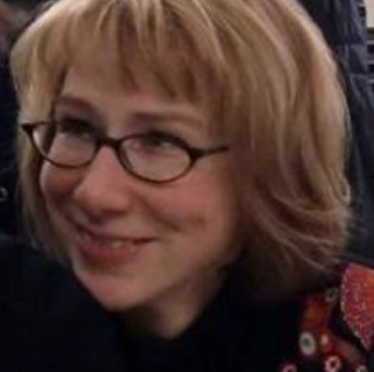
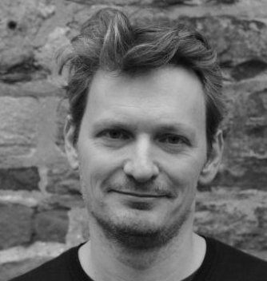
Thank you!
Follow-up info:
Cecile Mabilotte - Cecile.MABILOTTE@ec.europa.eu
Lucie Lamoureux - lucie.lamoureux@mksp.eu
Ivan Kulis - ik@ecdpm.org

Slide 65
References
Community Roundatble, Community maturity model
DEVCO (2014) Learning and Knowledge Development Strategy
FAO, Community Design Aid
Feverbee, The Proven Path
Fogg, BJ., Behavior model
Millington, R. (2012) Buzzing Communities, FeverBee
Wenger, E. (2002) Cultivating Communities Practice, Cambridge, MA: Harvard University
Wenger-Trayner: Introduction to Community of Practice.

