Slide 1



ACP Joint Policy Dialogue
West african initiatives on NDCs implementation process
ACP House, 5th November 2018

Slide 2

GCCA+ - Preliminary diagnosis
=> Preparation phase implemented by Expertise France in order to refine activities and governance scheme of the programme + ensure concertation among the institutional partners.
Diagnosis phase with following key questions:
What is the implementation status of the 17 NDCs of the region? Highlight the key aspects of the commitments made by the countries, their progresses and identified barriers/gaps to reach their goals
What are the « climate capacity building » initiatives currently running at regional level (carried out by international, panafrican and regional organizations)?
What are the gaps in the services offered to the member countries?
What could be the role of regional institutions in terms of « climate capacity building » ?
GCCA+ - Diagnosis – Oct 2018
2

Slide 3
Potential role for regional institutions in Paris agreement implementation
Two key principles: subsidiarity and complementarity
Pooling efforts to create synergies, for instance regarding topics related to data acquisition, treatment and analysis, but also on « niche » topics which can not be treated at national level (research);
Pooling efforts to foster political regional leadership, in particuliar regarding climate negotiations but also access to climate finance ;
Creation of knowledge/exchanges platforms in order to enhance regional solidarity ;
Use the Commission’s regulatory mechanism to suggest (directives) or impose (règlements) evolutions towards low carbon development pathways ;
Assist, whenever asked by member countries, national level in order to translate regional orientations into national public policies or regulatory mechanism.
➔ Regional climate framework strategy may be useful in this way for better coordination and understanding!
GCCA+ - Diagnosis – Oct 2018
3

Slide 4
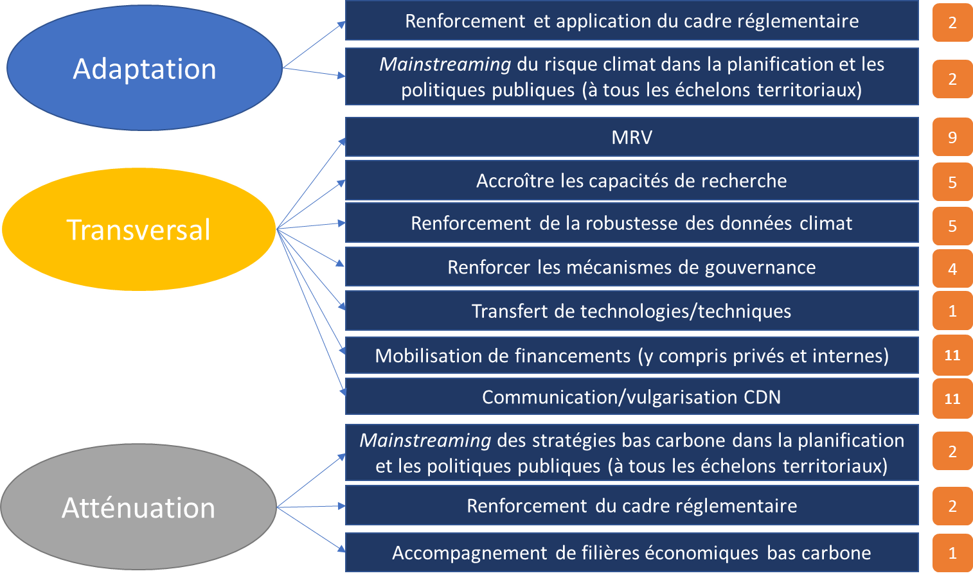
Focus areas considered as « Climate Capacity building »
GCCA+ - Diagnosis – Oct 2018
4

Slide 5
Recommendations
1. ECOWAS and specialized institutions develop operational and institutional capacities to meet member countries needs related to focus areas of GCCA+, into climate international negotiations and Paris agreement implementation
2. Regional (ECOWAS) and national (member countries) strategies and priorities related to climate change within focus areas of GCCA+ are strenghtened and their implementation supported
3. Adaptation pilot-projects, including ecosystem-based adaptation solution, already tested and implemented within ECOWAS countries and referenced as good practices for future replication are disseminated and upscaled.
4. Regional organizations and ECOWAS member countries foster strategic dialogue, strenghten negotiations capacities, share informations, competencies, results and knolwledge on climate action.
5. Capacities of technical institues, universities and regional centers to providing services on training, research and innovation mentoring in adaptation and mitigation sectors are strenghtened.
6. Innovative approaches for leveraging climate investments and finance including public and private sectors are prepared and tested.
GCCA+ - Diagnosis – Oct 2018
5

Slide 6
Thank you for your attention!
GCCA+ - Diagnosis – Oct 2018
6

