Slide 1

GCF – EU Meeting
ACCESSING GCF FINANCE
Presenters:
Joseph Intsiful (PhD), Senior Climate Information and Early Warning Systems Specialist
Division of Mitigation and Adaptation
5 November 2018 | ACP, Brussels

Slide 2

Overview
Background
Portfolio and Approved Projects
Summary & Conclusion
Notes:
Introduction

Slide 3
GCF Mandate
Background
Notes:
The mandate of the Country Programme Division is to enable countries and accredited entities to be SUCCESSFUL and IMPACTFUL through:
Establishing dialogue with National Designated Authorities (NDAs) and focal points and creating and maintaining a portfolio of dynamic and diverse Accredited Entities
Starting point for relationship with the Fund, NDAs (focal points) are government institutions that serve as the interface between each developing country and the Fund. They provide broad strategic oversight of the GCF’s activities in the country and communicate the country’s climate action priorities. Currently, the Fund has 145 NDAs / Focal Points.
Accredited Entities are the institutions (public and private) that apply for accreditation to access the Fund’s resources for projects and programmes. Entities submit projects for funding consideration by the GCF Board, a process coordinated by the NDA (focal point) to ensure country ownership (no-objection letter signed by NDA or focal point).
Currently, the Fund has 54 entities: 27 direct access entities (i.e. sub-national, national or regional organizations that need to be nominated by developing country NDAs or focal points) and 27 international access entities (i.e. United Nations agencies, multilateral development banks, international financial institutions and regional institutions).
Leading a Structured Dialogue with countries
The Board’s strategic vision for GCF includes a continuous and focused engagement and dialogue between countries (National Designated Authorities), Accredited Entities, other stakeholders and the Fund.
To support this process, CPD leads the organization of regional dialogues to rally GCF’s partners around common goals and a shared vision for country and regional action, and to provide a platform for partnership building and ‘matchmaking’ between countries and entities.
Preparing Country Programmes
Roadmap of engagement for countries to structure their programming priorities with the GCF, as well as identify needs related to readiness support, project preparation and accreditation.
Development of country programmes and entity work programmes lie at the centre of the programming exercise, aligning countries’ climate change priorities with the expertise and comparative advantage of accredited entities.
A practical and ‘living’ document that also includes a pipeline of projects that the country would like to undertake with the Fund, aligned to GCF’s strategic impacts, investment criteria and operational modalities.
Building and enhancing the capacity of countries and entities through the Readiness Programme and the Project Preparation Facility (known as PPF)
An enabler (or ‘seed fund’) for developing countries by providing support to strengthen systems and processes to effectively access the Fund, manage projects and deliver intended impacts.
Readiness resources are catalytic to ensure countries can attract investments to transition into low-emission and climate-resilient economies and societies.
Fund offers a range of readiness products depending on specific needs of countries and entities. (More details in upcoming slides)

Slide 4
Context
GCF Mandate
The Paris Agreement and the supporting Decision emphasizes the GCF’s role as a key provider of predictable financial resources in the post-2020 framework.
Para. 4 of GCF Governing Instrument (GI)..” in the context of sustainable development, the fund will promote the paradigm shift towards low-emission and climate resilient development pathways
Notes:
The mandate of the Country Programme Division is to enable countries and accredited entities to be SUCCESSFUL and IMPACTFUL through:
Establishing dialogue with National Designated Authorities (NDAs) and focal points and creating and maintaining a portfolio of dynamic and diverse Accredited Entities
Starting point for relationship with the Fund, NDAs (focal points) are government institutions that serve as the interface between each developing country and the Fund. They provide broad strategic oversight of the GCF’s activities in the country and communicate the country’s climate action priorities. Currently, the Fund has 145 NDAs / Focal Points.
Accredited Entities are the institutions (public and private) that apply for accreditation to access the Fund’s resources for projects and programmes. Entities submit projects for funding consideration by the GCF Board, a process coordinated by the NDA (focal point) to ensure country ownership (no-objection letter signed by NDA or focal point).
Currently, the Fund has 54 entities: 27 direct access entities (i.e. sub-national, national or regional organizations that need to be nominated by developing country NDAs or focal points) and 27 international access entities (i.e. United Nations agencies, multilateral development banks, international financial institutions and regional institutions).
Leading a Structured Dialogue with countries
The Board’s strategic vision for GCF includes a continuous and focused engagement and dialogue between countries (National Designated Authorities), Accredited Entities, other stakeholders and the Fund.
To support this process, CPD leads the organization of regional dialogues to rally GCF’s partners around common goals and a shared vision for country and regional action, and to provide a platform for partnership building and ‘matchmaking’ between countries and entities.
Preparing Country Programmes
Roadmap of engagement for countries to structure their programming priorities with the GCF, as well as identify needs related to readiness support, project preparation and accreditation.
Development of country programmes and entity work programmes lie at the centre of the programming exercise, aligning countries’ climate change priorities with the expertise and comparative advantage of accredited entities.
A practical and ‘living’ document that also includes a pipeline of projects that the country would like to undertake with the Fund, aligned to GCF’s strategic impacts, investment criteria and operational modalities.
Building and enhancing the capacity of countries and entities through the Readiness Programme and the Project Preparation Facility (known as PPF)
An enabler (or ‘seed fund’) for developing countries by providing support to strengthen systems and processes to effectively access the Fund, manage projects and deliver intended impacts.
Readiness resources are catalytic to ensure countries can attract investments to transition into low-emission and climate-resilient economies and societies.
Fund offers a range of readiness products depending on specific needs of countries and entities. (More details in upcoming slides)

Slide 5
GCF Investments and Anticipated Impacts
(As of 24 October 2018 (up to B21)
Investments
Pledged amount of $10.3 billion
Committed amount of $4.6billion (USD 1 billion fromB21)
Implementing $1.6 billion
Total value of $16.4 billion
Impact
93 Approved projects (19 new projects from B21)
272m Beneficiaries
1.6b tonnes of CO2 equivalent avoided

Slide 6
Investment Criteria and Policies
Performance against
investment criteria
Consistency
with GCF policies
Impact potential
Environmental and social safeguards
Paradigm shift potential
Gender policy
Sustainable development potential
Risk framework
Needs of the recipient
Fiduciary standards
Country ownership
Results management and reporting
Efficiency and effectiveness
Legal framework
Notes:
Secretariat input is aimed at improving two aspects: Performance against investment criteria, and compliance with GCF policies.

Slide 7

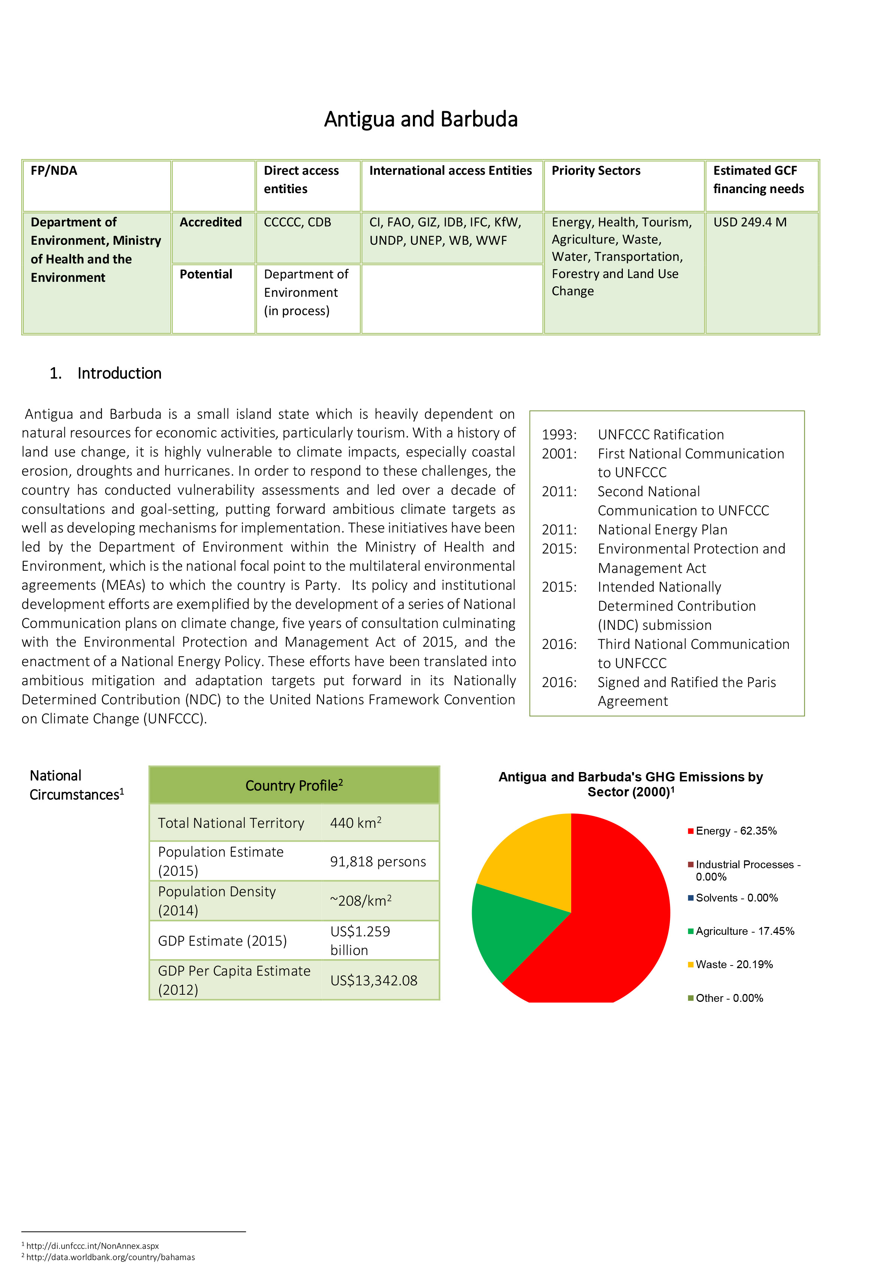
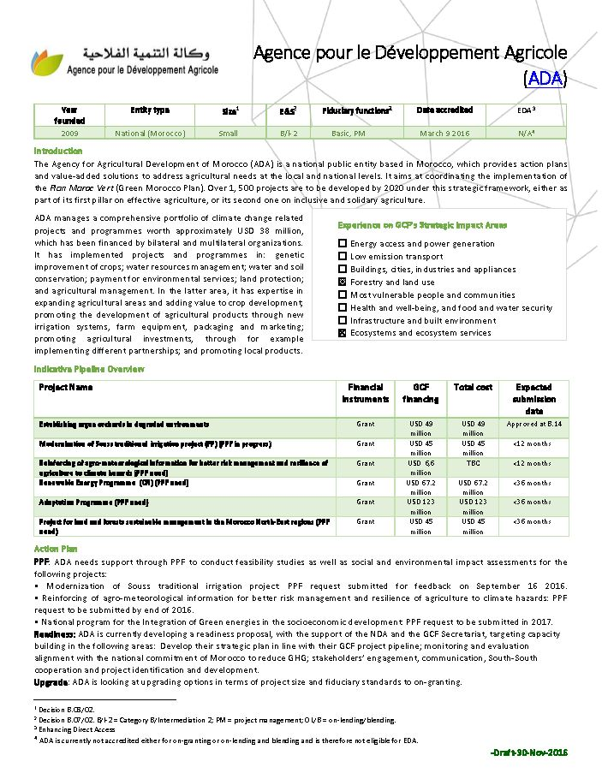
Programming Overview
READINESS (including adaptation
planning)
COUNTRY & ENTITY
Programmes
PROJECT CONCEPTS
PIPELINES
PPF
INDCs
TNAs
  Country and Entity Programmes are foundation, resulting in project proposals
  Structured Dialogues and direct access events further support funding proposal quality

Slide 8
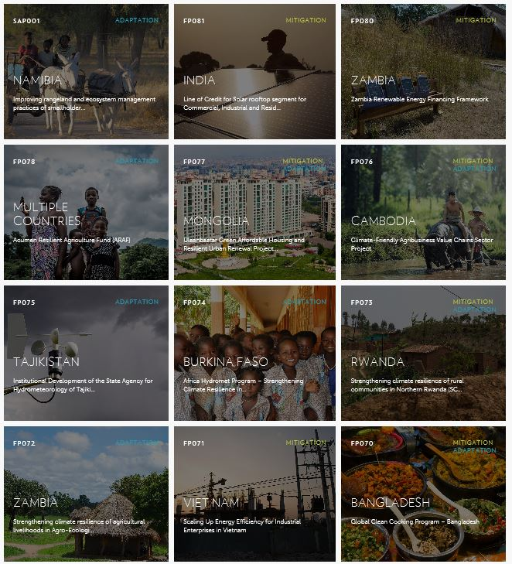
Funding Windows
Standard project/programme window
Enhanced Direct Access
(Devolved & decentralized decision-making, $200M,10 pilots)
Simplified Approval Process
(up $10M, low ESS requirements)
REDD+ Results-Based Payments
Notes:
CAVEAT: These windows are also for PRIVATE SECTOR as well! It’s just that the majority of the pipeline/portfolio is composed of public-sector projects. We welcome private sector to access GCF funding through these windows, particularly SAP!

Slide 9
GCF Mandate
Portfolio and Approved Projects (prior to B21)
Notes:
The mandate of the Country Programme Division is to enable countries and accredited entities to be SUCCESSFUL and IMPACTFUL through:
Establishing dialogue with National Designated Authorities (NDAs) and focal points and creating and maintaining a portfolio of dynamic and diverse Accredited Entities
Starting point for relationship with the Fund, NDAs (focal points) are government institutions that serve as the interface between each developing country and the Fund. They provide broad strategic oversight of the GCF’s activities in the country and communicate the country’s climate action priorities. Currently, the Fund has 145 NDAs / Focal Points.
Accredited Entities are the institutions (public and private) that apply for accreditation to access the Fund’s resources for projects and programmes. Entities submit projects for funding consideration by the GCF Board, a process coordinated by the NDA (focal point) to ensure country ownership (no-objection letter signed by NDA or focal point).
Currently, the Fund has 54 entities: 27 direct access entities (i.e. sub-national, national or regional organizations that need to be nominated by developing country NDAs or focal points) and 27 international access entities (i.e. United Nations agencies, multilateral development banks, international financial institutions and regional institutions).
Leading a Structured Dialogue with countries
The Board’s strategic vision for GCF includes a continuous and focused engagement and dialogue between countries (National Designated Authorities), Accredited Entities, other stakeholders and the Fund.
To support this process, CPD leads the organization of regional dialogues to rally GCF’s partners around common goals and a shared vision for country and regional action, and to provide a platform for partnership building and ‘matchmaking’ between countries and entities.
Preparing Country Programmes
Roadmap of engagement for countries to structure their programming priorities with the GCF, as well as identify needs related to readiness support, project preparation and accreditation.
Development of country programmes and entity work programmes lie at the centre of the programming exercise, aligning countries’ climate change priorities with the expertise and comparative advantage of accredited entities.
A practical and ‘living’ document that also includes a pipeline of projects that the country would like to undertake with the Fund, aligned to GCF’s strategic impacts, investment criteria and operational modalities.
Building and enhancing the capacity of countries and entities through the Readiness Programme and the Project Preparation Facility (known as PPF)
An enabler (or ‘seed fund’) for developing countries by providing support to strengthen systems and processes to effectively access the Fund, manage projects and deliver intended impacts.
Readiness resources are catalytic to ensure countries can attract investments to transition into low-emission and climate-resilient economies and societies.
Fund offers a range of readiness products depending on specific needs of countries and entities. (More details in upcoming slides)

Slide 10
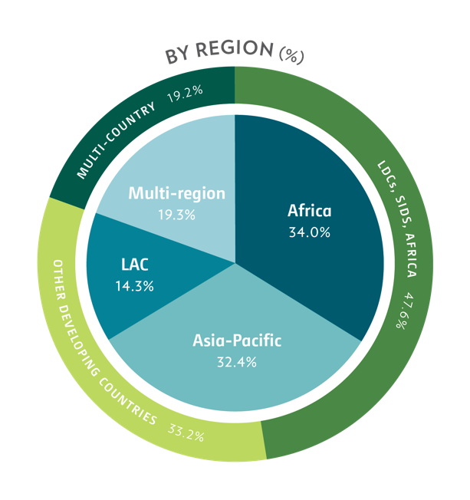
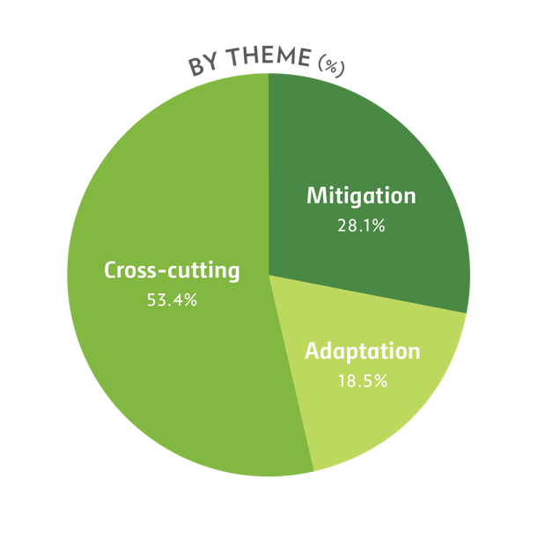
Mitigation impacts
819MtCO2eq
GCF Pipeline: Funding Proposals
Geographic distribution and theme
87 FPs totaling USD 5.1 billion of GCF funding
Adaptation impacts
137 million beneficiaries
10
Notes:
[Internal note: This slide shows the distribution of 77 funding proposals in the pipeline across the region and theme. The distribution is by the requested GCF AMOUNT, not by the number of proposals.]
Geographically, Asia-Pacific requested the largest share of the GCF funding, followed by LAC. Africa accounts for close to 30 per cent. Proposals targeting LDCs, SIDS and African States amount to almost half of the funding requested. By thematic window, cross-cutting projects targeting both mitigation and adaptation results constitute the largest share, accounting for 45 per cent.
The climate impact of the pipeline is expected to be 735 million tonnes of CO₂ equivalent in emission reductions and increased resilience of 135.5 million people.

Slide 11
Mitigation impacts
1.3 billion tCO2eq
GCF Portfolio of Approved Projects
76 FPs totaling USD 3.7 billion of GCF funding
(Co-financing: USD 9.3 billion)
Adaptation impacts
217 million beneficiaries
Requested amount of GCF funding
BY STATUS (%)
BY INSTRUMENT (%)
Guarantee
3%
Equity
11%
Projects
under implementation
37%
Projects not
yet under implementation
63%
Grant
43%
Loan
43%
USD 274 M disbursed¹
¹ As of 26 June 2018.

Slide 12
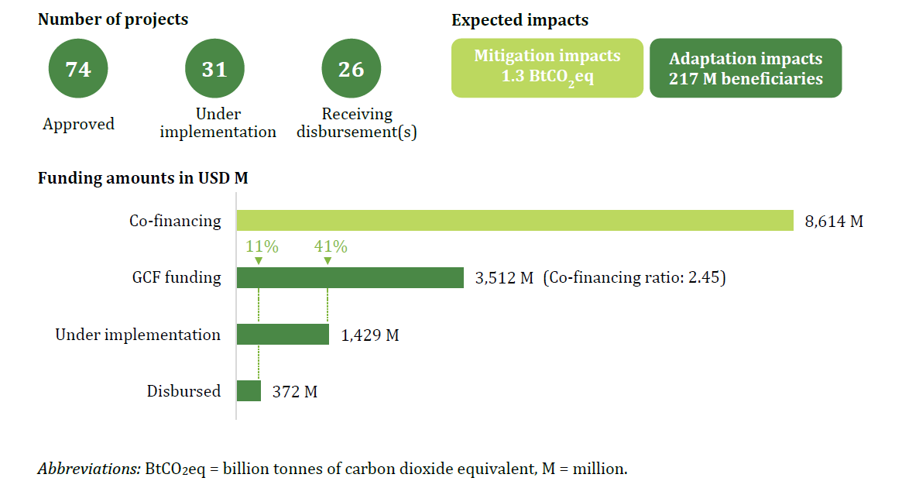
Key Numbers from the GCF Portfolio

Slide 13
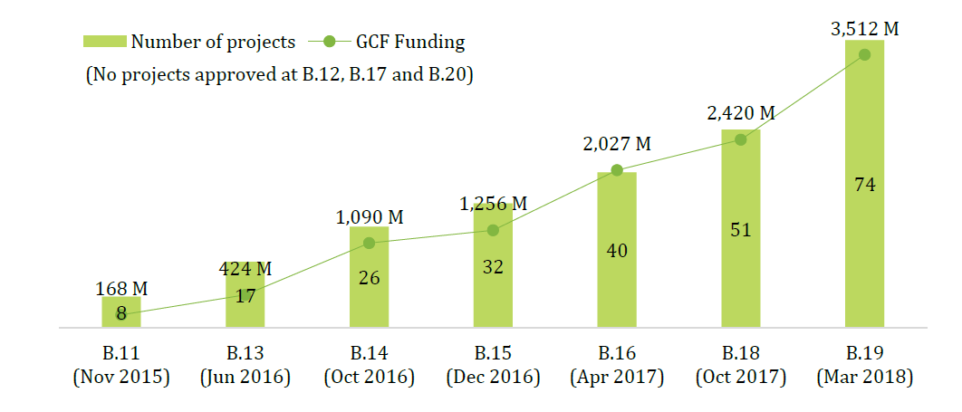
Number of approved projects and
GCF funding from B.11 to B.20

Slide 14
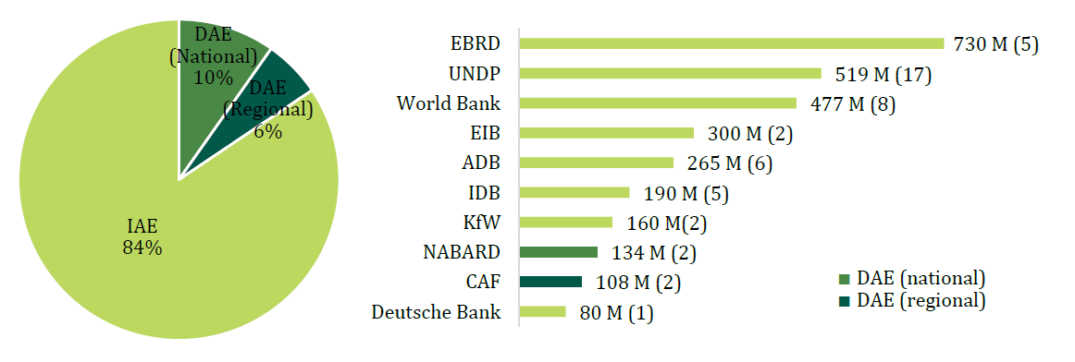
GCF funding amount by access modality and
accredited entity in USD (number of projects)

Slide 15
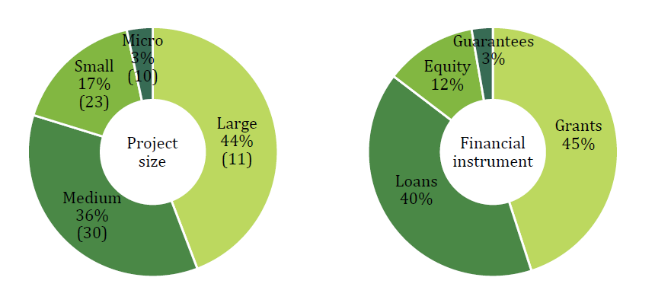
Approved projects by project size and Financial instrument
and percentage of GCF funding (number of projects)

Slide 16
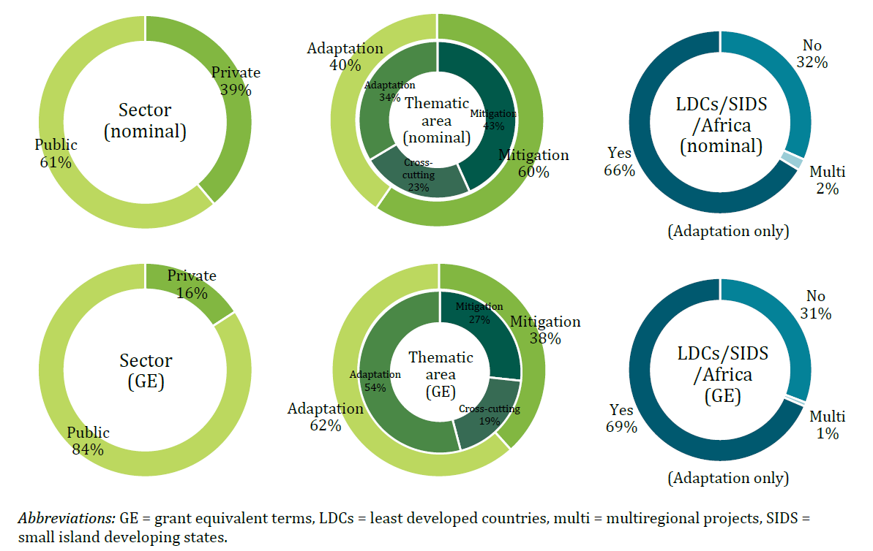
GCF funding amount by sector, thematic area and
adaptation allocation for LDCs/SIDS/African States
in nominal and grant Equivalent terms (percent)

Slide 17

Thank You
Notes:
As we have seen, the quality of the received proposals varies greatly.
Readiness support would be much needed, especially for direct access entities.
It is a resource-intensive process, which requires the Secretariat’s capacity to be strengthened.

