Slide 1
Political Economy Analysis – overview of presentation
Concept
Methodology
Examples
Implications
What is PE?
Overview of PE approaches
PE example Jordan
Implications for external support
Why is PE needed?
Common aspects of PE approaches
PE example Ethiopia
How can PE Help?
Outline of typical PE methodology
PE example Tanzania
PE specific factors for water sector

Slide 2
Political Economy Analysis – what is it?
“Political economy analysis is concerned with
the interaction of political and economic processes in a society:
the distribution of power and wealth between different groups and individuals, and
the processes that create, sustain and transform these relationships over time.”
OECD/DAC
Is it new?
Is it the same as governance assessment?
What is different?

Slide 3
PEA – why is it needed?
Traditional assessments and development approaches have underestimated the influence of the political economy – technical and financial focus
We observe: persistent problems, dysfunctional institutions survive, stubbon resistance to reforms and change, collective action fails despite participatory approaches, capacity building with little impact
Nearly every LFA or problem tree had ”lack of political willingness” and stopped there (often making such willingness an assumption that was never fufilled)
These factors hugely influence the effectiveness of aid – in some circumstances can even make it counterproductive (e.g. Agric. Jordan)
Some (not all) of the explanations can be found through looking at political and economic and social factors – drivers of change - power relations – incentives – interests – social norms and institutions

Slide 4

PEA – underlying factors
Focus of traditional analysis
Focus of political economy analysis
Notes:
Naivity – swinging between naivity and cynicism
but why this lack of willingness – does it make sense to do it or not? If it does why is it not done? Are the technical arguments misunderstood?

Slide 5
PEA – how can it help?
PE analysis can:
Reveal how power and resources are distributed and contested
Provide insights into underlying interests, incentives, rules and institutions.
Support more effective and politically feasible development strategies,
Ensure more realistic expectations of what can be achieved
Help outline the risks involved.
Identify the main opportunities and barriers for policy reform
Indicate how donors can use their influence to promote positive change
GSDRC 2010
Notes:
Looks at the whole iceberg

Slide 6
PEA – what are the approaches?
Power analysis
Macro level
Drivers of change
Macro level
Structural/institutional factors that support/impede poverty reduction
Strategic corruption & governance analysis (SCAGA)
Macro, local, sector level
State/society relations, formal/informal governance structures
Poverty, social impact analysis (PSIA)
Macro, meso, micro – focus on specific reforms
Problem driven governance & political economy (PGPE)
Macro, local level, sector, specific policies/projects
Human rights, democracy, poverty, process , formal/ informal institutions, legitimacy and abuse of power
Society structures/power relations; distributional impact of policy intervention
Why reforms have succeeded or failed

Slide 7
PEA – common strands in different approaches
Politics and power
at the center of change, politics both reacts to and creates incentives
Country realities and value systems
Start with understanding local systems rather than withexternal norms – make few assumptions
Underlying factors
Recognise long term underlying factors of history, conflict, geography, culture
Institutions
Focus on institutions – formal /informal, recognise they may no longer reflect common values
Development agencies as actors
A political agenda does not have to be geo-political – money iitself is enough

Slide 8
PEA – methodology
EC is in the process of developing a methodology based on SGACA and directed towards a sector level analysis drawing on experience of a variety of methods and use of 2 processes: i) scoping ii) indepth at identification stage
3 main blocks of analysis
Foundational factors
Territorial integrity
History of the state
Revenue base
Socio-economic structure
Geo-strategic position
Indigenous peoples- autonomous regions
Current context – here and now
How day to day politics works (buy the position)
Which actors can the capacity to act
What are the actor interests and influence/ power
What pressures are they responding to (internal / external)
What events / changes are current/ imminent e.g. election ; conflict; natural disaster; oil; refugees
Country level Analysis
Sector level Analysis
Rules of the game
Formal rules
Informal rules/practice
Political competition/change
Power distribution
Institutionalisation
State-society relations
Notes:
Kasmir – india
Bolivia – arctic – canada
The resource curse
The war on terror
History of cold war alliances – vietnam - angola

Slide 9
PEA – methodology
Using PEA at country level
Iterate between PEA and EC principles, policies, development objectives, lessons learned, other donor action to inform choice of focal sectors.
PEA informs macro-economic, PFM and development policy assessments (and so influence aid modalities).
PEA informs country risk assessment (including cumulative impact of aid dependency)
PEA informs approaches to policy / political dialogue
Using PEA at sector level
Iterate between PEA and sector expertise (systems, policies, critical constraints).
Overlap between reform priorities and incentives / capacity of key stakeholders?
PEA informs entry points, approaches, design, partner choice, risks, timescales.
PEA improves facilitation, policy dialogue.
But beware “complacency!”
Adapted from Jan 2010
Notes:
Questions to be asked:

Slide 10
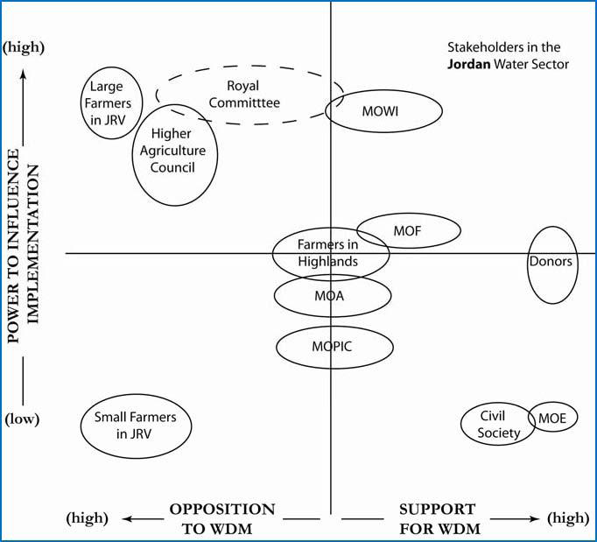
PEA – issue/ sector level – Jordan
Reasons why Water Demand Management is not happening
Zeitoun, 2009

Slide 11
PEA – sector level – Ethopia
Entry points for change
Use of Capability – Accountability – Responsiveness approach (CAR) combined with PE where PE asks “why”
Findings
State capability (can the state get things done) - money, human resources, procedures, coordination, M&E
Accountability (are actors held to account) – formal systems are too easily bypassed
Responsiveness (i.e. is the state responsive to the needs of citizens) – patchy, demand side is low
Underlying factors:
Continued centralisation of power and state control of land;
Right control of the party over state institutions;
Relative weakness of opposition parties and civil society; and,
Continuing suspicion of the private sector.

Slide 12
PEA – sector level – Ethopia
Entry points for change
Findings
Water not on the political agenda
Decentralisation – water dependent on a highly political process
Staff are promoted out of party loyalty not merit
Incentive for upward accountability to party and not for downwared accountabilitly to people
Incentive to over report results
Some regions geographically and historically marginalised , performance is patchy
Recommendations
Strengthen demand from below – information and awareness
Tariff review – payment creates accountability
Independent M&E, poor information shields bad practice
Citizen report cards seem to work
Adapted from ODI 2010

Slide 13
PEA, example – issue level - Tanzania
Factors affecting PMO-RALG capacity
Functional/rational factors
Political factors
Internal
Skilled, experienced staff
Supportive systems e.g. good accounting, transport
Effective managers
Capacity building and training
Communication environment
Culture of accountability
Time management culture
Morale
Internal conflicts
Promotion by merit
External
Presence of an overall strategy
Sufficient recurrent costs
Financial and other incentives to act in the interests of the organisation
Presence of offices in both Dodoma and Dar-es-Salaam
Productivity loss due to power interruptions
Power of the Ministry
Acceptance by other institutions of the institutions mandate
Presence of civil society that act as a watchdog role
Success and pace with which pay reform, civil service and other reforms are being implemented.
Need to attend to immediate politically set tasks.
Presence/ tolerance of corruption
Notes:
Prime Minister’s Office, Regional Administration and Local Government - analysis 2007

Slide 14
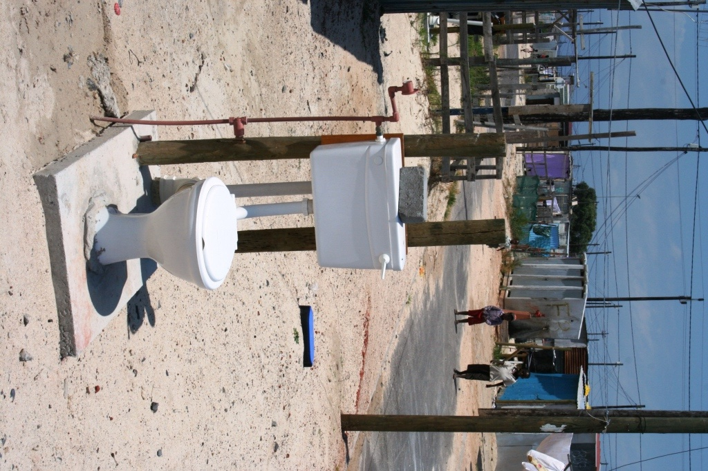
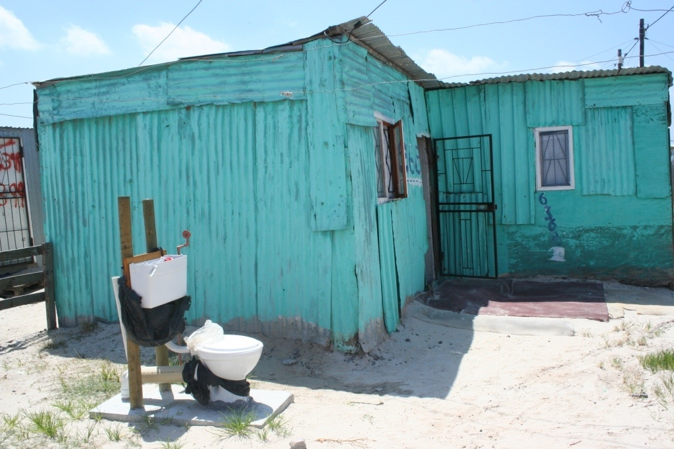
PEA - water sector
How can this happen?

Slide 15
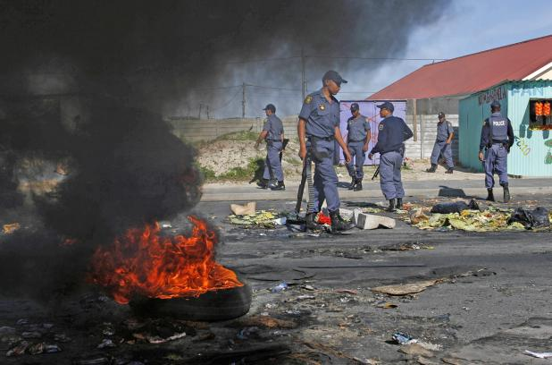
PEA - water sector
...and then lead to this?

Slide 16
PEA – water sector specific factors
Service sector: Customer focus is new ; labour unions of service play a key role; delivering basic services has a low social prestige;
Public service: Civil service plays a key role in service delivery; service delivery is hampered by low capacity, low wages, lack of clarity of rules, dysfunctional institutions with perverse incentive structures and weak transparency; people view it as a government responsibility and abdicate
Prone to corruption: Sector vulnerable to political interference, patronage, misallocation of funds and corruption – service in high demand can be hijacked politically
Power: Access to water and the control of access to water services is power; officials and agencies in service delivery have high levels of discretion in the allocation of resources, the planning and the implementation of projects;
Inequality in access: There are marked disparities in access to water services in terms of quantity, quality and price; between rural and urban areas as well as within urban areas (e.g. between urban poor and middle class);

Slide 17
PEA – water sector specific factors
Aid-dependent sector: Due to the high development costs, water services are dependent on external funding;
Natural monopolist structure: Difficult to introduce competition – benchmarking - water vendors’ business can be destroyed
Challenges of public financing: High costs for the development of water service systems require large public investments; public financing requires the coordination of national, local and external funds and predictable and transparent financing procedures;
Multitude of actors: A multitude of state and non-state actors is involved in water service delivery at various levels of government and with various roles and responsibilities; this requires good coordination and strong frameworks for interaction;
Adapted from Plummer & Slaymaker 2007

Slide 18
PEA – implications for external support
The big picture
The little picture
National farmers union
Ministry of Finance
Line / Sector
Ministries
Cabinet
fees
services
Front Line
Service Providers
farmers
Parliament
Some implications for external support
Look at the linkages and accountability
If it doesn’t work – ask why – don’t rush to replace
Strengthen from within unless rotten
Think about entry point
Donor
Client/Citizen
18

