Slide 1
Experiences with Transboundary River Basin Management in Eastern Europe and the Middle East;
Role of regional support mechanisms
Gert Soer, team leader ‘Support to MED EUWI project’
Regional Water Seminar, Brussels, 28-30 June 2011

Slide 2
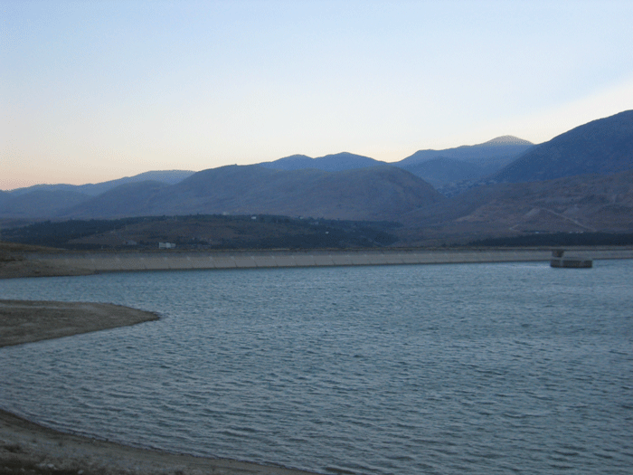
Activities of the Project “Support to MED EUWI”
Country dialogues on Integrated Water Resources Management:
Egypt, Palestine & Lebanon
Support to the Joint Process WFD-EUWI
Working groups
Pilot projects (Buna/Bojana & Jordan River)
Regional Water Seminar, Brussels, 28-30 June 2011

Slide 3
The Joint Process deals with river basin management
Sebou pilot project in Morocco on water economic issues
2007-2008
Five working groups on water management issues
2003 until now
Litani river pilot project in Lebanon on organizational issues
2008-2009
Pilot project on RBM organisation in the Jordan River basin
starting 2011
Pilot project on integration of ICZM and IWRM in Buna/Bojana
starting 2011
Regional Water Seminar, Brussels, 28-30 June 2011

Slide 4
Case studies
Lithuania/Latvia; Transboundary management of the Venta and Lielupe river basins (1999)
Russian Federation: Water management in the Oka river basin (2000-2001)
Ukraine/Slovakia/Hungary/Rumania: Flood protection in the Tisza river basin (2004-2005)
Israel/Jordan/Lebanon/Palestine/Syria: Jordan river basin (2011)
Regional Water Seminar, Brussels, 28-30 June 2011

Slide 5
Some characteristics
 | size | countries | population | annual SW resources | water per capita
 | [km²] |  | [million] | [million m³] | [m³/year]
Venta and Lielupe river | 29,500 | 2 | 1.0 | 4,600 | 4,510
Oka river basin | 245,000 | 15 * | 45.0 | 39,500 | 878
Tisza river basin | 157,186 | 5 | 14.0 | 28,400 | 2,029
Jordan river basin | 18,900 | 5 | 9.4 | 1,300 | 138
* oblasts
Regional Water Seminar, Brussels, 28-30 June 2011

Slide 6
Venta/Lielupe basin
SITUATION AT THE START OF THE PROJECT:
Nutrient rich wastewater (urban and agriculture) in upper branches of the rivers
Sensitive area with respect to eutrophication (natural river flows, Gulf of Riga, Baltic Sea)
Very little consultation between the two countries on upstream/downstream issues
Latvia
Lithuania
Regional Water Seminar, Brussels, 28-30 June 2011

Slide 7
New management structure - Venta / Lielupe basin
Democratic stakeholder structures
Minister meeting (when needed)
River Basin Commission Lithuania
Scientific Centers
Transboundary River Basin Commission
River Basin Commission Latvia
Environmental Agencies
European Commission
Regional Water Seminar, Brussels, 28-30 June 2011

Slide 8
Venta/Lielupe basin
ACCOMPLISHED IMPROVEMENTS:
National River Basin Commissions for each river
Technical protocol (treaty) between Lithuania and Latvia on the management of the river basins (2003)
Joint River Basin Commission under WFD since 2006
Joint transboundary management (operation and planning)
River Basin Commissions have own income (like in France) and subsidize capital investments (in their own country)
TRANSBOUNDARY → ACCELERATION OF POLLUTION CONTROL INVESTMENTS
Regional Water Seminar, Brussels, 28-30 June 2011

Slide 9
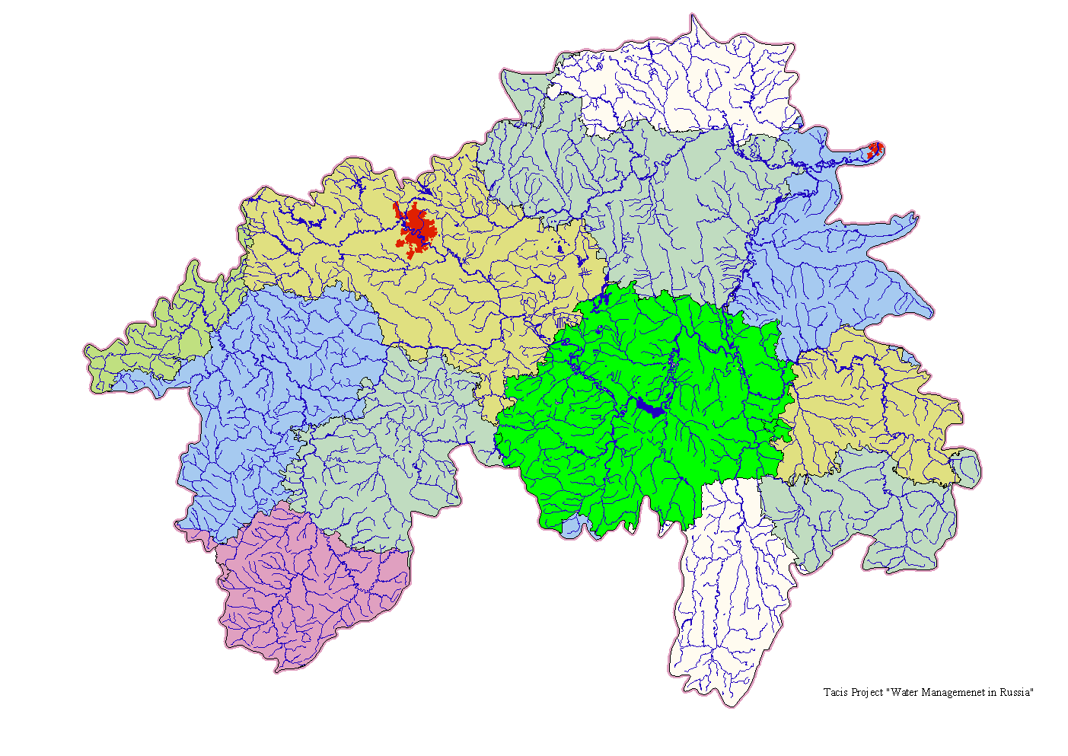
Oka river basin
SITUATION AT THE START OF THE PROJECT:
Sufficient water resources
Mainly water quality problems (toxic components, BOD) causing problems for drinking water supply
Upstream-downstream conflict between polluters and water users
Polluters are not paying for damage
Decision-making system does not deliver; existing river basin organizations are mainly scientific and planning, but planning is not implemented
Regional Water Seminar, Brussels, 28-30 June 2011

Slide 10
New management structure – Russian Federation
Prime Minister
Ministry of Natural Resources
Basin Water Council (stakeholders)
Federal Technical Services
BWO Moskva-Oka (operational unit)
Technical Services of federal subjects
Regional Water Seminar, Brussels, 28-30 June 2011

Slide 11
Oka river basin
ACCOMPLISHED IMPROVEMENTS:
An Oka River Basin Committee was established in 2001 with participation of stakeholders
A new Water Code was finalized by the Duma (Russian Parliament) in 2006 giving new authority to the River Basin Committee with respect to planning
The proposed river basin organizations are slowly being put in place since 2006
TRANSBOUNDARY → BETTER COMMUNICATIONS AND BETTER MACRO DECISIONS ON THE BASIN LEVEL
Regional Water Seminar, Brussels, 28-30 June 2011

Slide 12
Tisza river basin
SITUATION AT THE START OF THE PROJECT:
Canalization of upstream river channels leading to flooding problems downstream
Inadequate water storage capacity in upstream areas
Engineering solutions (ever higher dikes) instead of resilient flood management
Inadequate flood warning system upstream-downstream
Water quality calamities from mining activities in Rumania (cyanide spill January 2000)
Concentrations of heavy metal and organic micro-pollutants in sediment exceed standards
Regional Water Seminar, Brussels, 28-30 June 2011

Slide 13
Management structure – Tisza river
ICPDR
Donors
Tisza Group
(Governments and other organizations)
Stakeholders (water users, NGOs, scientists)
Operation and implementation by the countries
Line ministries
Regional Water Seminar, Brussels, 28-30 June 2011

Slide 14
Tisza river basin
ACCOMPLISHED IMPROVEMENTS:
Bilateral agreements since 1955
International Commission for the Protection of the Danube River (ICPDR) since 1994
After Serbia joined the ICPDR, the Tisza group (riparian countries) have signed a MoU in 2004 on transboundary cooperation
Analysis report in 2007
Joint river basin management plan planned for 2009, draft in 2010, but not yet completed
No real Joint River Basin Commission with delegated authority (yet)
TRANSBOUNDARY → NATIONAL DECISIONS NOT COUNTERPRODUCTIVE ANYMORE
Regional Water Seminar, Brussels, 28-30 June 2011

Slide 15
MED EUWI Jordan river pilot project
1997 UN Convention on International Watercourses
Jordan, Lebanon and Syria ratified this convention; Palestine declared to sign and ratify when they become a state. Israel did not sign or ratify the convention
Obligation to cooperate
Obligation not to cause significant harm
Equitable and reasonable utilization
Obligation to protect and conserve the ecosystems
This case is of particular interest as it is the first time WFD principles are applied in a transboundary context where water scarcity is the main issue
Regional Water Seminar, Brussels, 28-30 June 2011

Slide 16
Jordan River
Proposed river basin consultation structure
Government of Jordan
bilateral consultations
Government of Israel
consultations
GLOWA
Palestinian Authority
MED EUWI
consultations
EXACT
Joint consultations
FOEME
Government of Lebanon
technical support
European Commission
Arab
Jordan River Basin Initiative
consultations
Secretariat
Government of Syria
Other donors
Regional Water Seminar, Brussels, 28-30 June 2011

Slide 17
Jordan River
Purpose of the consultations
Make inventory of water resources and uses, using uniform assessment methods
Investigate pressures on water resources
Explore measures in the pipeline to relieve pressures
Discuss equitable division of water resources
Develop alternative scenarios to relieve pressures
Make resource allocation more equitable
Reassess transboundary agreements if needed
Regional Water Seminar, Brussels, 28-30 June 2011

Slide 18
Lessons learned in transboundary RBM
Enabling conditions need to be in place
water management = information management
functional transboundary consultation structure
River basin:
Dialogue (Upstream - downstream / between riparian countries) essential for achieving transboundary management (most effective measures)
Regional:
Knowledge management and joint learning until now insufficiently developed (Mediterranean region)
Regional Water Seminar, Brussels, 28-30 June 2011
Notes:
It is important to explain and demonstrate this also to recipient countries and stakeholders
Sharing information, having procedures in place is important, but there should be dialogue with the objective of consensus building
The essence is knowledge management which is something completely different from training

Slide 19
Present status of transboundary RBM
Transboundary Commissions in place :
Relatively wide but varying powers
such as data sharing, planning, consensus building, action plans
Centralized financial functions :
Mainly study and planning
but not investments (except for federal states)
Regional Water Seminar, Brussels, 28-30 June 2011
Notes:
It is important to explain and demonstrate this also to recipient countries and stakeholders
Sharing information, having procedures in place is important, but there should be dialogue with the objective of consensus building
The essence is knowledge management which is something completely different from training

Slide 20
Starting up RBM – Sequence of actions
Institutionalize consultation structure
Ensure preconditions are in place (public exposure, data sharing)
Improve information status and monitoring
Acquire technical tools (DSS, WEAP model, etc.)
Prepare RBM Plans
Financing of measures
Regional Water Seminar, Brussels, 28-30 June 2011
Notes:
It is important to explain and demonstrate this also to recipient countries and stakeholders
Sharing information, having procedures in place is important, but there should be dialogue with the objective of consensus building
Water Ewvaluation and Planning System
The essence is knowledge management which is something completely different from training
This also applies to transboundary managment

Slide 21
Technical tools
Data analysis and reporting :
Informs on pressures, status and effect of measures
Modelling tools :
Simulation of not measurable realities (extreme floods, water quality accidents)
Playing with what-if scenarios
Decision Support Systems :
Quantify socio-economic and environmental impacts
Dialogue :
Methodology to reach consensus based on scenarios and their impact
Regional Water Seminar, Brussels, 28-30 June 2011
Notes:
Proper data analysis and reporting informs us about the status in the river basin (of pressures, of pollution, of the effect of measures)
Sharing information, having procedures in place is important, but there should be dialogue with the objective of consensus building
Water Ewvaluation and Planning System
The essence is knowledge management which is something completely different from training

Slide 22

FINANCIAL FLOW (Lithuania)
WATER
Other
ENVIRONMENTAL
Taxes
POLLUTION Taxes
RESOURCES Taxes
1.6 M€
2.4 M€
MUNICIPALITIES
Budget (660 M€)
3.7 M€
Revenue Service
(State Budget
1,780 M€)
STATE INCOME
18.5 M€
1.5 M€
1.3 M€
Fines and penalities
Municipal
Environmental
Protection
Fund (9.2 M€)
State
Environmental
Protection
Fund
1.2 M€
Current costs
of
Water objects
1.2 M€
0.2 M€
(34.7 M€)
WATER
PROJECTS
0.1 M€
INT. DONORS
NIB, EIB, NEFCO,
others
Grant and loans
14.6 M€
Grant 30%
Loans 30%
EU/PHARE PROJECT N° 229725/0301 MS

Slide 23
NEW FINANCIAL FLOW PROPOSAL
Other
ENVIRONMENTAL
Taxes
RESOURCES Taxes
POLLUTION Taxes
WATER
STATE INCOME
Revenue Service
(State Budget)
WATER
AUTHORITY
MUNICIPALITIES
Municipal
Environmental
Protection
Fund
Fines and penalities
WATER
PROJECTS
State
Environmental
Protection
Fund
INT. DONORS
NIB, EIB, NEFCO,
others
Grant and loans
EU/PHARE PROJECT N° 229725/0301 MS

Slide 24
Regional Initiatives - Mediterranean
Some important initiatives not focussing but related to RBM/IWRM such as the Mediterranean Action Plan, the EU MEDA Water Programme, The H2020 Initiative
Civil Society Initiatives (GWP-Med, IME)
The Mediterranean Component of the EU Water Initiative (Improving IWRM through dialogue)
The Joint Process WFD-EU Water Initiative
Regional Water Seminar, Brussels, 28-30 June 2011
Notes:
1. Explain that RBM and IWRM are closely related, one as a management system and the other as a management philosophy

Slide 25
Benefits of regional cooperation
Improving knowledge
Learning alliances
Avoiding missed opportunities
Economy of scale by doing things together, building synergies and avoid repetition
Regional Water Seminar, Brussels, 28-30 June 2011
Notes:
1. Explain that RBM and IWRM are closely related, one as a management system and the other as a management philosophy

Slide 26
MED EUWI
Achievements and what went wrong
Learning alliances were formed (Water Directors meeting, Joint Process working groups) but not sustained
Concentration on bilateral support projects in stead of truly regional activities
IWRM introduced in different countries (ad-hoc support measures, mainly studies and “dialogues”)
Few efforts to improve national water management structures and management cultures
Insufficient SWAp in country dialogues so far
WFD principals and modalities still insufficiently known in the South and East Mediterranean countries
Regional Water Seminar, Brussels, 28-30 June 2011
Notes:
Explain that RBM and IWRM are closely related, one as a management system and the other as a management philosophy
Last sentence: These principles are valuable and deserve a wider application.

Slide 27
Thank you for your attention!
Regional Water Seminar, Brussels, 28-30 June 2011

