Slide 1
DG Human Resources & Security
PERFORMANCE THROUGH PEOPLE
information day "development economists"
Junior Professionals
in Delegations
Nancy Vanhaverbeke, DG HR.AMC4
1

Slide 2
"WHO IS WHO"
DG HR, AMC, HRBC, EEAS
2

Slide 3
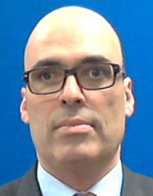
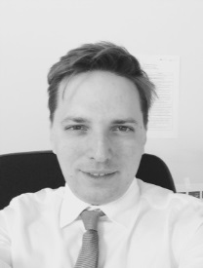
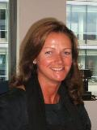
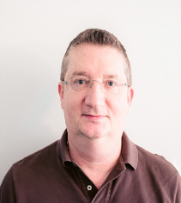
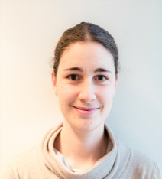


DEVCO HR BC Team
Jean-Hervé RAMAT
Head of Unit R5
Sylvain HUBERT
Deputy HoU R5 and BC
DEVCO HR Business Correspondent
Located in L-41
DEVCO HR BUSINESS CORRESPONDENT
EuropeAid-HR-BUSINESS-CORRESPONDENT@ec.europa.eu
FIONA LYONS
ALAIN SCHUYTS
DILETTA DISCHINGER
AUDREY FRANCO
3

Slide 4
BC Team: What is their role?
The HR BC has a strategic HR role to support DG HR's management in:
Defining an HR strategy for the DG which is aligned with our business goals and workforce needs
Supporting change through the design and implementation of new organisational structures
Identifying the HR priorities & needs of the DG and taking strategic HR decisions
Supervising efficient and effective HR administration by liaising with the AMC
4

Slide 5

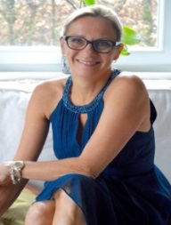
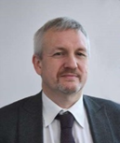
AMC4 TEAM
Nancy VANHAVERBEKE
Head of Unit AMC.4
Patricio NOLASCO
Deputy HoU AMC.4
AMC 4
But also:
4 teams – 60 staff members
serving DG DEVCO, NEAR, ECHO, FPI, TRADE Del
& other Non Relex DG posts in DEL) = +/- 7000 staff members
Located in J30
HR-AMC-J30@ec.europa.eu
5

Slide 6
AMC: What is their role?
The AMC is there to implement HR's policies and to manage staff
Supporting change: provide data and advices to support decision making and implement new structures in the DG
Attracting talents to the DG:
Ensure recruitment & selection → to have the right person at the right place
Investing in / retaining Talents:
Provide support to staff (career guidance, L&D, managerial development)
Improving daily life:
ensure fairness/equity in implementing the working conditions in a healthy working environment
6

Slide 7
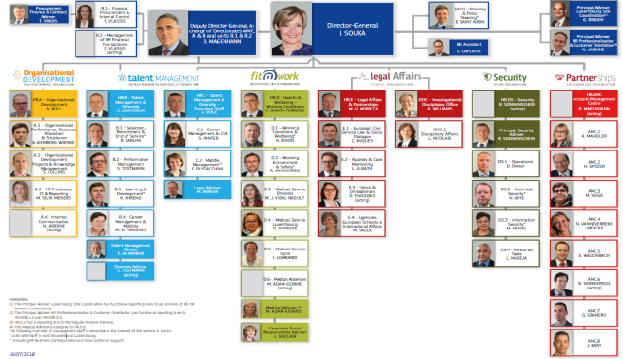
DG HR

Slide 8
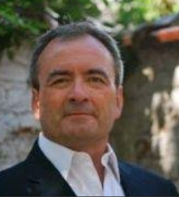
EEAS.BA-HR.2
Luc VERON
Head of Unit
Our partner for the management of staff in DEL : officials, contract agents, JPDs
8

Slide 9
AMC4: RELEX FAMILY
Management of staff matters
AMC 4 Cluster
9

Slide 10

AMC4: RELEX FAMILY
TEAM 1
TEAM 2
TEAM 3
TEAM 4
Organisational Development & RELEX specificity
Recruitment, mobility & performance
Talent Management
Health, wellbeing & working conditions
Planning, Organisation Support and HR Analytics*
Selection, Recruitment & Mobility
Talent Management
(incl. Career Guidance and Head hunting)
Health & Wellbeing
RELEX "support to the Centre of Gravity"
Management
Selection, Recruitment & Mobility
Learning & Development
Working Conditions & Time Management
Financial Management
of HR transactions
Performance Management*
* Incl. resource allocation,
TDE & budget support, JIS/SCR
* Incl. appraisal, promotion, underperformance
10

Slide 11
AMC4: JPDs = What ?
Junior Professionals in Delegation (JPDs)
Available information (including legal basis) on the EEAS Website
https://eeas.europa.eu/headquarters/headquarters-homepage/2463/junior-professional-in-delegation-jpd_en
11

Slide 12
AMC4: JPDs = Who ?
Main eligibility criteria
(Join Decision (2012) 17 final - 12.6.2012)
Citizenship : from one of the Member states
Military service : have fulfilled any obligation of this kind
University diploma: at least a university degree equivalent to a
Master degree in a domain relevant to activities in DEL
Languages: Have the capacity to communicate in the languages
    of the external relations necessary for their integration
    in the DEL environemnt
Professional experience: not required by preference to candidates with up to 4
years of relevant experience to the programme
12

Slide 13
AMC4: JPDs = How ?
Key elements from the decision
Coordination of the biennal call for expressions of interest by EEAS
12 months traineeship agreement, renewable for another 12 months
Monthly basic grant and any other financial contribution fixed by a decision (implementing rules) which will be published on EEAS website
The trainee has to conclude a set of individual health, accident and repatriation insurances before the start of the traineeship
Measures to cover maternity leaves
13

Slide 14
AMC4: JPDs = When ?
Step by step
January: Launch of the yearly round – publication EEAS website
End January: Deadline for applications to Member States
April-May:
          List of preselected candidates by MS → EEAS & Commission
          Selection & matching by EEAS and Commission
June: Communication of the results to MS, traineeship offers to selected candidates (78 for the 2017-2019 round)
September: Obligatory induction training in Brussels
September/October: Start of the traineeships in EU Delegations
14

Slide 15

15

