Slide 1
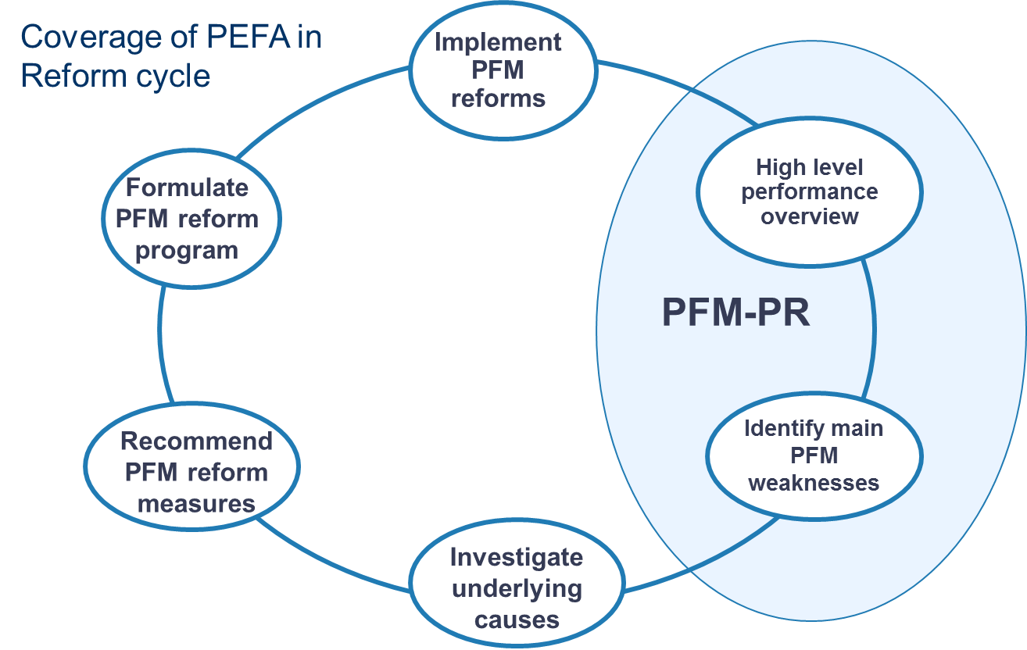
Public Finance Management
PEFA

Slide 2
For further information
Collect More – Spend Better (European Commission Staff Working Document)
https://ec.europa.eu/europeaid/sites/devco/files/swd-collect-more-spend-better.pdf
PEFA website: https://pefa.org/
Capacity for development website: Economics, public finance management and budget support discussion group https://europa.eu/capacity4dev/macro-eco_pub-fin/discussions

