Slide 1
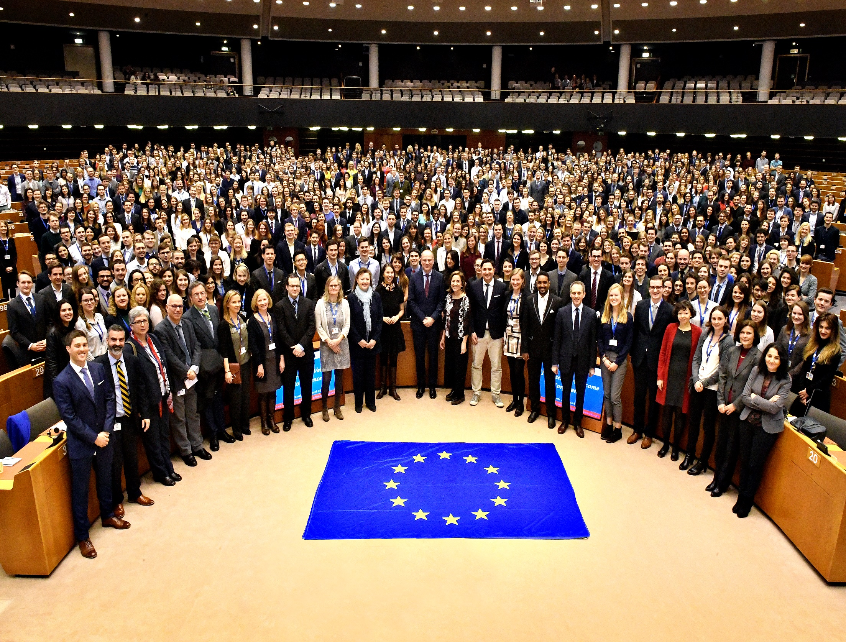
Traineeships
European Commission programme
Jack Kelly
Traineeships Office 15th November 2018

Slide 2
Agenda
Background
What’s in it for EU?
Programme
Social Life
Selection procedure and criteria
Facts and figures

Slide 3

Background
Blue book
Started in 1960
6 trainees

Slide 4
What’s in it for EU?
FOR THE TRAINEE Eye-opener on EU working methods Paid, quality traineeship in a large organisation Opportunity to put into practice knowledge in their fields of competence Hands-on insight of a real multicultural environment Work experience | FOR THE COMMISSION Create a network of EU "goodwill ambassadors" Create a pool of university graduates to collaborate with the EU in the future Input of university graduates who offer a fresh eye Learn from trainees’ up-to-date academic or private sector expertise

Slide 5
The programme
Programme
The European Commission Traineeship programme ("Blue Book") is the world's biggest by number of applications and places offered
It offers a five-month traineeship to university graduates from the Member States and third countries
The Commission recruits around 650 trainees twice a year (two sessions starting respectively on 1 March and 1 October each year)
Based primarily in Brussels and Luxembourg but also in the reps, grange, Vigo, London and Copenhagen

Slide 6
The programme
Units
Traineeship learning programme
Specific programmes DG or reverse mentoring

Slide 7
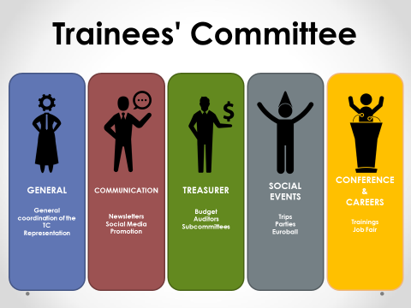
Social Life
The Trainees Committee
Subcommittees
Porte-paroles

Slide 8
Selection Criteria
Minimum requirements to apply include:
Candidates must have completed the first cycle of a higher education course (university education) and obtained a full degree or its equivalent (3 years minimum) by the closing date for applications
Candidates from Member States must have very good knowledge of at least two EU languages, of which one should be one of the working languages of the European Commission (English, French or German)

Slide 9

Selection Process
October 2019
Application January 2019 (7th to 31st)
Evaluation (eligibility check) May
Reservations(by DGs) June
Offers July

Slide 10




Facts and figures
Nationalities
Most represented Least represented
Education – 92% Master’s degree in
Political Sciences 21 %, Law 20 %, EU studies 8%
Age
27
2012 – 2015 figures

Slide 11
The Stage evaluation Advice for results advisers
Facts and figures
Reference period: March 2017
84.5% - tasks were in line with trainees' qualifications;
99% - learned about policies and activities of their service/unit/DG;
94% - learned about the Commission in general.
Job offer before the end of the traineeship
 | March 2017
Yes, within the Commission | 16 %
Yes, within another European institution | 2.5 %
Yes, outside the European Institutions | 23 %
No | 58.5 %

Slide 12
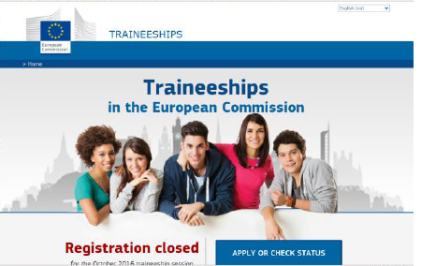
The Websites
Traineeships website
General information, application forms and selection procedure
http://ec.europa.eu/stages/index_en.htm
Trainees’ Committee
http://www.traineescommittee.com/

