Slide 1
Budget support
DEVCO/A4
European Commission
Brussels
15 November 2018

Slide 2
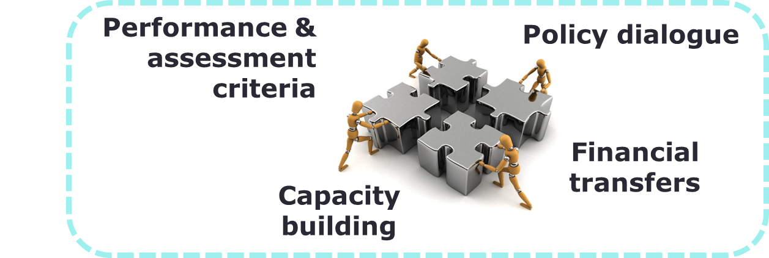
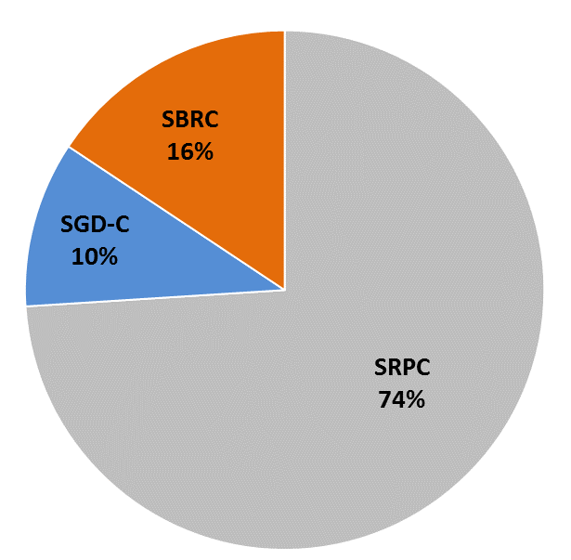
Budget support = development effectiveness
Dialogue on reforms, focus on results
Alignment with countries’ policies
Using countries’ systems
Ownership = sustainable results
3 types of contracts:
  Sustainable Development Goals Contract (SDG-C)
  Sector Reform Performance Contract (SRPC)
  State and Resilience Building Contract (SRBC)

Slide 3

Conditions and SDGs
⚠ fundamental values ⚠
4 general conditions:
  Credible & relevant dev./sector policy of the country
  Stability-oriented macroeconomic policies
  Progress in public finance management
  Budget transparency & oversight
Implemented in all sectors
Close coordination with all stakeholders
Additional performance indicators triggering more funds: variable tranche

Slide 4
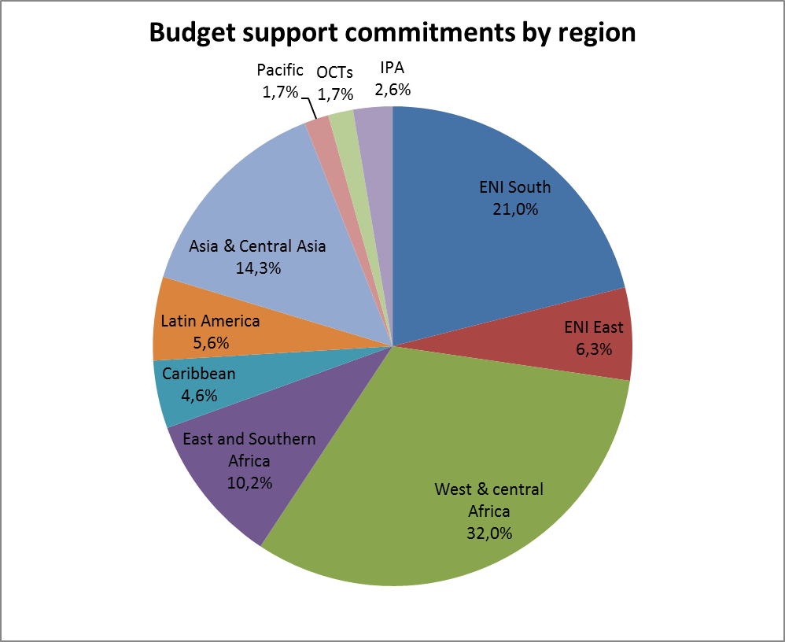
EU budget support > a global modality
90 countries & OCTs
Portfolio € 12.7 bn
270 contracts total
€ 1.6 bn comm. in 2017
€ 1.8 bn paid in 2017
SSA + ENI = 70%
EU largest grant budget support provider globally (80% DAC flows)

Slide 5
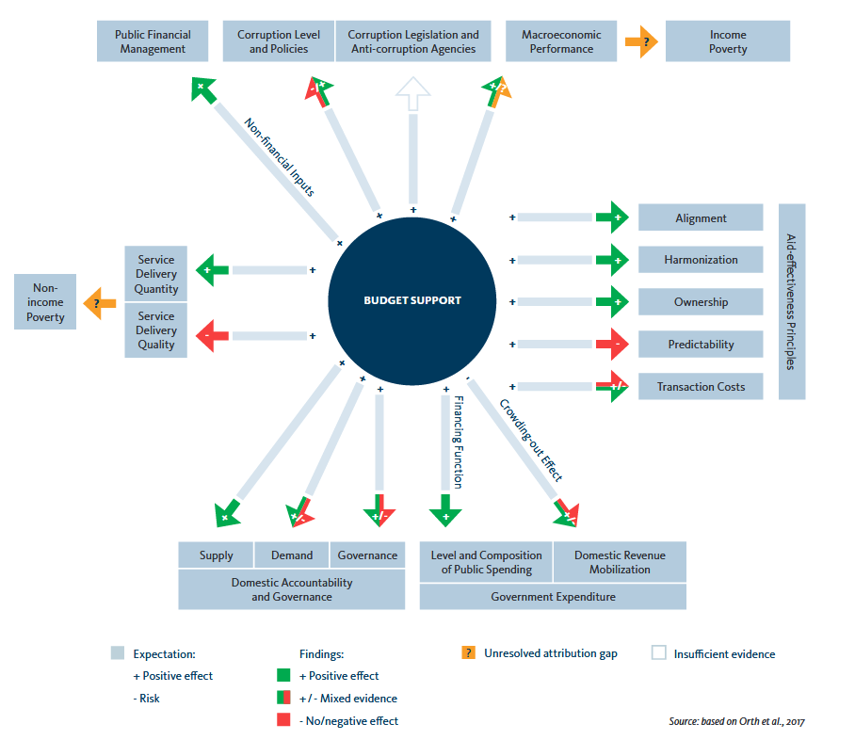
Effectiveness recognised
German Institute for Development Evaluation (DEVAL): synthesis of 95 evaluations over 1994-2015
(link)

