Slide 1
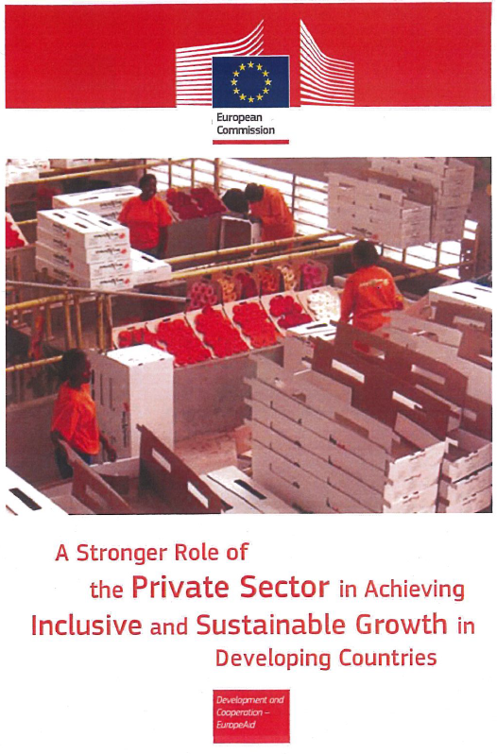

Zissimos Vergos
Unit DEVCO C.4 – Private Sector and Trade
https://ec.europa.eu/europeaid/european-commission-communication-com2014263-stronger-role-private-sector-achieving-inclusive-and_en
Notes:
Having a decent job is widely recognised as the best way out of poverty. The private sector provides some 90 per cent of jobs in developing countries, and is thus an essential partner in the fight against poverty. It is also needed as an investor in sustainable agricultural production if the world is to meet the challenge of feeding 9 billion people by 2050. And through innovation and investment in low-carbon and resource-efficient solutions, it will have a major role to play in the transformation towards an inclusive green economy. Given the private sector’s potential for generating inclusive and sustainable growth in developing countries, private stakeholders including businesses, financial intermediaries, associations and workers and employers organisations are emerging as ever more active in the development field, both as a source of finance and as partners for governments, non-governmental organisations (NGOs) and donors.

Slide 2
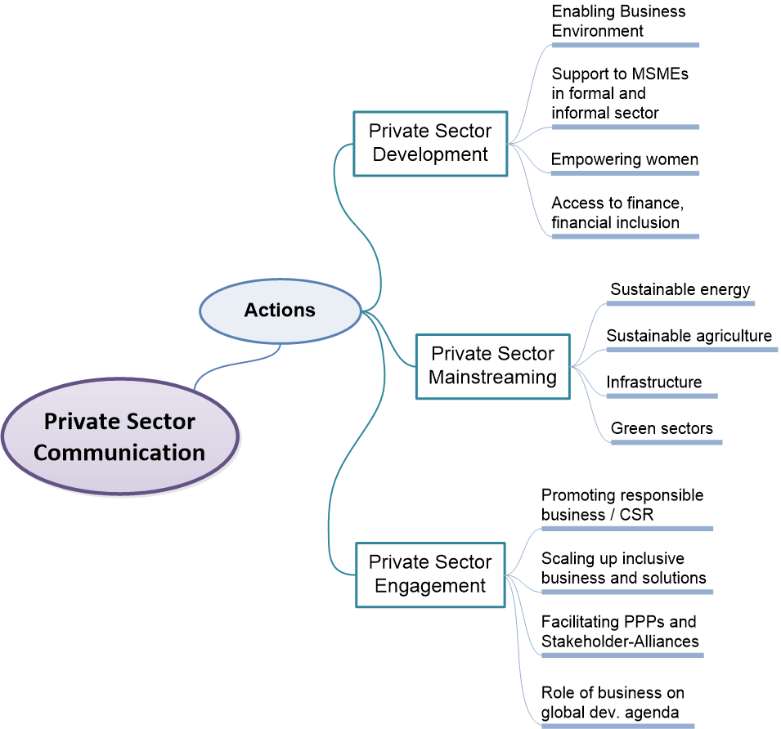
Actions on PSD and PSE
Private Sector Communication
Macro
Micro
Meso
Regional
National
Local
Notes:
Building on past achievements and lessons, and taking account of feedback received from consultations with stakeholders this Communication proposes a strategic framework for strengthening the role of the private sector in achieving inclusive and sustainable growth. It consists of two levels at which the EU believes it can add value and effectively complement actions by its Member States, development financing institutions and other development partners.
In terms of private sector development support, the Commission wants to remain an important partner of governments and business intermediary organisations in developing countries for supporting the creation of an enabling business environment and the development of local enterprises that are equipped to create decent jobs, generate public revenues, and harness the opportunities offered by globally integrated markets. In so doing, the Commission will look for new ways of harnessing the potential of the private sector as a financing partner, implementing agent, advisor or intermediary to achieve more effective and efficient delivery of EU support, not only in the field of local private sector development, but also in other areas of EU development cooperation such as sustainable energy, sustainable agriculture and agribusiness, digital and physical infrastructure, and the green and social sectors.
Looking beyond the private sector as a partner in development cooperation, the proposed strategic framework will also include actions and tools to help the private sector achieve positive development results as part of its core business strategies. This means that the Commission intends to play a stronger role as facilitator of companies’ own engagement for development, for instance by encouraging responsible investment in developing countries, or sustainable supply chains and production patterns.
This strategic framework is being reflected in the programming of EU development assistance from 2014 to 2020 with regard to national and regional private sector development strategies such as the joint ACP-EU work on a new cooperation framework for private sector development in ACP countries, at the level of thematic programmes that address private sector engagement as a cross-cutting issue, and in sectoral interventions designed to mainstream engagement with the private sector in agriculture, sustainable energy, and infrastructure, or in green and social sectors.
Consultations on the issues relevant for this Communication were carried out between November 2013 and February 2014 with EU Member States, partner governments, local authorities, European and local private sector representatives, social partners and NGOs.
These interventions are closely related to, and complemented by, activities in the field of trade and development that are outlined in the 2012 Trade, Growth and Development Communication [COM(2012) 22 final].
Macro-level and sectoral interventions to strengthen the business environment require complementary provision of support services at the meso and micro levels to increase productivity and accelerate investment and decent job creation. Emphasis will be put on supporting micro, small and medium-sized enterprises, which play a particularly vital role in job creation, and in raising productivity and working conditions in the informal economy.

Slide 3
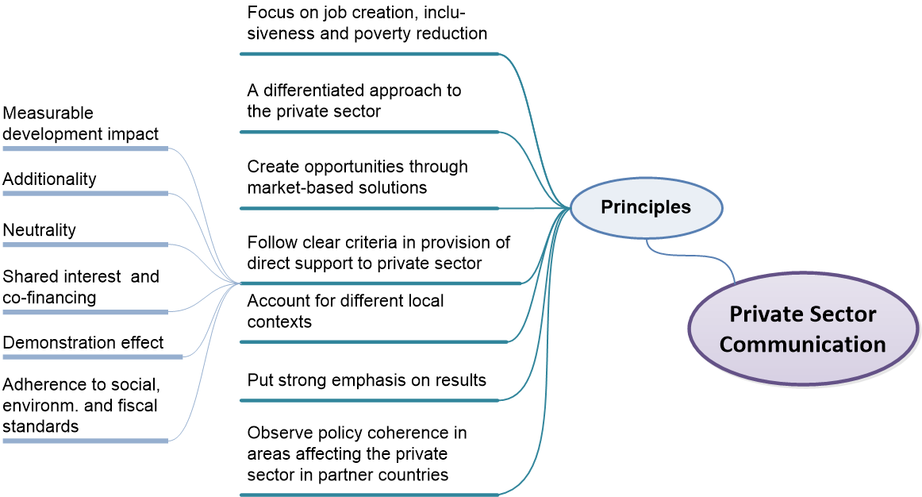
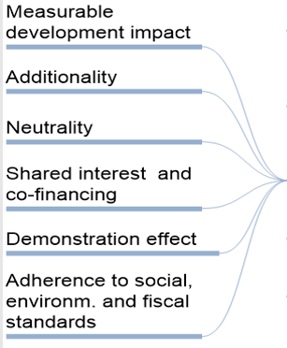
Private Sector Communication
Principles & Criteria for Private Sector Support
Notes:
3
DEVCO C4
3
The EU’s support for private sector development and its engagement with both the local and international private sector will be guided by clear principles that complement aid effectiveness principles and are intended also to inspire efforts by EU Member States, financing institutions, and other development partners of the EU.
The EU shall implement clear criteria in the provision of direct support to private sector actors. While official development assistance is clearly justified for intervention at macro and meso levels, it can also be effective at micro level to speed up local enterprise development or to overcome market failures and sub-optimal investment situations. However, to guarantee development impact and sustainability, avoid market distortions, and mitigate reputational and fiduciary risks, clear criteria have to be applied in decisions on support to enterprises or financial intermediaries through direct grants or subsidised business development services, or in the form of guarantees, insurance or concessional finance. The European Commission has developed a set of criteria to guide such decisions. They complement the rules laid down in the Commission’s financial regulations and are broadly aligned with standards applied by other development partners

Slide 4
Macro
(Policy, legal and regulatory issues)
Meso (Intermediary Organisations,
Access to Sector Services, Private sector representative organisation, Providers of business development and financial services
Micro (Enhancing inner capacities of entreprises)
Notes:
Intervention
level
Broad areas of
intervention Key activities
Macro level
Financial sector policies
and regulatory frameworks
• Reform of financial sector policies
• Support to improve banking regulations and supervisory systems
Strengthening regulators
and supervisory authorities
• Provision of training and advice to central bank on supervision
and banking regulations
• Provision of training and advice to financial sector regulators and
supervisory authorities
• Strengthening of national/regional training institutions for the financial
sector
Meso level
(financial
institutions
and BDS
providers)
Strengthening financial
institutions (financial
service providers)
• Assistance to associations of banks and non-banking financial
institutions to develop their capacity to create awareness amongst
their members on issues and opportunities related to enhanced
access to finance for SMEs
• Establishment of SME finance units within commercial banks and
training of their staff on SME lending (e.g. on risk management,
collateral / alternative requirements, cash flow based lending)
• Strengthening expertise of service providers (incl. MFIs) e .g. in
auditing, financial and risk management, accounting systems,
management of information, etc.
• Support to rating agencies for microfinance (incl. R&D and performance
assessments)
• Strengthening of business support organisations in order to
enhance their capacity to provide information and advice to SMEs
in the area of finance
Development of financial
infrastructure
• Support to the creation / strengthening of financial information
infrastructure (credit bureaux, credit reference services126,
collateral registers, rating agencies)
Development and delivery
of financial services
• Product development (including trade finance and export
guarantees127, microfinance products).
• Provision of capital to investment funds for onward funding
• Provision of capital to banks and MFIs: equity, loans, guarantee
funds
• Provision of grant funding for risk-sharing and capacity building
in relation to start-ups and green-field investments (for MFIs )
Micro level
Facilitation of access to
finance for SMEs128
• Support to enterprises in finding financial information, preparing
bankable business plans and/or loan applications (i.e. through
SME support centres/schemes)
• Pre-investment feasibility studies and due diligence129 assessments
for local enterprises
• Information dissemination to SMEs

Slide 5


Private sector in EU aid policy
2017
Aid for Trade
2018
Towards a more efficient financial architecture for investment outside the EU
2018
A new Africa – Europe Alliance for Sustainable Investment and
Jobs
2017
EU Communication
"For a renewed impetus of the Africa-EU Partnership"
2017
New Consensus
on Development
2016
Global Strategy on Foreign and Security Policy
2015
Addis Ababa declaration
on financing
for development
2015
UN Paris Agreement on Climate Change
2016
Commodities
Super Cycle
Low
2015
Trade for All
2014
A Stronger Role
of the Private Sector
2015
Europe Migrant Crisis
Inequality/Poverty
Demography
Climate Change
Trade/GVCs
Digitalisation
Geopolitical
2011
Agenda for change
2008
Financial Crisis

Slide 6
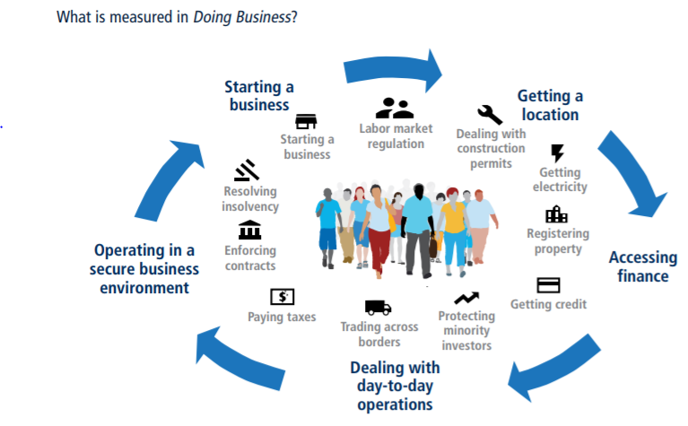

Business environment

Slide 7
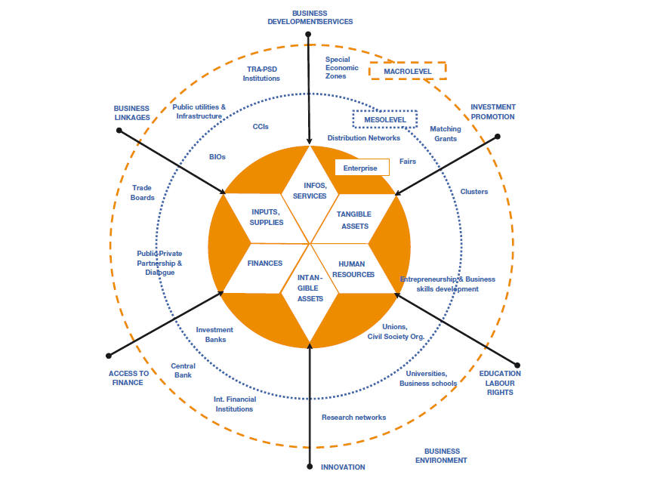
Notes:
At macro level, competitiveness relates to improving the relationships of production systems with domestic
markets and/or the global economy. The so called ‘business enabling environment’ (i.e. policies, strategies,
legal and regulatory framework and relevant implementation capacities by national and local administrations),
sector-specific or inter-sectoral schemes, the extent and quality of industry- and market-related
infrastructure etc., all have the potential to support or hinder the competitiveness of an enterprise, an
industry or a country.
• At meso level, competitiveness of firms is influenced by linkages with and capabilities within their partners
such as financial institutions, marketing agents/distribution networks, suppliers and service providers, business intermediary organizations, training institutions, R&D institutes, etc.
• At the micro level, competitiveness of the individual firm can be enhanced by increasing the efficiency in
the combined use of factors, both at strategic level (e.g. product/service development, business planning
– including new marketing strategies, process re-engineering, managerial upgrade) and operational
level (rationalisation of production processes, standards compliance, adoption of appropriate technology
and equipment, sourcing of relevant financing, etc).

Slide 8
70. Successful implementation also requires forging stronger partnerships beyond
governments. The EU and its Member States will expand partnerships with the private sector, civil
society, including trade unions and employers' organisations, multilateral organisations, academia,
diaspora groups and others. They will continue to support capacity building of relevant stakeholders.
72. The EU and its Member States recognise the key role of the private sector as an engine for
long-term sustainable development and the need to engage with them through structured
dialogue and shared development objectives. The EU and its Member States will develop practical
partnership arrangements that are collaborative, transparent and open for business and other
stakeholders' participation. They will support sustainable and ethical business practices and create
incentives for private sector investment in global sustainable development.

Slide 9
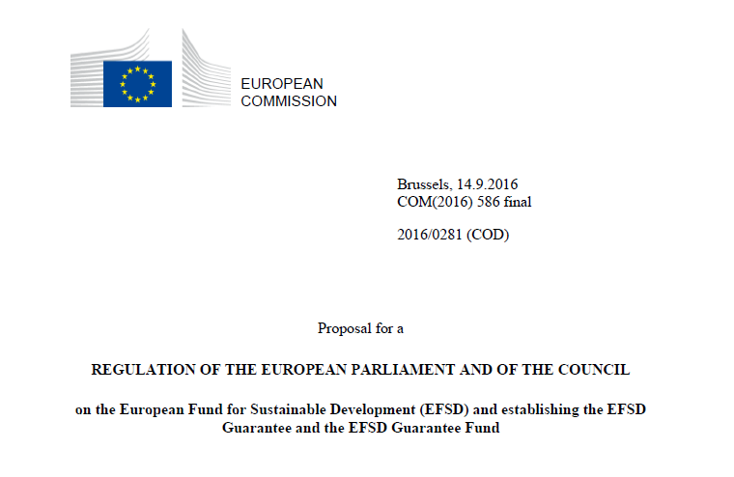
(P.2 1 & P. 26)…..and finally a range of dedicated thematic, national and regional EU development cooperation programmes combined with structured political dialogue targeted at improving the investment climate and overall policy environment in the countries concerned (pillar 3)….

