Slide 1


Implementation of support to decentralisation and local governance
Group 3: Financing modalities for local governments/governance

Slide 2
Objectives of the session
To exchange experiences with support for financing modalities for local governments.
The session will focus on two differnt.
mechanisms or modalities for providing funds to local governments and increase their performance
To jointly identify implementation challenges and lessons learned with those modalities.

Slide 3
What we will do in this group
Short introductory presentation with focus on two performance-oriented financing modalities
Presentation of case studies by participants
Discussion

Slide 4
The role of donors for local government financing
Own resources of local governments plus transfers received from central governments are often insufficient and do not allow for the delivery of basic local services and infrastructure citizens demand.
Donors often play a crucial role in supplementing domestic funds and advising on the design of financing mechanisms.
Harmonisation of external assistance for financing modalities tends to be a key challenge.

Slide 5
Focus on two financing modalities
Municipal contracts:
  Can be supported in most countries that have engaged in decentralisation (group 1-3 (4), guiding principles).
  Focus on experiences from West Africa/Ghana .
Performance-based grant system:
  More limited use (active and advanced intermediate decentralising countries, group and 2).
  Focus on experience with basket funding for the District Development Fund in Ghana .

Slide 6
What are municipal contracts?
A consensual and binding, performance-based, agreement between a municipality and the central government for a 4-5 year period.
Key Components
  - a priority investment plan
  - a municipal maintenance plan
  - a municipal adjustment or reform programme
Scope of the contract: reform of the municipality as well as agreements for financing of infrastructure and services.
Source: Goundriaan 2010, p. 11

Slide 7
Basic objective and scope of municipal contracts
Objective
To support integrated urban/local development through urban investment and improved municipal governance and management.
Scope and process
The wider process of contracting involves a series of audits (urban, financial, organisational)
A participatory process of strategy development, priorisation of investment programmes and reforms.
Strong focus on capacity building.

Slide 8
What are performance based grant systems?
Mechanisms for transferring funds from central to sub-national/local governments (LGs)
Extent to which LGs access transfers from central governments is conditioned upon overall performance
  Compliance with minimum conditions to ensure capacity to handle grants ;
  Size of grants depending on assessed performance against pre-determined and agreed measures.
Source: UNCDF (2010), p.iii

Slide 9
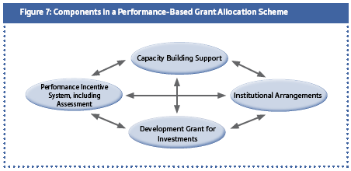
Source: UNCDF (2010), p. 25

Slide 10
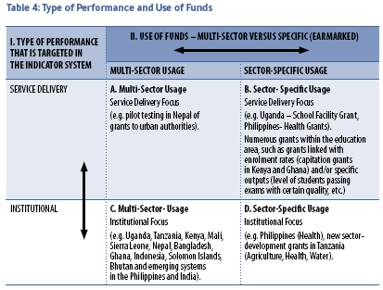
Grant objectives and focus
Source: UNCDF (2010), p. 16
Notes:
Notes:
The focus of PGBS can vary. According to UNCDF (2010) performance-based grants can be categorised along two dimensions:
The type of perforamnce the grant intends to leverage, in particular generic institutional perforance versus sector-specific performance
The use of funds, i.e. either sector-earmarked or braod non-sectoral /discretionary funds.

Slide 11
Some design issues to consider
Definition and testing of benchmarks/indicators for performance
  Generic vs. sector specific
  Minimum conditions vs. performance measures
  Quantitative vs. qualitative indicators
Weighing and scoring of measures
Quality control, audit of assessments and mechanisms for appeal
Administrative capacity and cost of the assessment system

Slide 12
Factors to consider when helping to design funding modalities
Maturity of decentralisation process
Political stability, administrative capacities, creditworthiness of local government
„Available“ aid modalities (project-funding, basket funding, sector budget support)
Commitment of central government to engage in policy dialogue with donors.
Possibilities for harmonisation and alignment.

