Slide 1


Monitoring and evaluating support to decentralisation and local governance: challenges and trends
Harmonisation, Decentralisation and Local Governance

Slide 2
Session overview
Introduction
Basic concepts
Some trends in the debate and practice of M&E
Innovative practices
Group work: practice cases (in 2 parallel groups)
  Group 1: M&E in a project context
  Group 2: M&E in the context of sector budget support
Feedback to the plenary (following day)

Slide 3
Session objectives
Create awareness of issues and trends in the recent debate on M&E of support to decentralisation
Provide participants with some guidance for the design of M&E systems, including capacity building with partners.
Stimulate exchange on challenges and lessons learned on M&E systems in the context of a project and sector budget support.

Slide 4
Focus of the presentation
  Specific challenges in M&E of support to decentralisation and local governance
  Important trends in the international debate and practice
  PM&E, domestic accountability and capacity building with partner institutions
  References to resources and guidance for practitioners
Notes:
Points to highlight
Monitoring and evaluation of support to decentralisation and local governance is a rather complex and technical subject which could easily fill a whole day, if dealt with in a comprehensive was and taking account of the different needs of the participants (governance and sector experts, aid managers that operate in a project or budget support context, diving into the indicators and result frameworks discussion).
The following presentation will therefore
focus on some trends in the discussion and practice of this field
orientations provided by the iDWG-DLG
pointing participants to case material on more innovative approaches to M&E, focusing on PM&E tools and M&E capacity building with local and
national stakeholders of decentralisation processes.

Slide 5
Monitoring and evaluation: Some concepts

Slide 6
M&E philosophies and methods
What monitoring and evaluation encompasses varies from donor/aid agency to another
  Differences in M&E culture
  Debates on appropriate approaches and methods
Increased efforts of harmonisation since the beginning of this decade
  Initiatives of the DAC Network on Development Evaluation
  Committments of the Paris Decleartion and AAA
Notes:
Points to highlight before this slide
The subject of M&E has gained importance in the context of the debate on MDGs and the commitments of the Paris Declaration and AAA to result based management and mutual accountability. This is also reflected in the discussion on support to decentralisation and local governance. Since the beginning of the millennium, an increasing number of publications and seminars have been dedicated to the topic of M&E of support to decentralisation (see Steinich 2000, van Osterhout 2004, Le Bay and Loquai 2008).
Moreover, efforts have been made to agree on a common M&E terminology and harmonise approaches (see initiatives of the DAC Network on Development Evaluation, guidelines and glossary of key terms (see OECD 2010, literature list).
Yet, there remain differences in the in M&E culture and practice between donors and aid agencies, e.g.
- the definition of terms (impact, outcome)
- the priority given to M&E in every day work
- the preference for specific approaches and methods (e.g. PM&E tools, randomized trials)
- the sharing and dissemination of evaluation results

Slide 7
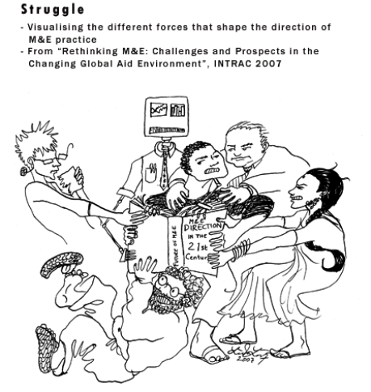
M&E philosophies and methods
Yet differences remain….
Source: http://www.developmentcartoons.com/image3.html
Notes:
Points to highlight:
This cartoon obviously exaggerates the differences, but there is some truth in it….

Slide 8
Monitoring
Monitoring refers to a continuous process of data collection that takes place at regular intervals.
  Provides insights into trends (‘‘sense of direction“)
  focuses on quickly available data rather than indepth analysis.
  data can later be used to support evaluations.
  Systemic: needs to be institutionalised and linked to decision-making processes.

Slide 9
Evaluation
“An assessment, as systematic and objective as possible, of a planned, on-going, or completed development intervention.“ (OECD 2007)
  Purpose: determine the relevance and fulfillment of objectives, development efficiency, effectiveness, impact and sustainability.
    provide information that is credible and useful
    should enable the incorporation of lessons learned into the decision–making processes of both “recipients” and donors.
Notes:
Points to highlight
M&E can take place at the activity, project, programme and policy level.
The terms “monitoring” and “evaluation” are often used together as “M&E”, suggesting a symbiotic relation. This relationship exists, because evaluations require information generated in the course of monitoring, but as the slide 10 illustrates M&E in the project cycle are distinct activities.

Slide 10
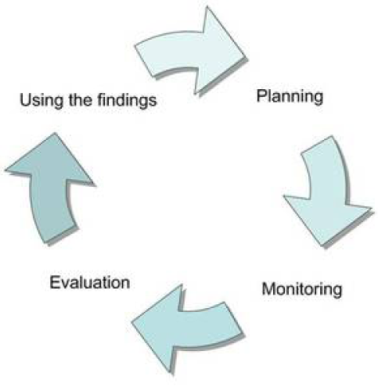
M&E at the project level
Source: http://openeducation.zunia.org/typo3temp/pics/f2c3c1f989.jpg

Slide 11
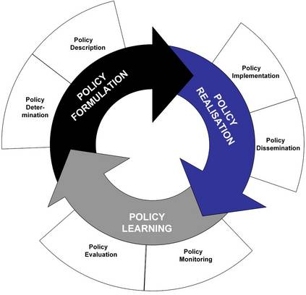
M&E at the policy level
Source: http://www.transport-era.net/about-ent/description-of-ent/procedures-for-cooperation.html
Notes:
Points to highlight
After having commented on this slide the trainer underlines that two forms of M&E activities should be distinguished (USAID 2009):
- M&E that seeks to assess progress in implementing decentralisation reforms. This form of M&E would draw mainly on what is sometimes called output indicators, e.g. the number of council meetings held, the number of deliberations of local councils sent to supervisory authorities, the number of municipal agents trained. Such indicators can help to document whether necessary steps have been taken towards effective support of implementation of decentralisation programmes and may be useful management tools for programme implementation.
- M&E that seeks to assess the impact of decentralization on broader development goals such as democratization, political stability, inter-regional equity or poverty reduction. This kind of exercise is much more challenging. It raises the question whether and how outcome can be attributed to specific measures of support. Aid agencies have tackled this challenge in different ways, e.g. USAID by advocating randomized evaluations, GTZ by constructing “result-chains”, AFD and SNV by arguing that outcomes are best captured in by “capitalizing” experiences).
It should also be noted that there is a difference between evaluating the impact of decentralisation reforms and the impact of a donors’ intervention in support of decentralisation and local governance.

Slide 12
Challenges in M&E of support to decentralisation and local governance

Slide 13
Quote from an evaluation report
‘‘In the documents reviewed, the team generally found that the positive effects of decentralised governance were assumed to be self evident and not in need of further explanation (…)‘‘
‘‘Perhaps because of this assumption the existing structures of objectives and indicators in the project documents reviewed appeared to be disjointed and allowed for only cloudy insights (…)‘‘
‘‘The team found that in none of the surveyed countries had baselines been established, or benchmarks, against which developmeetn couldbe measured. Admittedly the major methodological difficulty in the area (...) is that of causality (…). Also the performance of institutions in general and of local governments in particular is very difficult to measure.“ (UNDP and BMZ 2000)
Notes:
Points to highlight
The quote comes from a one of the first joint evaluations of support to decentralisation, the joint UNDP-Government of Germany Evaluation „The UNDP role in decentralization and local governance“ conducted in 2000.
The issues outlined in this quote are typical of findings of in evaluation reports on programmes of support to decentralisation and local governance that were conducted at that time. It points to some of the specific challenges practitioners face in regard to M&E of support to decentralisation.
Over the last 10 years, questions of M&E have received increasing attention. Since then, donors and aid agencies, including UNDP and German development organisations, in particular GTZ, have invested in research on M&E of support to decentralisation (e.g. Steinich 2000, Scherff 2004, Lorenz and Zimmermann 2004) and made substantial efforts to come to terms with these challenges.
However, evaluator still regularly criticize the insufficient attention been given to a clear formulation of objectives or the absence of tools for tracking and assessing change in terms of outcomes and impacts of support.

Slide 14
Challenges
Specific methodological challenges
Highly political nature of the processes
Statistical capacities and data problems
Shift towards programme based approaches
A lack of guidance?
Notes:
Points to highlight
The literature on M&E of support to decentralisation and local governance highlights that M&E fin this field of cooperation raises a number of specific challenges (Steinich 2000, van Osterhout 2004, Scherff 2004):
Methodological challenges.
Decentralisation and local governance reforms are multi-dimensional, involve a large number of stakeholders and take place at different levels of a political/administrative system. To monitor and evaluate progress is thus a rather complex task.
Moreover, the progress and outcome of these processes is influenced by many external factors. It is thus difficult to establish to what extent the support of one donor, aid agency can influence these complex processes (which is an argument for coordination and harmonisation!).
Interventions at the national level are far removed from those who should ultimately benefit – the citizens. It is thus often difficult if not impossible to establish sound relationships of causality between input, outcome and impact variables for projects and programmes that support these reform processes.
Decentralisation reforms are highly political and risky
They are often stop-and go processes and can be reversed (re-centralization).
External aid can certainly influence and shape these processes, especially in highly aid dependent countries, but ultimately it is domestic politics that determine the pace and direction of these reforms.
M&E systems thus have to be geared to “moving targets”. They may need to foresee risk indicators and exit criteria. Moreover, assessments of outcomes of (support to) decentralisation processes are politically sensitive and may not always be desirable for „tactical reasons“ (e.g. if they draw attention to risks or politically unpopular measures required for the implementation of reforms, that the partner government does not want to flag for fear of opposition to reforms).
Weaknesses of decentralised statistical and analytical capacity.
In many developing countries, statistical and analytical capacities are weak and this applies in particular to those of newly established local
government.
National statistics offices may not be sufficiently present at decentralised levels, organizational structures and procedures for insufficiently geared to the new political realities (e.g. lack of cooperation between line ministries and local governments, off-loading of responsibilities for data collection to poorly equipped local entities).
Thus, locally disaggregated data may not be available in the initial stage of a decentralisation process.
Shift towards programme based approaches
Like in other areas of cooperation, the shift towards new aid modalities, such as budget support and other programme-based approaches, poses new challenges in terms of M&E.
As discussed in previous chapters, these new aid modalities are often used for providing assistance to nation-wide grant or subsidy schemes for local government.
A lack of guidance?
Evaluators often criticize the lack of attention given to the formulation of clear objectives, the establishment of baseline data or identification of appropriate result and outcome indicators.
Aid mangers often retort that there is a lack of operational guidance.
Research for this course, showed that there is indeed rather limited guidance on this subject in handbooks or training material of donor agencies.

Slide 15
Arguments for ‘‘investing“ in M&E of support to decentralisation and local governance
Management and steering of suppport
Assessing progress and impact in implementing support and decentralisation reforms
Learning
Accountability to taxpayers and partners
Mobilising political support
Opportunities for strengthening domestic accountability (systems)
Empowerment
Notes:
Points to highlight
On the justification and mobilisation of political support:
The discussions in donor agencies shows that it is not always evident to justify support in this area to political decision-makers in donor countries. The concept of decentralisation is rather abstract, many outcomes of support are intangible . Moreover, many potential outcomes only materialise with a long time-lag and there is no immediate relationship with MDGs.
It therefore seems particularly important to provide evidence of developmental outcomes of development cooperation in this area and to illustrate how support can impact on political systems and the life of people in developing countries.
On opportunities for strengthening domestic accountability (systems).
The literature on support to decentralisation and local governance plead for approaches to M&E that strengthen the capacities of national and local stakeholders to monitor and assess outcomes of reforms.
Empowerment
This is a central objective and claim of participantory monitoring and evaluation approaches.

Slide 16
Trends in the recent debate on M&E of decentralisation and harmonisation

Slide 17
I
Recent trends
  Development and use of new approaches
  Shift towards programme based approaches poses new challenges.
  Increased investments in national and local M&E capacities and systems.
  Development of PM&E tools that can be used in M&E of (support to) decentralisation and LG
  Worldwide interest in performance assessment tools for local governments.
  Efforts of harmonisation and alignment
Notes:
Points to highlight
Worldwide interest in performance assessment tools for municipalities. The trainer may want to highlight that in the last 10 years there has been an interest in performance assessment tools for local governments. Many innovative and highly participatory tools have been designed and tested in developing countries.
Efforts of harmonization and alignment. This point refers to the efforts of iDWG-LGD (guidelines) and spontaneous efforts of actors in the field to jointly develop and test M&E instruments in the context of support provided for the implementation of national decentralisation programmes in developing countries.

Slide 18
Orientation provided in the ‘‘Guiding principles“
  Support the establishment and strengthening of domestic M&E systems.
  Important ingredients
      Fiscal analysis units with staff to continuously monitor local government finance
      An extensive data system that will allow quantatitive monitoring and evaluation
  Strengthen statistical and analytical capacity at the national and sub-national level
Notes:
Remark:
Slide 18-20 give an overview of the orientations provided by the iDWG-DLG in the “specific guidelines”. Clearly, the guidelines reflect some of the recent trends discussed before. It is proposed that the trainer points to these orientations and encourages participants to comment and discuss them after the presentation and in the groups.

Slide 19
Orientation provided in the ‘‘Guiding principles“
  Develop an integrated assessment framework for the political, administrative and service delivery elements
  Develop appropriate result indicators for pro-poor DLG outcomes
  Consider extending PEFA Performance Measurement Framework to decentralised level.
  Mainstream decentralisation in general budget support mechanisms
  Establish national platforms and steering committes at the local level

Slide 20
Orientation provided in the ‘‘Guiding principles“
  More implicit:
  Build linkages between domestic accountability, result-based monitoring and M&E.
  Involve stakeholders of decentralisation (representatives of the central state, local government and civil society) assessments of support.
  Joint diagnostic reviews and assessments at the outset of programmes are the basis for harmonised M&E efforts

Slide 21
Focus on some innovative practices
  PM&E, domestic accountability, capacity building with partners and harmonisation

Slide 22
Using PM&E approaches for M&E
Existence of a host of PM&E tools for M&E of decentralisation and local governance
Tools have become popular, because they can be used to promote specific objectives of decentralisation/local governance and for purposes of M&E of support
PM&E methods always need to be tested and adapted with stakeholders to country/local context
Notes:
Points to highlight
PM&E tools have become increasingly popular in the context of support to decentralisation, because if appropriately built into donors‘ and patners‘ M&E systems, they allow to meet different objectives
empower stakeholders of decentralisation/local gov.
strengthen national/local M&E capacity and culture
contribute to developing domestic accountability systems
generate data at the decentralised level that is relevant for donors and stakeholders of decentralisation
bring together a variety of perspectives from the national and local level

Slide 23
What is PM&E?
“PM&E is a process through which stakeholders at various levels engage in monitoring or evaluating a particular project, program or policy, share control over the content, the process and the results of the M&E activity and engage in taking or identifying corrective actions.”
  No pre-set or externally defined indicators
  Stakeholders actively involved in reflecting and assessing project/policy
  PM& builds on the capacity of local people to analyse, reflect and take action
Notes:
Points to highlight
This is a rather concise explanation of what PM&E encompasses. To better understand the core principles of PM&E, and how it can be used in support of decentralisation and local governance, participants should consult the paper of Hilhorst and Guijt (2006), that is listed as a key reading.
How PM&E differs from conventional methods of M&E is explained in the policy brief by Guijt and Gaventa (1998) listed under further readings.
It should be noted that sometimes, approaches that are not participatory, but just rely on some consultation mechanism are presented as participatory to legitimize top down planning or decision-making, thus perverting the spirit of PM&E and decentralisation.

Slide 24
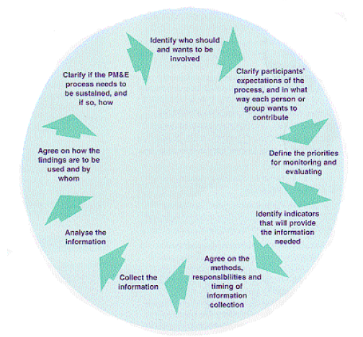
Sequencing of steps in a PM&E process
Source: Guijt and Gaventa, 1998, http://www.ids.ac.uk/index.cfm?objectid=01D512C5-5056-8171-7BA528050E140ED9
Source: Guijt and Gaventa, 1998

Slide 25
Examples of experiences with PM&E tools (viewing copies)
Comprehensive performance self-assessment tools for municipalities: Mali, Benin, Niger
Citizens‘ report cards, Ghana
Local government council score card exercise, Uganda
Citizens control and participatory local impact monitoring in the education sector, Benin
Citizen Consulting and Monitoring Groups, Albania
Notes:
Points to highlight
The purpose of this slide is to point participants to interesting experiences and tools that have been developed to strengthen M&E capacities of stakeholders of decentralisation and local governance and that can help to domestic accountability systems in partner countries.
There is no time to discuss these examples in detail, but case studies on these approaches are freely available on the net and viewing copies of relevant guides and reports are be displayed in the seminar room. Participants are encouraged to have a look.
Experiences with the design and test of performance self-assessment tools for municipalities in Mali, Niger and Benin (first bullet point) and with citizens‘ control and participatory local impact monitoring in Benin have been analysed in case studies and summarised in ECDPM Brief 19 (see key readings). Copies of these publications can be displayed as viewing copies.
A short description of experiences with „Citizen Consulting and Monitoring Groups in Albania“ is given in the paper by Hilhorst and Guijt (2006) listed as a key reading.
Material on the experiences with citizens‘ report cards in Ghana and the local government council score card exercise has been summarised in reports that are freely available on the web and can be displayed as viewing copies.

Slide 26
Building statistical and analytical capacities
…for monitoring and evaluating decentralisation
  Country-wide tool for monitoring capacity building (support to) local governments (OISE), Mali
  Participatory development of municipal baselines for planning and M&E in Mali and Cameroon
  Design and test of geographic information systems for municipalities (Mali)
  Participatory poverty profiling at district level (Ghana)
Notes:
Points to highlight
This slide gives examples of innovative approaches to building statistical and analytical capacities that are needed for strengthening M&E systems of partner countries.
The experiences quoted are not all examples of PM&E approaches, but refer to efforts to strengthen capacities for data collection, analysis and interpretation at the national and sub-national level.
Basic information on the country-wide tool for monitoring capacity developemt (support to ) local governments in Mali is summarised in box 2 of the trainers‘ guide.
Experiences with the the participatory development of municipal baselines for planning and M&E in Mali and Cameroon (Lodenstein et al. 2007, Tamini et al. 2007 ), the test of geographic information system for municipalities in Mali (Dumont and Samaké 2007), district based poverty profiling in Ghana (Dery and Dorway 2007) and basic health sector information systems for municipal actors (Toonen et al. 2007) are summarised in one of the key readings (Loquai and le Bay 2010). Case studies of these approaches are freely available on the web and could be displayed.

Slide 27
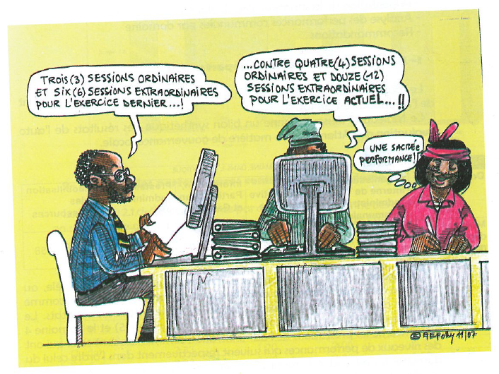
Source: ANCB 2007. Auto-évaluation de la gouvernance locale au Bénin , rapport général, Cotonou, p. 75.
Notes:
This drawing features in the report on the self-performance assessment of municipalities in Benin, an exercise that has been piloted by the National Association of Municipalities of Benin with the support of a number of donros (SNV, le PNUD, la GTZ et HELVETAS) (the trainer can shows the report and make it available as a viewing copy).
The drawing illustrates the aim of the use of PM&E tools: enabling stakeholders in partner countries to assess decentralisation and local governance.

Slide 28
Strategic alliances and harmonisation
Case studies highlight the benefits of strategic alliances between donors and partners
  Joint testing and replication of (P)M&E methods
  Ownership by national bodies and ‘‘validation“ is crucial for nation-wide dissemination
Harmonisation requires platforms for exchange, but these often rely crucially on ‘‘committed individuals“
Different M&E cultures can stand in the way of harmonisation and alignment.

Slide 29
Conclusions
Joint design and testing of (P)M&E tools needs time.
There are challenges involved in managing the dynamics of multi-stakeholder approaches to M&E.
Identification and fine-tuning of indicators is a process.
M&E results need to be followed up.
Notes:
Explanations
The following conclusions that can be drawn from the above mentioned case material:
Joint design and testing of tools needs time. Designing and testing M&E tools that involve different actors in decentralisation at the national, regional and local levels takes time. When working with councillors and local civil society actors who have little or no experience with M&E tools, they need to be allowed time to learn how to identify, discuss and interpret indicators and statistics. This is a key aspect of capacity building for M&E of decentralisation and local governance. Furthermore, many cases show that trust among actors and working procedures are not built overnight. In multi-ethnic and multi-lingual contexts, time for translations is also required. Otherwise the various stakeholders involved in designing and testing a tool could feel uncomfortable interacting and articulating their viewpoints.
Identification and fine-tuning of indicators is a process. This holds true to some extent for most M&E exercises. But it is particularly relevant for the experiences described in this brief. Decentralisation and local governance have a process dimension. It is therefore unrealistic to try to define too many indicators at the start of a test-run of a specific M&E tool. Even once formalized, it is important that a tool retain some flexibility for fine-tuning, if necessary even changing indicators to reflect the dynamic nature of reform processes..
There are challenges involved in managing the dynamics of multi-stakeholder processes. As the case study on the performance self-evaluation tool in Mali illustrates, those engaging in multi-stakeholder exercises and strategic alliances when designing and testing M&E tools should be cautioned: the path from design to widespread use may be long and fraught with problems. If an approach is to be participatory and draw on the support of a wide range of representative actors, with different views and opinions, contributions have to be carefully managed. The assistance of an external consultant or resource person experienced in applying such an approach is a valuable, if not necessary, asset.
M&E results need to be followed up. Most of the approaches and tools described provide participants of the M&E exercises with new insights on the performance and effects of local governance. These include not only information on positive changes and good performance, but also on things that went wrong, were only moderately productive or which need to be changed. Care has to be taken that corrective measures are firmly agreed and followed up. Otherwise, local actors’ interest and incentive to engage in M&E will fade. Besides, all of the stakeholder groups will be challenged to adapt their attitudes and ways of working so as to dissolve any sources of misunderstandings or distrust identified during M&E exercises.

