Slide 1


DFID exposure to closing civic space
Survey results

Slide 2
Survey of country offices
Between 19 and 25 of DFIDs priority countries covered across the survey.
Most responses from governance adviser but social development and climate advisers were also targeted.
Respondents asked about their understanding of the issues and responses have been weighted accordingly.
Rich qualitative data in comments not yet analysed.

Slide 6
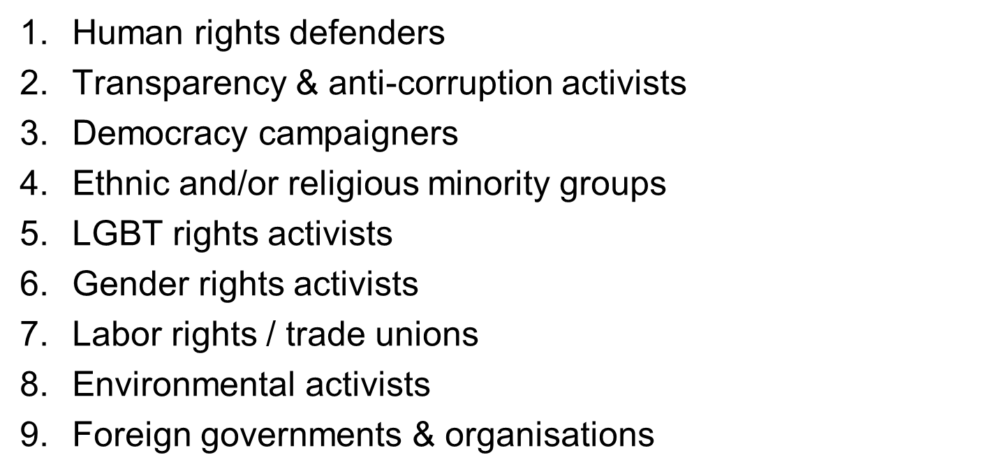
Who is targeted? (forced ranking)

Slide 7
Early observations
Confidence in expertise but inconsistency in analysis
Almost 70% have adapted programmes
Three quarters report a coordinated international response
Desire for more country to country information sharing
Need for more central support and leadership

